Slide 1
UED-308091 - Development and testing of biological sample environments for ultrafast electron diffraction and imaging at the MUED beamline at BNL
PI: Julian Chen, Bioscience Division, LANL
Collaborators: Destry Monk, Salvador Sosa, Sandra Biedron, Manel Martinez, Steve Conradson (UNM); Marcus Babzien, Mark Palmer, Robert Malone, Jing Tao, Kevin Brown, Mikhail Fedurin, Junjie Li (BNL); Alan Hurd, John Sarrao, Christine Sweeney, Rohit Prasankumar (LANL)
9 December 2020
DC review: Alan Hurd, 8 December 2020
Notes:
Content Slide Notes
“UNCLASSIFIED” marking of slides is not a security requirement and may be deleted from the Slide Master (View › Master › Slide Master). In general, slides should be marked “UNCLASSIFIED” if there is potential for confusion or misinterpretation of something that could be deemed classified. For guidance on marking slides containing classified and unclassified controlled information, see the Protecting Information Web site at http://int.lanl.gov/security/protectinfo/.

Slide 2
UED-308091 - Development and testing of biological sample environments for ultrafast electron diffraction and imaging at the MUED beamline at BNL
Funding source:
DOE’s Established Program to Stimulate Competitive Research (EPSCoR)
Status: Funded
This material is based upon work supported by the U.S. Department of Energy, Office of Science, Office of Basic Energy Sciences, Materials Sciences and Engineering Division, Program of Electron and Scanning Probe Microscopies, under award number DE-SC0021365. This funding was made available through the Department of Energy's Established Program to Stimulate Competitive Research (EPSCoR) State-National Laboratory Partnerships program in the Office of Basic Energy Sciences. This research used resources of the Brookhaven National Laboratory's Accelerator Test Facility, which is a DOE Office of Science User Facility. This research used resources of the Argonne Leadership Computing Facility, which is a DOE Office of Science User Facility.
9 December 2020
Notes:
Content Slide Notes
“UNCLASSIFIED” marking of slides is not a security requirement and may be deleted from the Slide Master (View › Master › Slide Master). In general, slides should be marked “UNCLASSIFIED” if there is potential for confusion or misinterpretation of something that could be deemed classified. For guidance on marking slides containing classified and unclassified controlled information, see the Protecting Information Web site at http://int.lanl.gov/security/protectinfo/.

Slide 3
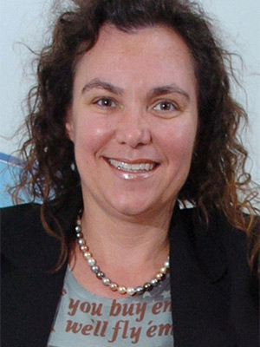

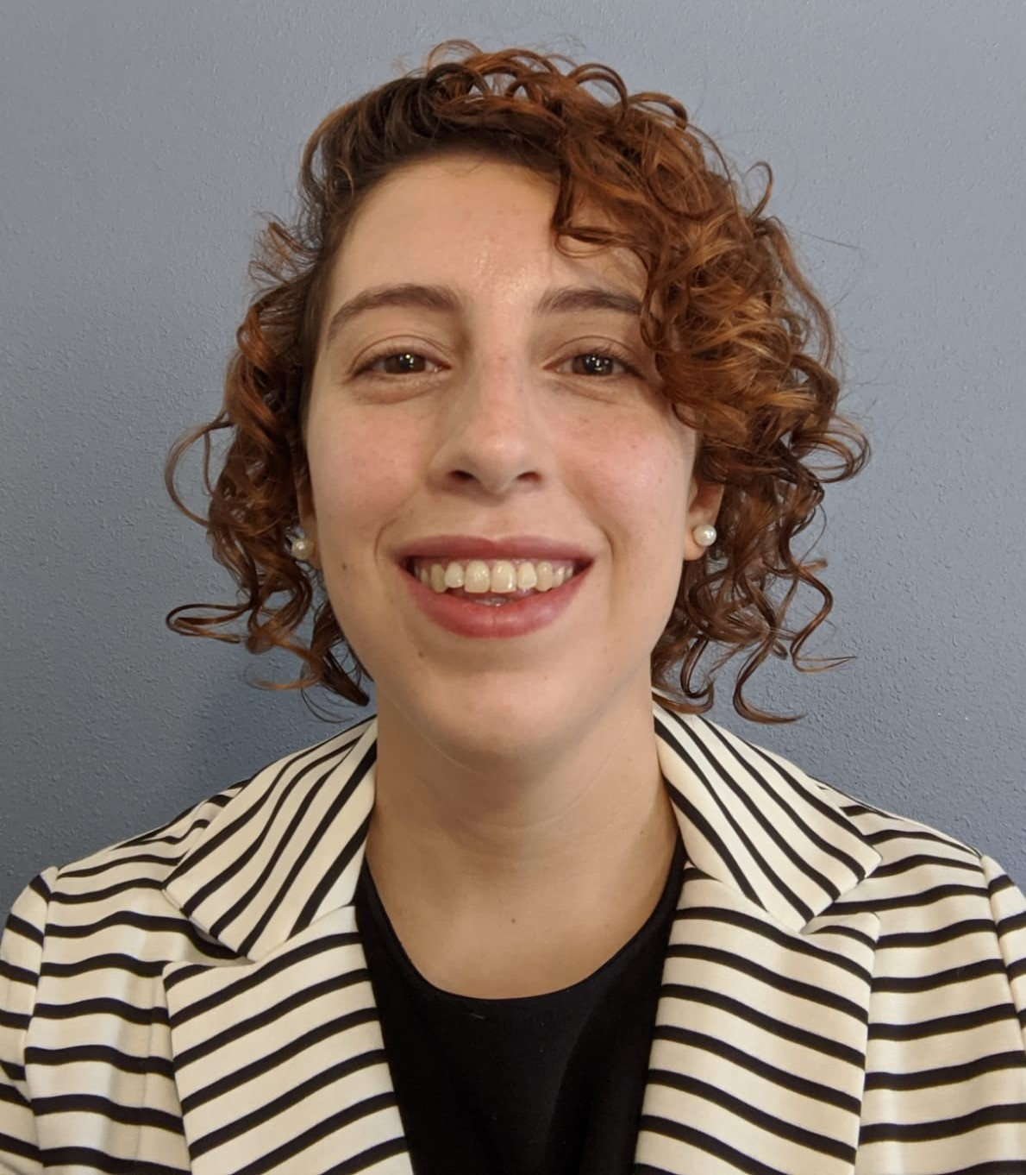
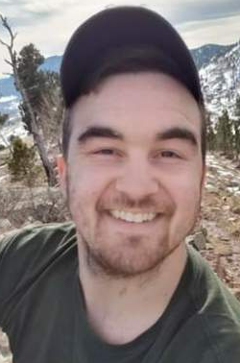
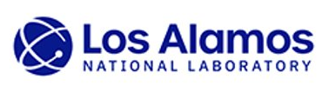
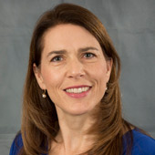
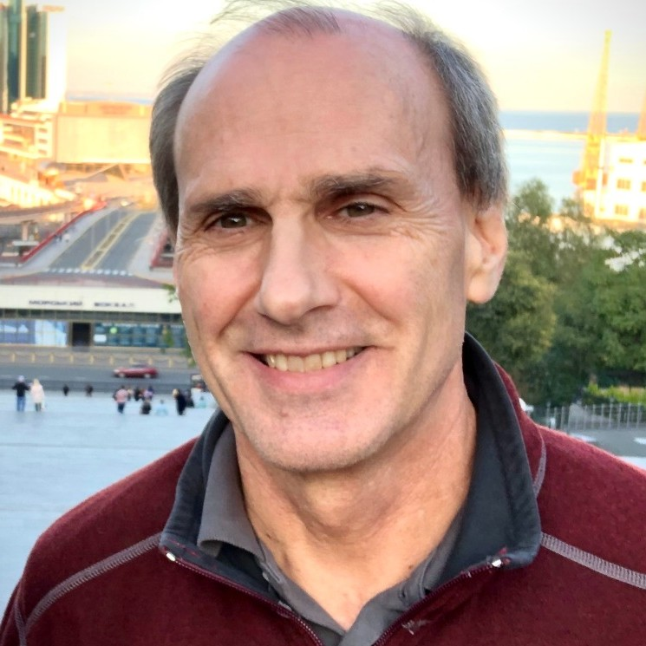
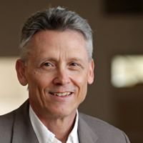
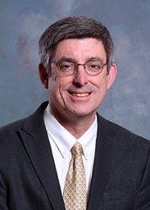

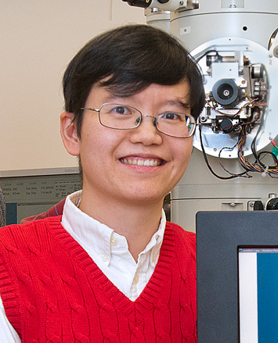
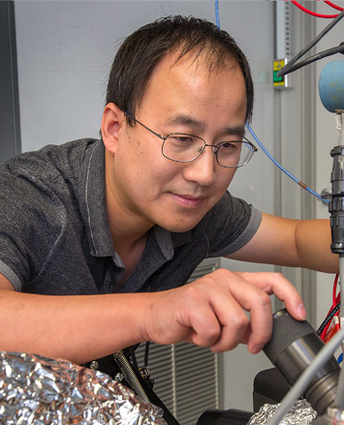
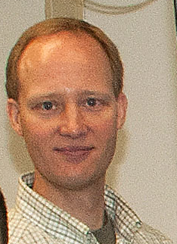
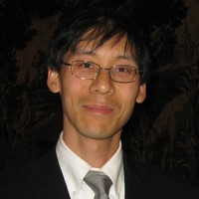
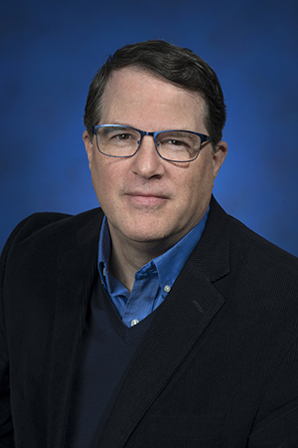
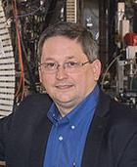
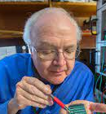
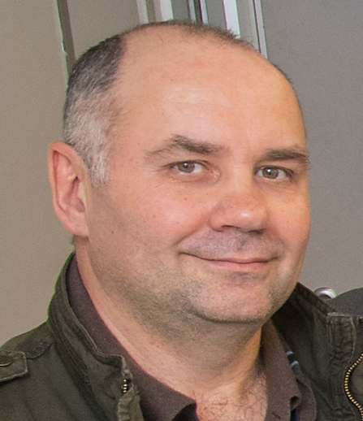
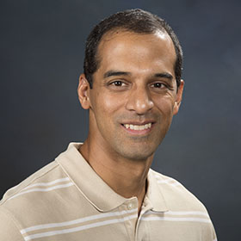
Funding secured through DOE EPSCoR program
Sandra Biedron (PI)
Manel Martínez-Ramón (Co-PI)
Steven Conradson
Mariana Fazio
Salvador Sosa
Destry Monk
Marcus Babzien
Jing Tao
Christine Sweeney
Mark Palmer
Junjie Li
Alan Hurd
John Sarrao
Mikhail Fedurin
Julian Chen
Kevin Brown
Robert Malone
Rohit Prasankumar

Slide 4
Specific objectives
Enabling science experiments on soft matter and biological samples at the MUED beamline
Sample environment development
Testing on macromolecular crystals (lysozyme, crambin)
Testing on biological membranes (2-D bacteriorhodopsin arrays)

Slide 5
Specific objectives- why biology?
Why ED / EM at 2-5 MeV?
Penetrating power
Ultra-high resolution (0.1 – 0.2 Å), currently not accessible for most synchrotron beamlines / poor QE of CCD detectors
Potentially less radiation damage? Possibility of studying samples at ambient temperatures
Current commercial TEM instruments (ThermoFisher Krios) operate in the 20-300 keV range
Time-resolved studies (ms resolution with current repetition rate), pump-probe using visible laser setup
Synergy with UED proposals presented on 12/7/20

Slide 6
Sample environment development
Modification of the sample chamber for soft matter experiments (hydrated samples):
Flow cells for serial crystallography
Single-crystal studies (rotatable / tiltable mounts)
Sample cells for membranes / whole cells
Long-term benefit for facility: study of biological samples, e.g. membranes (viral fusion), imaging of intact cells, biology at ambient temperatures vs. cryogenic temperatures, stepping stone towards use in UEM mode vs. UED mode

Slide 7
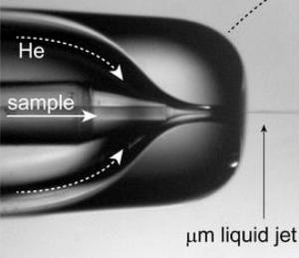
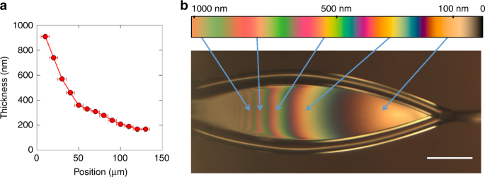
Sample environment development
General categories:
Flow cells for serial crystallography
Single-crystal studies (rotatable / tiltable mounts)
Sample cells for membranes / whole cells
LCLS liquid jet
Koralek et al. Nature comm. 2018

Slide 8
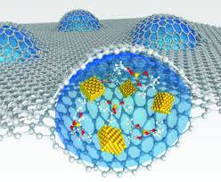
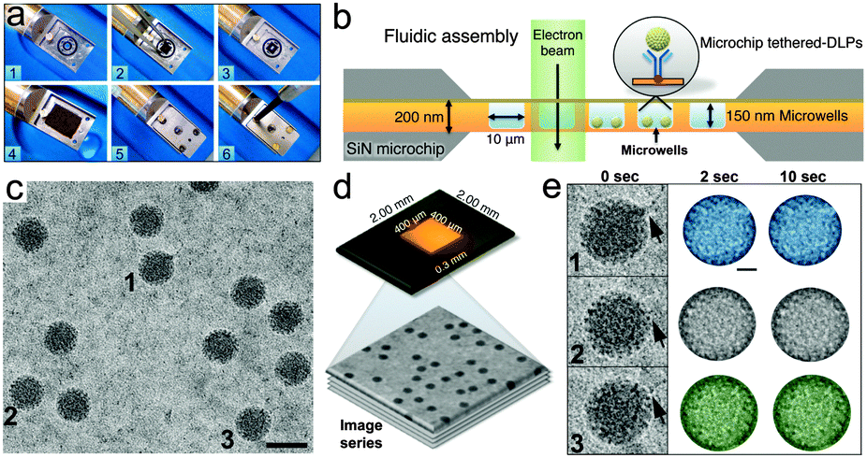
Sample environment development
General categories:
Flow cells for serial crystallography
Single-crystal studies (rotatable / tiltable mounts)
Sample cells for membranes / whole cells
Graphene-encapsulated liquid cell
Koralek et al. Nature comm. 2018
Varano, et al. Chem. Comm. 2015

Slide 9
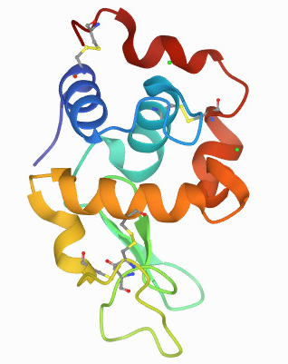
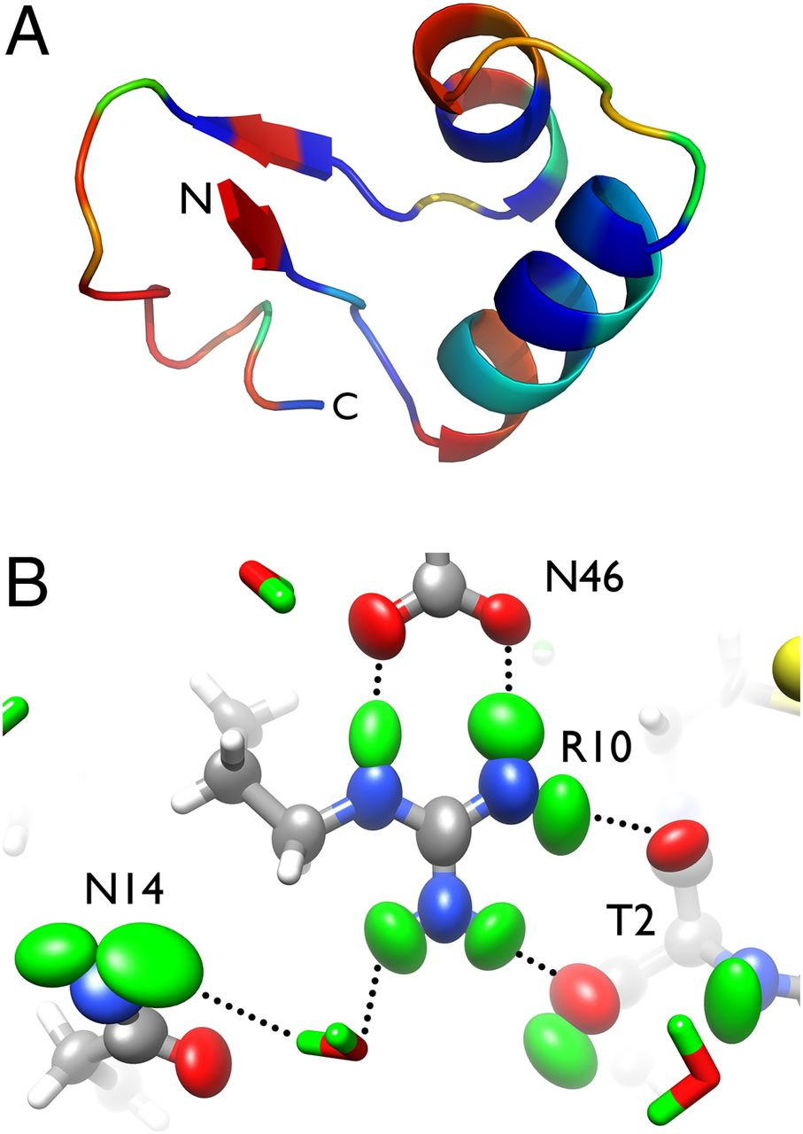
Test biological systems
Lysozyme (tetragonal / triclinic)
P4₃2₁2, a = 79.0, c = 38.0 Å, diffraction to 0.9 Å
P1, a = 27.1, b = 31.3, c = 33.8 Å, α = 88.0º, β = 72.0º, γ = 67.9º
Diffraction to 0.66 Å (Z. Dauter, et al.)
Crambin (monoclinic)
P2₁, a = 22.8, b = 18.8, c = 41.0 Å, β = 90.9º
Diffraction to 0.38 Å (J. Chen, A. Joachimiak, et al.)
Neutron diffraction to 1.1 Å (J. Chen)
Chen, et al. PNAS 2012

Slide 10
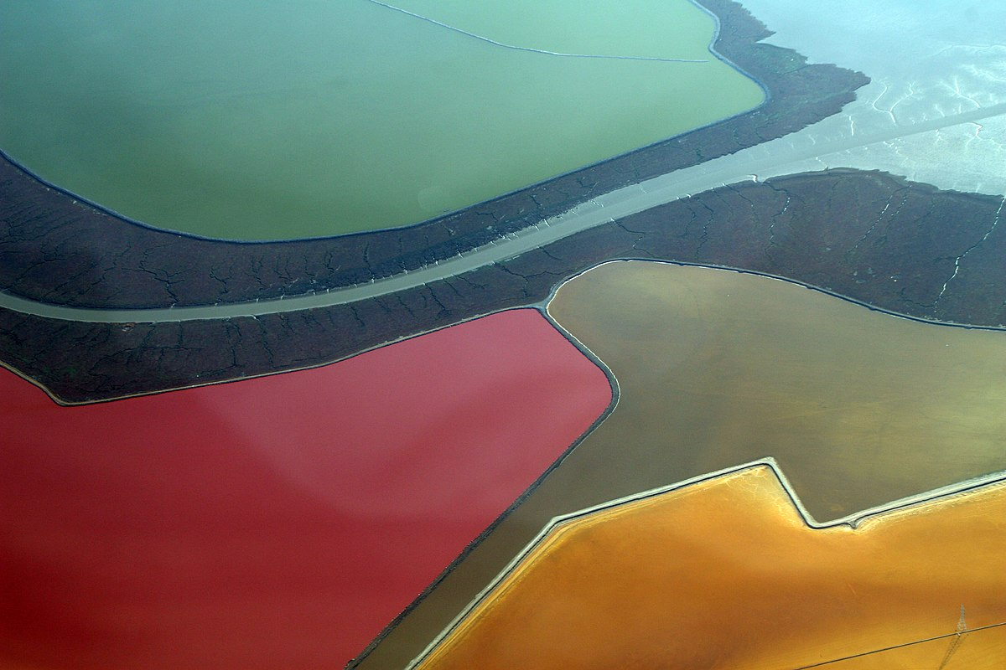
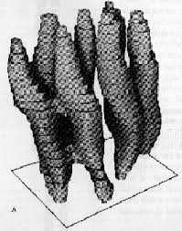
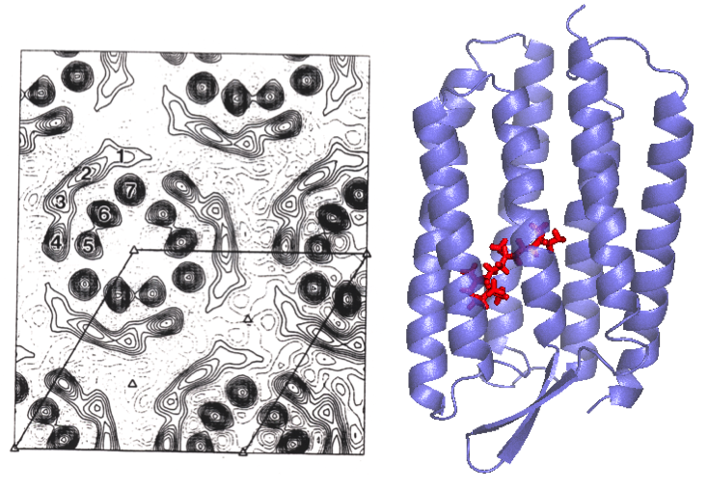
Test biological systems
Bacteriorhodopsin (purple membrane of Halobacter salinarium)
Henderson and Unwin, Nature 1975

Slide 11
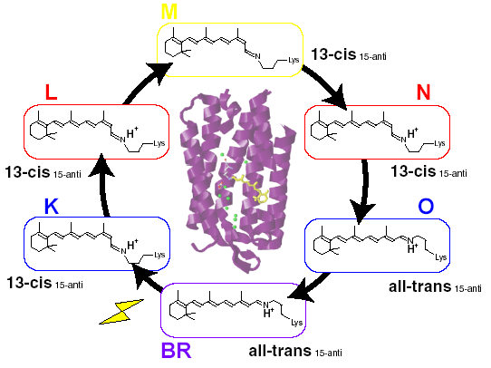
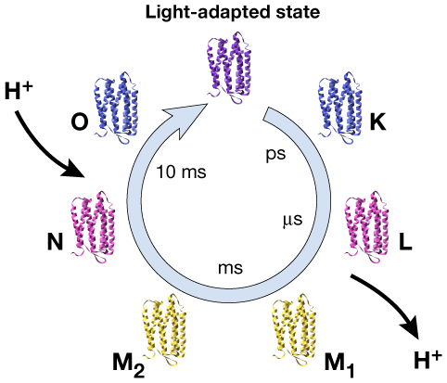
Test biological systems
Bacteriorhodopsin photocycle
Hirai and Subramaniam, PLOS One, 2009
Akira and Hideki, Sensors, 2009

Slide 12
Possibilities for time-resolved biology
Membrane fusion processes- i.e. virus particle / host membrane interactions
Dynamics of large biological assemblies, e.g. ribosomes
Stopped-flow kinetics
and much more. . .

Slide 13
Special Equipment Requirements and Hazards
UED setup
User Sample and Setup
  Fabricated flow cell or other components modified from commercial sources. Will rely on LCLS / EuXFEL examples and MUED sample chamber specs to design
Pump Laser Requirements
  Visible (for bacteriorhodopsin experiments, 3rd year of proposal)
Hazards & Special Installation Requirements
  Modifications to the sample chamber (flow cell, goniometer, sample stage)

Slide 14
Experimental Time Request
CY2021 Time Request
Capability | Setup Hours | Running Hours
UED Facility | 168 (7 days) | 168 (7 days)
Time Estimate for Remaining Years of Experiment (including CY2021)
Capability | Setup Hours | Running Hours
UED Facility | 504 (21 days) | 504 (21 days)

