Slide 1
AE-101
Optical Materials for Ultrahigh-Power​ Long-Wave Infrared Lasers
(status report)
Misha Polyanskiy
2020-12-09

Slide 2
AE-101
“We propose a systematic study of the properties of a wide range of materials under the action of ultra-intense long-wave infrared (LWIR) laser pulses. The information that will be obtained during the proposed effort is critically needed for the development of the next-generation multi-terawatt LWIR lasers.”
(Acc. Stewardship proposal)
Title | Optical Materials for Ultrahigh-Power​ Long-Wave Infrared Lasers
Status | Active (reporting completion of year 1 out of 3)
PIs | Mikhail Polyanskiy Igor Pogorelsky
Collaborators | BNL: M. Polyanskiy, I. Pogorelsky, M. Babzien, R. Kupfer UCF CREOL: K. Vodopyanov, A. Muraviev II-VI Infrared: A. Argondizzo
Funding | DOE Accelerator Stewardship grant KA2601020 (PI: M. Polyanskiy) BNL LDRD grant #20-010 (PI: I. Pogorelsky)
Funding Status | Received

Slide 3
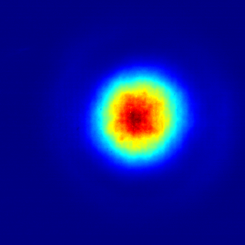
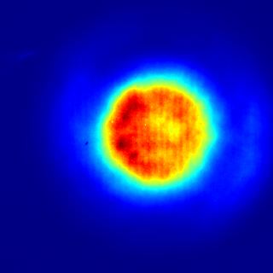
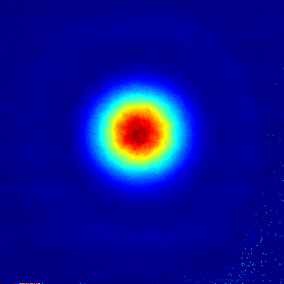
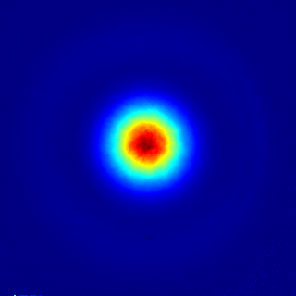
Experimental set-up for single-shot measurement of non-linear absorption and refraction
14 m
Sample
NaCl
Joulemeter
Beam on the aperture
1.1 J
5.2 J
1
Beam
profiler
98 mm
BK7
BK7
12.88 mm Dia.
Teflon aperture
aperture
0
BK7
[ Imaging lens ]
Beam on the sample
140 mJ
560 mJ
1
High energy available from ATF’s LWIR laser allows observation of self-focusing in an easy-to-measure centimeter-size beam
Diffraction-based beam forming scheme is used to achieve a reproducible quasi-Gaussian intensity distribution
42 mm
0.5
0

Slide 4
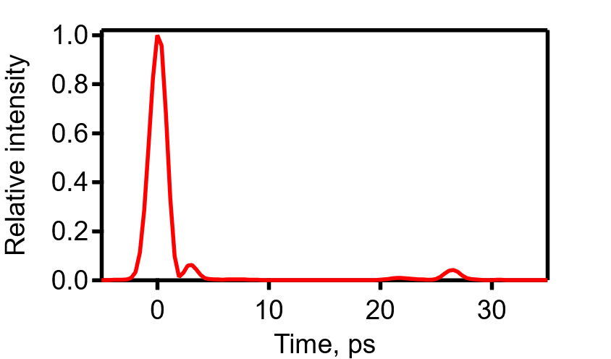
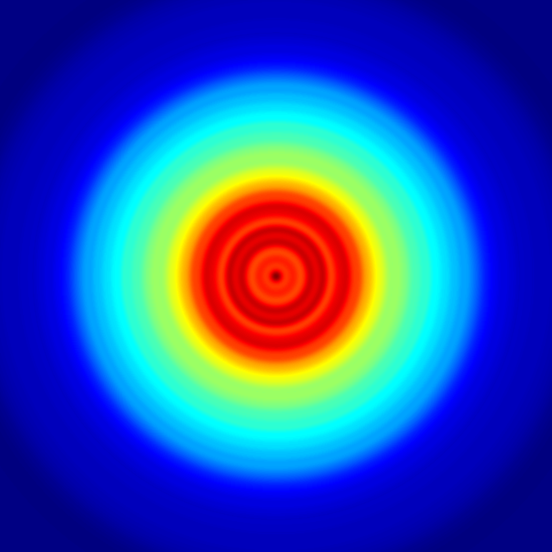
n₂ of air
560 mJ
MODEL
Input plane with
12.88 mm aperture
Output
plane
To be submitted to Optics Letters
14 x 1 m air layers
14 meters of air
1 m
Phase shift by a layer of air
Free-space Fresnel propagation
Temporal- and spatial- profile of the input pulse used in calculations
Time
Space
Literature:
1~6×10⁻²³ m²/W @ 0.8 μm
5×10⁻²³ m²/W @ ~10 μm, 200 ps pulse
Ø12.88 mm
Accurate value of n₂ of air enables a high-fidelity calculation of the beam shape on a material sample for a given pulse energy

Slide 5
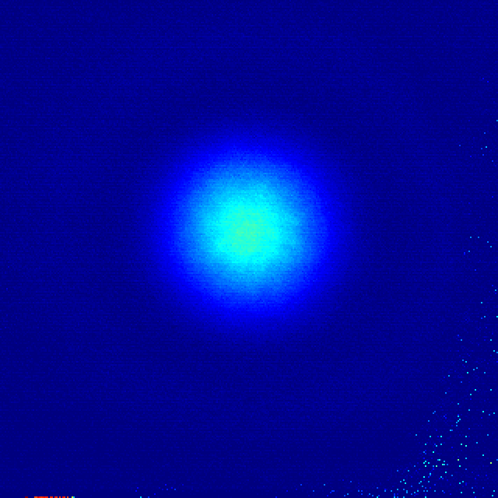
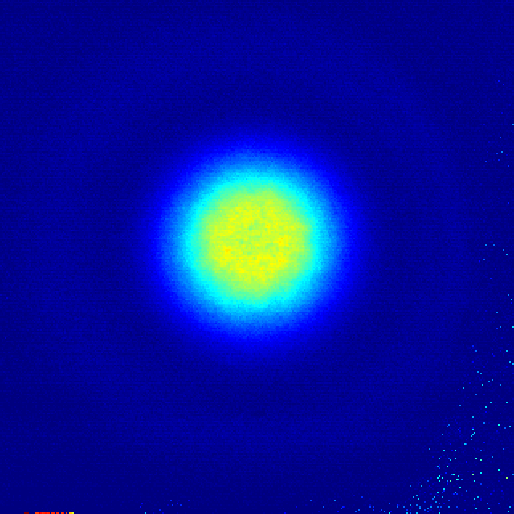
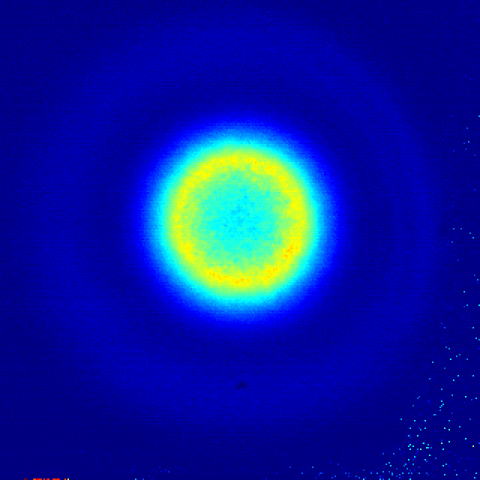
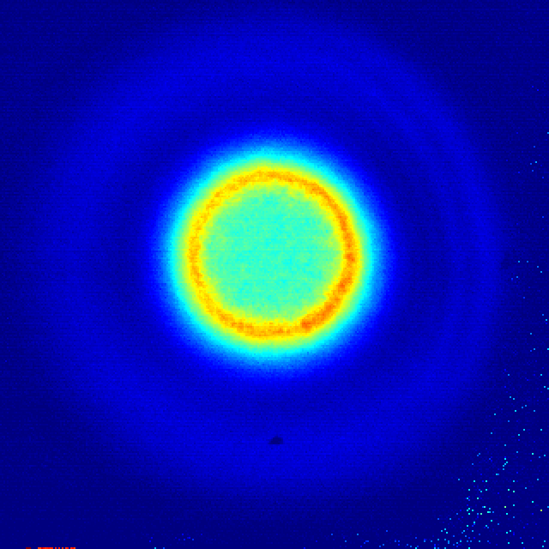
Preliminary results: NaCl, ZnSe, Ge
Materials with negligible nonlinear absorption
(NaCl, KCl, BaF2[?]..)
Materials with non-negligible nonlinear absorption
(ZnSe, ZnS, Ge, Si…)
NaCl
ZnSe
85 mJ
150 mJ
300 mJ
500 mJ
Nonlinear absorption can be measured independently of n₂
Determination of n₂ must rely on a pulse propagation model that includes nonlinear absorption and refraction (fitting parameter)

Slide 6
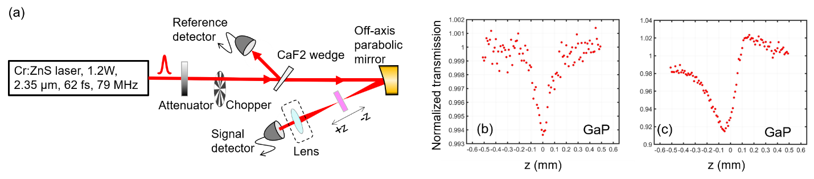
Progress at UCF (CREOL)
Crystal | GaP | ZnSe | GaSe | ZGP
Bandgap (eV) | 2.78 (direct) 2.26 (indirect) | 2.7 | 2.0 | 2.0
Thickness (mm) | 0.46 | 0.10 | 0.46 | 1.0
Theoretical multiphoton order N | 6 | 6 | 4 | 4
Experimental multiphoton order N derived from the slope in Fig.2 | 5.8 [001] 5.1 [111] | 6.0 [111] | 3.8 [y-axis] | 4.4 [110] (o-wave)
Peak intensity (GW/cm²) corresponding to the nonlinear absorption of 1 cm⁻¹ | 100 | 95 | 143 | 52
n₂ (m²/W) | 2.0×10⁻¹⁹ | 2.0×10⁻¹⁹ | 3.9×10⁻²⁰ | 2.6×10⁻¹⁹
One of advantages of the Z-scan method is a much smaller sample, hence more materials can be studied
Reference-point comparison with a smaller sample set at ATF and extrapolation on groups of similar materials will be used to establish wavelength- and pulse duration- dependencies of nonlinear optical properties in a broad range of conditions

Slide 7
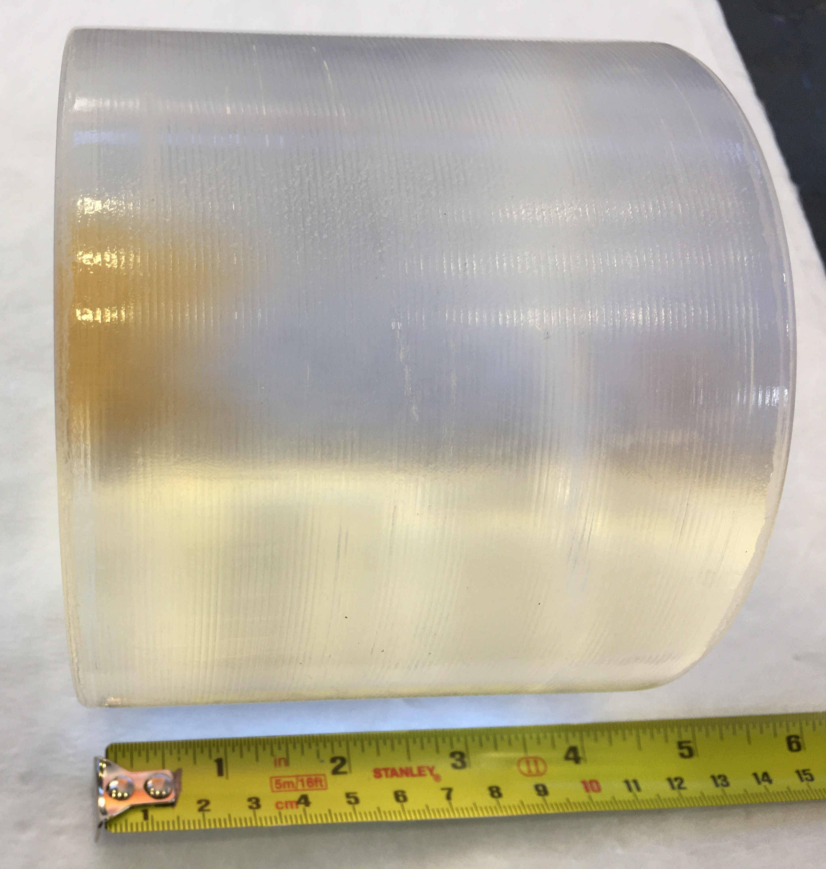
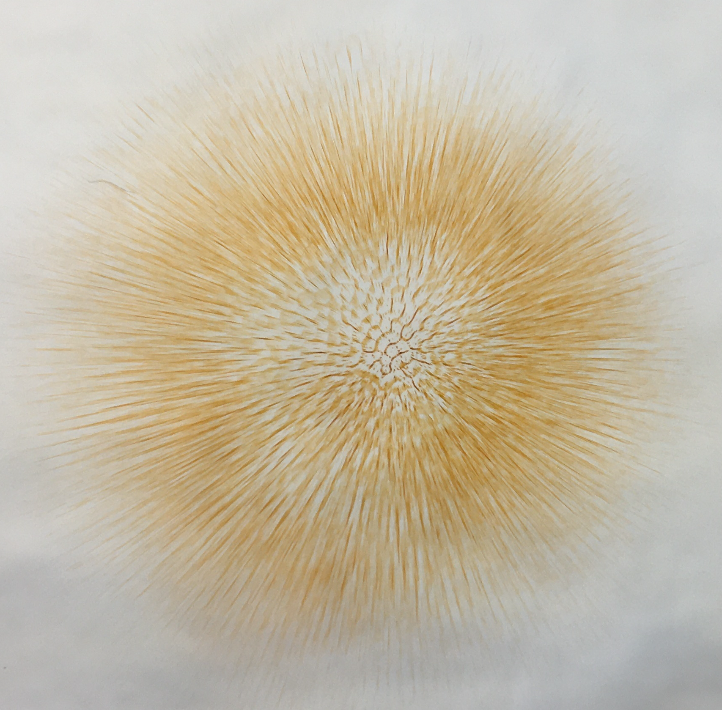
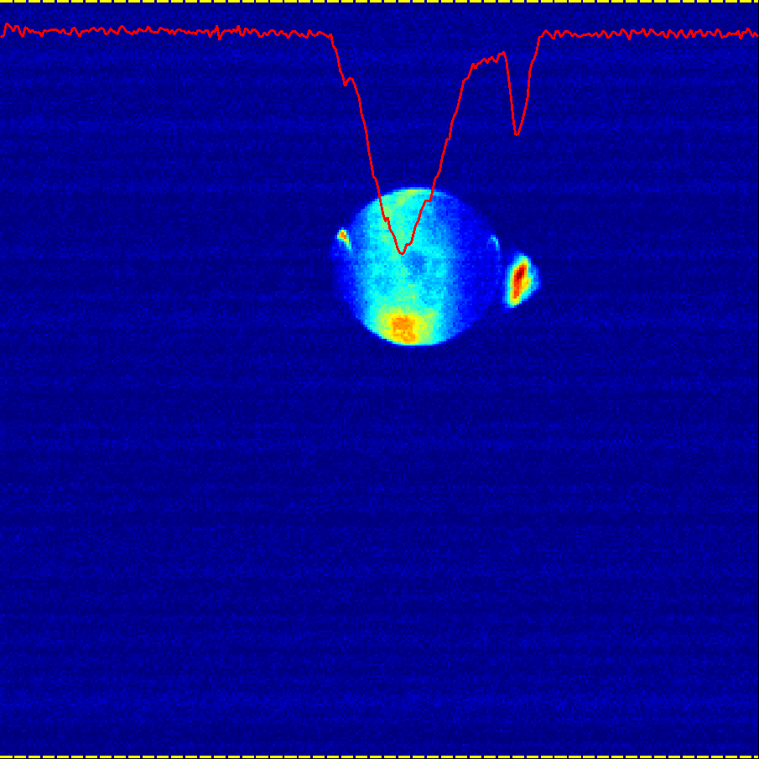
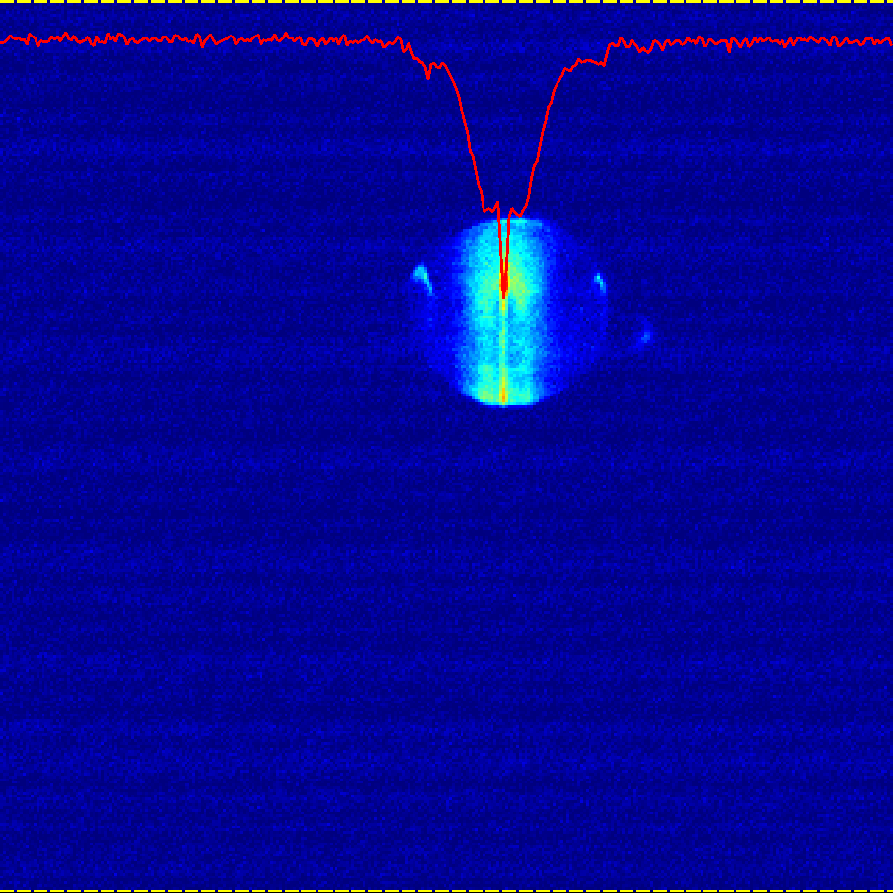
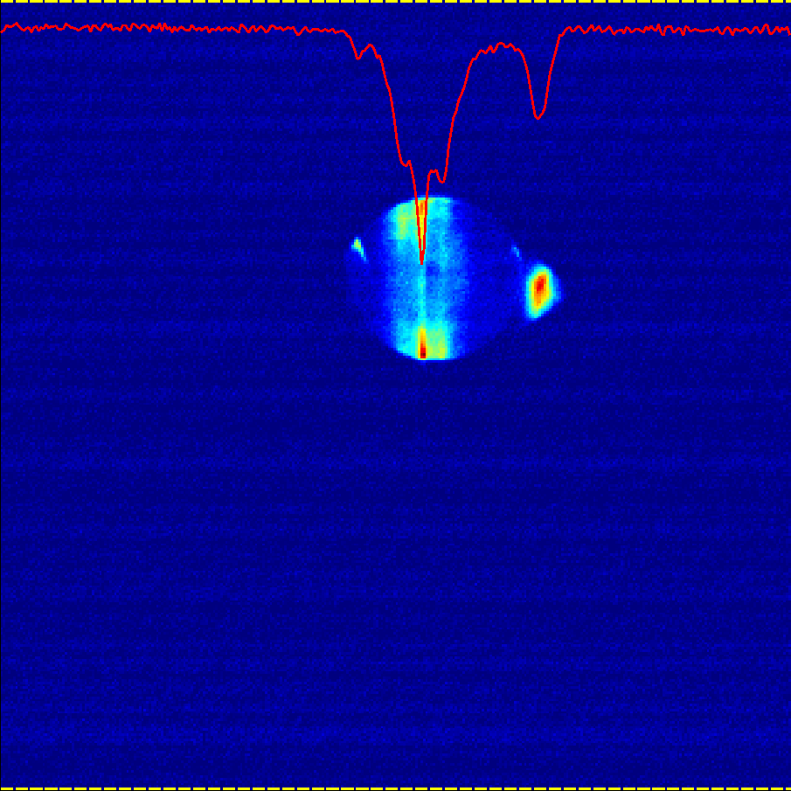
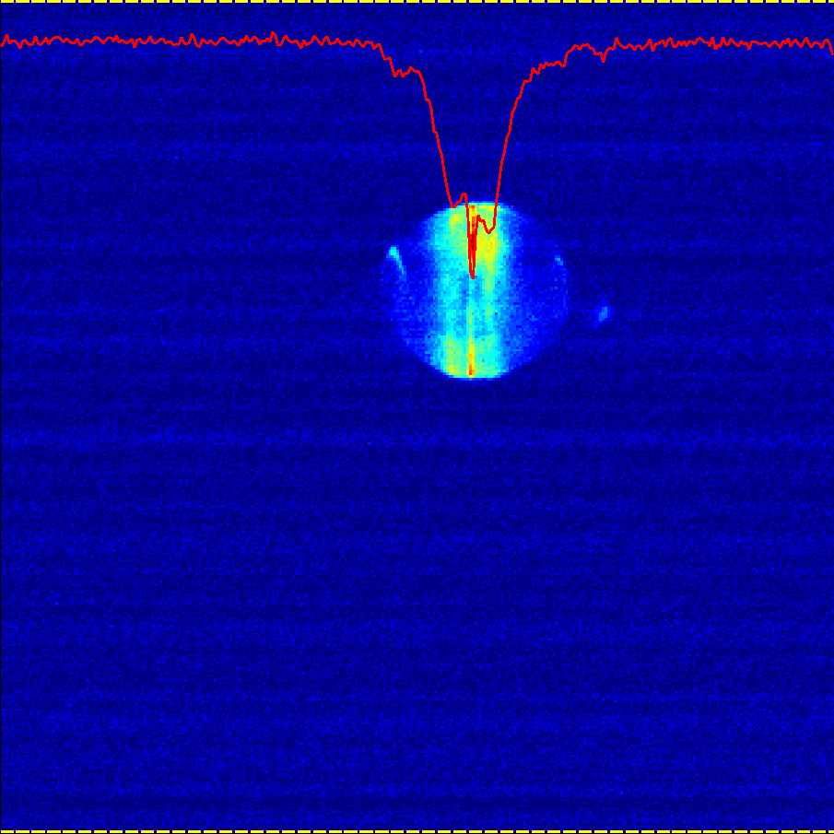
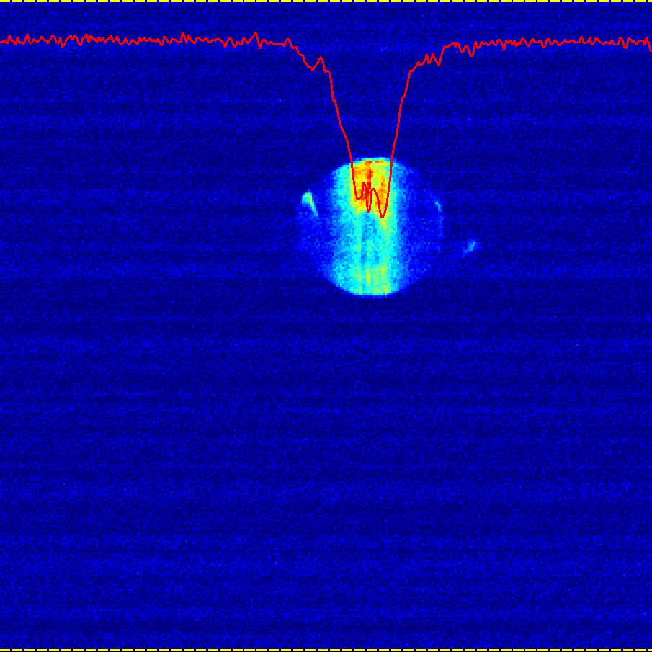
Post-compression proof-of-principle
Color centers indicate pulse compression and laser filamentation in 10 cm of NaCl
~2.5 J
<1.5 J
>3.5 J
Laser direction
Autocorrelator: reproduceable self-compression
Experiment:
Autocorrelation
Initial Pulse
Simulation:
Compressed pulse
Autocorrelation
Initial Pulse
2021
Use high-quality beam + new ac crystal
Multiple slabs of compressing material separated by spatial filters*
KCl/NaCl combination
  KCl: stronger nonlinearity
  NaCl: stronger linear dispersion
  * e.g. free-space propagation

Slide 8
2020 Summary
Experimental set-up for a single-shot measurement of nonlinear absorption and refraction is developed and tested
  A hard-edge aperture followed by a long free-space propagation is used for producing a high-quality beam
  Nonlinear index of air is measured for the first time for a picosecond LWIR pulse as a by-product of the setup development
Data analysis method is developed (+ new version of co2amp released)
Preliminary results for materials with negligible and non-negligible nonlinear absorption are obtained
A parallel effort is in progress at UCF
  More materials
  Expanded parameter space
  Cross-check of results
Promising results on nonlinear post-compression

Slide 9
2021 Plan
Measure nonlinear absorption and refraction of LWIR materials
  Start from materials with low nonlinear absorption (NaCl, KCl, BaF2…) that are most promising for nonlinear post-compression
  Switch to high nonlinear absorption materials (ZnSe, ZnS, Ge, Si, GaA, chalcogenide glasses…) later in the year. Add probing of the dynamics of field-induced absorption. Coordinate effort with UCF to achieve better understanding of material responses to various conditions.
Continue the effort on nonlinear post-compression
  Use high-quality beam
  Use results of n₂ measurements for theoretical calculations and interpretation of results
  Investigate combinations of NaCl, KCl, BaF2(?)… elements for self-compression
Design a setup for measuring optical damage
Hire a post-doc

Slide 10
2020 Activities & Impacts Associated with this Experiment (feel free to add pages as necessary)
Invited Talks:
  -
Manuscripts (books, conference and journal articles, other; please include works submitted by not yet accepted):
  -
Theses awarded
  -
Patents and/or hardware delivered:
  -
Other
  -

Slide 11
COVID-19 Pandemic Impacts
Please summarize any significant impacts from COVID-19 on your experiment and team during 2020
  Unable to hire post-docs
  More time for data analysis and theoretical research

Slide 12
Electron Beam Requirements
Parameter | Units | Typical Values | Comments | Requested Values
Beam Energy | MeV | 50-65 | Full range is ~15-75 MeV with highest beam quality at nominal values | -
Bunch Charge | nC | 0.1-2.0 | Bunch length & emittance vary with charge | -
Compression | fs | Down to 100 fs (up to 1 kA peak current) | A magnetic bunch compressor available to compress bunch down to ~100 fs. Beam quality is variable depending on charge and amount of compression required. NOTE: Further compression options are being developed to provide bunch lengths down to the ~10 fs level | -
Transverse size at IP (σ) | μm | 30 – 100 (dependent on IP position) | It is possible to achieve transverse sizes below 10 um with special permanent magnet optics. | -
Normalized Emittance | μm | 1 (at 0.3 nC) | Variable with bunch charge | -
Rep. Rate (Hz) | Hz | 1.5 | 3 Hz also available if needed | -
Trains mode | --- | Single bunch | Multi-bunch mode available. Trains of 24 or 48 ns spaced bunches. | -

Slide 13
CO₂ Laser Requirements
Configuration | Parameter | Units | Typical Values | Comments | Requested Values
CO₂ Regenerative Amplifier Beam | Wavelength | μm | 9.2 | Wavelength determined by mixed isotope gain media | -
 | Peak Power | GW | ~3 |  | -
 | Pulse Mode | --- | Single |  | -
 | Pulse Length | ps | 2 |  | -
 | Pulse Energy | mJ | 6 |  | -
 | M² | --- | ~1.5 |  | -
 | Repetition Rate | Hz | 1.5 | 3 Hz also available if needed | -
 | Polarization | --- | Linear | Circular polarization available at slightly reduced power | -
CO₂ CPA Beam | Wavelength | μm | 9.2 | Wavelength determined by mixed isotope gain media | 9.2
Note that delivery of full power pulses to the Experimental Hall is presently limited to Beamline #1 only. | Peak Power | TW | 2 | ~5 TW operation is planned for FY21 (requires further in-vacuum transport upgrade). A 3-year development effort to achieve >10 TW and deliver to users is in progress. | 2
 | Pulse Mode | --- | Single |  | Single
 | Pulse Length | ps | 2 |  | 2
 | Pulse Energy | J | ~5 | Maximum pulse energies of >10 J will become available in FY21 | 5
 | M² | --- | ~2 |  | 2
 | Repetition Rate | Hz | 0.05 |  | 0.05
 | Polarization |  | Linear | Adjustable linear polarization along with circular polarization will become available in FY21 | Linear

Slide 14
Near IR Experimental Laser Requirements
Ti:Sapphire Laser System | Units | Stage I Values | Stage II Values | Comments | Requested Values
Central Wavelength | nm | 800 | 800 | Stage I parameters have been delivered, while Stage II parameters will be available for user experiments once our vacuum transport installation is complete (now planned for FY21 after COVID-19 delays) | -
FWHM Bandwidth | nm | 20 | 13 |  | -
Compressed FWHM Pulse Width | fs | <55 | <75 | Transport of compressed pulses will initially include a very limited number of experimental interaction points. Please consult with the ATF Team if you need this capability. | -
Chirped FWHM Pulse Width | ps | ≥50 | ≥50 |  | -
Chirped Energy | mJ | >30 | 200 |  | -
Compressed Energy | mJ | >14 | 100 |  | -
Energy to Experiments | mJ | >10 | >80 |  | -
Power to Experiments | GW | >250 | >1067 |  | -
Nd:YAG Laser System | Units | Typical Values | 2021 Modifications | Comments | Requested Values
Wavelength | nm | 1064 | 1064 | Single pulse | -
Energy | mJ | 5 | 100 |  | -
Pulse Width | ps | 14 | <20 |  | -
Wavelength | nm | 532 |  | Frequency doubled | -
Energy | mJ | 0.5 |  |  | -
Pulse Width | ps | 10 |  |  | -

Slide 15
Special Equipment Requirements and Hazards
Electron Beam
  -
CO₂ Laser
  Space to arrange 14 meters of open-air beam propagation between laser output and experimental setup (for diffraction-based beam forming)
Ti:Sapphire and Nd:YAG Lasers
  -
Hazards & Special Installation Requirements
  Large installation (chamber, insertion device, etc.): -
  Cryogens: -
  Introducing new magnetic elements: -
  Introducing new materials into the beam path: -
  Any other foreseeable beam line modifications: -

Slide 16
Experimental Time Request
CY2021 Time Request
Capability | Setup Hours | Running Hours
Electron Beam Only
Laser* Only (in Laser Rooms) | 40 | 120
Laser(s)* + Electron Beam
Time Estimate for Remaining Years of Experiment (including CY2021)
Capability | Setup Hours | Running Hours
Electron Beam Only
Laser* Only (in Laser Room) | 80 | 240
Laser(s)* + Electron Beam
* Laser = Near-IR or LWIR (CO₂) Laser

