Slide 1
ATF User Operations during COVID-19
Ann Emrick
12/11/20

Slide 2
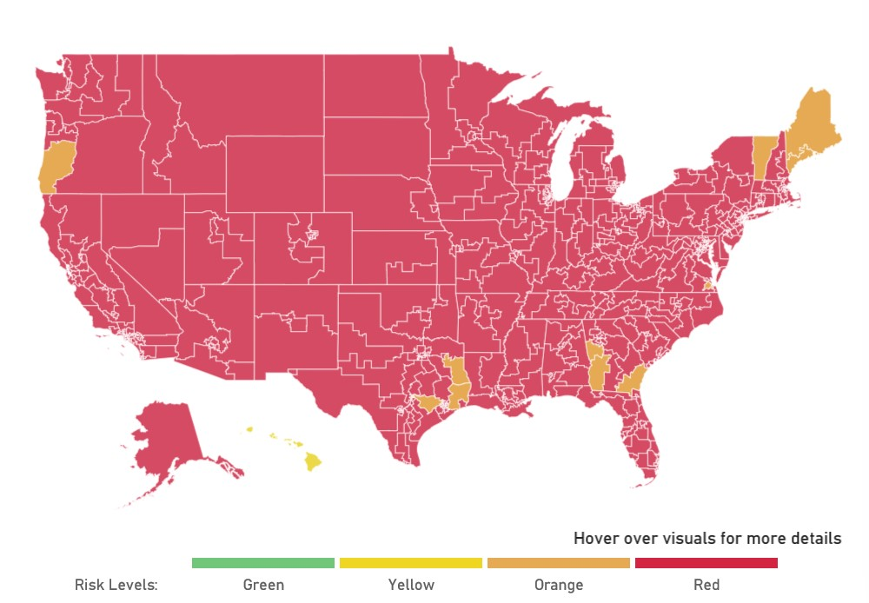
COVID-19 Guidelines Change As Conditions Change

Slide 3
Stats as of December 7
US New Case Rate increased to 61cases per 100k residents (the number of new cases per 100k residents over a 7-day rolling average)
The New Case Rates for New York State and Long Island have increased to 49.12 and 63.78
NY is using microcluster approach to stop spread
Long Island has 6.2% positivity rate
BNL is in ‘Limited Operations’ with approximately 65% of staff teleworking
BNL has ~65 cases since the start. No apparent on-site transmission. Controls appear to be working

Slide 4
BNL’s Recovery Plan..

Slide 5
Decision Process for On-site Access
Experiment must be approved as mission critical
  Delays will cause significant hardship to project (failure to meet deliverables, etc.)
  ATF Operations has been approved as mission critical.
If the work can be accomplished remotely it should be done off-site
  Can be hybrid so that some work can be done remotely and some on-site
If on-site access is required, required steps must be taken

Slide 6
Travel to NY* - Testing and Quarantine Requirements
Contiguous States to NY - Only BNL Entry Requirement
Non-Contiguous States
  You must obtain a diagnostic test for Covid-19 within three days of departure, prior to arrival in NY. Email test results to nurses@bnl.gov.
  Upon arrival to NYS, you must complete the NY State Traveler Health Form, and quarantine for three days following NY guidelines.
  Take a second diagnostic test for COVID-19 in NY on the 4th day of your arrival into NY. Email test results to nurses@bnl.gov. Once cleared you can come on-site
International Travel –Currently requires 14-day quarantine
* Rev: 11/4/2020

Slide 7
Pre-Entry Preparations
Complete usual User Appointment, access training, etc.
Be prepared
  Check Hotel for quarantine requirements
  Schedule a rapid test ahead of arrival so no waiting in line
Complete online COVID-19 Awareness Training
Review the Daily Health Check prior to on-site arrival
Wear face covering upon arrival at gate

Slide 8
Going Forward
These are the requirements as of today
Requirements change frequently – Check the BNL site for updated information
Contact us for any questions
  Ann Emrick
  (631)344-5756
  emrick@bnl.gov
Mary Jane Ilardi
(631)344-6361
milardi@bnl.gov

Slide 9


