Slide 1
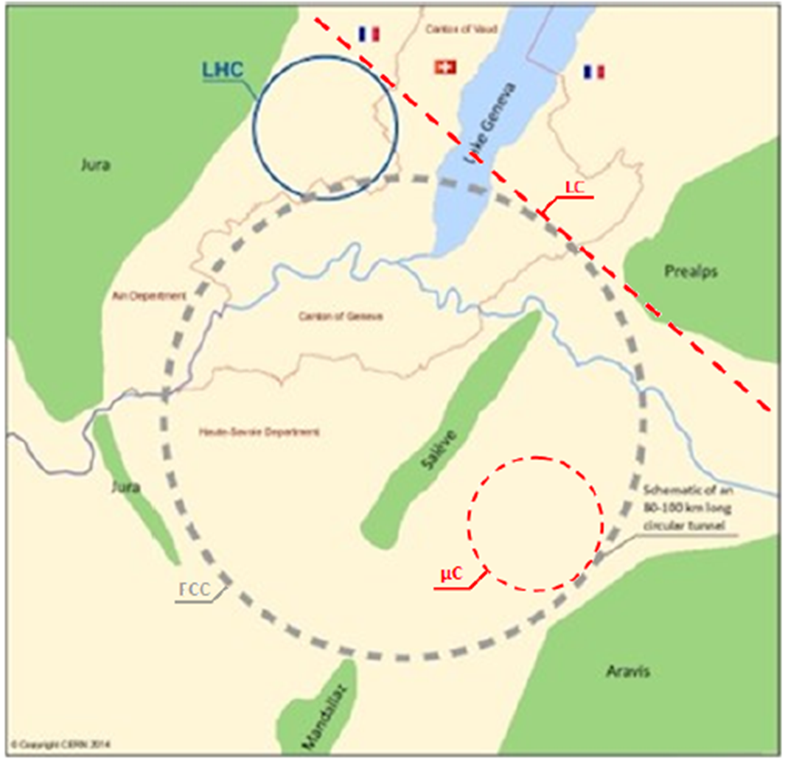
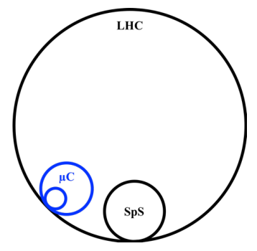
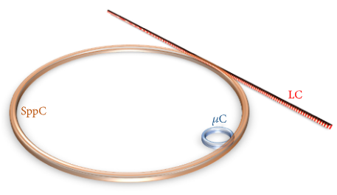
DIS-2021, 12-16 April 2021, Stony Brook, NY
Energy Frontier Lepton-Hadron and Photon-Hadron Colliders: Luminosity and Physics
Saleh Sultansoy
TOBB Ekonomi ve Teknoloji Üniversitesi, Ankara, Türkiye
Azərbaycan Milli Elmlər Akademiyası Fizika İnstitutu, Bakı, Azərbaycan
ATLAS, LHeC and FCC Collaborations, CERN
Member of Plenary ECFA (Jan 2019 – Jul 2020)
Advances in High Energy Physics (2017) 4021493
e-Print: 1905.05564 [physics.acc-ph]
Nucl. Instrum. and Meth., A 871 (2017) 47-53

Slide 2
ABSTRACT
Construction of linear collider (or dedicated e-linac) or muon collider (or dedicated μ-ring) tangential to energy frontier hadron colliders will give opportunity to investigate lepton-hadron and photon-hadron interactions at tens-TeV center-of-mass energies.
These lepton-hadron and photon-hadron colliders will essentially enlarge physics search potential of the hadron collider's host laboratory both in SM and BSM phenomena.
In this presentation main parameters of the LHC/FCC/SppC based ep, eA, μp, μA, γp and γA colliders will be discussed, together with their physics search potential.
Certainly, these machines have great potential for clarifying QCD basics.
Concerning BSM physics search, their potential exceeds that of corresponding lepton colliders essentially and is comparable (and complementary) with the potential of basic hadron colliders.

Slide 3
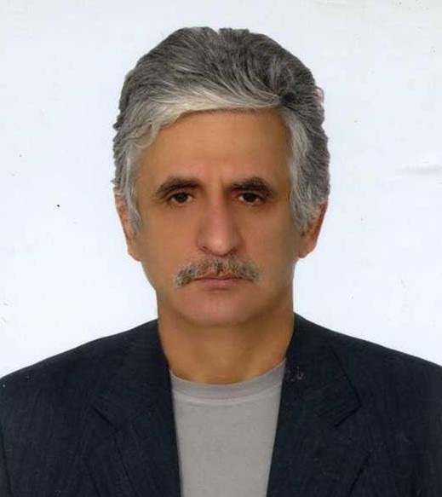
Content
1. Introduction
2. LHeC: 60 GeV ERL
3. LHeC: alternative scenarios
4. Energy frontiers
5. QCD (not H) Explorer
6. BSM Physics
7. Conclusion and recommendations
8. Review articles
9. Warning

Slide 4
1. Introduction
20 years ago the Standard Model had two experimental missing's:
Higgs mechanism in electroweak part
Confinement hypothesis in QCD part
Electroweak part was completed by discovery of the Higgs boson at the LHC.
QCD part is still uncompleted, Confinement should be clarified.
Two regions are crucial:
Bjorken x close to 1, will be investigated at EIC,
Small x (<<10⁻⁴) at high Q² (>>10² GeV ²), will be investigated at LHeC and energy frontier lh/γh colliders.
In addition, LHeC and energy frontier lh/γh colliders will provide pdf’s for adequate interpretation of HE-LHC, FCC and SppC data.
Concerning BSM physics, it should be mentioned that potential of lh/γh colliders:
essentially exceeds that of corresponding lepton colliders
is comparable with (and complementary to) potential of corresponding hadron colliders.

Slide 5
Table 1. Future Energy Frontier Colliders: colliding beams vs collider types
 | Ring-Ring | Linear | Linac-Ring
pp, pA, AA | HE-LHC, FCC, SppC | - | -
ee, γe, γγ | - | ILC, CLIC, PWFA-LC | -
ep, eA | - | - | LHeC, FCC/SppC based
γp, γA | - | - | HE-LHC/FCC/SppC based
µµ | µC | - | -
µp, µA | LHC/FCC/SppC based | - | -
→ ILC+FCC/SppC → PWFA+FCC/SppC
+ HL/HE-LHC based µh
+ FCC/SppC based µh

Slide 6
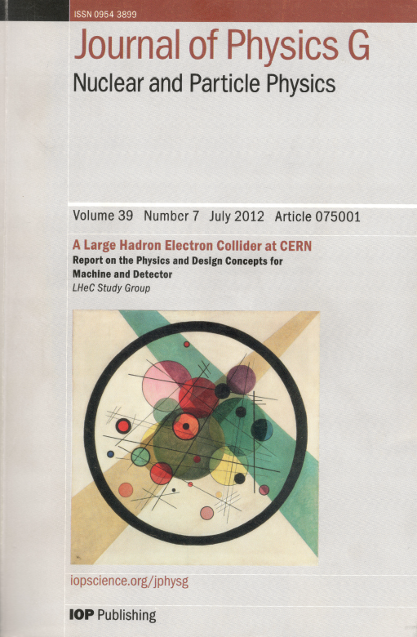
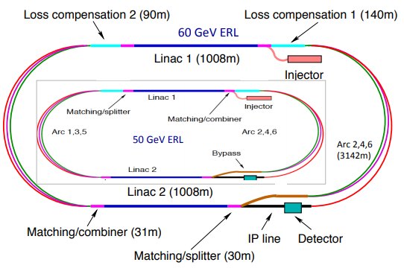
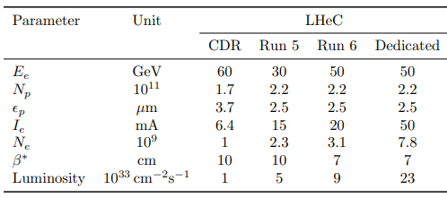
2. LHeC: 60 GeV ERL

Slide 7
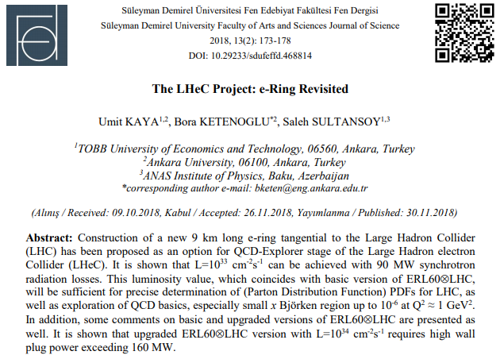
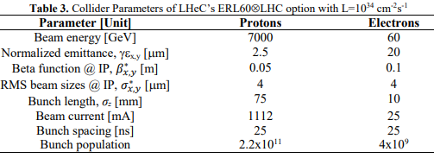
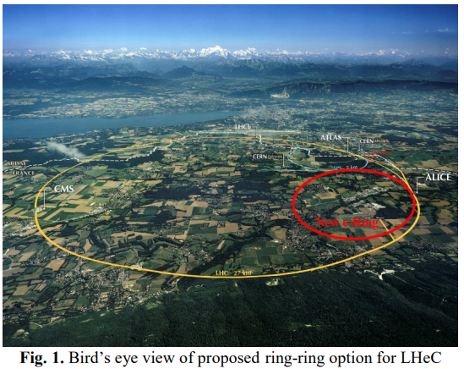
3. LHeC: Alternative Scenarios
Wall plug power is over 160 MW !
Next stage: 9 km e-ring → µ-ring with E_{µ} = 3 TeV
√S : 1.3 TeV → 9.1 TeV
Another alternative, namely, one-pass linac will give opportunity to upgrade electron beam energy, if necessary! + γp and γA options!

Slide 8
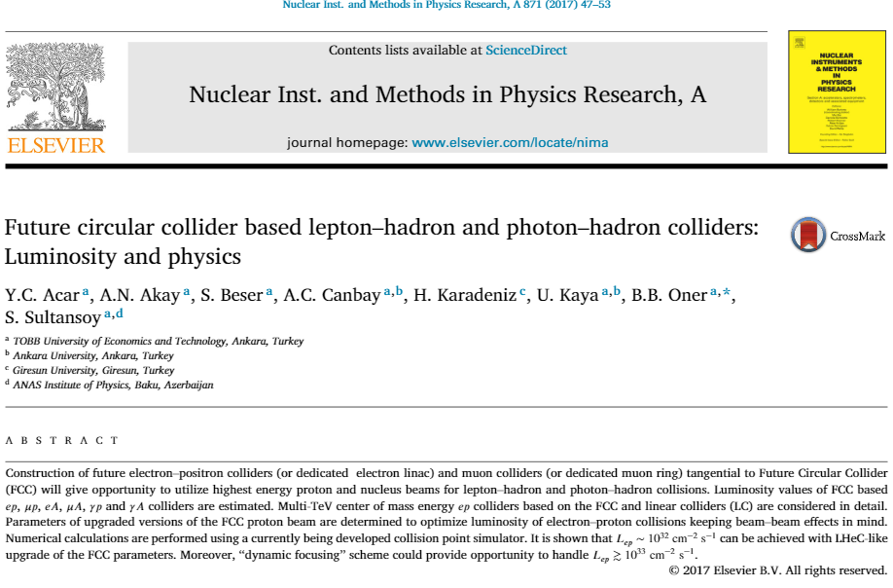
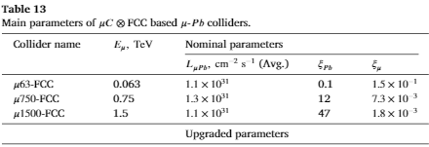
4. Energy Frontiers
FCC based ep, γp, µp, eA, γA, µA, FEL γA colliders

Slide 9
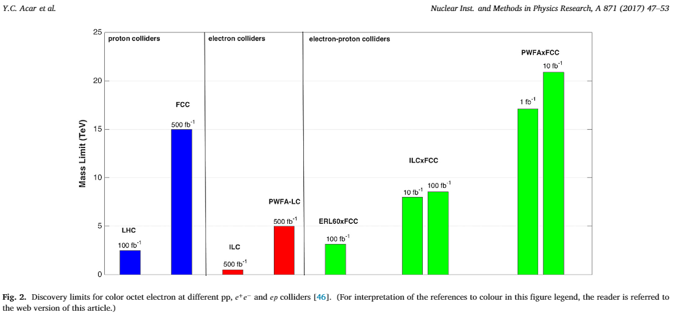
4. Energy Frontiers
FCC based ep, γp, µp, eA, γA, µA, FEL γA colliders

Slide 10
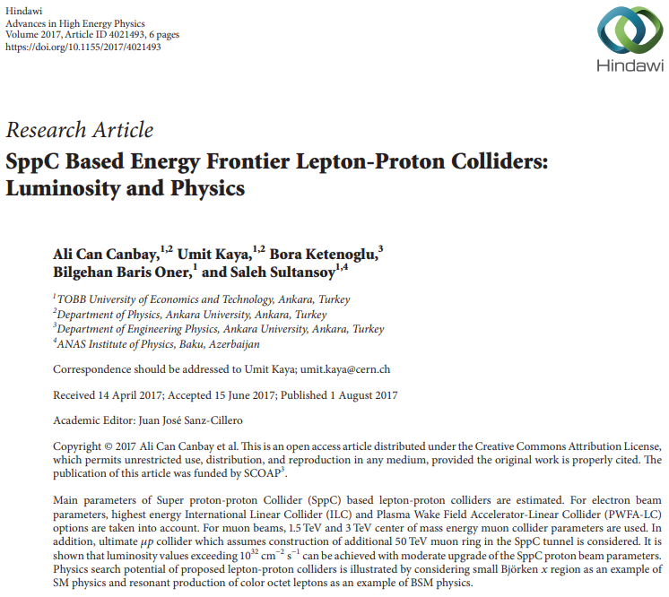
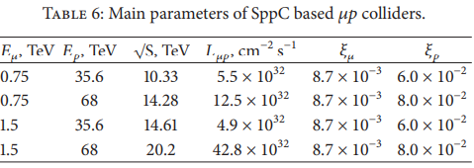
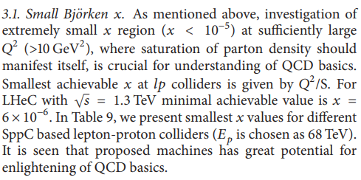
4. Energy Frontiers
SppC based ep and µp colliders

Slide 11
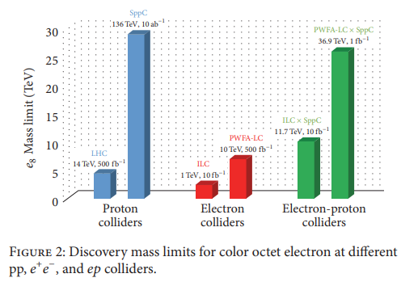
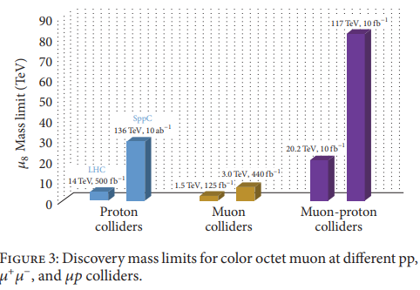
4. Energy Frontiers
SppC based ep and µp colliders

Slide 12
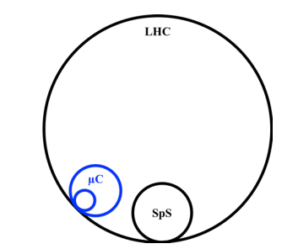
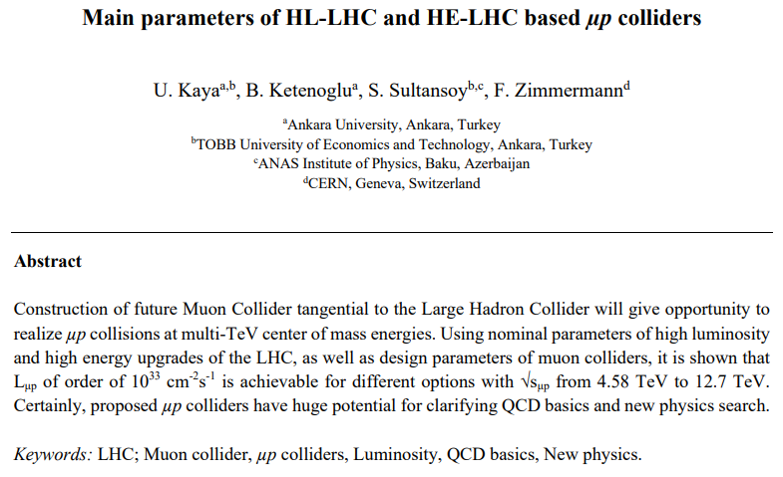
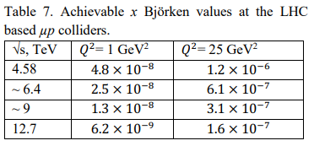
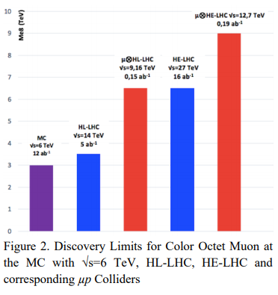
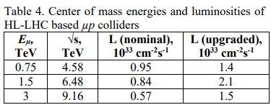
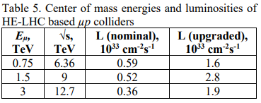
4. Energy Frontiers
HL/HE-LHC based µp colliders
https://arxiv.org/ftp/arxiv/papers/1905/1905.05564.pdf

Slide 13
5. QCD (not H) Explorer(s)
Higgs mechanism is responsible for 1% of mass of visible universe,
QCD is responsible for remaining 99% !!!
Luminosity vs energy in lepton-hadron collisions:
Higgs physics requires highest lumi,
QCD basics requires highest energy.
Modified ERL60+LHC with L = 10³⁴ cm⁻² s⁻¹ requires too much wall plug power, while even this luminosity may not be sufficient for precision Higgs boson physics.
Let's leave the Higgs boson to the lepton and hadron colliders !
Clarifying of QCD basics (including confinement hypothesis) may lead to exceptional results (including cosmology and technology) !

Slide 14
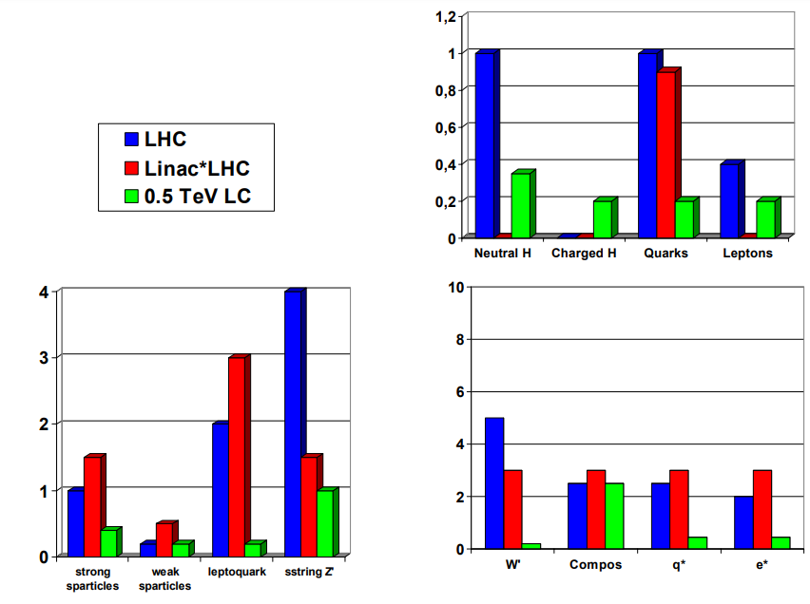
6. BSM Physics
https://accelconf.web.cern.ch/p05/PAPERS/TPAT098.PDF
See, also:
http://cds.cern.ch/record/798726/files/open-2004-026.pdf
This figure played an important role in the initiation of the LHeC process.
It would be very useful to do similar work for the FCC based lp. (two examples are shown in slides 9 and 11)

Slide 15
7. Conclusion and recommendations
Obviously, energy frontier lepton-hadron and photon-hadron colliders will essentially enlarge physics search potential of basic hadron colliders for both the SM and BSM phenomena.
Therefore, systematic study of accelerator, detector and physics search aspects of the LHC/FCC/SppC based energy-frontier ep, γp, µp, eA, γA and µA colliders is necessary for long-range planning of HEP.
I invite the DIS community to start these studies. Your experience will allow to complete this work in a few years. This will be beneficial for next European Strategy document preparation.
Concerning linac-ring type colliders:
energy recovery is mandatory for TAC Super-Charm Factory and EIC
60 GeV ERL may be considered as baseline (but not the sole) option for LHC (E_{p} /E_{e} ≈ 120)
60 GeV ERL is not appropriate choice for FCC and SppC, since E_{p} /E_{e} ≈ 830 !
Finally, organization of special working group on the LHC/FCC based energy frontier lepton-hadron and photon-hadron colliders (maximally disentangled from ERL60/PERLE governance) will be very useful. It would be natural for DESY to take over this job.
We have to create a table with collider types in columns, physics phenomena (particles, interactions, ...) in rows and fill in it.

Slide 16
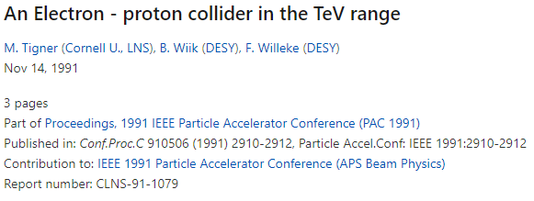
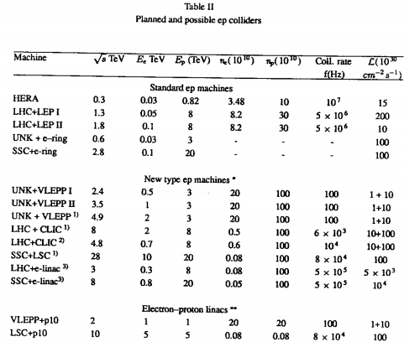
8. Review articles

Slide 17
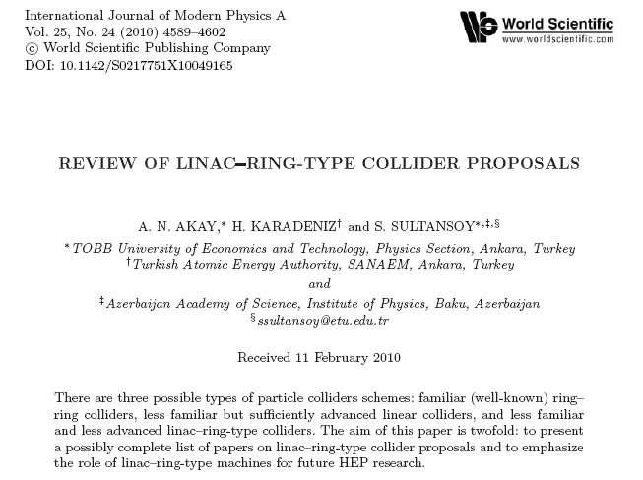
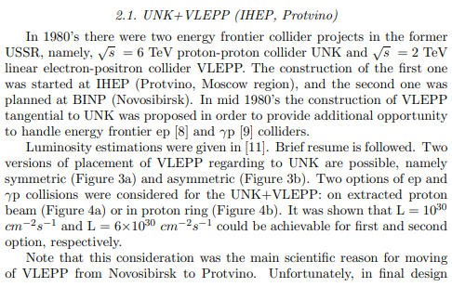
9. Warning
Note that this consideration was the main scientific reason for moving of VLEPP from Novosibirsk to Protvino. Unfortunately, in final design VLEPP placement was chosen to cross the UNK ring, instead of tangential. Obviously, this choice closed ep and γp options (clear indication of collapse of Eastern Block).
Hopefully, CERN will not repeat similar mistake…

