Slide 1
Hadron polarimetry
for the Electron-Ion Collider
Ana Sofia Nunes
DIS 2021
12-16 April 2021
(virtual @ Stony Brook University, USA)

Slide 2
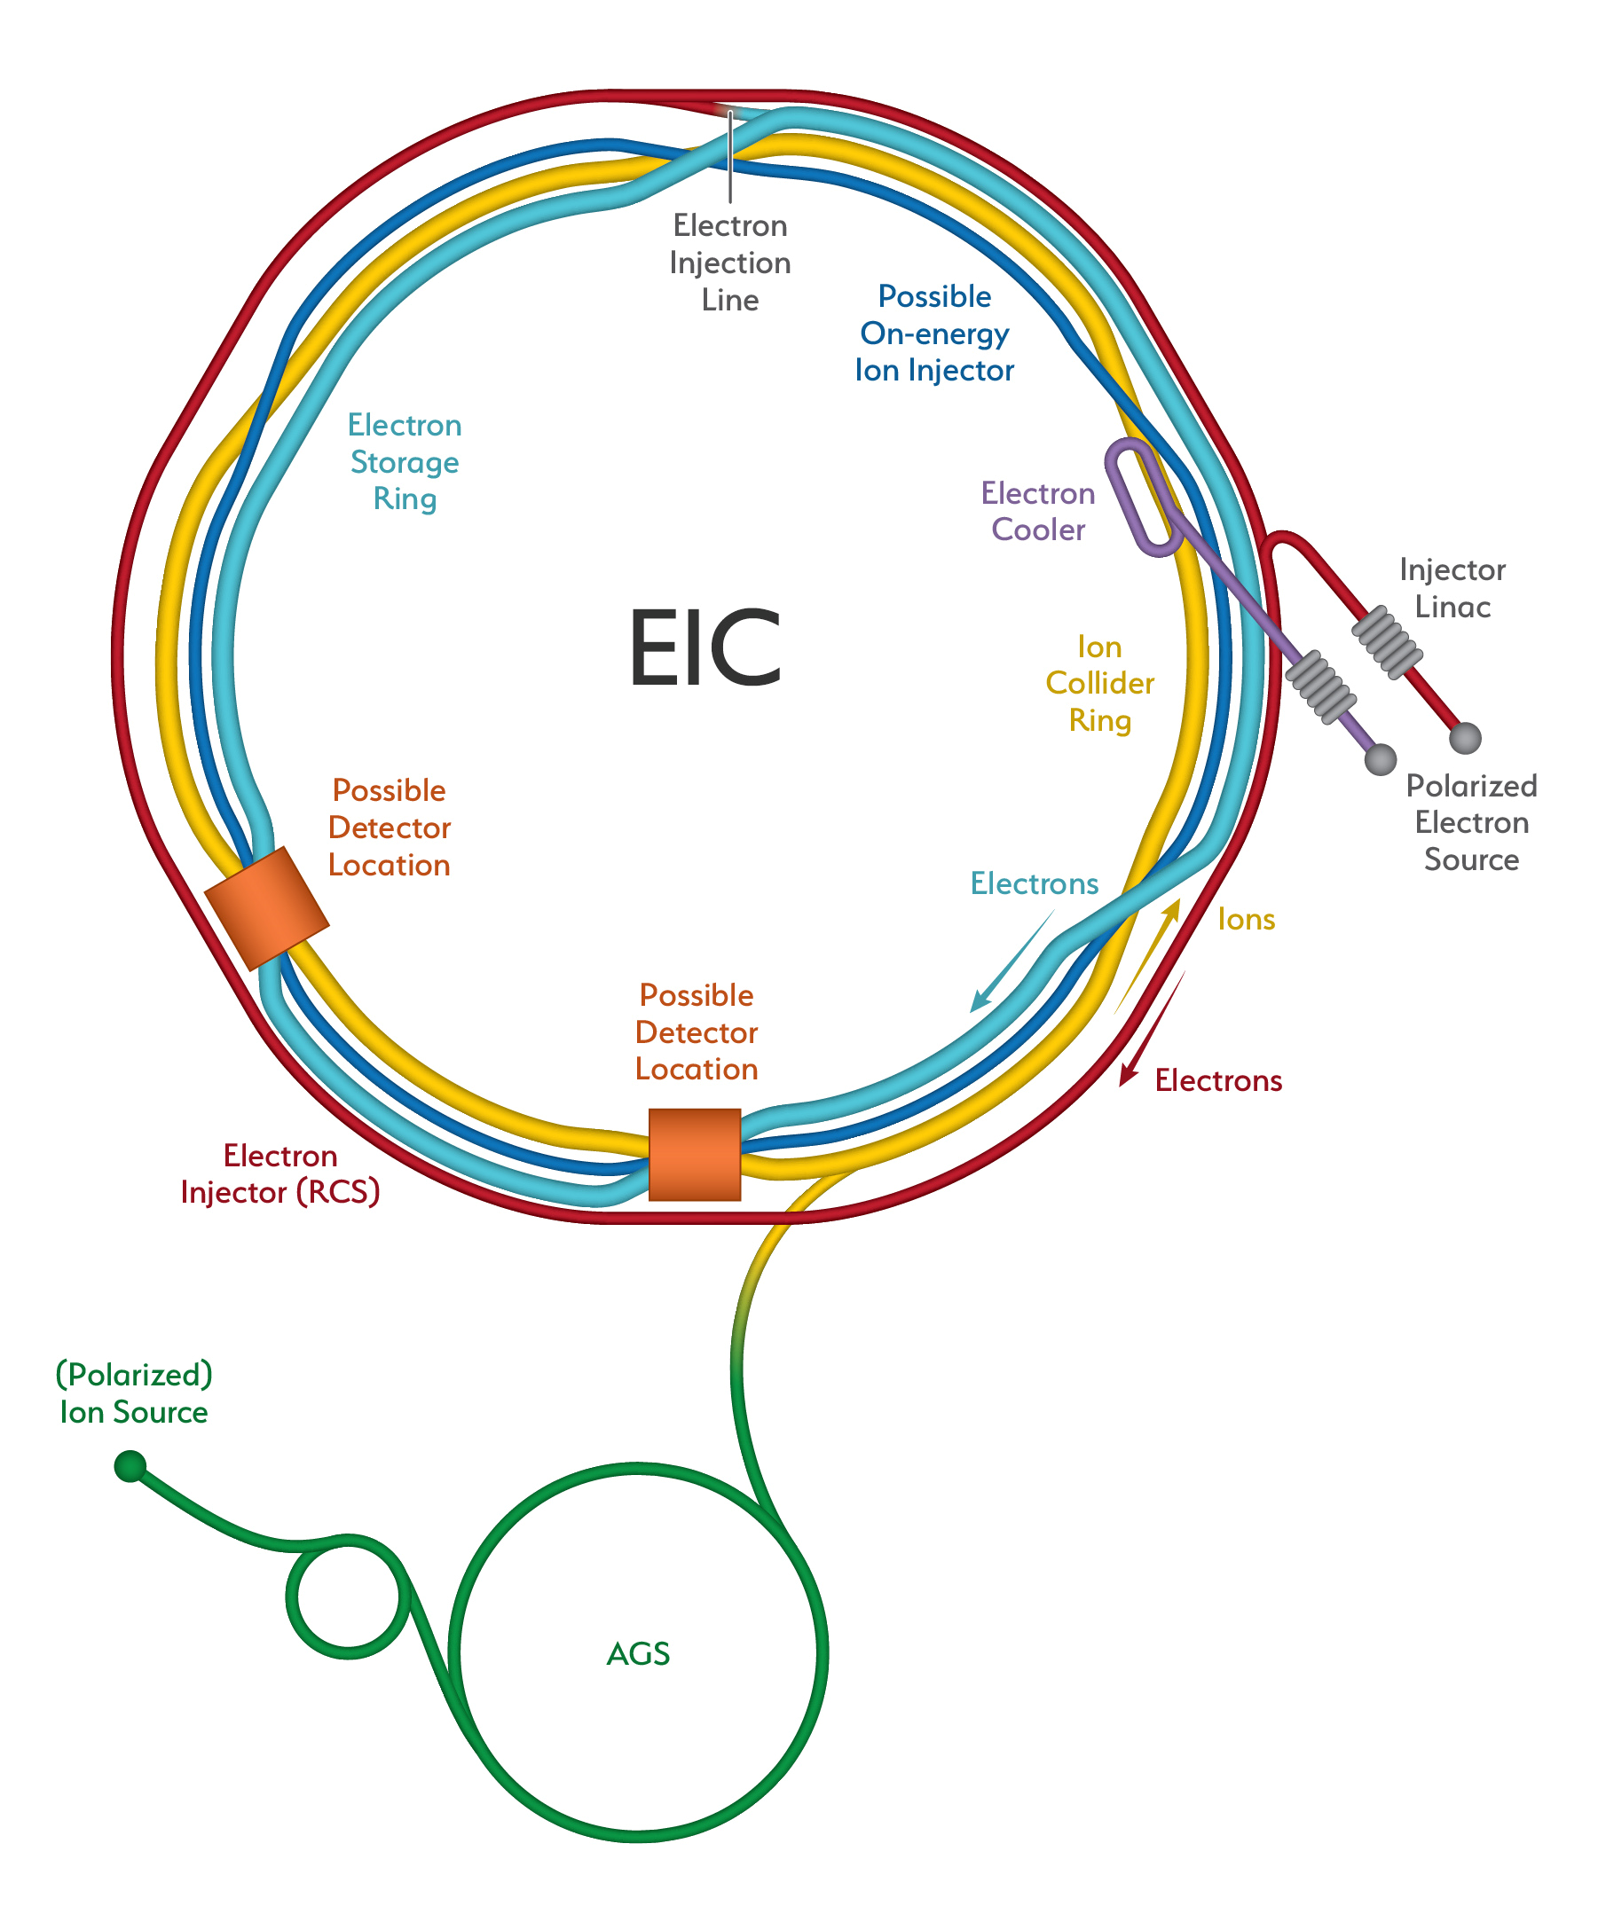
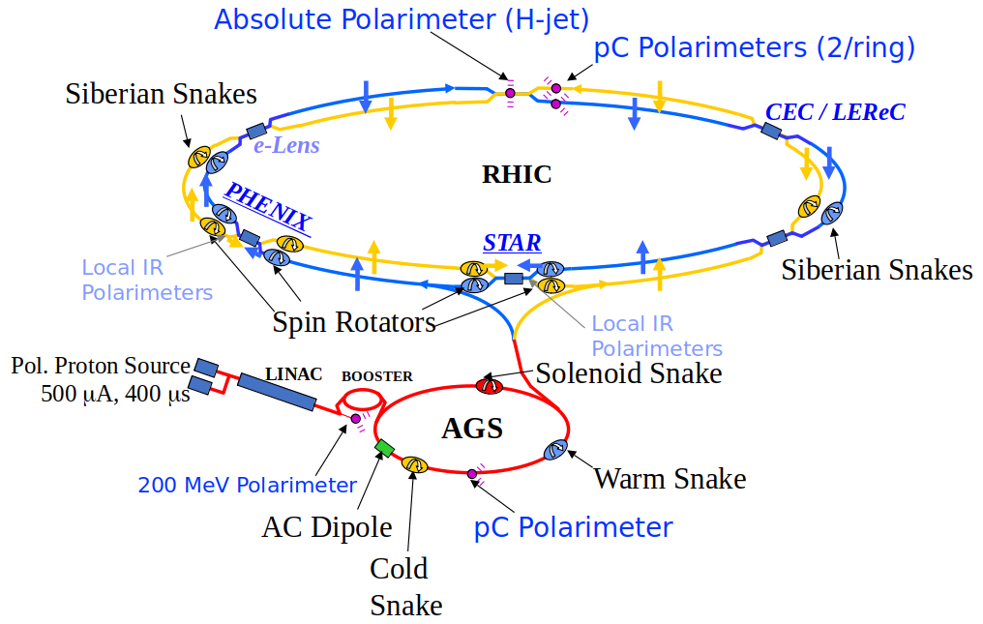
From RHIC to the EIC
Hadron polarimetry at RHIC:
Difficult because there is no process that allows from first principles to relate beam polarization and an observable
Achieved ~1.5% systematic uncertainty in polarization measurement, polarization profile and life time, bunch by bunch
Challenges for hadron polarimetry at the EIC:
~10x more beam bunches => Bunches closer in time
Different beam conditions => Higher temperatures at C wires in pC polarimeters, may limit their lifetime
Required 1% systematic uncertainty polarization measurement, bunch by bunch
³He beam polarization to be measured for the first time
Ana S. Nunes, Hadron polarimetry for the EIC, DIS 2021, 12-16 April 2021

Slide 3
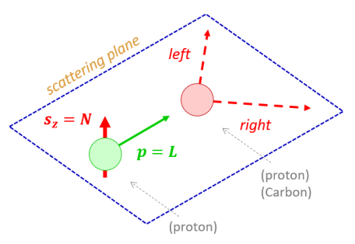
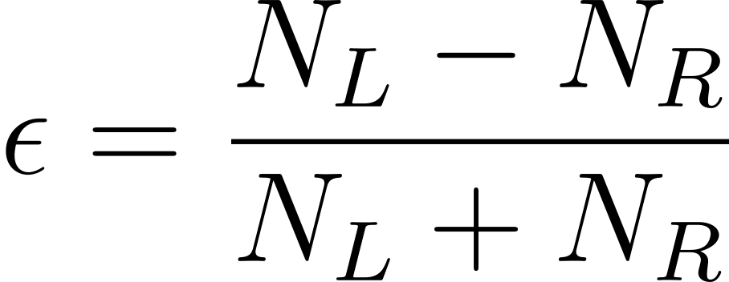
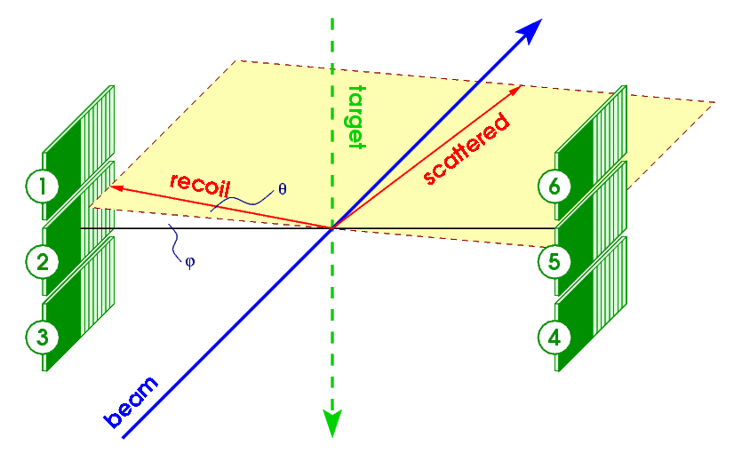
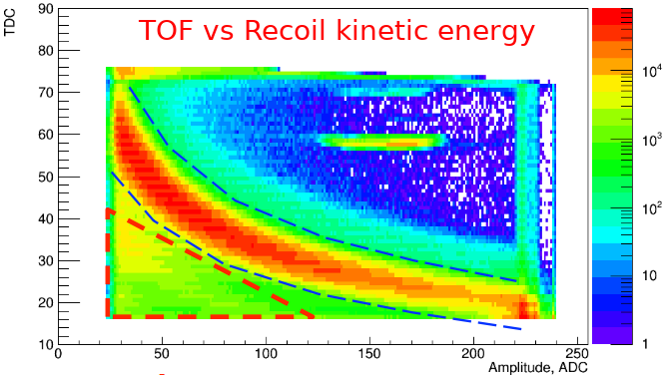
Hadron polarimetry method
Basis:
Elastic scattering in CNI-region
→ left-right asymmetry of recoil particles:
Asymmetry and polarization are related through analyzing power:
When one can polarize the target and
measure its polarization → absolute
beam polarization (as in the HJet):
Two-tier measurement @ RHIC:
HJet to measure absolute polarization with limited statistical power
pC polarimeters with high statistical power, to measure online polarization, polarization profile, polarization lifetime and bunch by bunch polarization
background
elastic events
Data from pC polarimeters at RHIC, before calibration
Ana S. Nunes, Hadron polarimetry for the EIC, DIS 2021, 12-16 April 2021

Slide 4
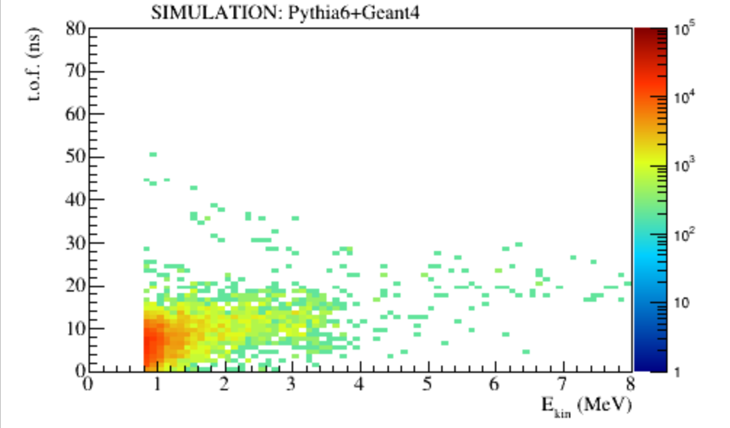
2017 HJet Data Run #20592
Simulations
Simulation (Pythia6+Geant4)
1Bevents. Includes: σ=3.5 ns long bunches,
material around interaction (HJetSim, by O. Eyser)
T.o.f., 2.0<E<2.4 MeV, by silicon strip
T.o.f., 2.0<E<2.4 MeV, by silicon strip
Main data features are reproduced by the simulation
Low energy, low time of flight background consist of results from charged pions, charged kaons, and a few photons and electron-positron pairs
Pion background => motivation for their detection/vetoing with a second layer of silicon sensors
There is still room for improvement in the background description
Charged pions
Ana S. Nunes, Hadron polarimetry for the EIC, DIS 2021, 12-16 April 2021

Slide 5
Summary and outlook
The EIC will be the first collider using polarized electrons and light ion beams (protons and ³He)
Challenges for the EIC:
require 1% systematic uncertainty and bunch-by-bunch polarization
³He polarization measurement never done in a high energy collider
high bunch frequency
increased background sensitivity → vetoing under investigation
increased beam heating of carbon targets → new materials to be considered
Tests can be done at RHIC (APEX) AND AGS in the next few years:
³He beam, unpolarized and polarized, together with ZDCs @ 18 m from HJet
Acknowledgements:
Elke Aschenauer, Bill Schmidke, Oleg Eyser, Haixin Huang, Andrei Poblaguev, Anatoli Zelenski
pC polarimeter RHIC proton beam scan
Ana S. Nunes, Hadron polarimetry for the EIC, DIS 2021, 12-16 April 2021

