Slide 1
IR1@EIC Detector concept/implementation
& EoI
E.C. Aschenauer (BNL)
in collaboration with
Rolf Ent (JLab)

Slide 2
Background
EIC facility is capable to support two interaction regions with a detector each
The EIC project includes:
the accelerator capable of
  ep and eA collisions
  High Luminosity: 10³³-10³⁴ cm⁻²s⁻¹
  Variable center of mass energies from 20− 100 GeV, upgradable to 140 GeV
  Electrons and protons/light nuclei highly polarized (70%)
  Ion beams from deuteron to the heaviest nuclei (d to U)
one interaction region
one detector capable doing the science described in the WP and NAS review
  Project $150 M + contingency $50 M
  Assumed in-kind: $~100M

Slide 3


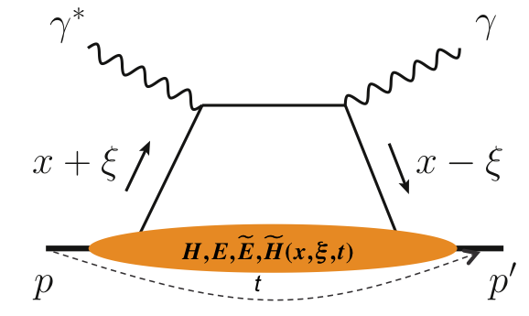
What is needed experimentally?
experimental measurements categories to address EIC physics:
Parton Distributions in nucleons and nuclei
QCD at Extreme Parton Densities - Saturation
Spin and
Flavor structure of nucleons and nuclei
Tomography Transverse Momentum Dist.
QCD at Extreme Parton Densities - Saturation
Tomography
Spatial Imaging
inclusive DIS
semi-inclusive DIS
exclusive processes
measure scattered lepton
multi-dimensional binning: x, Q²
reach to lowest x, Q² impacts
Interaction Region design
→ low mass detectors,
excellent e/h separation
measure scattered lepton
and hadrons in coincidence
multi-dimensional binning:
x, Q², z, p_{T}, Θ
particle identification over entire region is critical
measure all particles in event
multi-dimensional binning:
x, Q², t, Θ
proton p_{t}: 0.2 - 1.3 GeV
  cannot be detected in main detector
  strong impact on Interaction Region design
∫Ldt:
1 fb⁻¹
10 fb⁻¹
10 - 100 fb⁻¹
machine & detector requirements

Slide 4
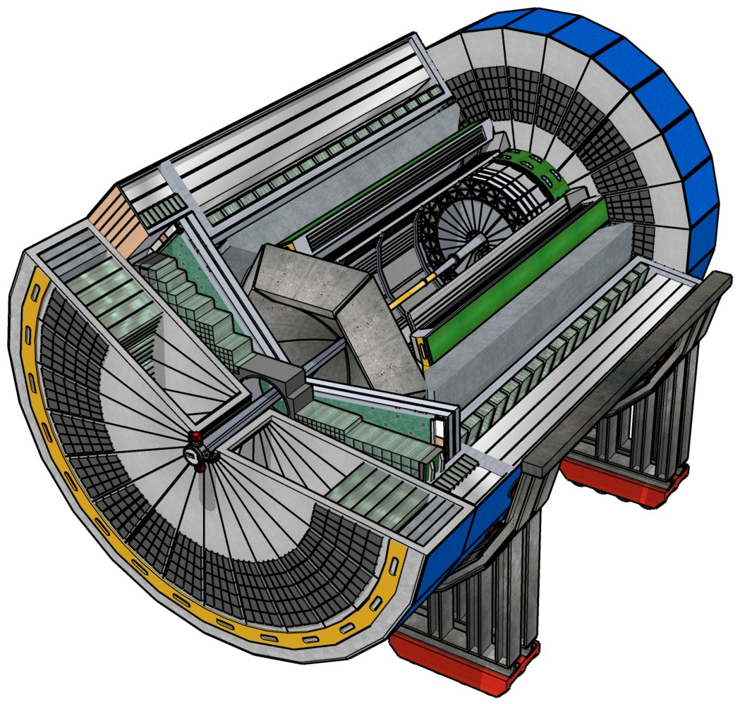
EIC Experimental Equipment
Any general purpose EIC Detector is complex
Overall detector requirements:
Large rapidity (-4 < η < 4) coverage; and far beyond in especially far-forward detector regions
High precision low mass tracking
  small (μ-vertex) and large radius (gaseous-based) tracking
Electromagnetic and Hadronic Calorimetry
  equal coverage of tracking and EM-calorimetry
High performance PID to separate π, K, p on
track level
  also need good e/π separation for scattered electron
Large acceptance for diffraction, tagging, neutrons from nuclear breakup: critical for physics program
  Many ancillary detector integrated in the beam line: low-Q² tagger, Roman Pots, Zero-Degree Calorimeter, ….
High control of systematics
  luminosity monitor, electron & hadron Polarimetry
For the success of the EIC science it is critical the Detector is fully integrated in the Interaction Region

Slide 5
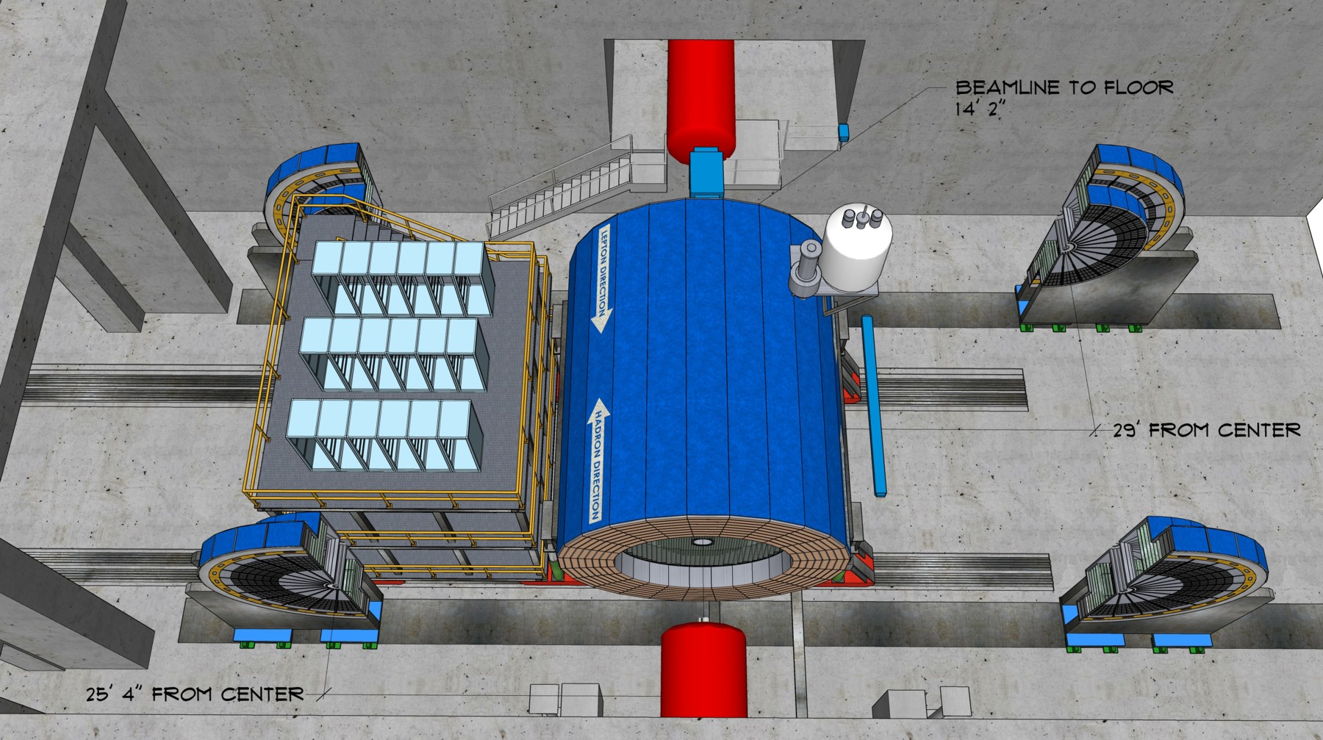
Highly integrated detector system
Total size detector: ~75m
Central detector: ~10m
Backward electron detection: ~35m
Forward hadron spectrometer: ~40m
Backward
p/A beam
electron beam
Forward

Slide 6
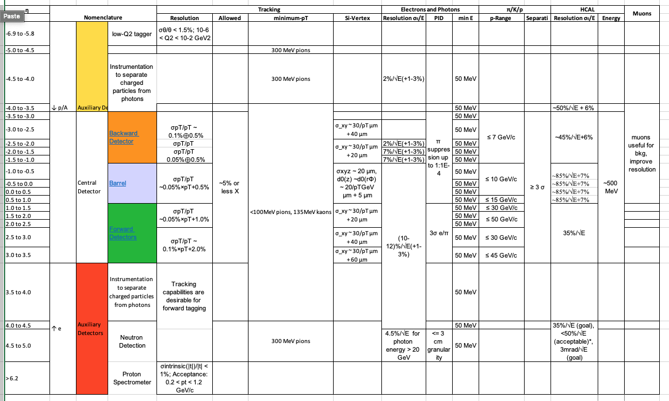
Detector integrated in EIC Project
Needs to follow CD schedule and achieve KPPs for CD-4a and CD-4
Detector and IR are strongly nested into each other
  should not diverge to much in their design majority
General purpose detector realizing the YR requirements
Physics requirements

Slide 7
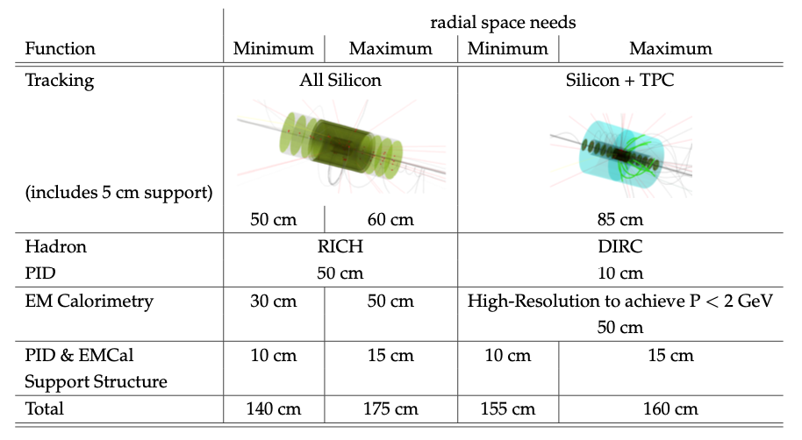
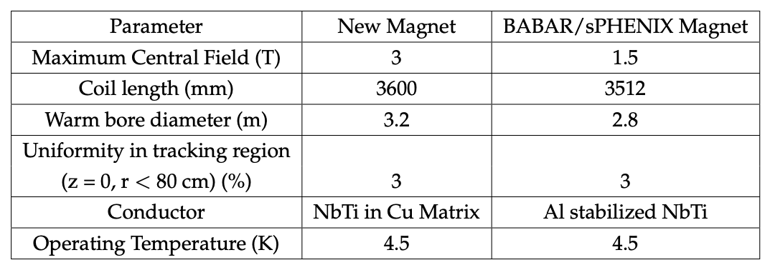
Detector integrated in EIC Project
Space considerations versus Magnet size:

Slide 8
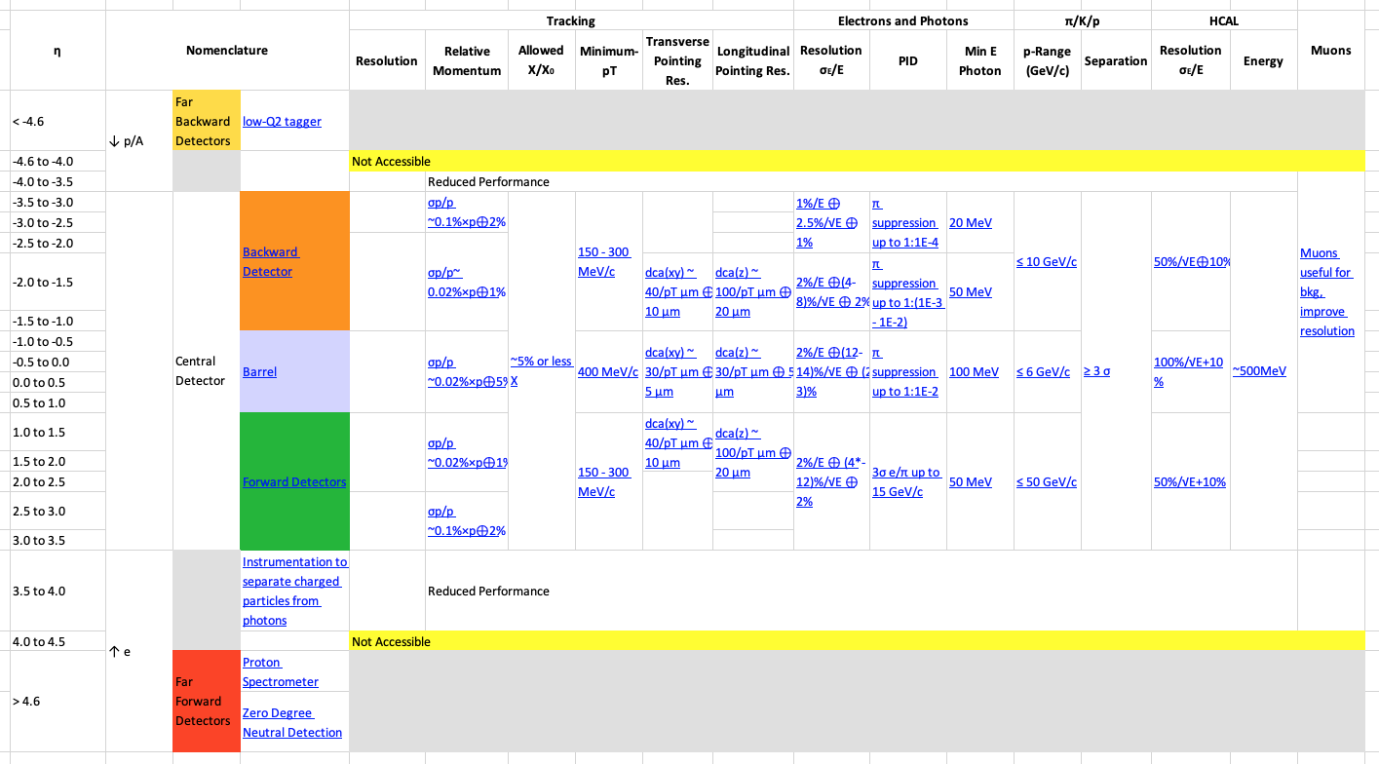
Detector integrated in EIC Project
Follow closely EIC-UG Yellow Report results for detector performance:
Detailed detector simulations and technology performance evaluations tabulated
  performance for 3 Tesla field

Slide 9
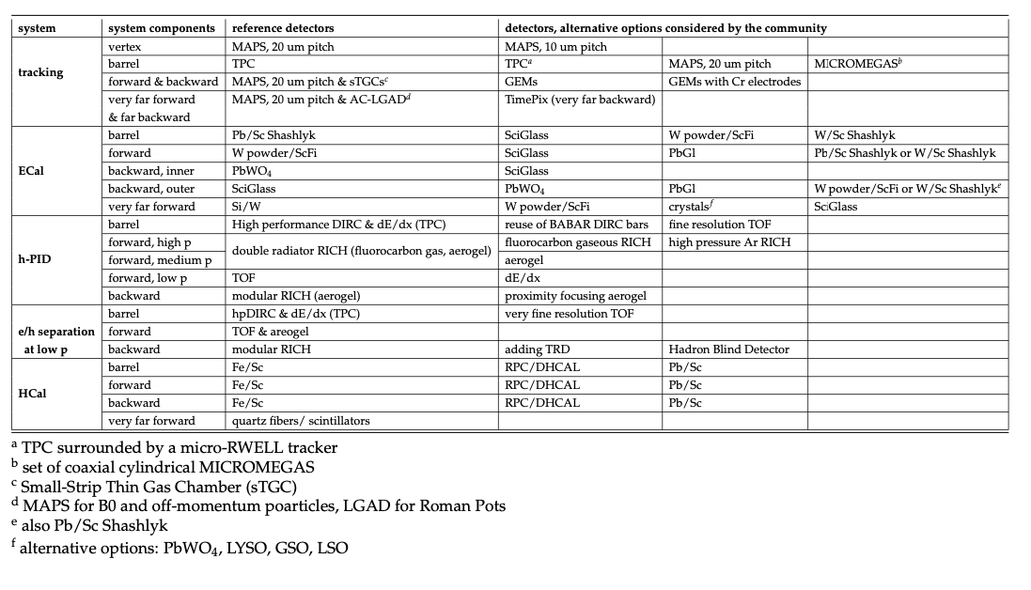
Detector integrated in EIC Project
EIC-UG Yellow Report results for detector performance:
Detailed detector simulations and technology performance evaluations tabulated
  performance for 3 Tesla field

Slide 10
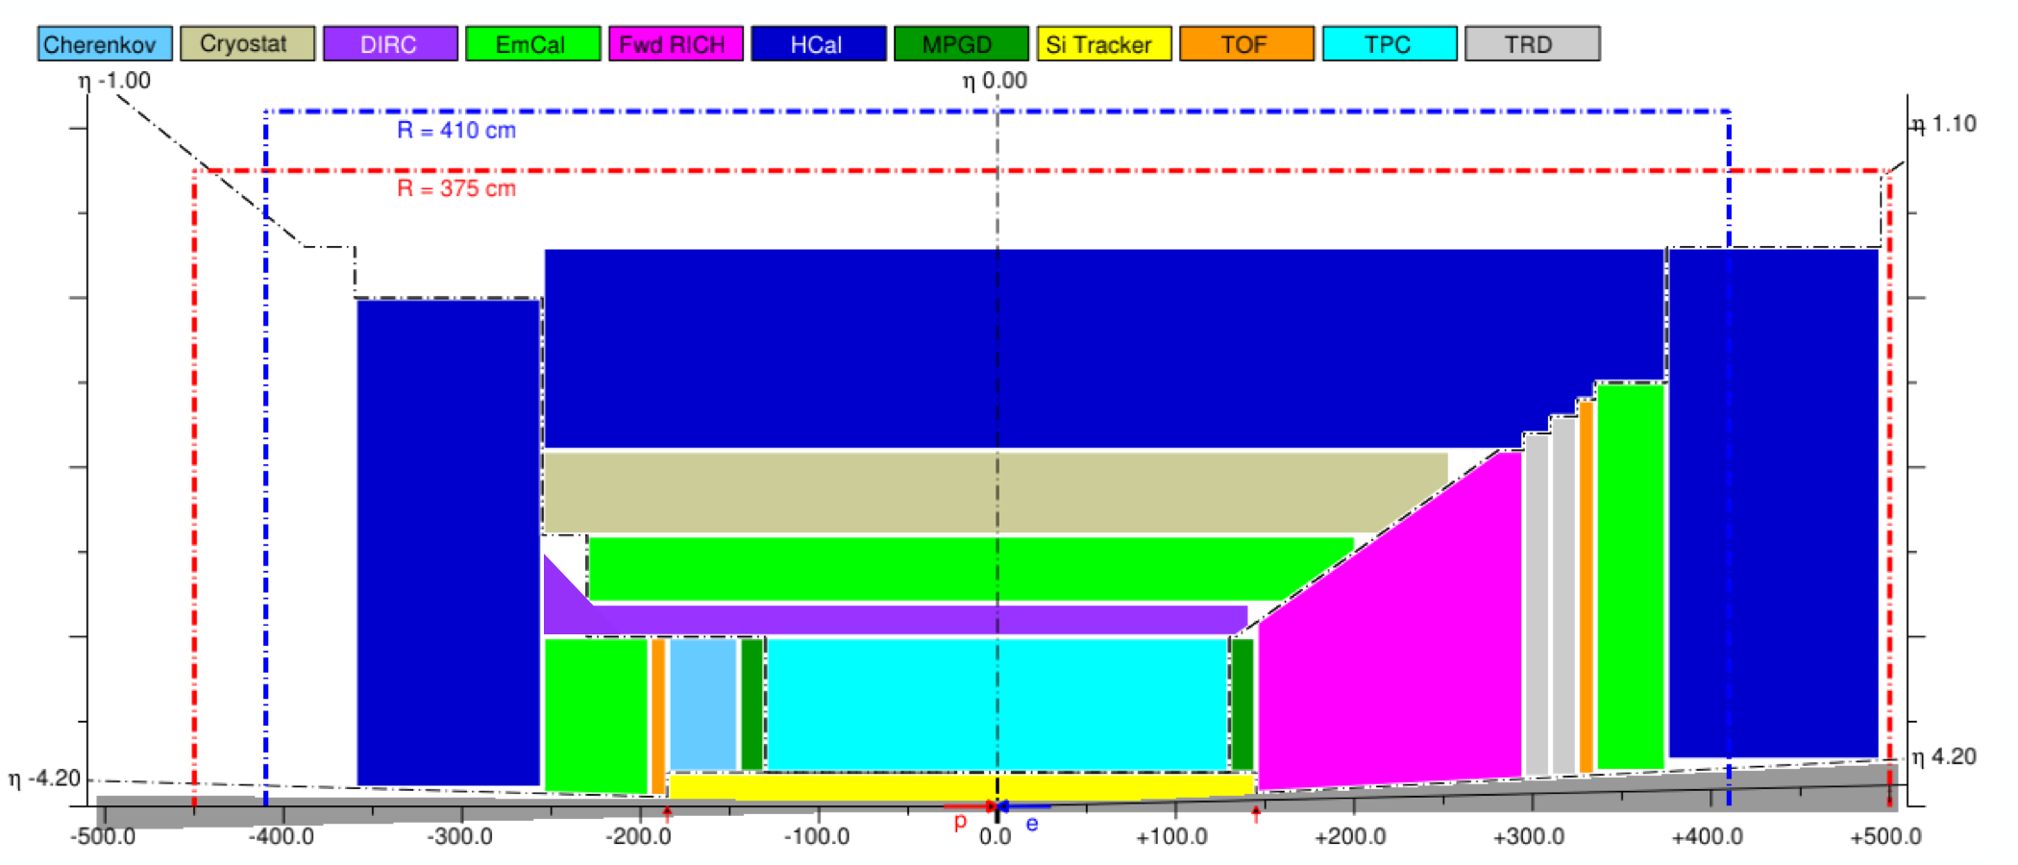
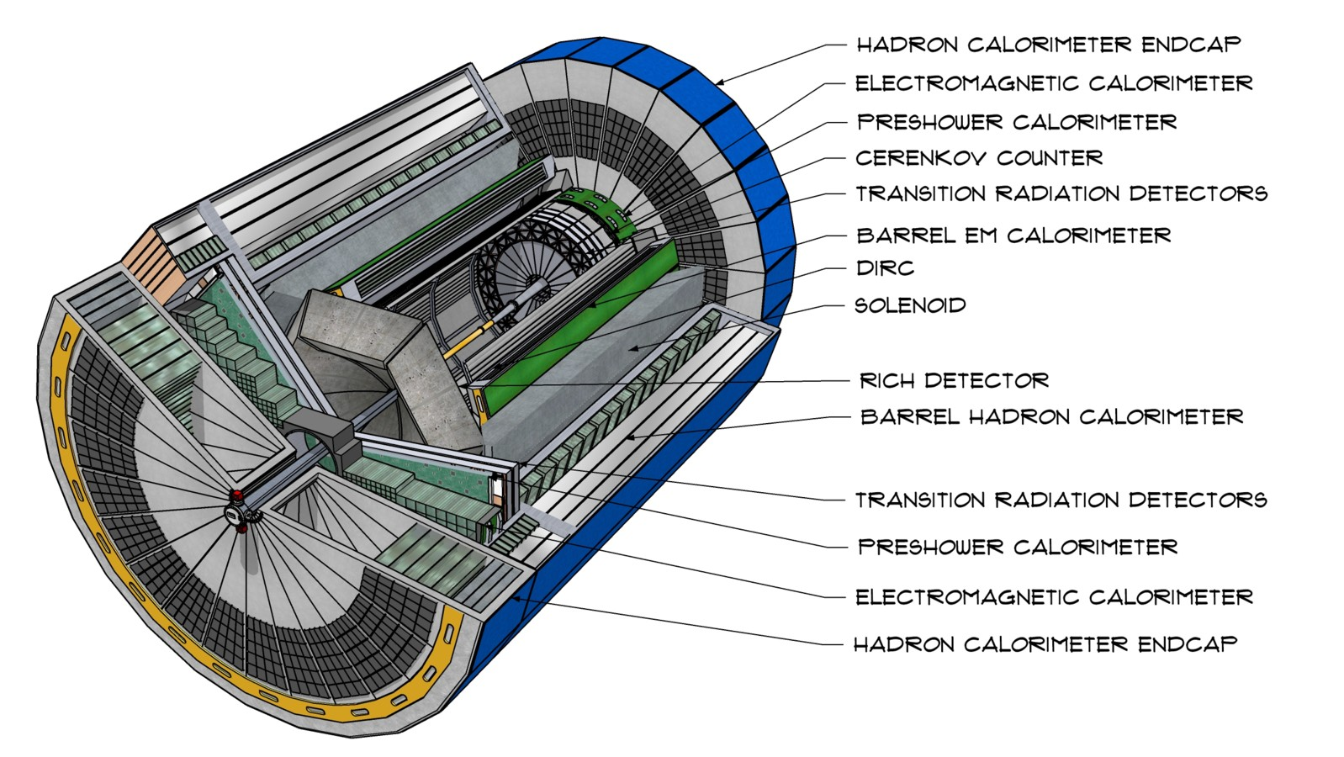
Detector integrated in EIC Project
2-d and 3-d representation of the reference detector
basis for integration work into IR

Slide 11
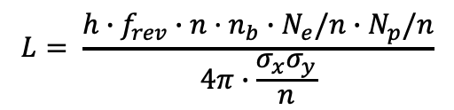
Interaction Region Boundary Conditions
High Luminosity:
What are the main ingredients to achieve high Lumi ~ 10³⁴ cm⁻²s⁻¹ at EIC
Large bunch charges N_{e} ≤ 1.7·10¹¹, N_{p} ≤ 0.69·10¹¹
  impact on beam backgrounds (SR, beam gas)
Large Number of bunches for a fixed accelerator circumference, n_{b}=1160
  requires a crossing angle collision geometry
    impact on detector acceptance, not symmetric in rapidity
  total beam currents large
    impact on beam backgrounds (SR, beam gas)
Small beam size at collision point achieved by
  small emittance, requiring either:
    strong hadron cooling to prevent emittance growth or
    frequent injection → needs to be integrated from the beginning in detector design
  and strong focusing at interaction point (small β*)
    quadrupoles as close to the detector as possible → distance IP to the first FFQs → L*
    limits overall space for the detector → Detector Size directly coupled to Luminosity
$$L= \frac{{h∙f}_{rev}∙{n·n}_{b}∙N_{e}/n∙N_{p}/n}{4π∙\frac{σ_{x}σ_{y}}{n}}$$

Slide 12
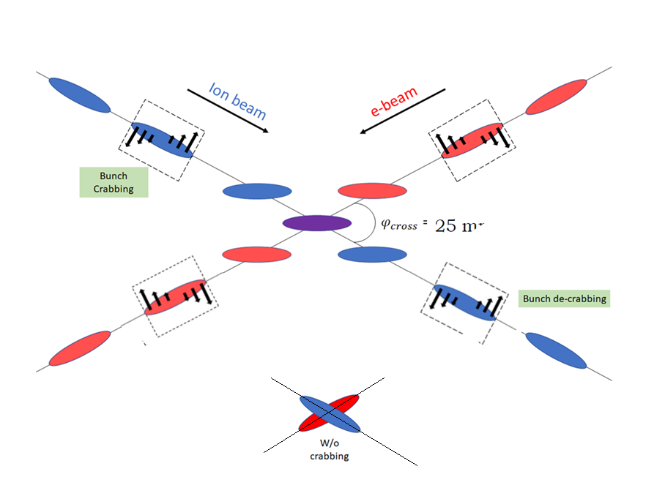
Interaction Region Boundary Conditions
Consequences of Crossing Angle
Crossing angle of 25 mrad
  allows to bring focusing quads close to IP
  avoid parasitic collisions due to short bunch spacing,
  reduce detector background
    → beams less in one common beam pipe
  Multi-staged separation → separate beam
  from particles needed for physics
  → space for forward equipment along beam line
25 mrad
However, crossing angle causes
  Low luminosity
  more challenging Beam dynamics
  → avoided by Crab Crossing
Impact on Physics:
Size of crab angle directly impacts angular opening of the first forward spectrometer dipole B0 (polar angle)
Impact on main detector acceptance → beams not back to back → solenoid aligned with electron beam → very small charged particle bending on one side of the outgoing hadron beam line → poor momentum resolution (and a strong functional azimuthal asymmetry of the acceptance at high h)
Roman Pots only possible between IP and Crab Cavities

Slide 13
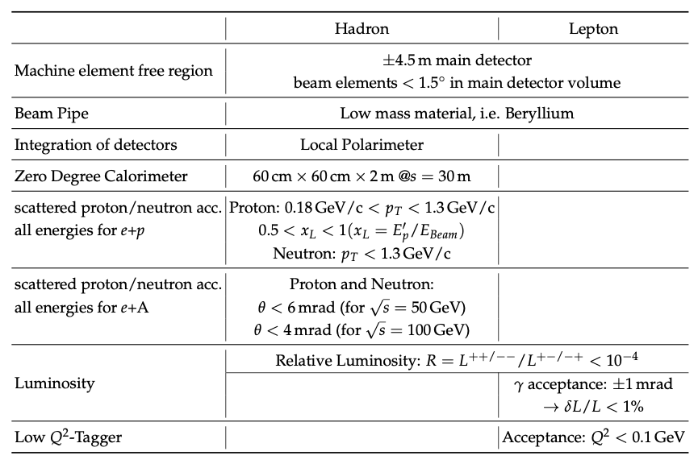
Interaction Region
Requirements from Physics:
Impacts Luminosity
space -4.5 m -- + 5 m
low p_{T}: Impact on divergences
high p_{T}: magnet bore size
x_{L}: impact on beam dispersion
Impact on crossing angle
hadron dipoles

Slide 14
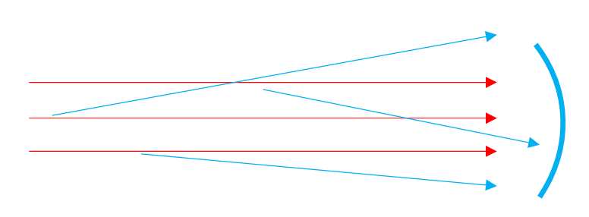
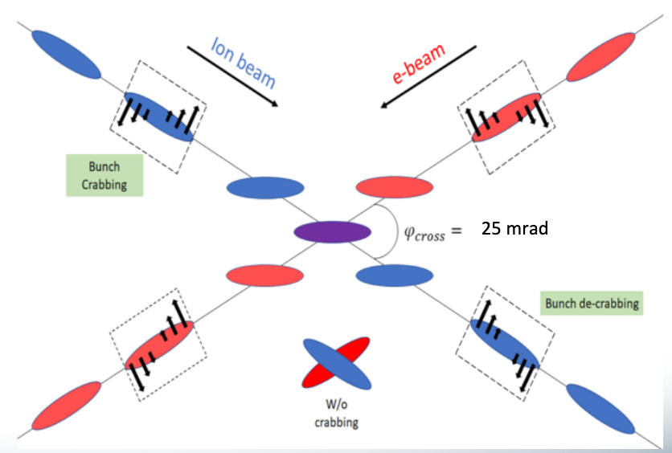
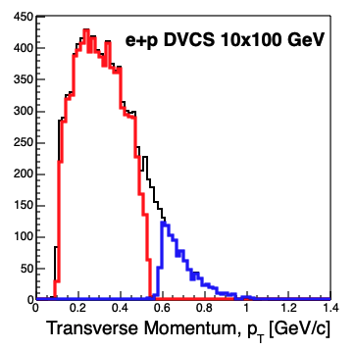
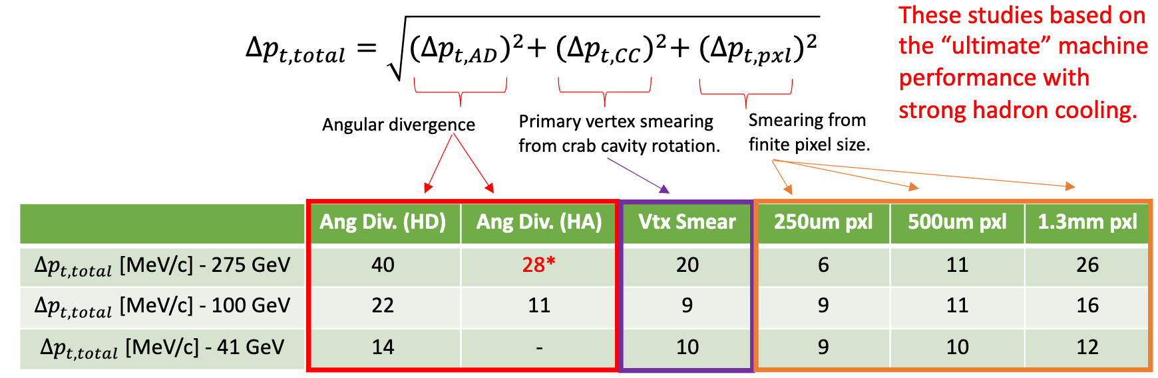
Interaction Region Detector Requirements
GEANT Simulation of Interaction Region
Including:
angular divergence of beam
Primary vertex smearing from
crab cavity rotation
detector technology and performance
Detector | Angular Accep.[mrad] | P_{t} coverage
ZDC @ ~30m | 𝜽 < 5.5 (𝜂 > 6) | pT<1.3 GeV
Roman Pots | 0.0* < 𝜽 < 5.0 (𝜂 > 6) | Low pT (t) (*cutoff → beam optics)
Off-Momentum Detectors | 0.0 < 𝜽 < 5.0 (𝜂 > 6) | Low-rigidity particles from nuclear breakup
B0-Forward spectrometer | 5.5 < 𝜽 < 20.0 (4.6 < 𝜂 < 5.9) | High pT (t)
Generated
Roman Pots
B0 Det.

Slide 15
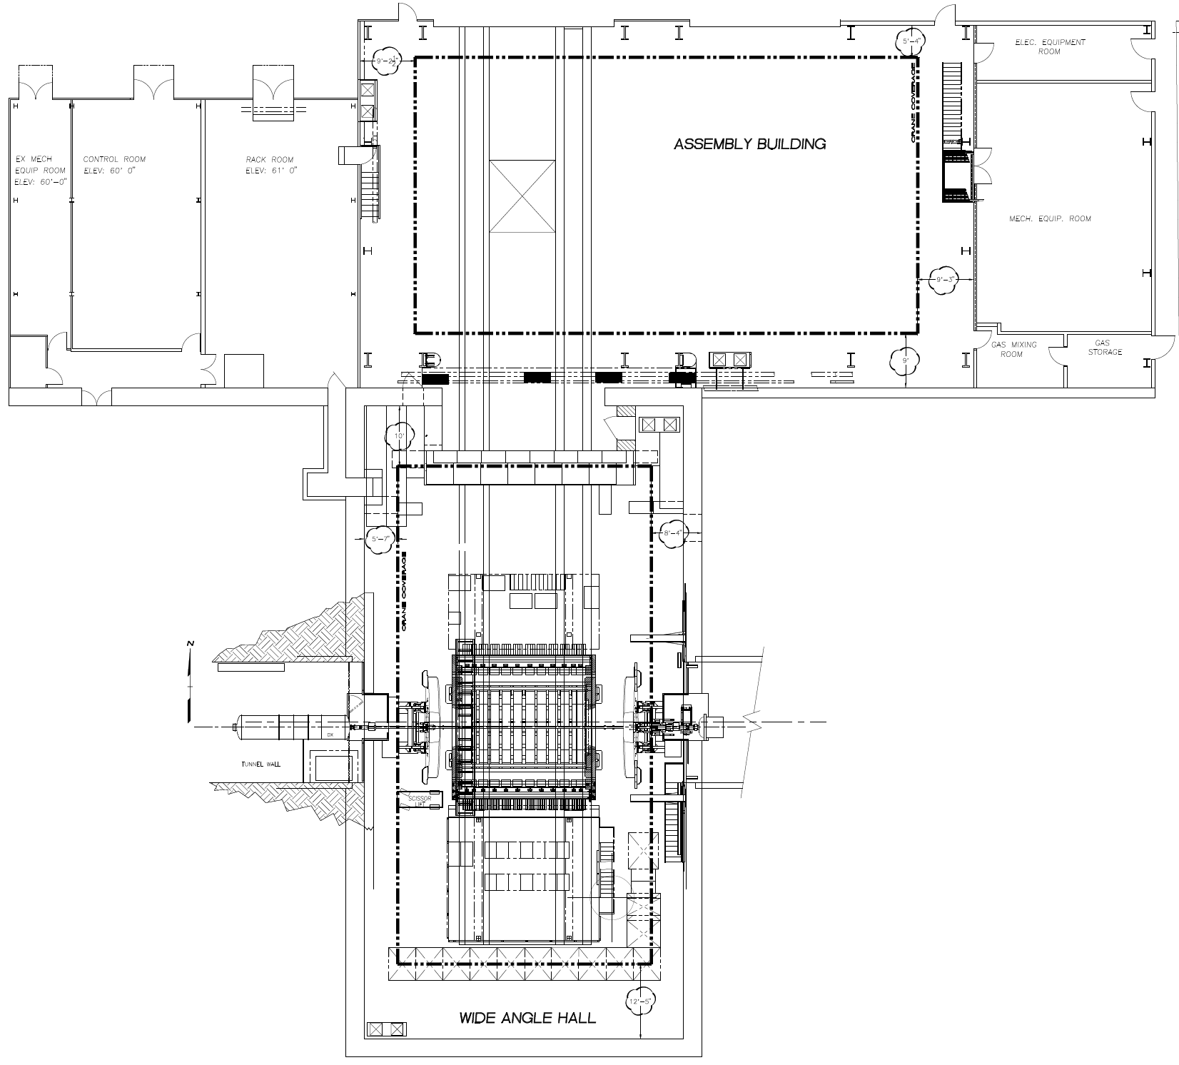
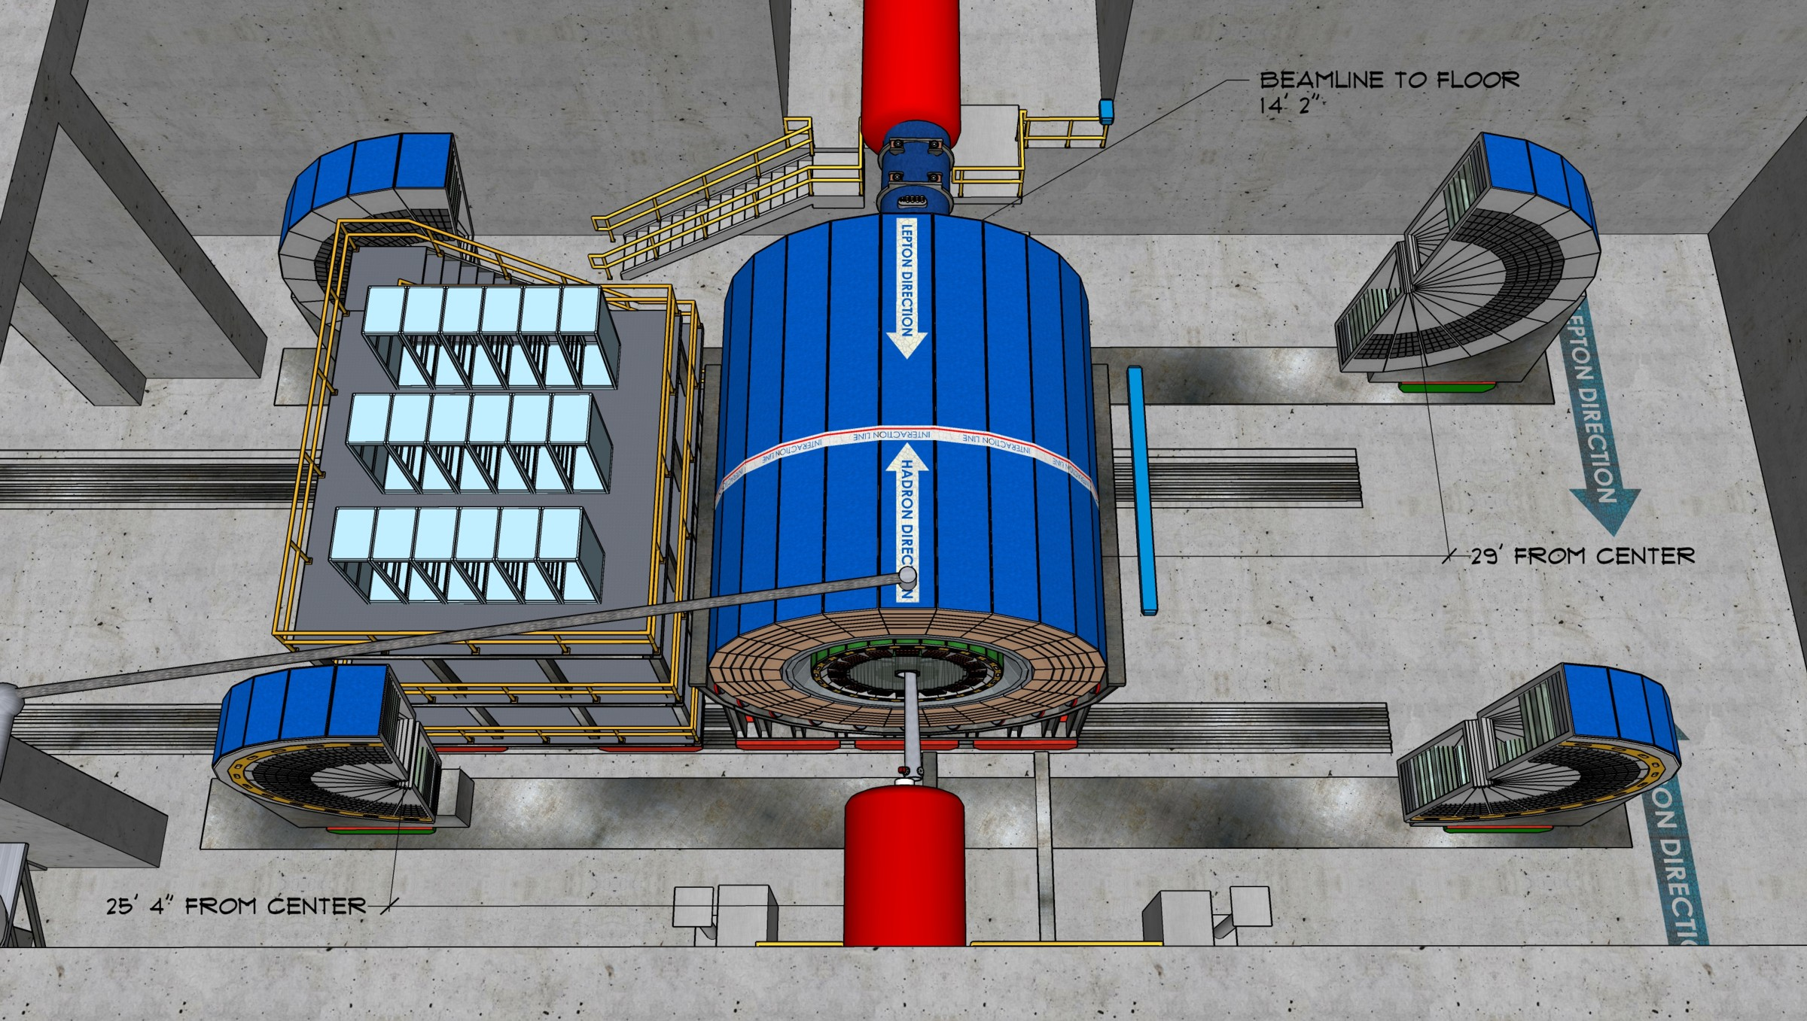
Integration
Boundary Conditions:
Note IP shifted 80 cm to ring inside compared to RHIC
RCS → limits radial size of detector to < 3.7 m
distance end of h-endcap to B0: ~50 cm
fit interaction region layout in collider hall and tunnel
choose experimental hall with best conditions for detector assembly and maintenance
choose interaction region which needs least modifications and allows fastest start of installation of IR accelerator equipment
Project risks on schedule due to installation schedule and possible reuse of solenoid
strongly point to IP-6 as location and a new magnet
IP-6
Hall length | ~3200 cm
Hall width | ~1615 cm
Door width | 823 cm
Door height | 823 cm
RCS

Slide 16

Integration

Slide 17
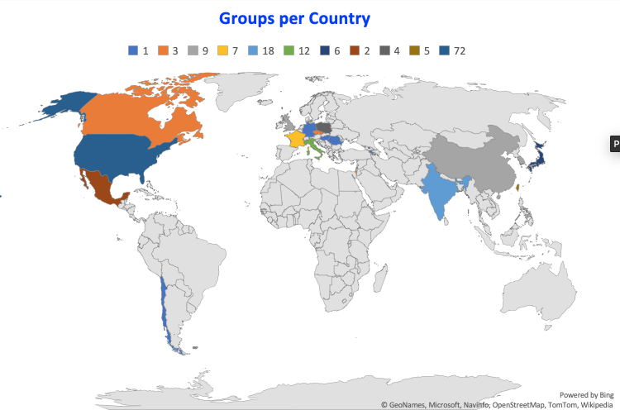
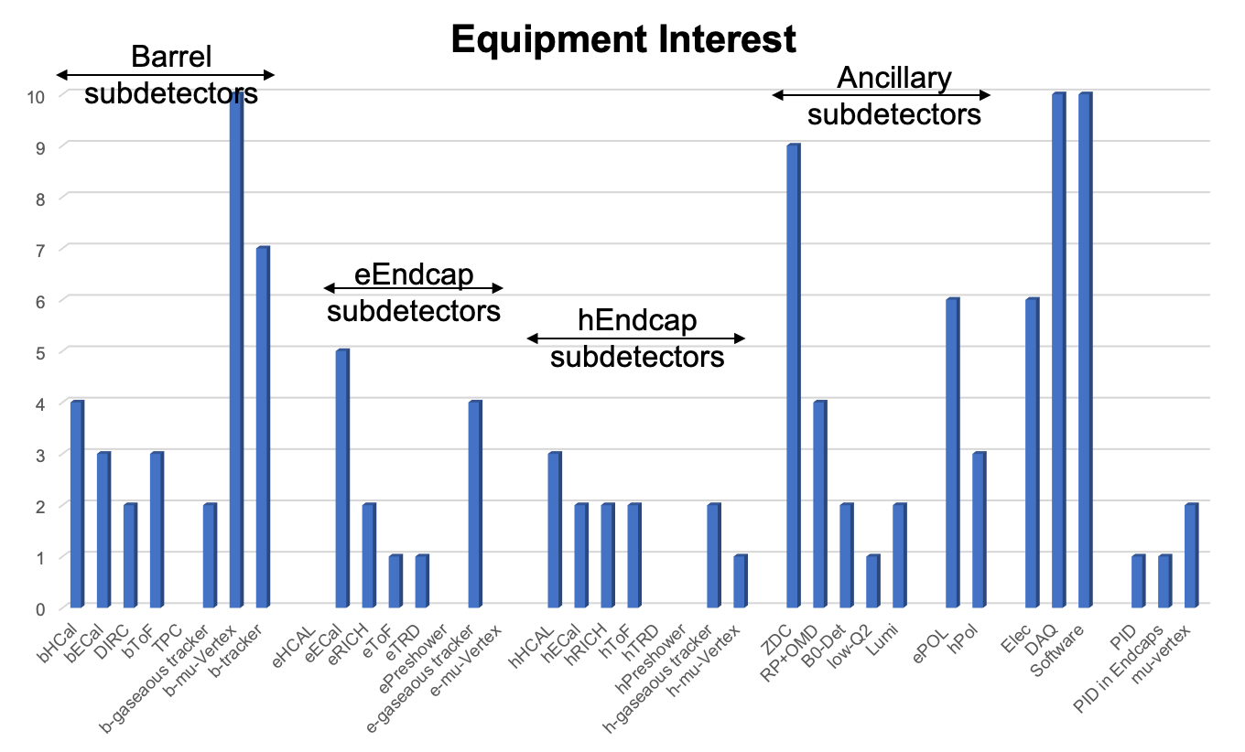
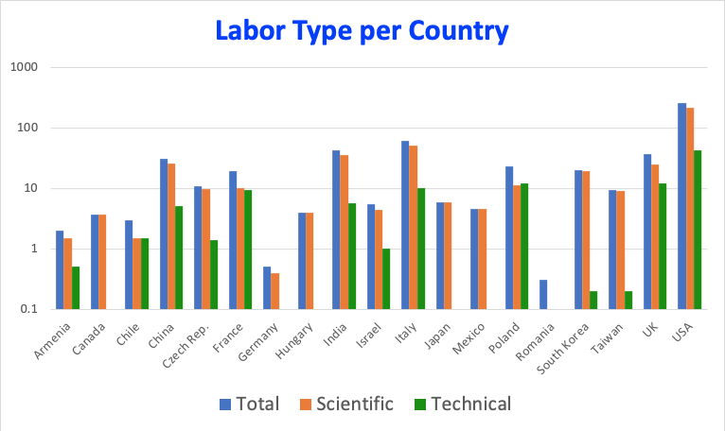
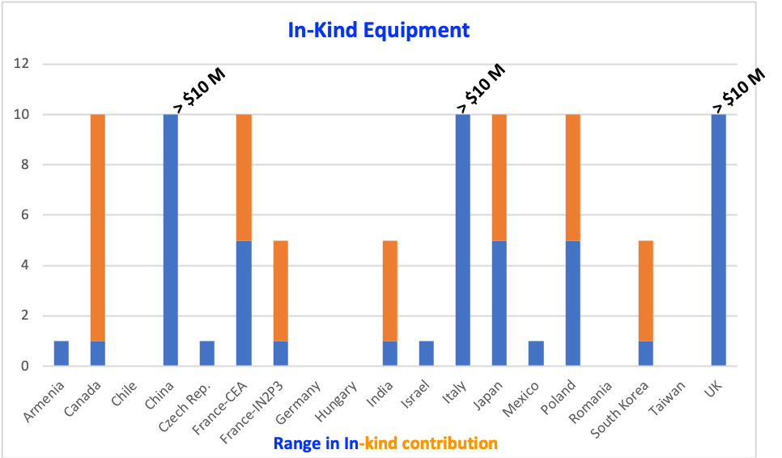
Expressions of Interests for EIC Experimental Equipment
Received 47 EoIs and assessment publicly available here: https://indico.bnl.gov/event/8552/
Accelerator and as such 2nd IR are considered not addressed by this call
double counting removed as good as possible
EoI response very encouraging → You/we did very well
517 FTEs with 100 being technical
Ranges have some judgement factor involved

Slide 18


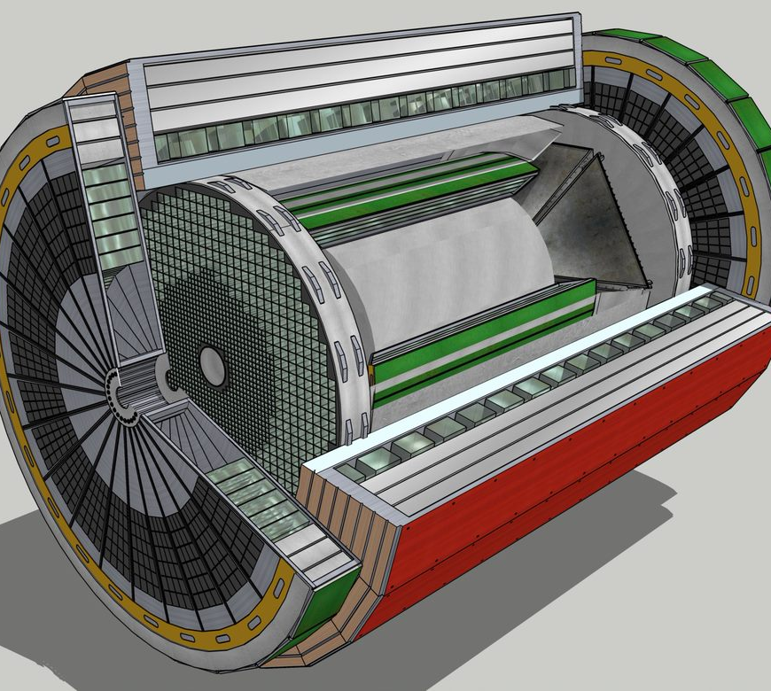
Summary
Essential to robustness of science program to have two detectors
Current reference detector and ”project IR” design follow as closely as possible the requirements defined in the YR initiative
2nd IR funding as of yet unclear
two detectors for EIC

Slide 19


Slide 20
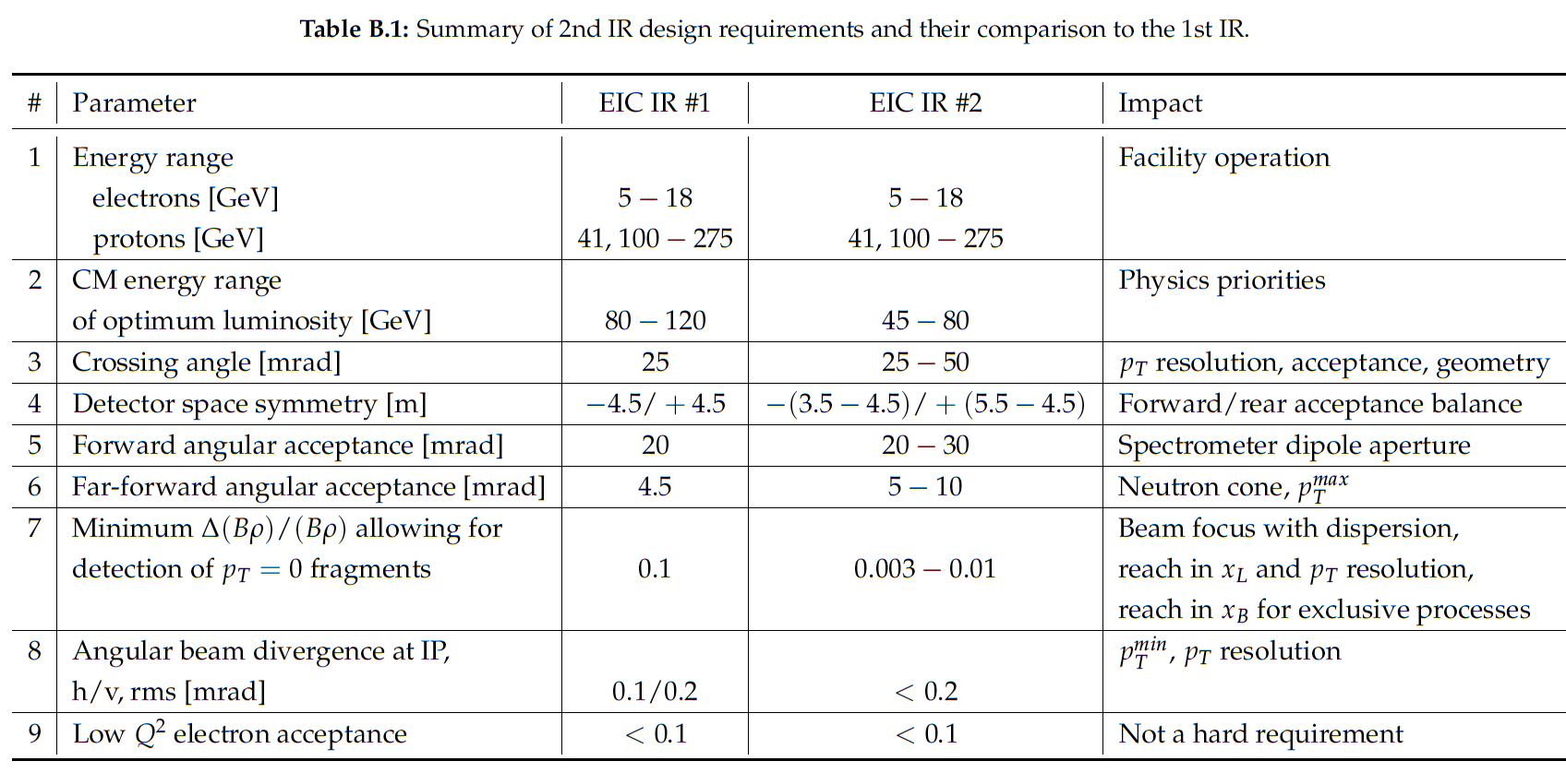
Boundary Conditions
Interaction Region:
All beams transport over full energy range
Magnet aperture-edge fields < 4.6 T
    Detune low-beta or do not run for E_{p}>~180 GeV
Sufficient DA and momentum aperture
Total beam-beam < 0.03 (p), 0.1 (e)
Beam aperture >10σ (p); >15σ_{x}/20σ_{x} H/V (e)
    Electron aperture accommodates non-Gaussian tails
Dispersion and dispersion’ constraints at crab cavities

Slide 21

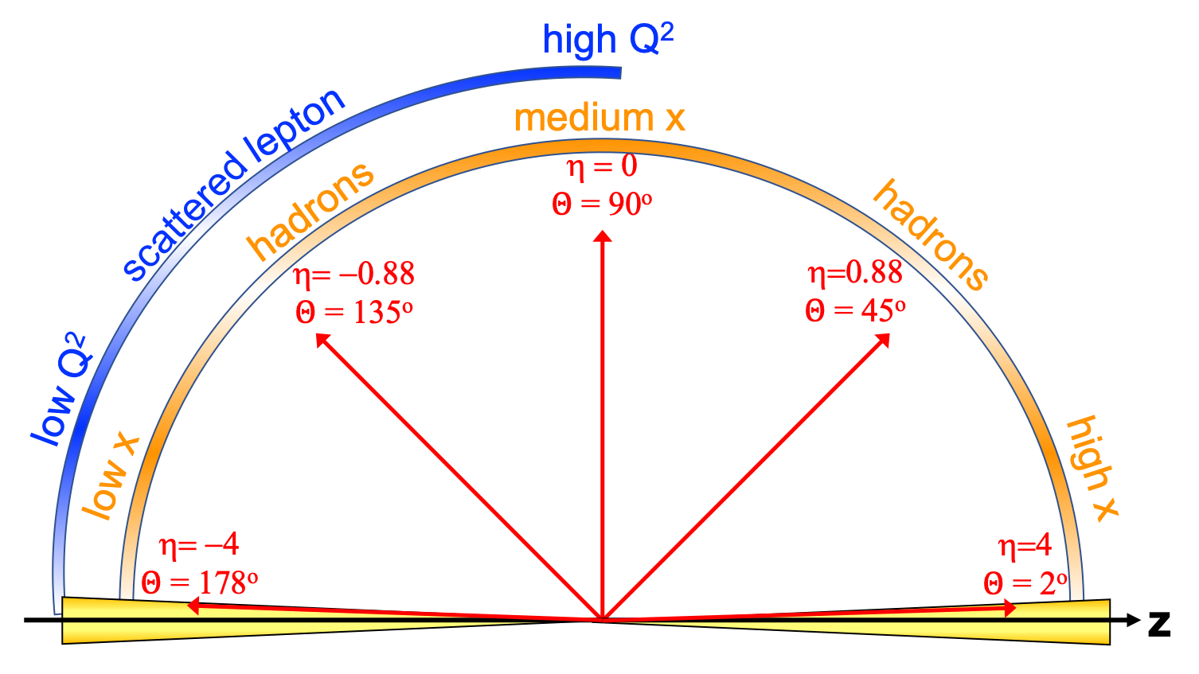
EIC General Purpose Detector: Concept
p/A beam
electron beam
inclusive DIS:
semi-inclusive DIS
Backward-η
Forward-η
Central
Detector
HCAL
Lepton
Endcap
Magnet
Hadron
Endcap
HCAL
ECAL
HCAL
ECAL
ECAL
Tracking
PID
PID
PID
Tracking
very low Q²
scattered lepton
Bethe-Heitler photons
for luminosity
Tracking
particles from nuclear
breakup and
from diffractive reactions
exclusive DIS
ZDC
Luminosity Detector
Forward Tracking
Low Q²-Tagger

Slide 22
The EIC: A Unique Collider
EIC
LHC /RHIC
collide different beam species: ep & eA
consequences for beam backgrounds
  hadron beam backgrounds,
  i.e. beam gas events
  → synchrotron radiation
asymmetric beam energies
boosted kinematics
  high activity at high |η|
Small bunch spacing: >= 9ns
crossing angle: 25mrad
→ impact on acceptance close to beam
wide range in center of mass energies
factor 6
both beams are polarized
→ stat uncertainty: ~ 1/(P₁P₂ (∫L dt )^{1/2})
collide the same beam species: pp, pA, AA
→ beam backgrounds
  hadron beam backgrounds,
  i.e. beam gas events, high pile up
symmetric beam energies
kinematics is not boosted
  most activity at midrapidity
moderate bunch spacing: 25 ns
no significant crossing angle yet
limited range in center of mass energies
LHC: factor 2
RHIC: factor 26 in AA and 8 in pp
no beam polarization
→ stat uncertainty: ~1/(∫L dt )^{1/2}
Differences can impact detector acceptance and detector technologies

Slide 23
Interaction Region
Boundary Conditions:
Experimental Equipment fully integrated in IR spans +/- ~40 m
length of Central Detector impacts luminosity
Distance 1st focusing quad to IP → L*
Beam elements / magnet structures limit central detector
Main detector -4.5/+5m & IR-instrumentation needs to be before Crabs
Synchrotron fan, crossing angle 25 mrad determine angular acceptance for main detector and beam-line / IR instrumentation
→ IR instrumentation angular range to < 1.5º (20 mrad)
→ Main detector instrumentation to |η| ~ 3.5 – 4.0
e beam
p/ion beam
far-backward
e-detection
e final-focus quads
“Central detector”, includes e-endcap, central, and p/ion endcap detectors
forward dipole
incl. h-detection
Ion final-focus quads
forward dipole
far-forward h detection
far-forward
h-detection
Low-Q²
spectroscopy
Inclusive Structure Functions, TMDs, heavy flavors and jets, electrons for GPDs
GPDs/DVCS, tagging, diffraction
high/medium t
Baryon decay
π/K structure
evaporated n
GPDs/DVCS, tagging, diffraction
lowest-t

Slide 24
 | Activity Name | 2019 | 2020 | 2021 | 2022 | 2023 | 2024 | 2025 | 2026 | 2027 | 2028 | 2029 | 2030 | 2031 | 2032
 | CD-0 Mission Need
 | CD-1 Preliminary Baseline
 | CD-2 Performance Baseline
 | CD-3 Construction Start
 | CD-4A Initial Operations
 | CD-4 Project Complete
 | Physics/Detector book 1
 | Call for Detectors/ Collaboration Formation
 | Design of Detectors
 | Down-select to Two Full-Size Detectors
 | Detector/IR TDRs, Detector/IR construction
 | Expressions of Interest for Detectors
 | 2nd IR workshop
 | 2nd IR conceptual design
 | 2nd IR accelerator R&D
 | 2nd IR engineering & design
 | 2nd IR construction & installation
DOE Driven
EICUG Driven
DRAFT
2nd IR Driven

Slide 25
2nd IR Flowchart
11/20 Call for Expression of Interest
02/21 EICUG 2nd IR workshop
Sufficient interest to decide on 2nd detector and IR?
YES
Discuss with DOE/NP how to do 2nd detector and 2nd IR scope
NO
06/21 Survey international engagement in EIC Accelerator & 2nd IR design
Sufficient interest to request integration of 2nd IR?
YES
Discuss with DOE/NP possibility of integration of 2nd IR scope in EIC TPC
NO
Continue conceptual design of 2nd IR, Initiate R&D plan to validate concept.
Sufficient interest to continue 2nd IR design?
YES
NO
Complete conceptual design of 2nd IR
2nd IR at CD-4B timescale is not within the range of EIC possibilities
06/24 Sufficient non-DOE interest in 2nd IR?
YES
Discuss with DOE/NP how to do 2nd IR scope
NO

Slide 26
What is important to define Complementarity
Different CMS energies, luminosities can place emphasis on complementary kinematic regions (possible staging?) …
  most physics topics require a wide range in (x,Q²)
  → need to run at different √s
  → Vary x-Q² / η correlation for SiDIS, HF, exclusives …
Some topics (eg far forward) may require dedicated set-up of detector or interaction region
  synchrotron radiation fan and crossing angle define acceptance
    solenoid aligned with lepton beam
      asymmetric acceptance in central detector in hadron beam direction
  gaps between different detectors along beamlines can be optimized differently in both IRs
Other possible key parameters:
  Material budgets
  Solenoid / forward magnetic field strength
  Space for detector (minimum: +/-4.5m longitudinally)
  Beamline instrumentation vs. IR design
  Technology readiness

Slide 27
Complementary Working Group Activities
Discuss detailed aims and needs with Physics Working Group conveners
“Have you identified key physics aims that conflict with
the current baseline /schematic detector and IR design?”
Discuss with Detector Working Group conveners
“Assuming we have two detectors, how you could build in complementarity
within the overall constraints imposed by the accelerator
and associated considerations?”
Many subsidiary questions
… no compelling argument (yet) for a second detector
with specialised / limited physics focus.
→ Working assumption is two complementary GPDs
Advantage:
one device for all physics, better back-
ground rejection and systematic control
Lifetime = Facility lifetime
Disadvantage:
More challenging to design

Slide 28
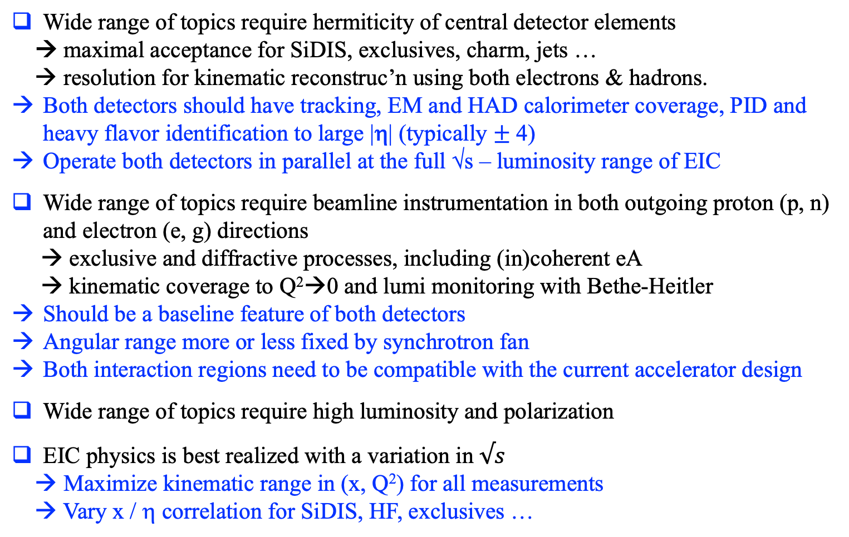
Some`Bold’ Summary Statements:
Common features of two detectors
Wide range of topics require hermiticity of central detector elements
→ maximal acceptance for SiDIS, exclusives, charm, jets …
→ resolution for kinematic reconstruc’n using both electrons & hadrons.
Both detectors should have tracking, EM and HAD calorimeter coverage, PID and heavy flavor identification to large |η| (typically $±$ 4)
Operate both detectors in parallel at the full √s – luminosity range of EIC
Wide range of topics require beamline instrumentation in both outgoing proton (p, n) and electron (e, g) directions
→ exclusive and diffractive processes, including (in)coherent eA
→ kinematic coverage to Q²→0 and lumi monitoring with Bethe-Heitler
Should be a baseline feature of both detectors
Angular range more or less fixed by synchrotron fan
Both interaction regions need to be compatible with the current accelerator design
Wide range of topics require high luminosity and polarization
EIC physics is best realized with a variation in $√s$
→ Maximize kinematic range in (x, Q²) for all measurements
→ Vary x / η correlation for SiDIS, HF, exclusives …

Slide 29
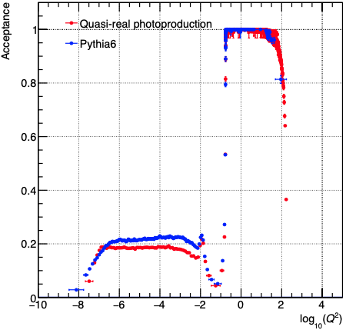
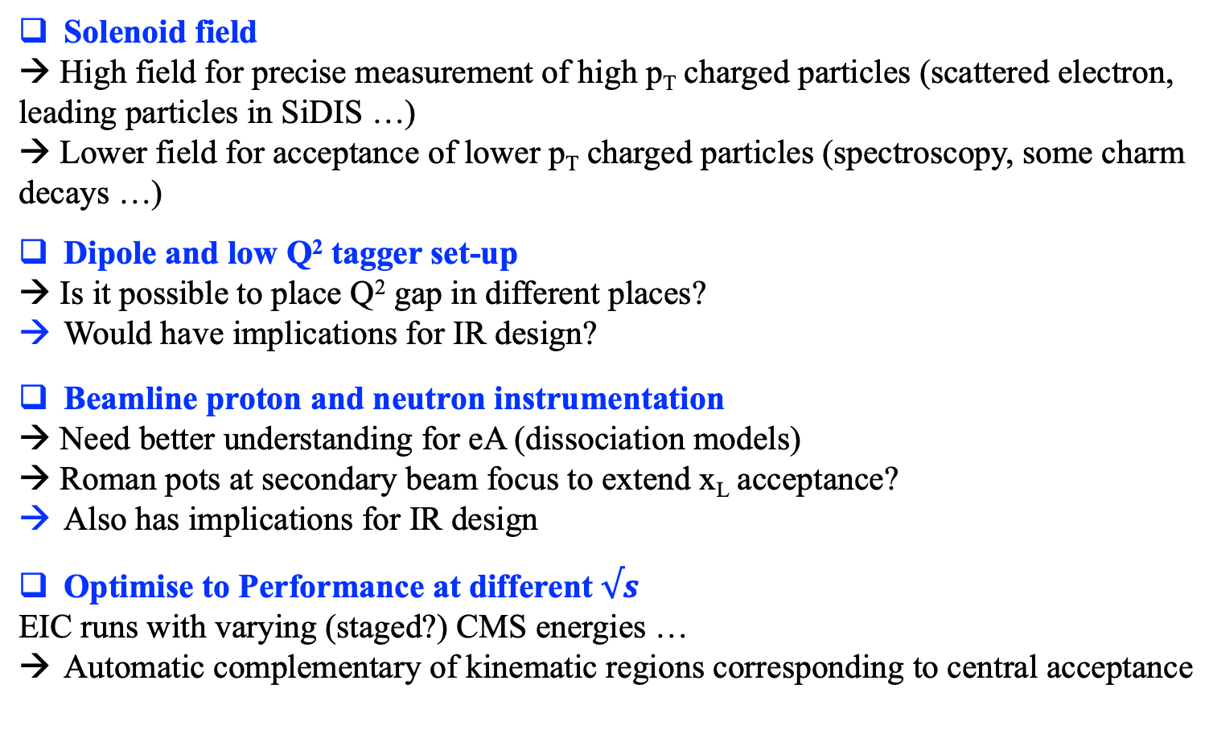
Some`Bold’ Summary Statements:
Opportunities for Complementarity
Solenoid field
→ High field for precise measurement of high p_{T} charged particles (scattered electron, leading particles in SiDIS …)
→ Lower field for acceptance of lower p_{T} charged particles (spectroscopy, some charm decays …)
Dipole and low Q² tagger set-up
→ Is it possible to place Q² gap in different places?
Would have implications for IR design?
Beamline proton and neutron instrumentation
→ Need better understanding for eA (dissociation models)
→ Roman pots at secondary beam focus to extend x_{L} acceptance?
Also has implications for IR design
Optimise to Performance at different $√s$
EIC runs with varying (staged?) CMS energies …
Automatic complementary of kinematic regions corresponding to central acceptance

Slide 30
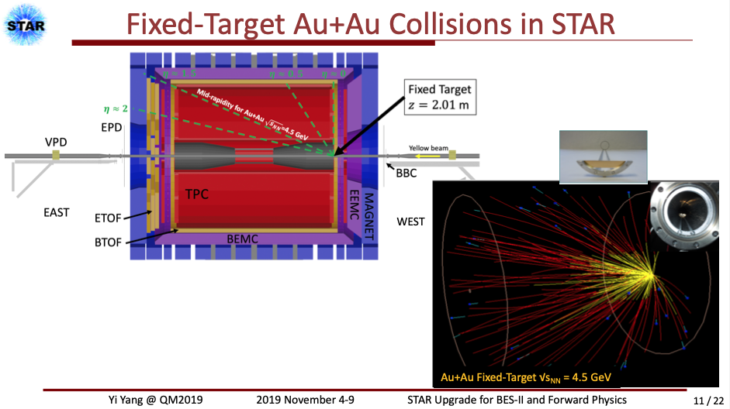
More In-built Complementarity
Integrate possibility of fixed target mode into detectors (based on either e- or p-beam) to emphasize new kinematic ranges that would normally be very forward or backward
→ High x physics in ep / eA
→ Novel regions for pp / pA
→ Successfully done previously at ALICE, LHCb, STAR

