Slide 1
IR2@EIC Design Status, Luminosity vs CM Energy, Polarization
Vasiliy Morozov
on behalf of 2nd IR Design Team
Workshop Series on the 2nd Interaction Region at the EIC
December 15-16, 2020

Slide 2
2nd IR Design Team
Jefferson Lab: V. Burkert, R. Ent, Y. Furletova, R. Gamage, D. Higinbotham, A. Hutton, C. Hyde, F. Lin, T. Michalski, V.S. Morozov, R. Rajput-Ghoshal, A. Seryi, A. Sy, C. Weiss, M. Wiseman, W. Wittmer, Y. Zhang
BNL: E.-C. Aschenauer, A. Kiselev, C. Montag, R. Palmer, B. Parker, V. Ptitsyn, F. Willeke, H. Witte
Stony Brook University: P. Nadel-Turonski

Slide 3
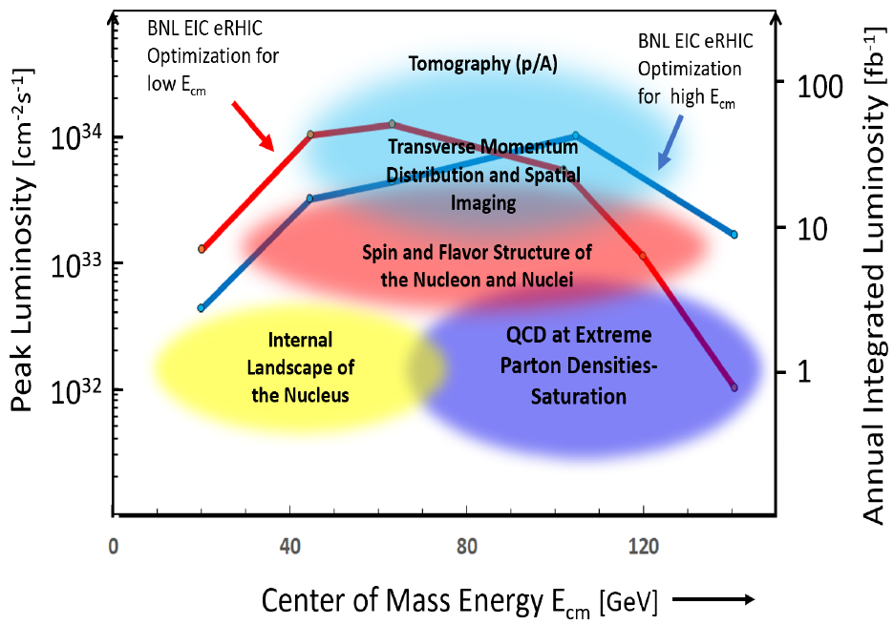
2nd IR Considerations
2nd IR of the EIC
Off project
Consider alternative design choices
Capability of having a 2nd IR is one of the EIC design specifications
Complementary measurements and capabilities to 1st IR
Interest and support of the nuclear physics community
High-level requirements
High luminosity at low and medium CM energies of ~60 GeV
Detector acceptance satisfying physics requirements at low and medium CM energies
Compatibility with running in parallel with the 1st IR

Slide 4
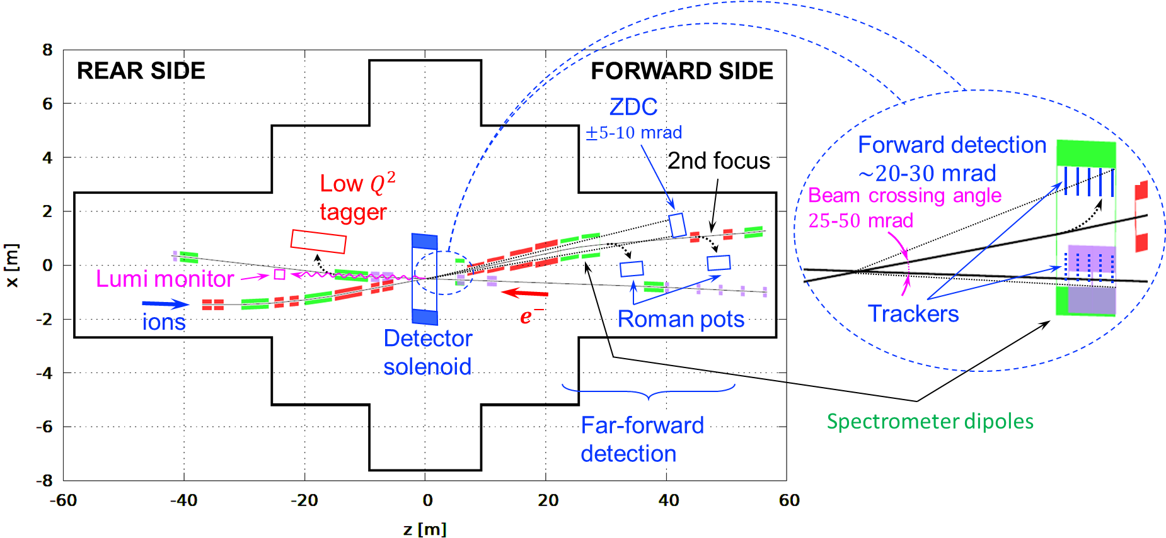
2nd IR Schematic

Slide 5
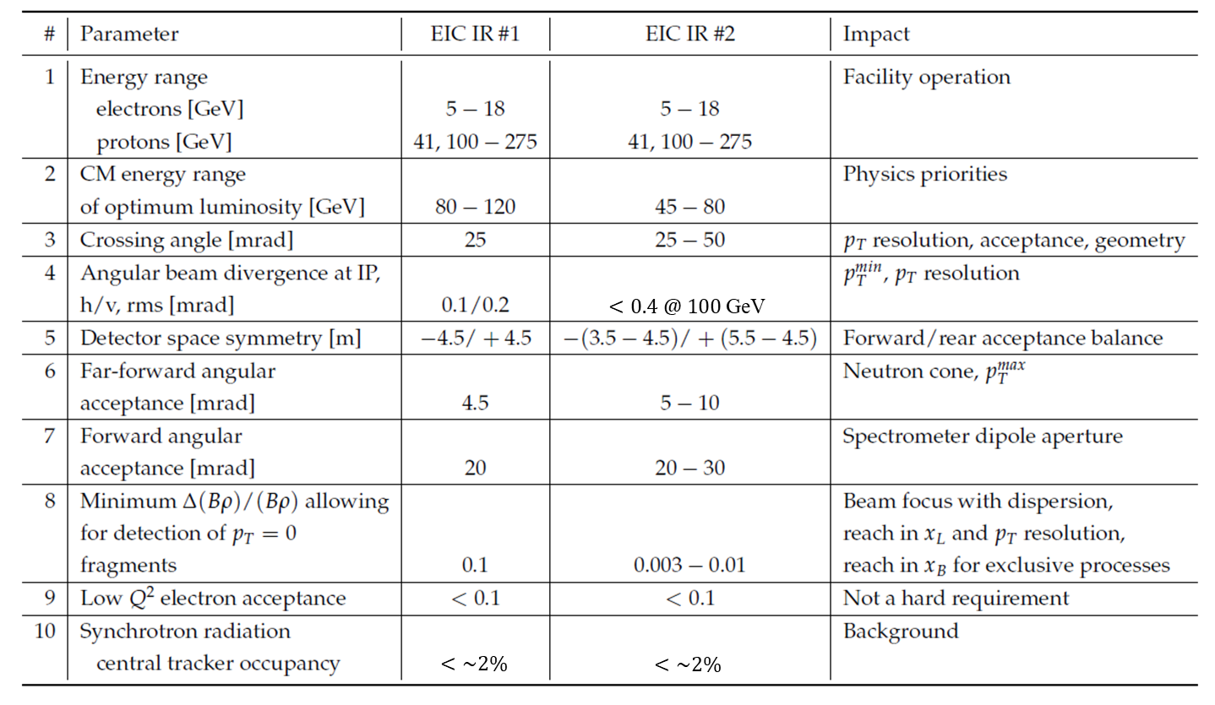
Complementarity to 1st IR

Slide 6
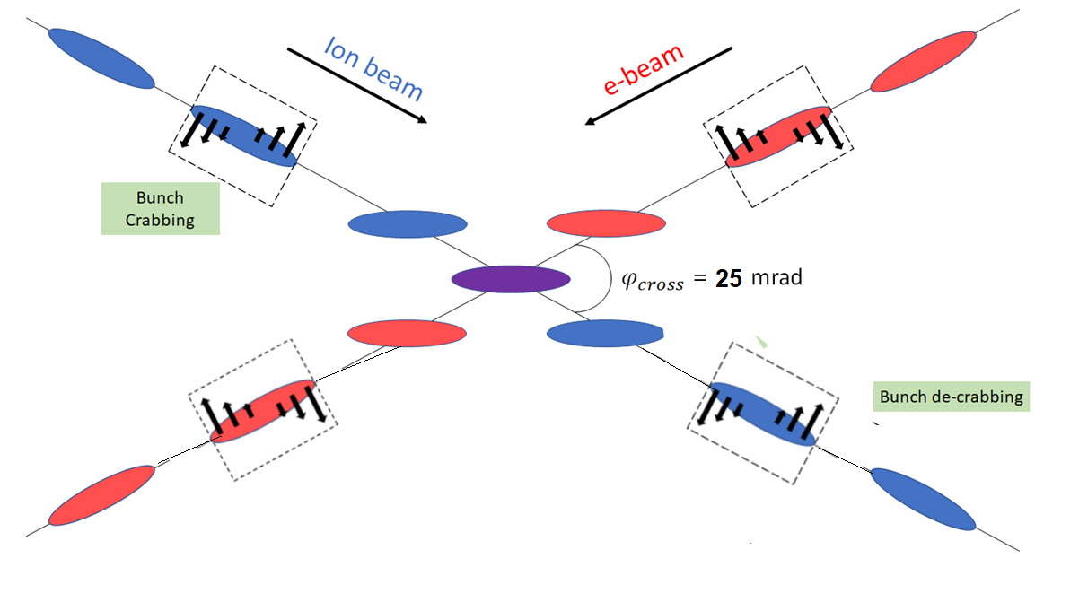
Crossing Angle
Crossing angle allows one to
- avoid parasitic collisions due to short bunch spacing
- place electron and ion machine elements side by side ⇒ independent beam energies
- move final focusing quadrupoles close to the IP ⇒ high luminosity
separate forward particle form the incoming electron beam and use large apertures in the forward ion quads and ⇒ improved forward and far-forward detection
move forward particles away from solenoid axis ⇒ improved momentum resolution
- shorten the common section of the detector beam pipe ⇒ reduced detector background
However, crossing angle may cause
- Luminosity loss
Beam dynamics issues
Negative impact on certain aspects of the detector performance
$p_{T}$ resolution
$e^{−}$ rapidity coverage
eliminated by Crab Crossing:
Effective head-on collision restored
Beam dynamic issues resolved

Slide 7
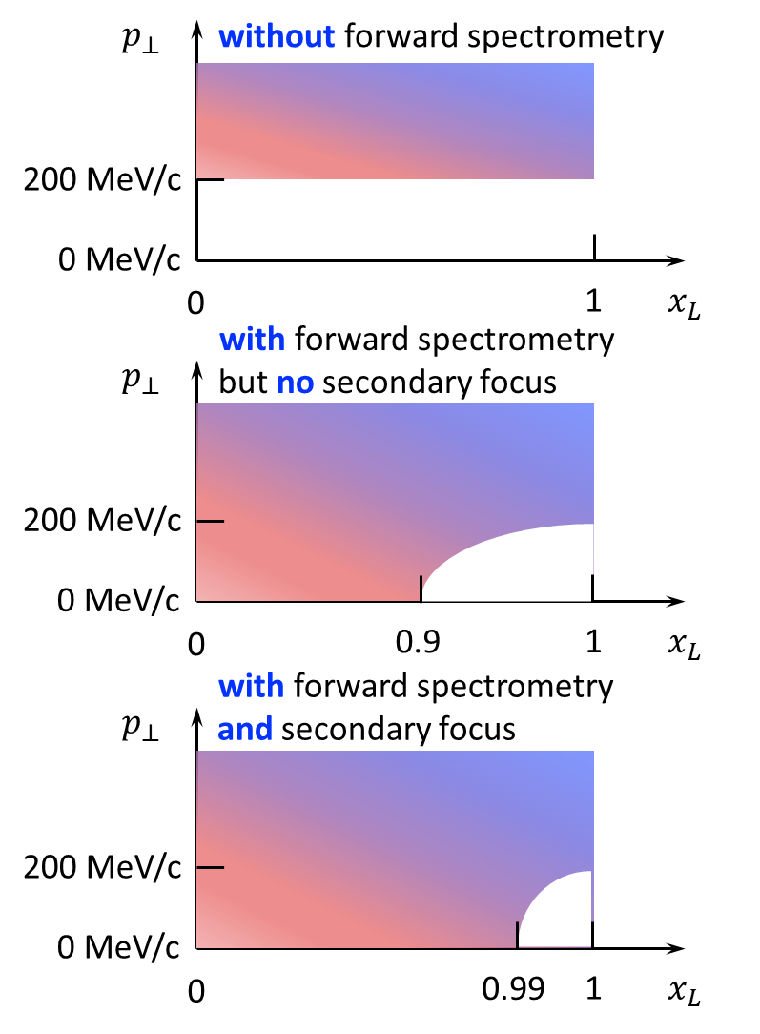
Acceptance as Function of $x_{L}$ and $p_{T}$
$p_{T}$ acceptance at $x_{L}=1$
$$p_{T}^{min}>10 p_{0} θ_{IP}=10 p_{0} \sqrt{\frac{ε}{β^{∗}}}$$
$x_{L}$ acceptance at $p_{T}=0$
Requires dispersion $D$
$$1−x_{L}>10\frac{σ}{D}=10\frac{\sqrt{βε+D^{2}σ_{δ}^{2}}}{D}$$
Secondary focus allows for
$$\left|Dσ_{δ}\right|≫\sqrt{βε}$$
Therefore, one can approach the fundamental limit
$$x_{L}<1−10σ_{δ}$$

Slide 8
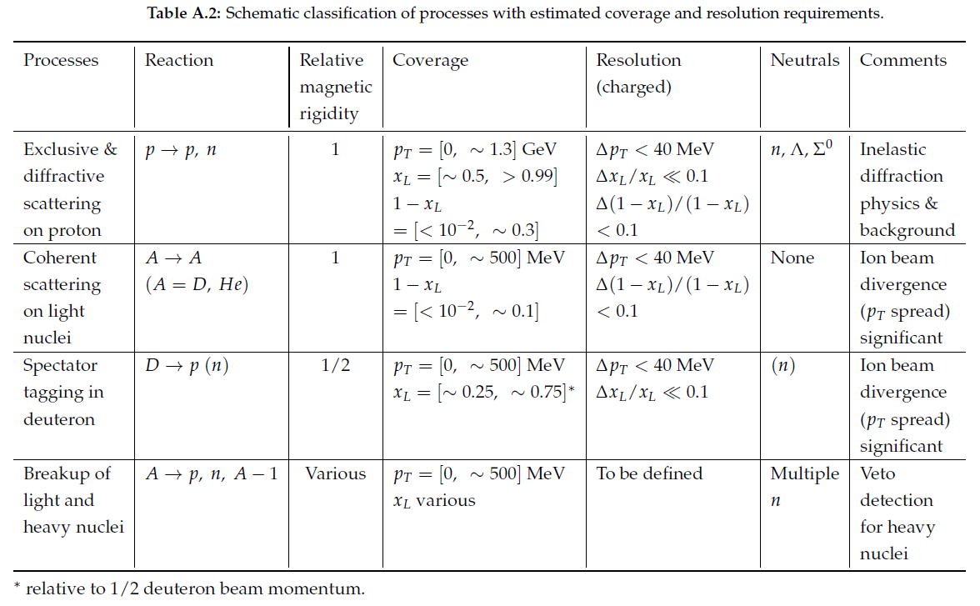
Physics Drivers for Low $(1−x_{L})$ at Small $p_{T}$

Slide 9
Geometric and Machine Constraints
Consistency with existing infrastructure: experimental hall and tunnel size
Integrate necessary components: spin rotators, crab cavities, ZDC, luminosity monitor, Roman pots, low-$Q^{2}$ tagger, etc.
Geometric and optical match to the rest of the collider rings
All beams transport over full energy range
Magnet aperture-edge fields < 4.6 T
Sufficient DA and momentum acceptance
Total beam-beam < 0.015 (p), 0.1 (e)
Beam aperture $>10σ$ (p); $>15σ_{x}/20σ_{y}$ H/V (e)
Dispersion and dispersion slope constraints at crab cavities

Slide 10
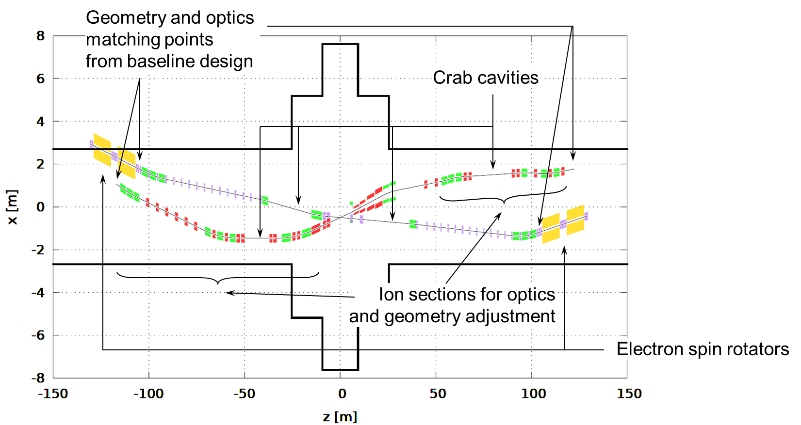
2nd IR Geometry and Optics Matching and Component Integration
Beam crossing direction flipped compared to the 1st IR
Not much flexibility in electron geometry because of electron spin rotator requirements
Electron beam line is a slightly modified baseline design
Enough knobs integrated into the ion beam line design to allow testing of different geometries
Started with 50 mrad crossing angle and plan to optimize it along with other parameters
To ion spin rotator
To ion spin rotator

Slide 11
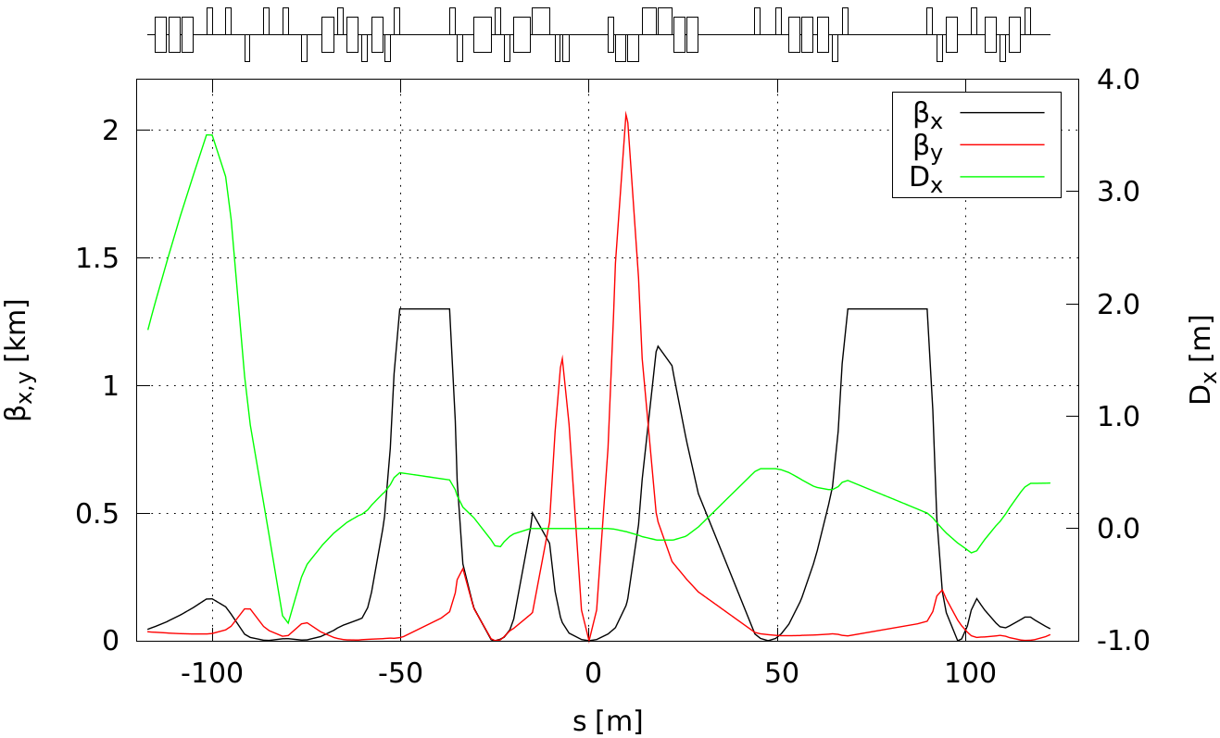
Ion 2nd IR Optics from 135 to 275 GeV
Lengths of downstream final focusing quadrupoles optimized to provide 10 mrad polar angle acceptance with aperture-edge fields below 4.6 T
Use constraints on $β_{x}^{max}=1.2$ km and $β_{y}^{max}=2$ km as in the 1st IR
Upstream section is based on the 1st IR
Doublet optics with reversible polarity of the second quad depending on the energy $β_{x/y}^{∗}=96/3.3$ cm (>135 GeV) $β_{x/y}^{∗}=37/2.5$ cm (<135 GeV)
Secondary focus with $\left(1−x_{L}\right)>7⋅{10}^{−3}$ acceptance
Same optics and geometry as in baseline
ions
IP
Roman pot
at 2nd focus

Slide 12
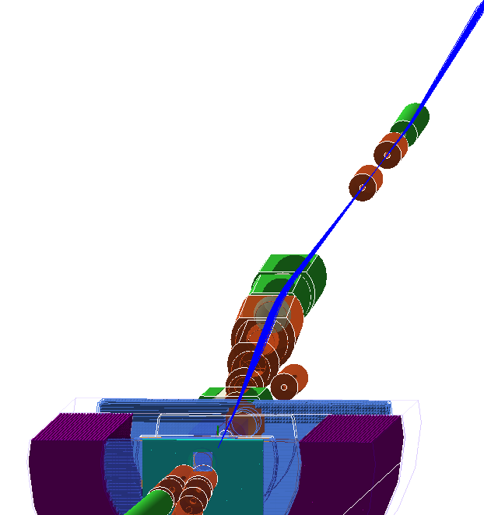
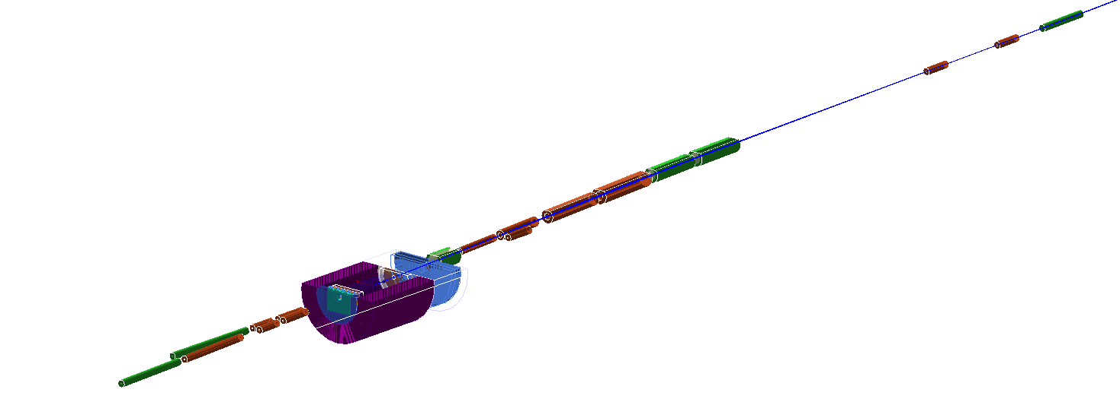
2nd IR Acceptance Simulations Under Way

Slide 13
Engineering Feasibility
Engineering feasibility of the most challenging magnets
Largest-aperture forward ion quad
Forward spectrometer dipole
Parameter | Quadrupole | Dipole
Magnet name | QFFDS02B | BXDS01B
Aperture radius (cm) | 22 | 29
Gradient/Field | 13.92 T/m | 4.59 T
Length (m) | 3.7 | 3

Slide 14
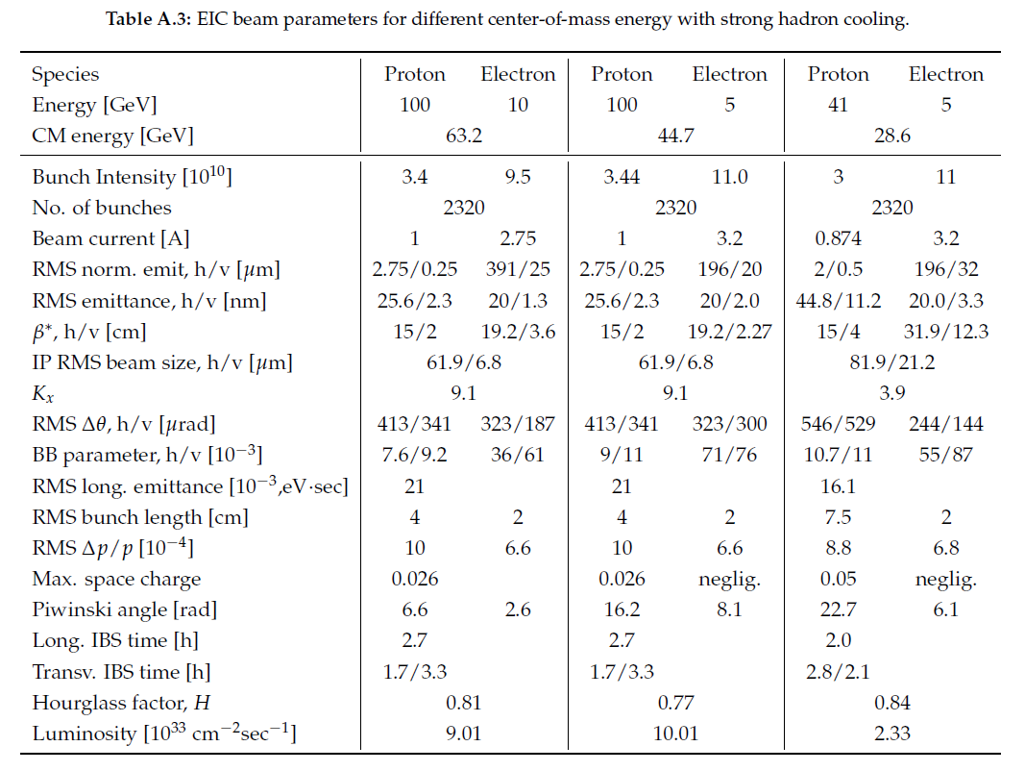
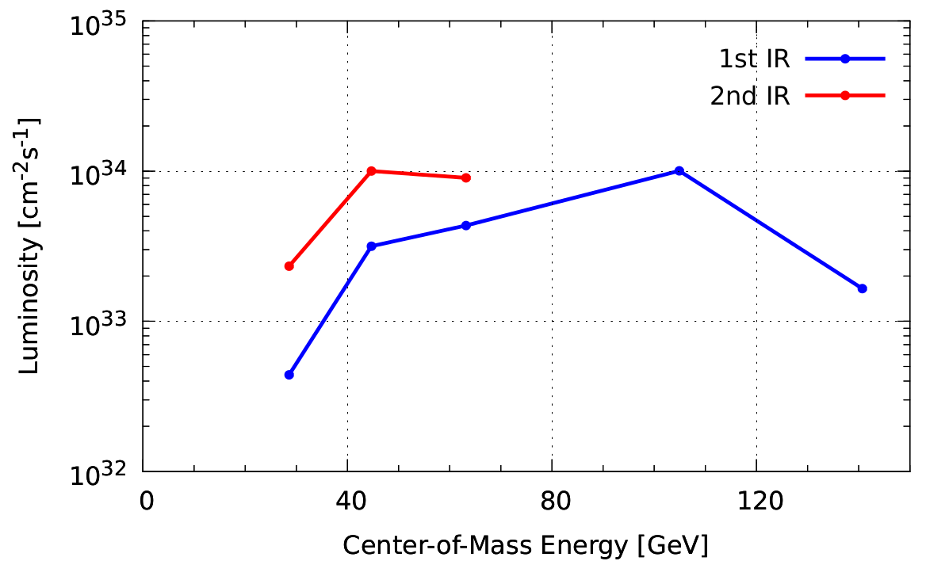
2nd IR Design Optimization
Grid search and optimization in the luminosity/ detector acceptance/ beam parameter phase space
Each iteration involves
Lattice design update
Luminosity estimate
Acceptance simulation
Streamline the process as much as possible
IRs optimized individually
10.0
9.0
2.3
4.5
3.7
$$×{10}^{33}$$
0.4
2nd IR $L$ analysis to be completed

Slide 15
2nd IR Configurations for Parameter Scan
 | Configuration #
Parameter | 0 | 1 | 2 | 3 | 4 | 5 | 6 | 7
1. Solenoid shift [m] | 0 | 0.5 | 0 | 0 | 0 | 0 | TBD | TBD
2. Full crossing angle [mrad] | 50 | 50 | 35 | 50 | 50 | 50
3. Forward acceptance polar angle [mrad] | 53 | 53 | 37 | 53 | 25 | 53
4. Far-forward acceptance polar angle [mrad] | 10 | 10 | 7 | 10 | 10 | 7
5. Number of bunches relative to baseline | x2 | x2 | x2 | x1 | x2 | x2
Luminosity re-optimization needed? | In progress | No | Yes | Yes | No | Yes

Slide 16
Two IR Operation
Possible scenarios
Only one IR is operated at a time (conceivable if other scenarios not available for some reason or performance is better than in other scenarios)
One IR operates in its optimum configuration in its optimum energy region while the other IR runs in parasitic mode
Combined operation of the two IRs is globally optimized
Additional machine components for the 2nd IR
IR magnets
Spin rotators
Crab cavities
Main constraints for simultaneous operation of the two IRs
Beam-beam tune shift
Total chromaticity
Limits such as beam divergences at the IPs

Slide 17
Comments on Polarization at 2nd IP
The same techniques are used to control the polarization at the 2nd IP as at the 1st one
The same polarization options are available at the 2nd IP as at the first one
The only special case is longitudinal deuteron polarization
Available at $Gγ=k$ energy points
The two IPs are separated by 1/6th of the ring. If spin is longitudinal at one IP, it will be longitudinal at the second IP if the spin precession between the two IPs in an integer number of 𝜋 ⇒ $Gγ=3k$
$$Gγ$$ | $$p_{nucleon}^{d}$$ | Within range? | Longitudinal at both IPs?
6 | 39.3 | Yes | Yes
7 | 45.9 | No | No
8 | 52.5 | No | No
9 | 59.0 | No | Yes
10 | 65.6 | No | No
11 | 72.1 | No | No
12 | 78.7 | No | Yes
13 | 85.3 | No | No
14 | 91.8 | No | No
15 | 98.4 | No | Yes
16 | 104.9 | Yes | No
17 | 111.5 | Yes | No
18 | 118.0 | Yes | Yes
19 | 124.6 | Yes | No
20 | 131.2 | Yes | No
21 | 137.7 | No | Yes

Slide 18
2nd IR Feasibility Study Plan
Completion of conceptual linear design
Footprint with optimization knobs developed
Conceptual linear optics design developed
Proof-of-principle studies of chromatic compensation schemes in the ion collider ring
Identify and use tracking to evaluate compensation schemes of the chromatic effect of the 2nd IR alone
Develop and evaluate by tracking a scheme for mutual compensation of the two IRs
Conceptual engineering assessment for critical/challenging components
Beam parameter optimization
Single-mode operation of the 2nd IR
Operation in parallel with the 1st IR
Simulation of detector acceptance
Parameter scan
Identify scan parameters and choose ~3-4 configurations of, e.g., crossing angle, repetition rate, and forward/ far-forward acceptance using nuclear physics input
Repeat items 4 and 5 for all of the different configurations
Summarize the 2nd IR concepts

Slide 19
Backup

Slide 20
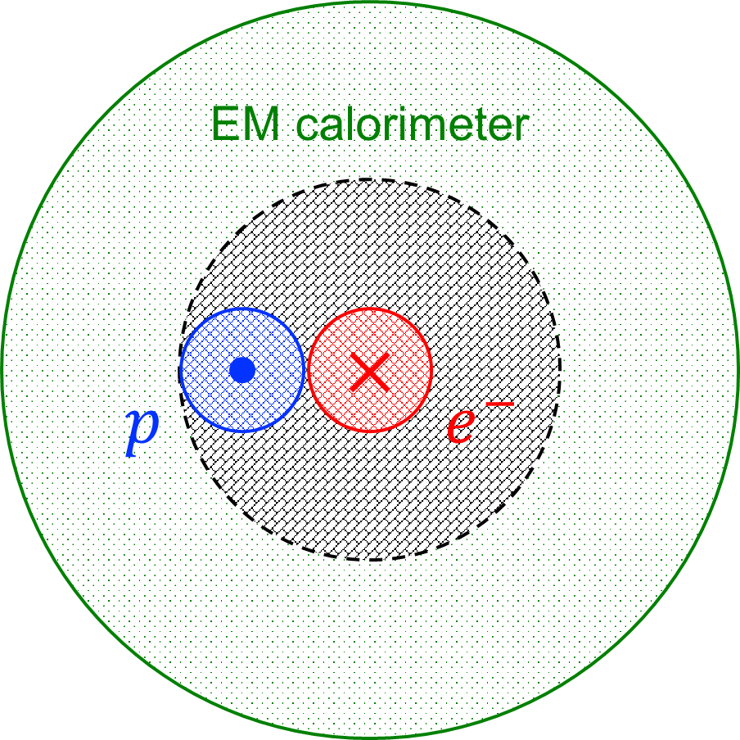
Detection Issues with Crossing Angle
Crabbing causes apparent smear of transverse beam size at the IP
Transverse vertex position can be found by
narrowing down its longitudinal position through precise timing of ~35 ps
simultaneously measuring particle’s position, angle and energy in the far-forward section
Crossing angle increases the gap in the $e^{−}$ rapidity coverage in the rear direction
Gap in $e^{−}$ rapidity coverage:
$p$ beam pipe solid angle (~20 mrad) + $θ_{cr}$

Slide 21
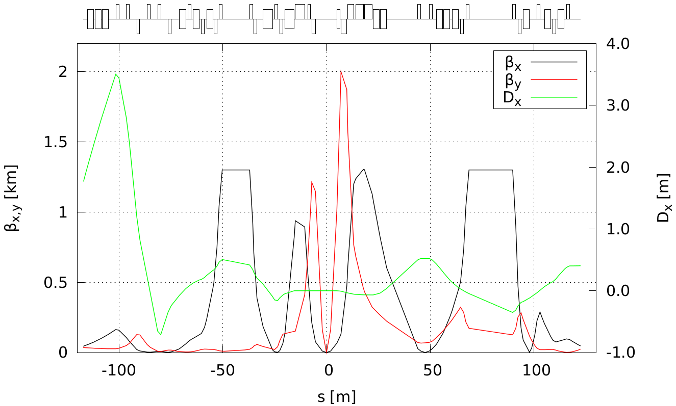
Ion 2nd IR Optics up to 135 GeV
All aperture-edge fields below 4.6 T
$β_{x/y}^{∗}=37/2.5$ cm with on $β_{x}^{max}=1.2$ km and $β_{y}^{max}=2$ km
IP
Roman pot
at 2nd focus

Slide 22
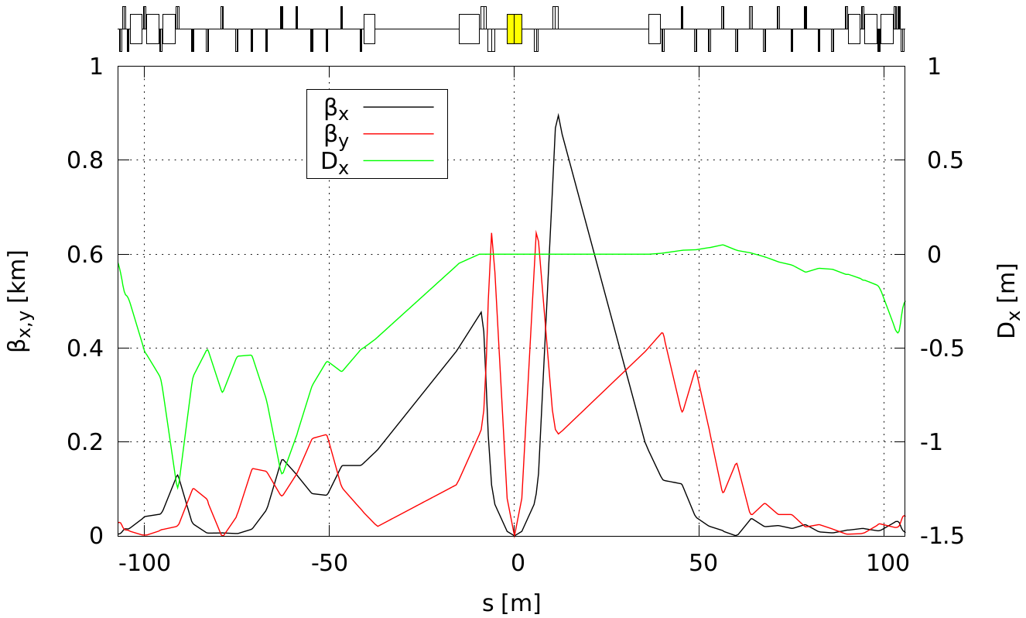
Electron 2nd IR Optics
Based on 1st IR electron optics design and modified to account for different crossing geometry
The bending angle between the spin rotator solenoids on each side and the IP are constrained by the polarization rotation requirements
Room for optimization in case of a larger than 25 mrad crossing angle due to larger transverse spacing of the electron ion beam, e.g. electron quads moved closer to the IP or aperture of the ion quads increased if beneficial
Same optics and geometry
as in baseline
$$e^{−}$$
IP

Slide 23
Constraints on Two IR Operation
Fundamental dynamical constraint: beam-beam tune shift
$ξ^{p}≲0.015$
$ξ^{e}≲0.1$
An empirical quantity that sets a limit on how much non-linearity originating from the beam-beam interaction can be tolerated by the beam before it loses stability
May result in luminosity sharing
Scaling of luminosity when beam-beam tune shift limited: $L∝{\max\left\{ξ_{x},ξ_{y}\right\}}/{ξ_{max}}$ where $ξ<ξ_{max}∼0.015\left(p\right), 0.1(e)$ is the beam-beam tune shift of the beam-beam limited beam.
When not limited by beam-beam, can potentially have a greater combined luminosity than with a single IR.

Slide 24
Other Constraints
Somewhat more loosely defined but critical dynamical constraint: natural chromaticity Momentum dependent tune shift that is inversely proportional to $β^{∗}$ No specific limiting value. Usually a few tens to a little over a hundred.
Stronger focusing at the IP may help with beam-beam tune shift but in addition to increasing chromaticity produces a larger beam divergence at the IP leading to further limitations associated with
Synchrotron radiation pattern
Beam pipe and magnet apertures
Limit on the beam size aspect ratio due to beam-beam
Detector acceptance

Slide 25
Issues with Doubling of Bunch Numbers
At a fixed luminosity, chromaticities of each IR are doubled
Beam angular divergences are increased by $\sqrt{2}$
Larger synchrotron ration cone
More challenging polarimetry due to shorter bunch spacing
Faster kicker for bunch swap in the electron collider ring
Impedance and instabilities need to be re-evaluated due to change of beam spectrum
Background due to events coming from parasitic collisions
Crabbing parameters need re-optimization

