Slide 1
Workshop Series on IR2 & Detector @ EIC
IR2@EIC Preparatory Meeting
Introductory Remarks
Volker Burkert (for the OC)
JLab
CFNS Meeting (remote) IR2@EIC Preparatory Meeting 12/15-16, 2020

Slide 2
EIC Electron & Ion Rings & Interaction Regions
EIC is capable of supporting two IRs and detectors. Project funding currently for one IR and 2/3 of one detector.
Stakeholders agree that 2nd IR with detector of similar timeline as EIC is desirable and routes to making this possible will be explored.
Jim Yeck , 4th YR meeting
November 11/19/20, LBL
Today’s meeting is a step towards this goal and to further explore complementarity from the different performance of the two IRs (as in graph)

Slide 3
Goals of the IR2@EIC Initiative
➔ Optimize the science output and impact of the EIC:
Primary interaction region optimized for high luminosity at CM energies > 80 GeV
Optimize 2nd interaction region to emphasize high luminosity at CM energies < 80 GeV
Other ways of optimization may be explored as well
Work with EIC Project and the community to achieve this optimization
➔ Scientific Output:
Evaluate the evolving landscape of the EIC science
Review complementary approaches for the overall optimization
Drawing on the results of the Yellow Report initiative and of the EoI results
Prepare White Paper with a detailed discussion of the conclusions reached

Slide 4
IR2@EIC Series of Workshops - Timeline
Preparatory/coordination Meeting
For the Series of the 3 workshops
Workshop III
Focus
Final Detector concept
IR2 integration
WP draft
(US - in person)
IR2@EIC Proposal
Submitted to CFNS
Workshop I
Focus on
Science, IR2,
Detector concept(s)
(virtual)
YR-Meeting
Presentation
TODAY
Proposal Approved
Documentation
Summer 2021
White Paper
June 1, 2020
July 15, 2020
Nov. 2020
Dec. 2020
Feb. 2021
Fall 2021
Workshop II
Focus on
Review IR2/IR1
Detector concepts,
Science documentation
(on foreign soil)
Preparatory work OC/EICUG/EIC Project

Slide 5
Agenda of today’s meeting
Review of major science aspects
IR2 design status and impact
Yellow Report analysis impact on science and detectors
Does IR2 initiate new software developments?
IR1 status and Expression of Interest
Discussions & short community contributions

Slide 6
Goals for 2021
The series of workshops is aimed at defining and promoting a scientific program and instrumentation of the EIC with the goal to maximize its science output.
The meeting today will help structure the series of workshops in 2021 with respect to scope and focus.
The community engagement is essential to the success. The series of workshops is also intended to attract new interests and collaborators to the EIC project.

Slide 7
Additional slides

Slide 8
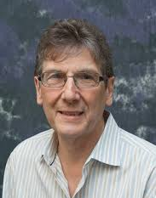
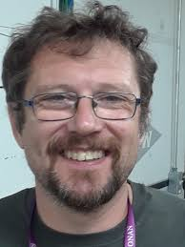
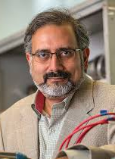
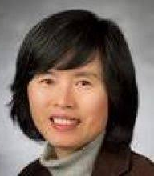
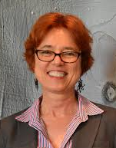
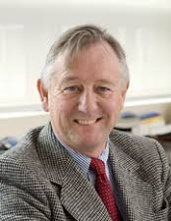
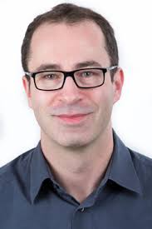
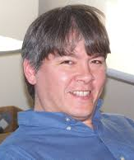
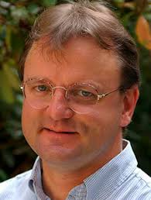
Workshop series on IR2@EIC Organization
Co-PI’s: V. Burkert (JLab), L. Elouadrhiri (JLab)
OC: M. Contalbrigo (Ferrara), A. Deshpande (Stony Brook), H. Gao (Duke), B. Jacak (LBL), R. Milner (MIT), F. Sabatie (Saclay/CEA), T. Satogata (JLab), B. Surrow (Temple)
Volker Burkert
Marco Contalbrigo
Abhay Deshpande
Latifa Elouadrhiri
Haiyan Gao
Barbara Jacak
Richard Milner
Franck Sabatie
Todd Satogata
Bernd Surrow

Slide 9
Agenda:
Chair: Richard Milner
09:50 - 10:00 Welcome - Abhay Deshpande
10:00 - 10:10 Introduction - Volker Burkert
10:10 - 10:50 Recent developments in nuclear science at EIC - George Sterman
10:50 - 11:30 Recent developments in exclusive nucleon science at EIC - Cédric Mezrag
11:30 - 11:45 Break
Chair: Haiyan Gao
11:45 - 12:25 Recent developments in SIDIS & Jets science at EIC - Feng Yuan
12:25 - 12:55 IR2@EIC design status - Vasiliy Morozov
12:55 - 13:55 Break
Chair: Todd Satogata
13:55 - 14:10 Call for detector proposal - Maria Chamizo, Robert McKeown
14:10 - 14:35 Software developments towards a 2nd IR - Markus Diefenthaler
14:35 - 14:55 YR results and analysis I (Science) - Andreas Metz
14:55 - 15:15 YR results and analysis II (Detectors) - Kenneth Barish
15:15 - 15:25 Break
Chair: Barbara Jacak
15:25 - 15:55 IR1@EIC Detector concept/implementation & EoI - Elke Aschenauer
15:55 - 17:00 Short contributions & discussion session

Slide 10
IR8
Two Interaction Regions - Schedule
IR6

