Slide 1
Long Shadow Detector (LSD)
TK Hemmick

Slide 2
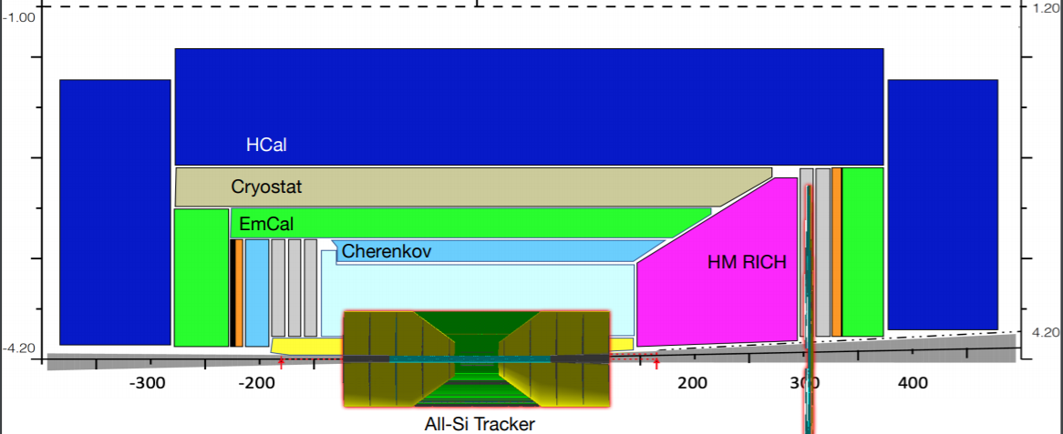
Detector cartoon from Rey Cruz-Torres (LBNL)
Free Real Estate!?
New Challenge:
10 GeV/c PID in the barrel
New Opportunity:
All silicon tracker option frees up additional space for PID detectors in the barrel.
What can we imagine in this new space to push PID to higher momentum?

Slide 3
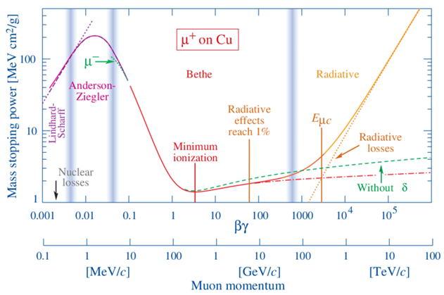
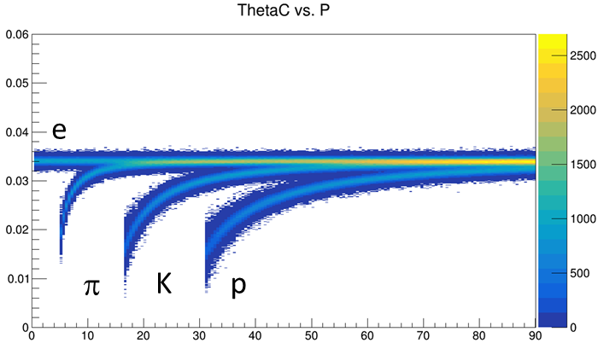
PID ~ Velocity
p = mγβ E = mγ velocity(β) measurement yields mass.
Direct measurement:
Record signal time at multiple locations, calculate v.
“Fast” detector = low transit time spread (most easily achieved at small transit time)
Velocity-dependent interaction(s) with detector:
Specific Ionization (aka $\frac{dE}{dx}$)
Cherenkov Radiation: $\cos{θ_{C}=\frac{1}{nβ}}$
θ_{C} measured wrt track direction.
Thus dependent upon deliverables from tracking
Bremsstrahlung: $P= \frac{q^{2}γ^{4}}{6πε_{0}c}\left({\dot{β}}^{2}+\frac{{\left(\vec{β}∙\dot{\vec{β}}\right)}^{2}}{1−β^{2}}\right)$
Transition Radiation: $I=\frac{Z^{2}e^{2}γω_{p}}{3c}$
eID mechanisms
Two Presentations:
Pushing the limits of dE/dx (Tom)
Pushing the limits of Cherenkov (Henry)

Slide 4
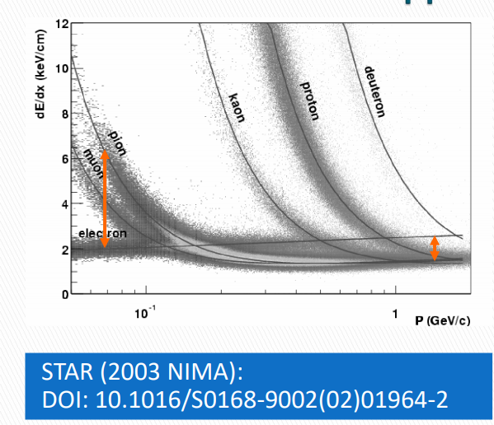
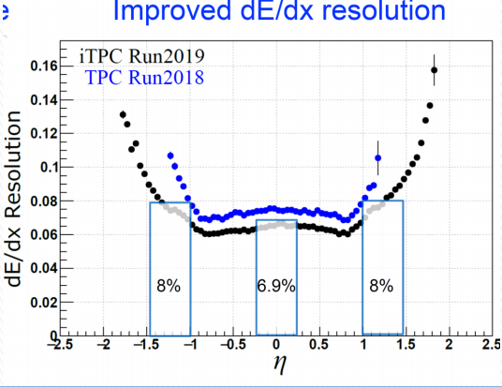
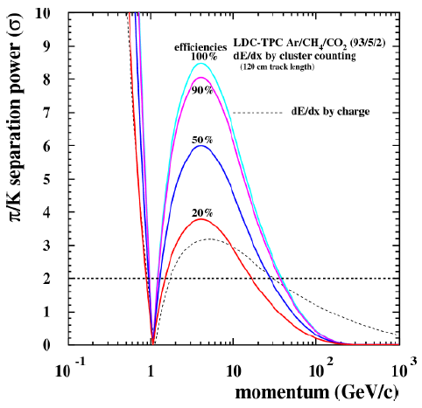
dE/dx w/ hybrid detector
Goal: Achieve dE/dx performance with least gas volume
Specific ionization is a function of β.
PID bands vs momentum.
Crossing ~β = 0.7 (TOF can help)
Limitations from Landau tails:
Primary ionization Statistics = Poisson
Total ionization = Landau
Traditional Approach:
Lots of gas & lots of samples
Forward thinking approaches:
Gas choice to minimize Landau
“Cluster Counting”
Dots = STAR
Boxes = sPHENIX Test Beam

Slide 5
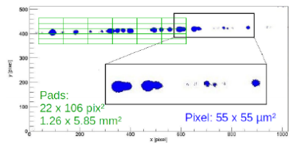
Scaling Expectations
Scaling to our available length:
$N_{cluster}∝Length$
$σ_{N}=\sqrt{N_{cluster}}∝\sqrt{L}$
Using a 3σ reference @ 40 cm gas:
$3\sqrt{\frac{120}{40}}=5.2$
Existing Concept (“Timepix”)
Avalanche onto Silicon Pixels
Tiny Pixels (smaller than cluster spacing)
Sufficient gain for single electron
In principle can work
EXTREMELY expensive for large area.
Can we accomplish with conventional tech?

Slide 6
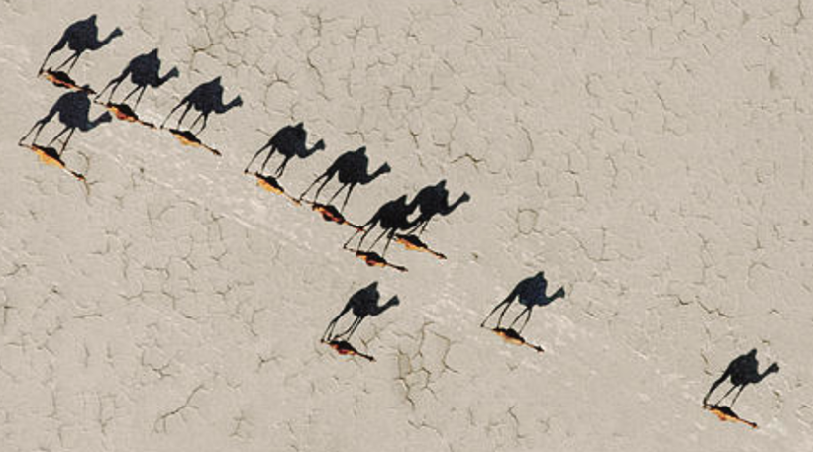
What is the meaning of “Long Shadow”?
Satellite Photo
Camel

Slide 7
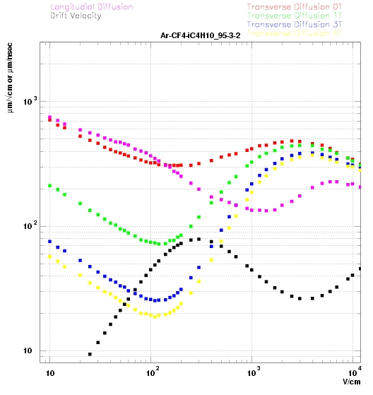
Long Shadow Detector -- LSD
Bad for Tracking
Good for PID
Multiple sections…
New Concept: Like a “Streak Camera”
Sensors
B-field
track
HV-
Silicon Tracker
Drift leverages huge Lorentz angle as “magnifier”
Clusters spread across space and time.
Higher B = Lower Transverse diffusion
Example: T2K(130 V/cm) has only $25\frac{μm}{\sqrt{cm}} at 3 Tesla$
Detect (count) clusters with conventional means.

Slide 8
Summary
Long Shadow Detector (LSD) presently just a hallucination.
Absolutely requires additional space
All-silicon tracking option?
Absolutely requires help due to dE/dx band crossings:
DIRC, TOF, ???
Likely prefers higher(est) magnetic fields
Garfield Simulations required to optimize sometimes competing constraints:
Maximal total cluster count.
Minimal cluster merging.
Readout can take multiple forms:
Standard charge collection (pads)
Optical read-out of GEMs:
e.g. Detecting electroluminescence w/ fast cameras [see f.i. NIMA 886(2018) 24].
Optical read-out looks the most appropriate for cluster counting (no ion-tail effects).
Can we replace cameras with SiPM arrays (NOTE: Avalanche supplies a MANY-photon signal lessening radiation damage concerns)
Garfield simulations are ongoing but not yet ready for today…stay tuned
Thank you, Silvia!

