Slide 1
The SBU EoI
October 19 - 2020

Slide 2
Interest for Potential Equipment Cooperation
PID:
High momentum reach RICH - forward RICH with INFN/Italy
Time Projection Chamber – dE/dx extension for sPHENIX TPC
Hadron Blind Detector for eID
DIRC with Catholic University of America (CUA), GSI/Germany
LAPPD with BNL
Tracking
Forward tracking system based on PANDA wire tubes
Polarimetry and forward calorimetry
Compton polarimetry – laser with UVa, UMass Amherst, JLab
Hadron polarimetry with MIT, RIKEN/Japan, BNL
Data acquisition
Streaming readout with Jlab, MIT, BNL, INFN (see EOI from BNLSBU, Software Working Group, IP8, INFN)

Slide 3
Level of Potential Contribution
All contributions from SBU are for in-kind labor contributions and existing facilities provided in our laboratory.
All in-kind labor contributions are heading toward design, construction, commissioning, and maintenance of the equipment under consideration.
Software support will be provided when applicable.
We assume design and engineering support from the EIC project. Material and supply costs to be provided by the EIC project.
Senior staff: 5 faculty, 6 research faculty, 10 post-docs, 10 graduate students, 20 undergraduate students
Machine shop staff : 4 full time technicians
Electronics shop staff: 1 full time technicians, 1 electronic engineer.

Slide 4
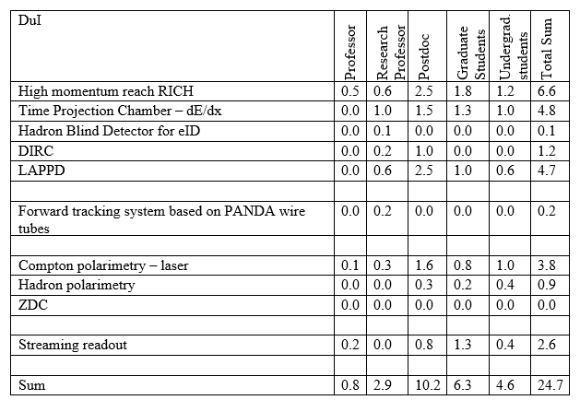
FTE

Slide 5
Additional Information
Large laboratory space. Large cleanroom (class 1000), well equipped machine shop. Machine shop work to be funded by EIC funds.
SBU has and had leading contributions to sPHENIX, SoLID, MOLLER, RHIC and JLab polarimetry, various EIC detector R&D program groups, PHENIX.
sPHENIX: TPC
SoLID: Heavy Gas Cherenkov/Light Gas Cherenkov detectors
MOLLER: GEM tracker
eRD2/6/14/23/26
PHENIX: RICH, Drift Chamber, HBD, SiVTX
JLab: polarimetry

Slide 6
Additional Resources
Lab space | sqft | Room description
S103 | 3023 | Target room
S200 | 701 | Res Lb
- 007 - | 2562 | Ctrl Rm/Res Lb
Clean room | 840 | (~ 15k ft^3)
Rm 7a/b/c/d | 2519
All | 9644

