Slide 1
Crab Crossing
Christoph Montag, BNL
October 21, 2020

Slide 2
EIC Interaction Region

Slide 3
Luminosity and focusing
Luminosity ~ 1/cross section
A smaller spot size at the IP means more luminosity
At the IP, (beam size)X(beam divergence)= const. in each plane (emittance)
For a given beam (= fixed emittance), a smaller IP beam size means larger divergence
Strong focusing β_{y} =5 cm
A larger beam divergence leads to a larger beam size at the nearest focusing magnets – (size at magnet)=(divergence)X(distance)
Magnets need to have larger aperture while gradient (= focusing strength) remains the same – peak field at magnet poles is technically limited
Focusing elements for both beams need to be as close as possible to the IP

Slide 4
Crossing angle collisions
Beam energies of electrons and hadrons are vastly different in EIC
Focusing elements for electrons would have only little effect on hadrons, while hadron magnets would overfocus electrons
Beams need to be separated into their respective focusing systems as close as possible to the IP
A separator dipole would have to deflect the (“weaker”) electrons and would therefore generate a wide synchrotron radiation fan that would need to pass through the detector – requires large beam pipe diameter (HERA-II)
Best solution: Crossing angle collisions!

Slide 5
Crossing angle and luminosity
In head-on collisions, every beam particle in one beam can potentially interact with every particle in the other beam
Long (~+/-6 cm), skinny (100 um) bunches colliding at an angle have very little overlap
With 25 mrad crossing angle, each particle can only interact with a +/-4 mm thick slice of the +/-6 cm long oncoming bunch

Slide 6
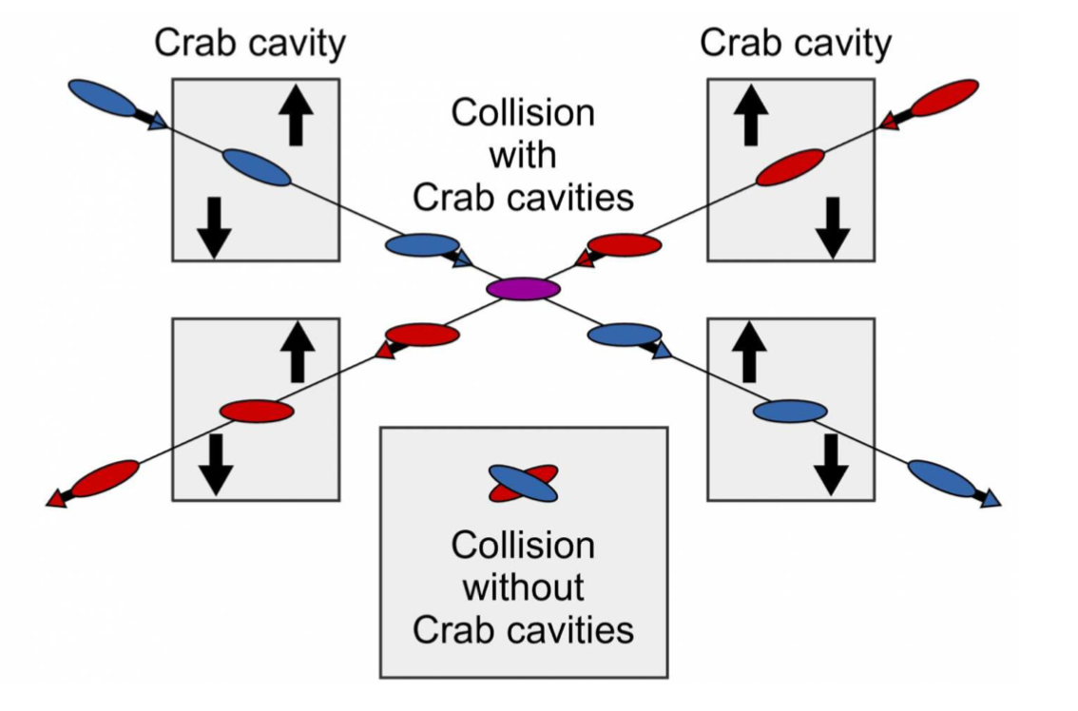
Crab crossing to the rescue
Head-on collision geometry is restored by rotating the bunches before colliding (“crab crossing”)
Bunch rotation (“crabbing”) is accomplished by transversely deflecting RF resonators (“crab cavities”)
Actual collision point moves laterally during bunch interaction

Slide 7
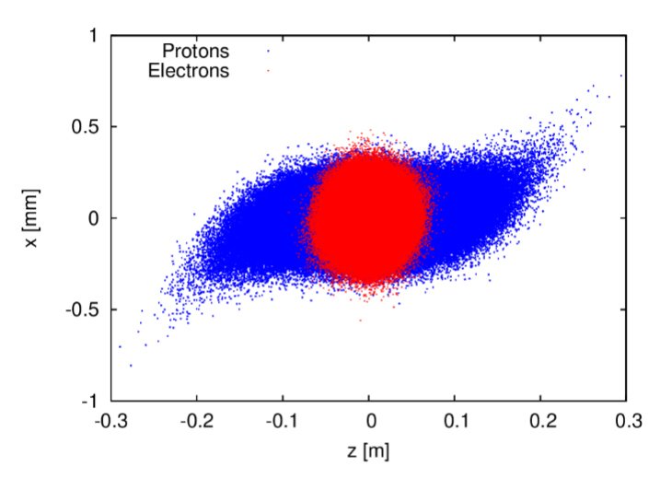
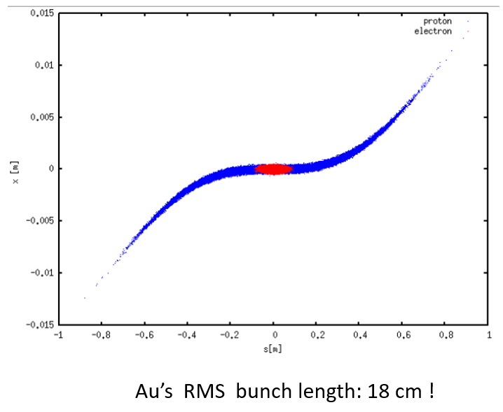
Nobody’s perfect
Bunch rotation (crabbing) is not linear due to finite wavelength of RF resonators (crab cavities)
Long hadron bunches are “S”-shaped during collision
Distorted shape results in transverse offset between electron bunch and head and tail of proton bunch – reduced luminosity and severe beam dynamics effects
Longer bunches, skinnier bunches, or increased crossing angle all make this worse
Higher harmonic crab cavities can “straighten out” the kick and therefore the bunch, but at a cost – space and money
EIC already plans on 197 MHz crab cavities, plus 394 MHz harmonics
197 MHz as low as technically feasible (niobium sheets for cavity production, cavity size in tunnel)

Slide 8
Summary
High luminosity requires focusing close to the IP
Need separate focusing channels for the two beams
Most efficient separation method: crossing angle
Crossing angle requires crab crossing to restore luminosity
Crab crossing is never perfect due to finite crab cavity wavelength

