Slide 1
Solenoid field compensation for the hadron beam
Vasiliy Morozov
Crossing angle and its implications for the central detector design October 21, 2020

Slide 2
Detector Solenoid Effects
Coherent orbit distortion
Transverse coupling
Rotation of the crabbing plane
Polarization tilt

Slide 3
Coherent Distortion of Ion Orbit
Top view
Ions
Side view
Ions
$$e^{−}$$
$$e^{−}$$
$$B_{z}$$
$$B_{x}$$
$$\vec{B}$$
End view
Ions
Vertical kicks by the solenoid fringe fields
$\frac{θ}{2}=\frac{1}{2}\frac{B_{sol}L}{2Bρ}<22$ mrad (41 GeV)
$$⊗$$
Rotation of the interaction plane inversely proportional to the beam energy

Slide 4
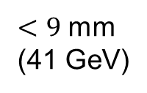
Correction of Ion Orbit
The closer the kicks to the IP, the smaller the orbit excursion
Orbit excursion inversely proportional to the beam momentum
Concern for field non-linearity at large offsets
Side view
Ions
$<9$ mm
(41 GeV)
$$e^{−}$$
Vertical kick #1 (radial magnetic field)
Vertical kick #2

Slide 5
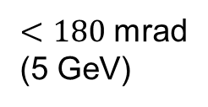
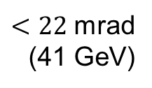
Transverse Coupling
Coupling is in general a global effect and involves consideration of the entire ring or the entire coupled section
Potential for negative dynamic effects
Can leads to redistribution of the horizontal and vertical emittances ⇒ smaller beam “flatness” ⇒ luminosity reduction
If not locally compensated at the IP can lead to change in the transverse beam shape ⇒ potential for luminosity reduction (beams enter solenoid uncoupled):
$$σ_{x}/σ_{y}\sim 10 μm$$
No solenoid + no coupling =
Full overlap ⇒ Full luminosity
Solenoid + coupling not compensated =
Partial overlap ⇒ Reduced luminosity
Solenoid + coupling compensated =
Full overlap ⇒ Full luminosity
$$σ_{x}\sim 100 μm$$
Ions
$$e^{−}$$
$$e^{−}$$
$$σ_{y}\sim 10 μm$$
$<180$ mrad
(5 GeV)
$<22$ mrad (41 GeV)

Slide 6
Rotation of Crabbing Plane
Another aspect of coupling
Potential for negative dynamic effects
Impact on luminosity
$$e^{−}$$
Top view
No solenoid + no coupling =
Full overlap ⇒ Full luminosity
$$σ_{x}\sim 100 μm$$
Ions
$$σ_{z}\sim 6 cm$$
Solenoid + rotation not compensated =
Partial overlap = Reduced luminosity

Slide 7
Rotation of Crabbing Plane Solution
Pre-rotated the crabbing plane using vertical crabbing kicks: ~140 kV for ions and ~430 kV for electrons
Top view
Solenoid + rotation compensated =
Full overlap ⇒ Full luminosity

Slide 8
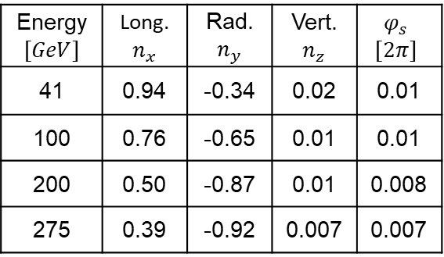
Polarization Tilt
The baseline scheme has no strong correctors on the rear side, so the polarization tilt is due to the rear side of the solenoid
Polarization orientation at the IP in this scenario is compensated by the rear ion spin rotator
The net spin effect of the entire IR involves account of the contribution of the forward side
The forward spin rotator compensation the remaining net effect
Top view
Ions
Energy $$[GeV]$$ | Long. $n_{x}$ | Rad. $n_{y}$ | Vert. $n_{z}$ | $$φ_{s}$$ $$[2π]$$
41 | 0.94 | -0.34 | 0.02 | 0.01
100 | 0.76 | -0.65 | 0.01 | 0.01
200 | 0.50 | -0.87 | 0.01 | 0.008
275 | 0.39 | -0.92 | 0.007 | 0.007
$$e^{−}$$
$$B_{z}$$
$$\vec{P}$$
$$B_{x}$$
$$\vec{B}$$

Slide 9
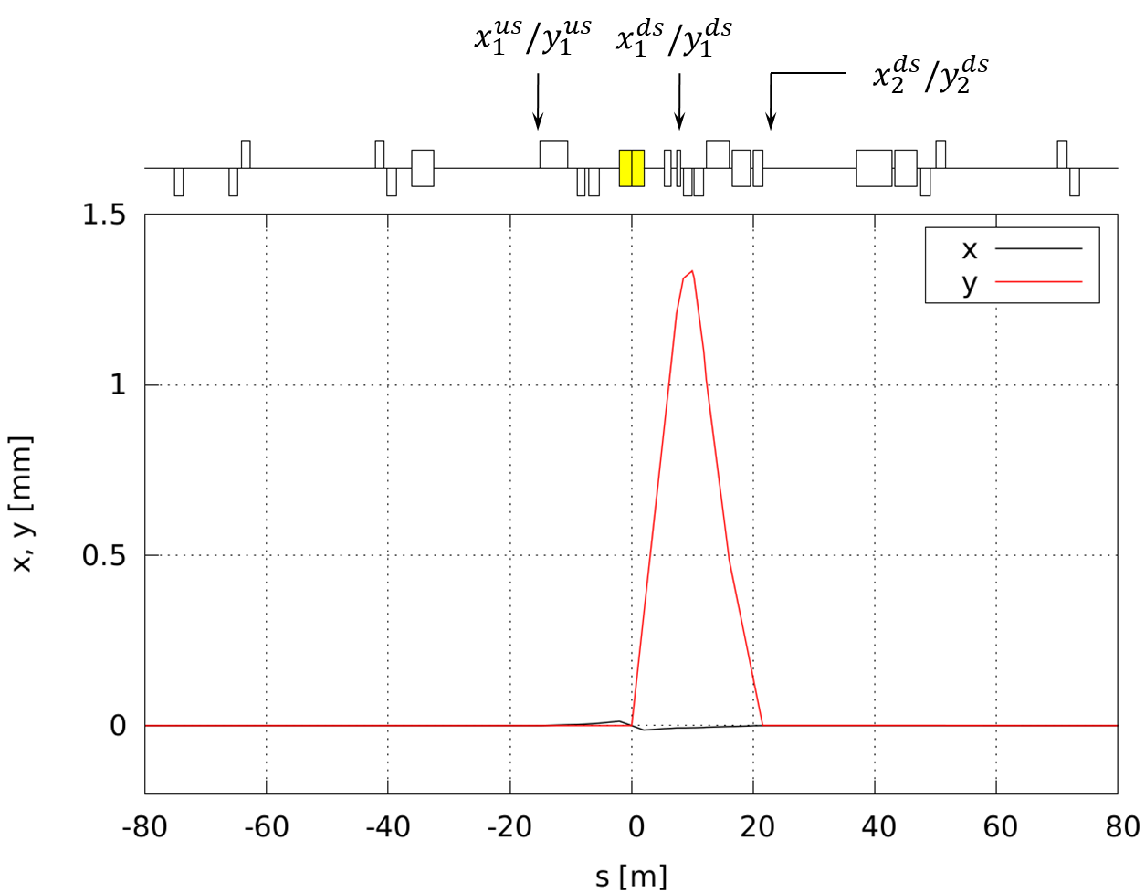
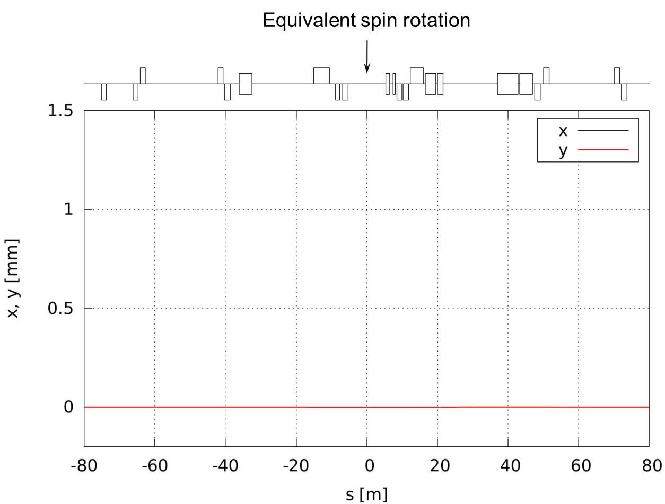

Net Effect of IR on Ion Spin
$$M_{tot}$$
$$M_{us}$$
$$M_{ds}$$
Energy $$[GeV]$$ | Long. $n_{x}$ | Rad. $n_{y}$ | Vert. $n_{z}$ | $$φ_{s}$$ $$[2π]$$
41 | 0.98 | 0.18 | -0.076 | 0.038
100 | 0.97 | 0.23 | -0.047 | -0.035
200 | 0.93 | -0.37 | -0.029 | 0.021
275 | 0.88 | -0.48 | -0.025 | -0.035

Slide 10
Introducing Crossing Angle for Electrons
The main challenge is handling of the synchrotron radiation
Other issues seem solvable but need to be checked
Size of the orbit excursion and its impact on magnet multipole requirements
Impact on vertical emittance
Effect on polarization lifetime

