Slide 1
Detector matrix/Updates:
Tracking
EIC central tracking baseline concepts
expected performance from current simulations
comparison with PWG requiremens
Domenico Elia, Kondo Gnanvo and Leo Greiner
for the EIC-YR Tracking WG

Slide 2
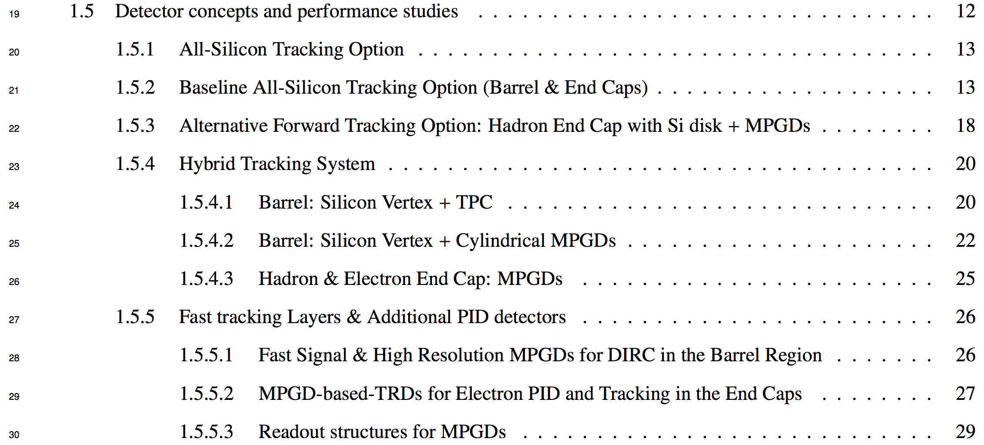
Central tracking baseline concepts
Simulation efforts in the Tracking WG:
strong and steady effort in the last couple of months by many groups:
  (bi-)weekly meetings: https://indico.bnl.gov/category/276/
  involvement/interplay of “silicon-” and “gaseous-”oriented contributions
  try to collect/highlight in the YR as much as possible of a large amount of work

Slide 3
Central tracking baseline concepts
Simulation efforts in the Tracking WG:
strong and steady effort along the last months by many groups
focus on two possible baseline detector designs:
  ALL-SILICON set of tracking layers and disks
  HYBRID design based on silicon tracking layers and disks with gaseous tracking detectors surrounding the silicon barrel layers (various gaseous options available) and MPGDs in the endcaps

Slide 4
Central tracking baseline concepts
Simulation efforts in the Tracking WG:
strong and steady effort along the last months by many groups
focus on two possible baseline detector designs:
  ALL-SILICON set of tracking layers and disks
  HYBRID design based on silicon tracking layers and disks with gaseous tracking detectors surrounding the silicon barrel layers and MPGDs in the endcaps
optimized layout configurations defined for both concepts:
  corresponding simulations allow to provide expected performance → next slides
  believe this a key contribution to the overall optimization of the EIC detector design (eg cost, size, magnet options, PID considerations etc) and useful ingredient for the ongoing complementarity discussion/studies → Leo’s talk tomorrow

Slide 5
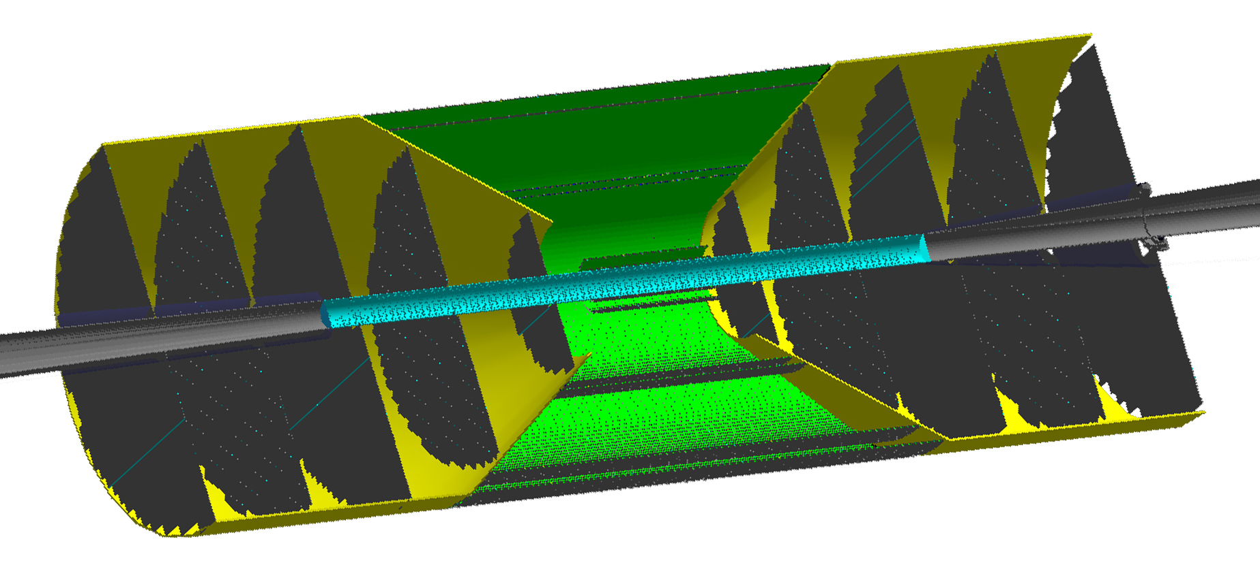
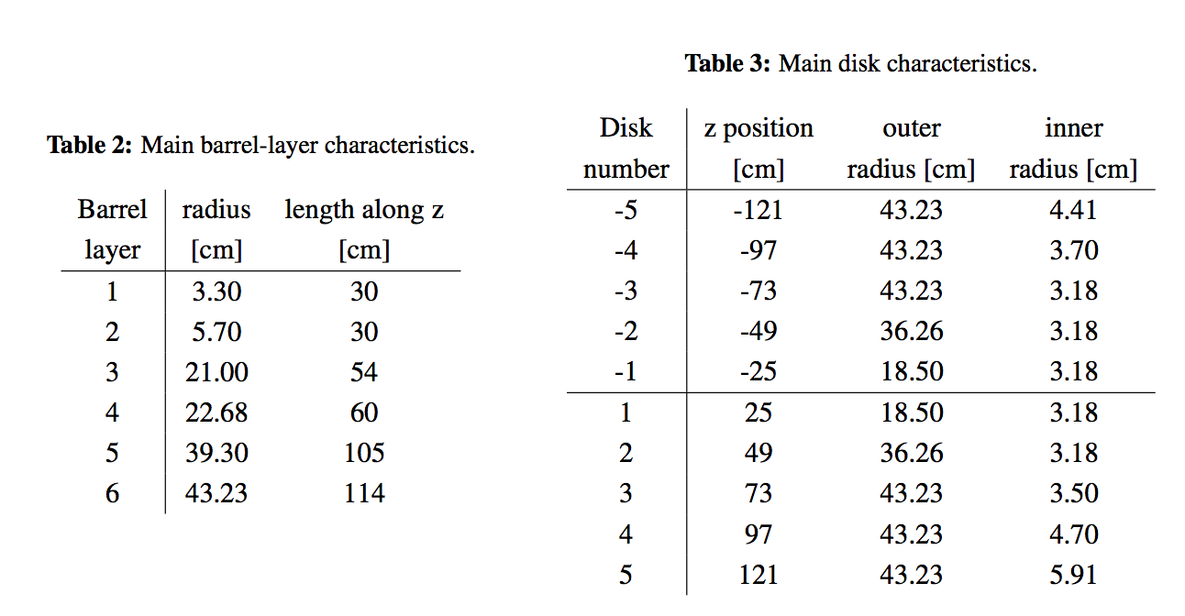
Central tracking baseline concepts
ALL-SILICON tracking system:
6-layer barrel, 5+5 disks for back/forward regions
Silicon detectors based on ALICE ITS3
(10x10 μm², all staves X/X₀ = 0.3%)

Slide 6
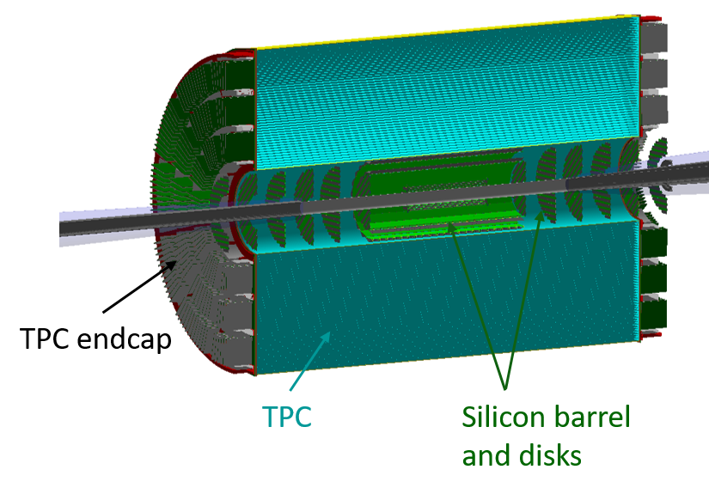
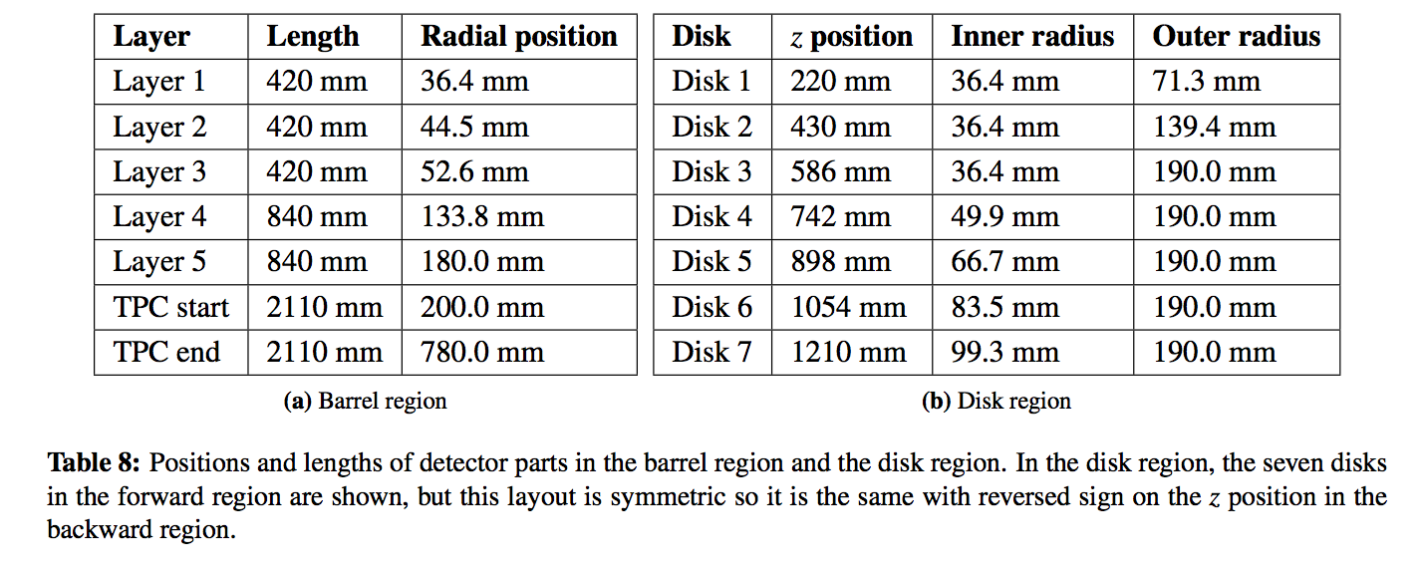
Central tracking baseline concepts
HYBRID tracking system:
silicon vertex + TPC (barrel), 7 silicon disks for back/forward regions
Silicon detectors based on ALICE ITS3 (10x10 μm²)
  3 innermost vertexing layers X/X₀ = 0.05%
  2 tracking layers X/X₀ = 0.55%
  disks X/X₀ = 0.24%
MPGDs disks in the endcaps not yet in the simulation

Slide 7
Expected performance from simulation
ALL-SILICON tracking system:
studied and optimized using the Geant4-based Fun4All framework
  momentum, pointing and angular resolutions (full coverage and 0 < p < 30 GeV/c)
  with different magnetic-field maps: BaBar (1.4 T) and Beast (3 T) solenoids

Slide 8
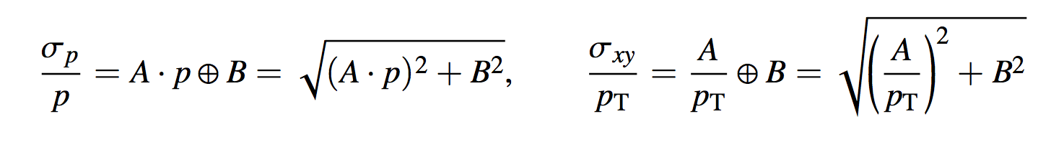
Expected performance from simulation
ALL-SILICON tracking system:
studied and optimized using the Geant4-based Fun4All framework
  momentum, pointing and angular resolutions (full coverage and 0 < p < 30 GeV/c)
  detailed study/parametrization of the corresponding distributions in η-bins:

Slide 9
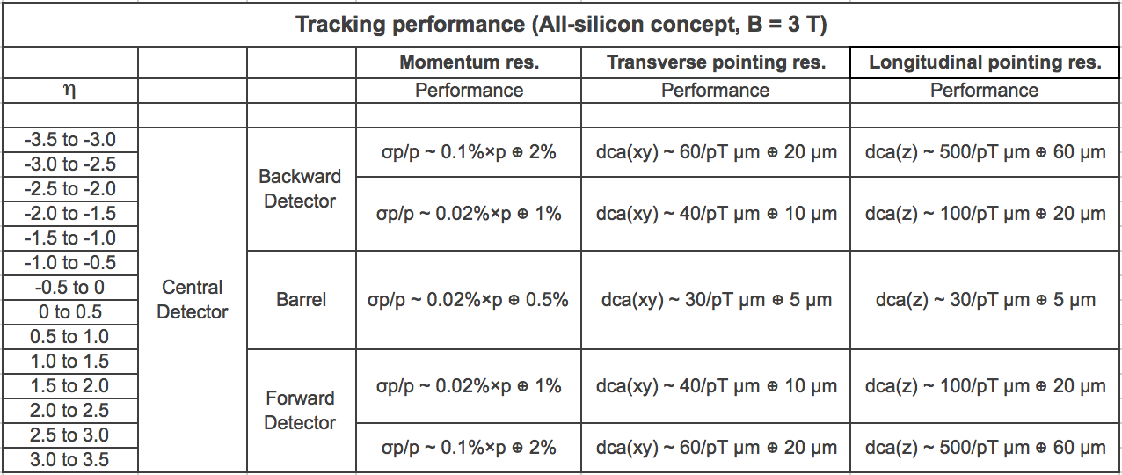
Expected performance from simulation
ALL-SILICON tracking system:
studied and optimized using the Geant4-based Fun4All framework

Slide 10
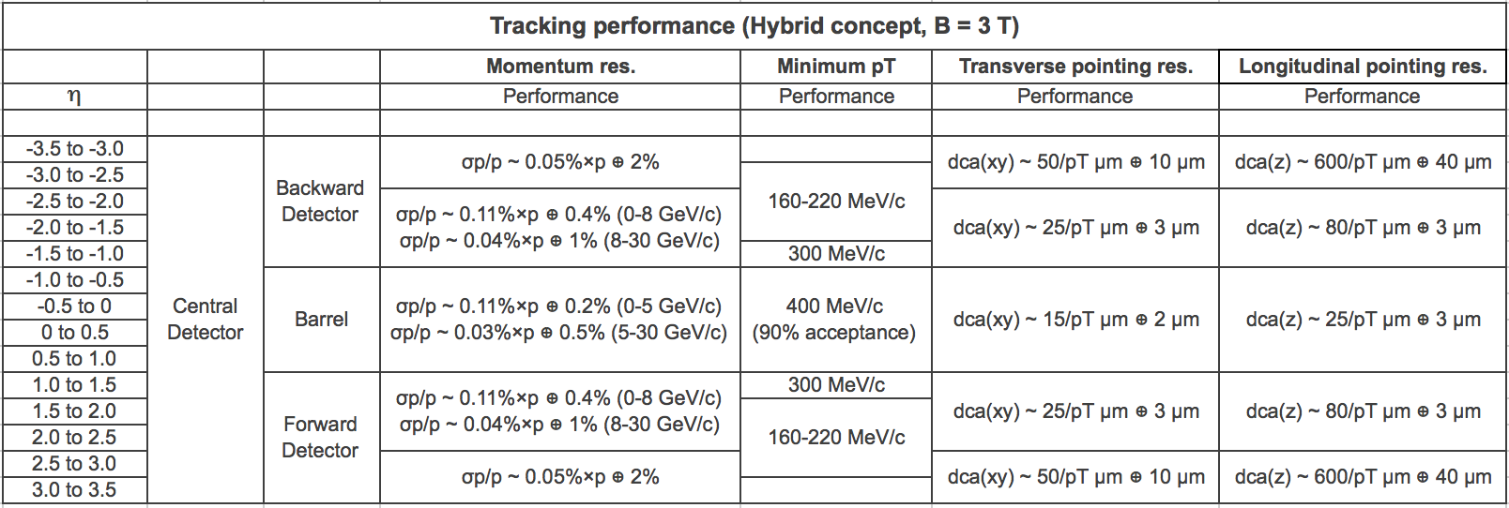
Expected performance from simulation
HYBRID tracking system:
similarly to all-silicon, detailed studies in the Fun4All framework
Under investigation:
resolutions with TPC need separate fits in two intervals

Slide 11
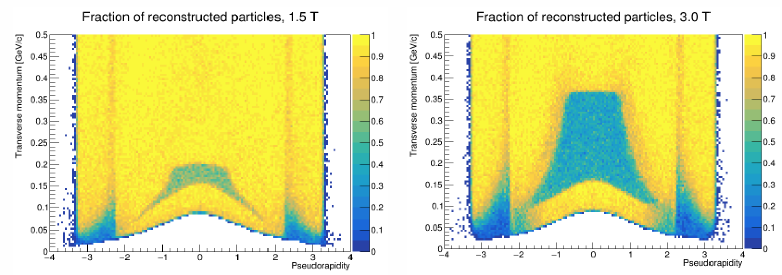
Expected performance from simulation
HYBRID tracking system:
similarly to all-silicon, detailed studies in the Fun4All framework
Further details here:
https://indico.bnl.gov/event/7915/
Nu
Still preliminary:
all numbers provided for 90% acc
spiralling tracks within TPC might be better handled with a clever reco
upper bound of inefficiency regions likely created by TPC reported

Slide 12
Expected performance from simulation
HYBRID tracking system:
similarly to all-silicon, detailed studies in the Fun4All framework
Studies in the endcaps to be updated with MPGDs planar layers

Slide 13
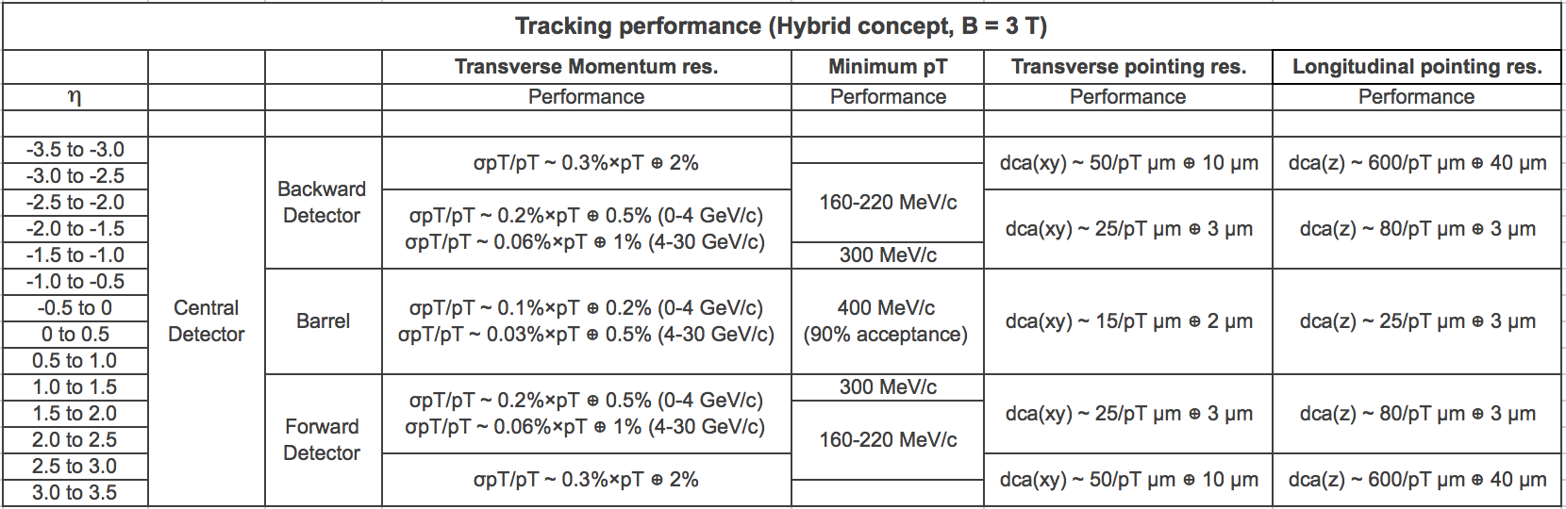
Expected performance from simulation
HYBRID tracking system:
similarly to all-silicon, detailed studies in the Fun4All framework
Studies in the endcaps to be updated with MPGDs planar layers

Slide 14
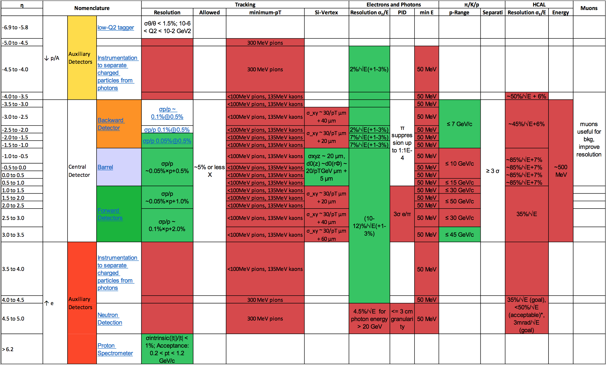
Comparison with requirements
PWG detector requirements @CUA 3rd YR workshop:
https://indico.bnl.gov/event/9080/contributions/40915/attachments/30452/47738/EICUGM-CUA-DWG-Convener-slides.pdf
Tracking

Slide 15
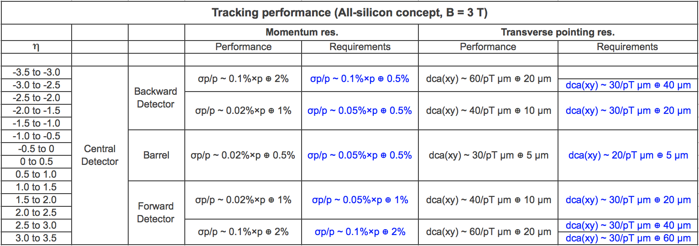
Comparison with requirements
ALL-SILICON tracking system:

Slide 16

Comparison with requirements
ALL-SILICON tracking system:

Slide 17
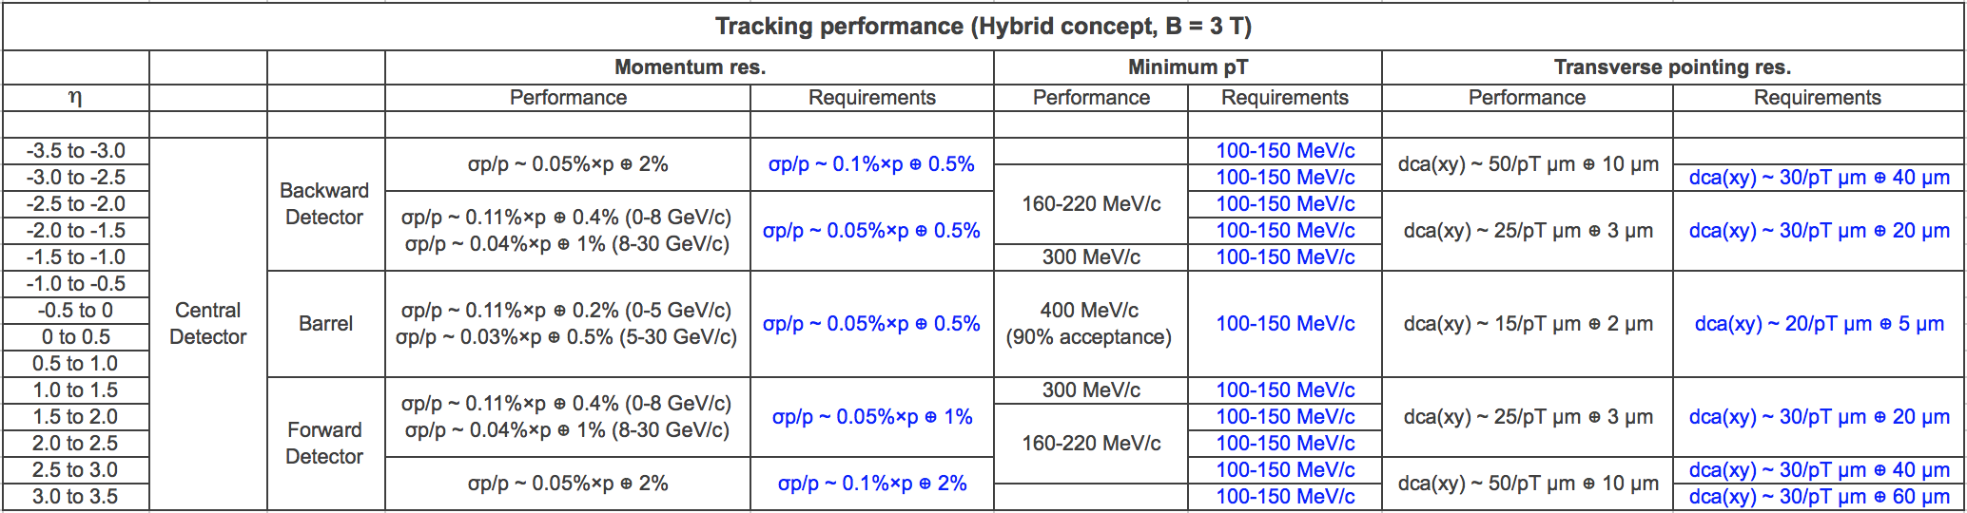
Comparison with requirements
HYBRID tracking system:

Slide 18

Comparison with requirements
HYBRID tracking system:

Slide 19
Conclusions
Tracking performance results:
two baseline detector concepts as reference tracking systems
optimized baseline layout implemented in Fun4All for both concepts:
  ALL-SILICON and HYBRID trackers studied to produce expected performance
  further studies ongoing, eg for (additional) gaseous detector components

Slide 20
Conclusions
Tracking performance results:
two baseline detector concepts as reference tracking systems
optimized baseline layout implemented in Fun4All for both concepts
main results and comparison with requirements:
  relative momentum and pointing resolution, minimum p_{T} vs η (with B = 1.5 / 3 T)
  pointing resolutions fine (even exceedings reqs) everywhere with both systems
  momentum resolution fine (especially in the central region) for B = 3 T
  min p_{T} easier to match reqs with large eff for B = 1.5 T (checks ongoing here)
Thanks to all groups and colleagues contributing to the Tracking WG studies!

