Slide 1
Accelerator/IR Overview
A. Drees for the EIC team
4th EIC Yellow Report Workshop at LBL
November 20th, 2020

Slide 2
Outline
Overview EIC complex
  RHIC
  ESR
  HSR
  Key parameters
IR Design Criteria
IR Layout Details
  Forward region
  Rear region
  Matching
  Magnet cryostats
Central Vacuum Chamber
  Synchrotron radiation
Summary

Slide 3
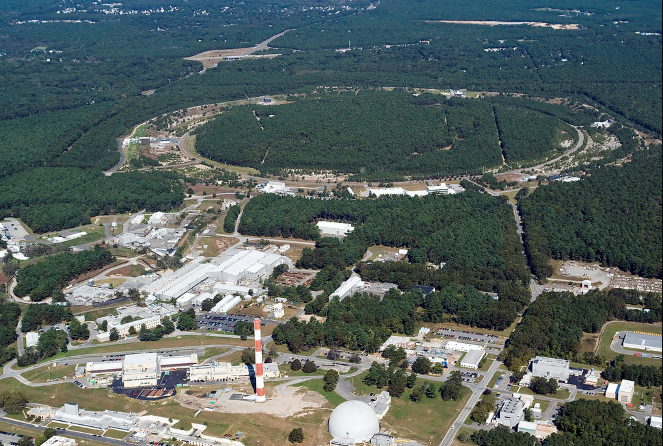

EIC Collider Concept
Design based on existing RHIC,
RHIC is well maintained, operating at its peak
Hadron storage ring 40-275 GeV (upgraded RHIC)
  many bunches (x10 RHIC)
  bright beam emittance
  need strong cooling or frequent injections
Electron storage ring (2.5–18 GeV (new))
  many bunches,
  large beam current (2.5 A) ➔ 10 MW S.R. power
Electron rapid cycling synchrotron (new)
  1-2 Hz
  Spin transparent due to high periodicity
High luminosity interaction region(s) (new)
  L = 10³⁴cm⁻²s⁻¹
  Superconducting magnets
  25 mrad Crossing angle with crab cavities
  Spin Rotators (longitudinal spin)
  Forward hadron instrumentation
BNL-EIC

Slide 4
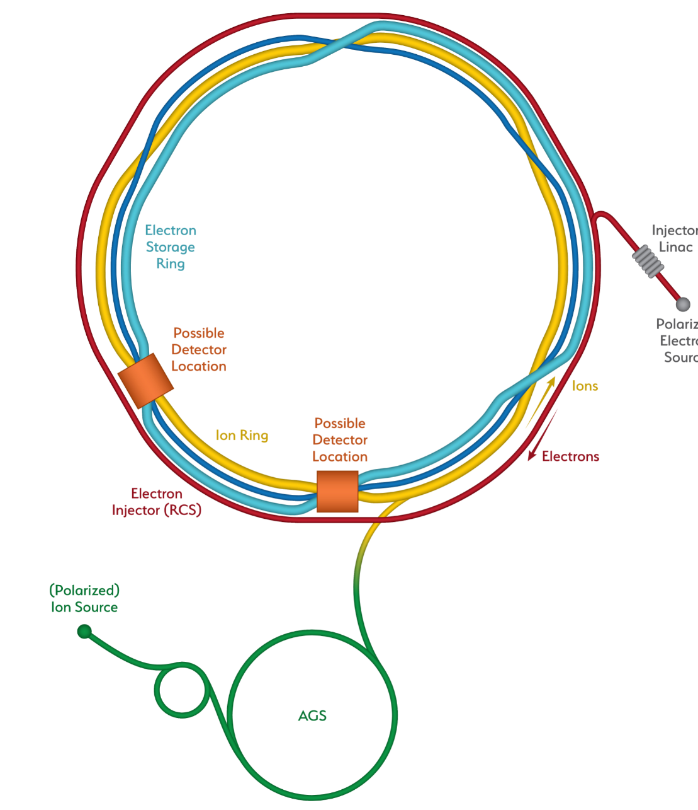

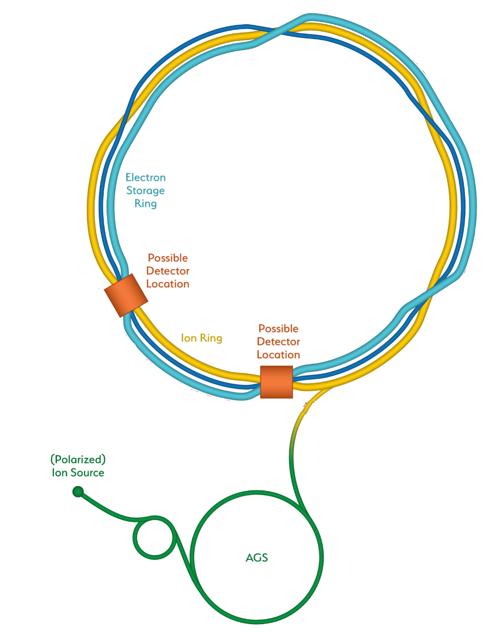
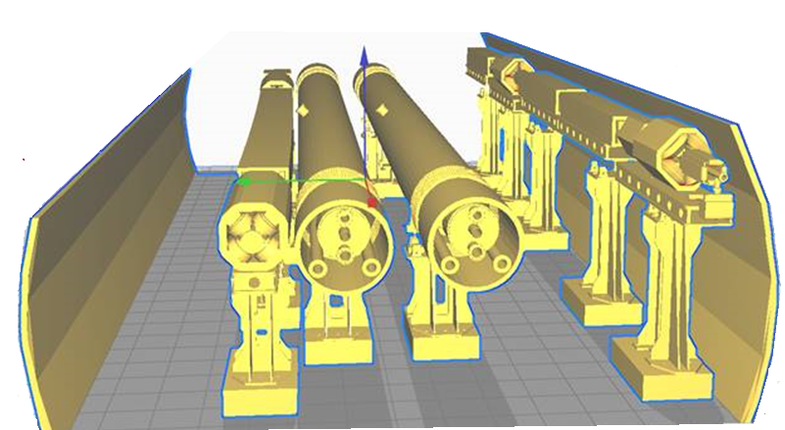
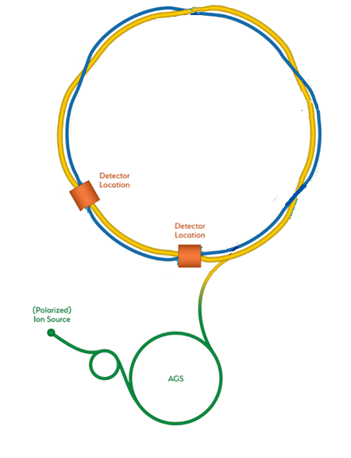
From RHIC to the EIC
ESR
HSR
RCS
EIC
Add electron storage ring
Which holds the electrons which collide with hadrons
We add an electron
Injector complex which delivers full energy electrons to the storage ring
The strong hadron cooling facility completes the facility
Existing RHIC with
Blue and Yellow ring
Hadron Storage Ring
Electron Storage Ring
Electron Injector Synchrotron
Possible on-energy Hadron
injector ring
Hadron injector complex

Slide 5
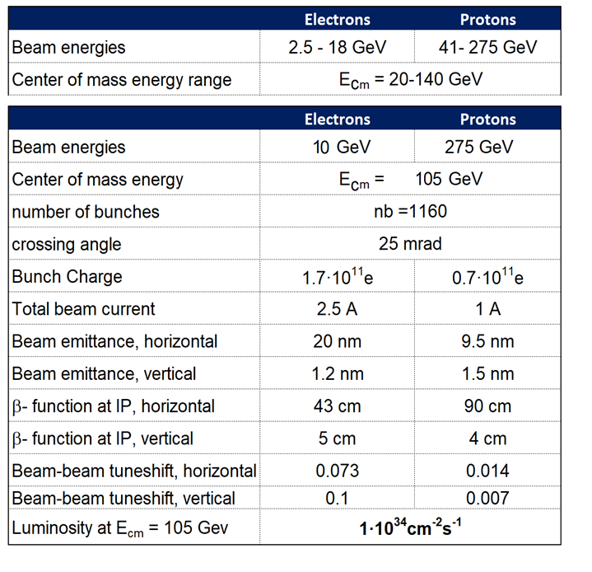
EIC CDR Parameters for E_{cm} and Luminosity

Slide 6
Interaction Region Design criteria
The Interaction Region with the colliding beam and surrounding detector is the most complex and most constrained section of a collider.
Inside the IR section we need to combine
  strong focusing,
  complex superconducting magnets with novel but-prototyped magnet technology
  Collisions with a crossing angle,
  large aperture for good acceptance of forward physics,
  tolerable chromatic aberrations,
  manageable synchrotron radiation,
  manageable impedance of the vacuum systems,
  feasible warm-cold transitions around super conducting magnets
Matching of the IR layout with the lattice of the ring
  Requires more dedicated and one-of-a-kind magnets
mask and collimation systems
provide favorable condition for luminosity measurements and auxiliary detectors

Slide 7
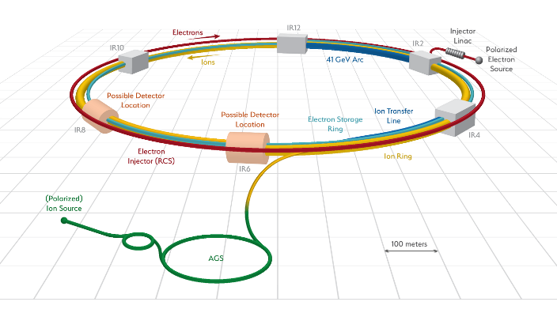
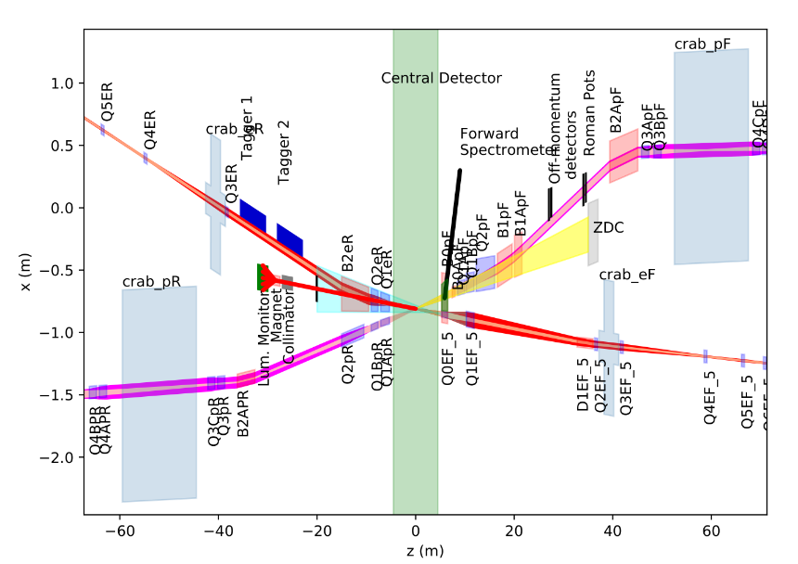
EIC IR: Overview
Rear
Forward
RHIC yellow ring: EIC hadron ring (HSR)
Add electron storage ring in existing tunnel (ESR)
Detector centered in center of IP
-Possible location: IP6

Slide 8
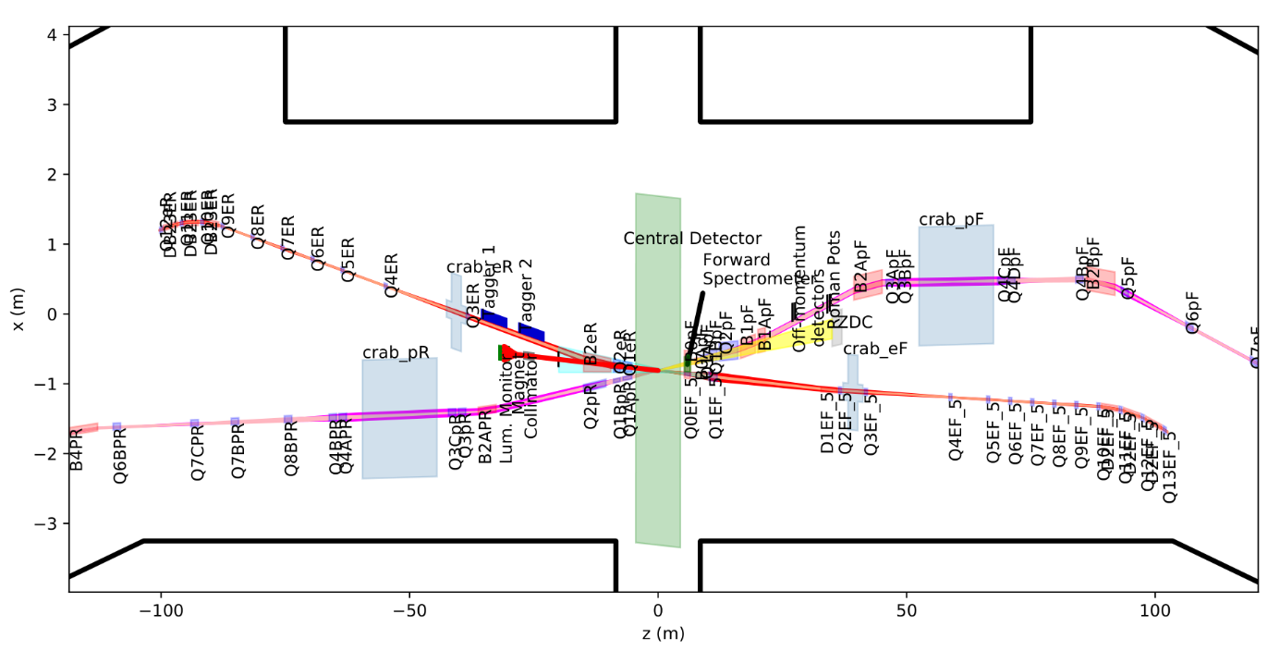
EIC IR
RHIC sec6
Rear
RHIC sec5
Forward
Electrons
Hadrons
Fits into RHIC tunnel and experimental hall

Slide 9
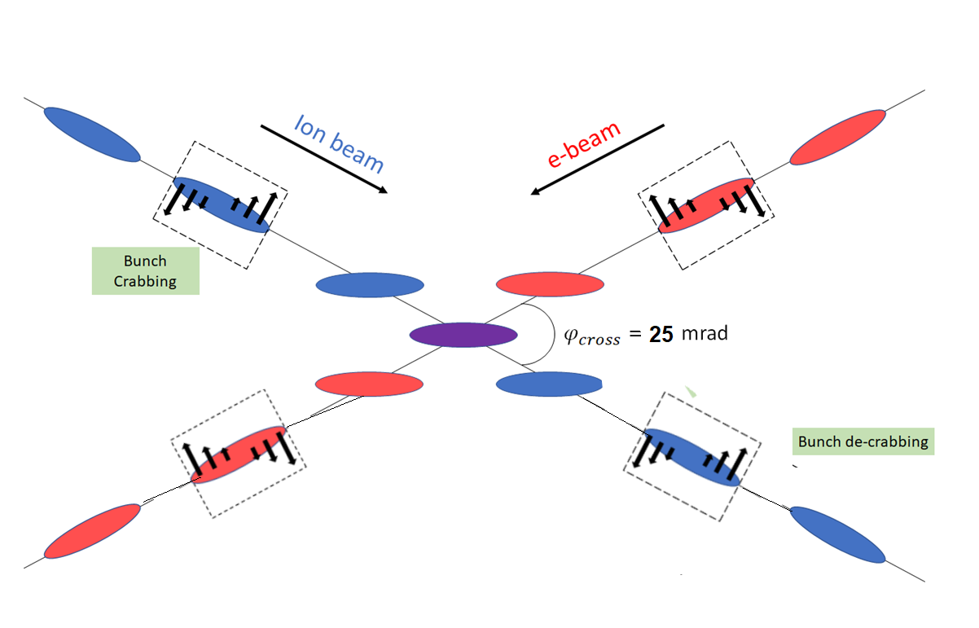
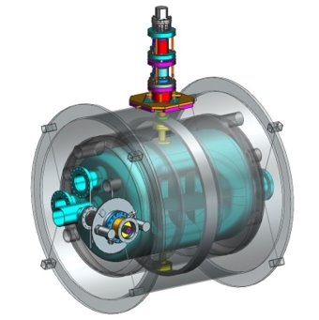
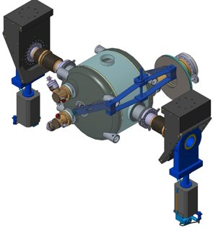
EIC Collisions with a Crossing Angle
Modest crossing angle of 25 mrad
- avoid parasitic collisions due to short bunch spacing,
- for machine elements, to improve detection
- reduce detector background,
However, crossing angle causes
- Low luminosity
- Beam dynamics issues
avoided by Crab Crossing
As a consequence:
Effective head-on collision restored
beam dynamic issues resolved
Several transverse RF resonator (crab-cavity) prototypes built
- tested with proton beam in the CERN-SPS

Slide 10
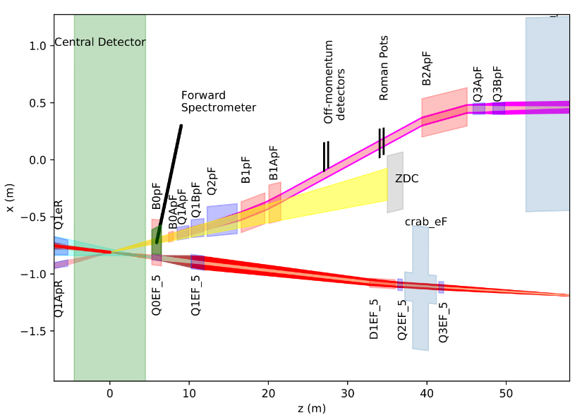
EIC IR: Forward Direction (RHIC sec5)
Requirements for hadron beam direction
  B0pF: Forward Spectrometer
  (6 - 20 mrad)
  Neutron Detector
  (+/-4 mrad)
  Roman pots
  (sensitive 1 to 5 mrad)
Mostly interleaved magnets
  Exception: B0 and Q1BpF/Q1eF
Large apertures of proton forward magnets
Hadrons
IP
Electrons
Name | R1 | length | B | grad | B pole
 | [m] | [m] | [T] | [T/m] | [T]
B0ApF | 0.043 | 0.6 | -3.3 | 0 | -3.3
Q1ApF | 0.056 | 1.46 | 0 | -72.608 | -4.066
Q1BpF | 0.078 | 1.61 | 0 | -66.18 | -5.162
Q2pF | 0.131 | 3.8 | 0 | 40.737 | 5.357
B1pF | 0.135 | 3 | -3.4 | 0 | -3.4

Slide 11
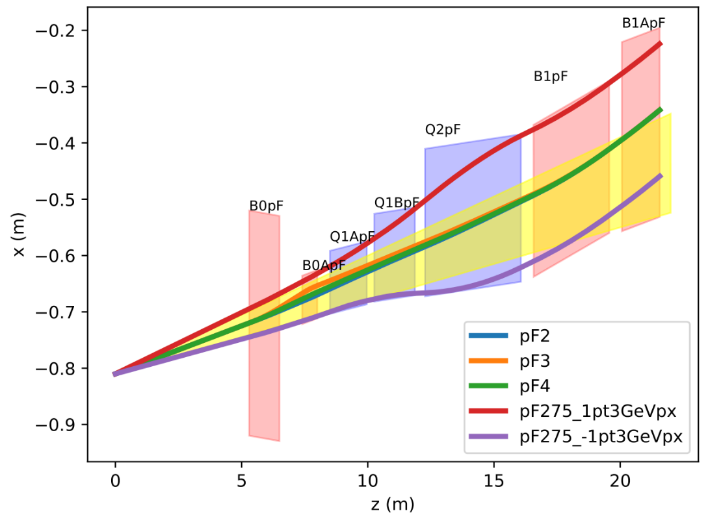
Hadron Forward - Apertures
Magnet aperture optimization:
Magnets tilted and displaced
Magnets split in two (e.g. Q1A and Q1B)
275 GeV
41 GeV
100 GeV

Slide 12
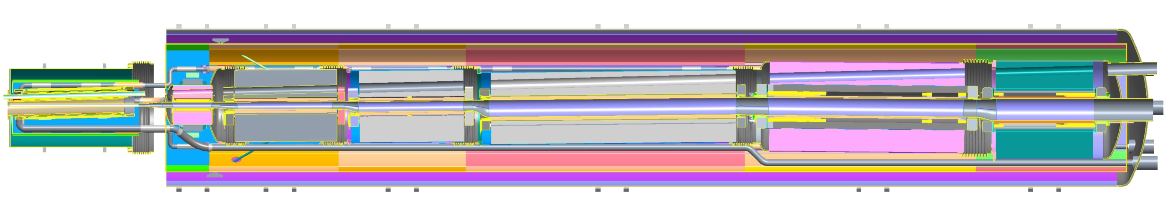
Forward Side, Two Cryostat Layout
Q0EF
Q1EF
Near IP End
Incoming Electron Beam
Outgoing Hadron Beam
B0PF
B0APF
Q1APF
Q1BPF
Q2PF
B1PF
B1APF
Highlights:
Final assembly will be done inside the RHIC tunnel.
Gaps between all magnets – space for coil leads (some nested in end plates), inner helium vessel welding.
Bellows between all cold masses, at outer yoke/shells – no positional shifting due to welding.

Slide 13
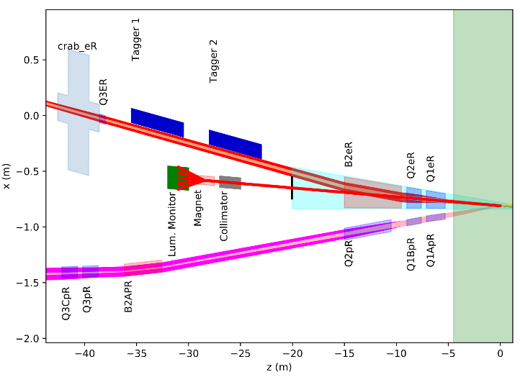
EIC IR: Rear Direction (RHIC sec6)
B2eR: separate photons from beam, separate low Q² electrons from beam
2-in-1 magnets
  Lepton magnet aperture defined by SynRad fan
  Hadron magnets: 10σ beam size aperture
Electrons
Bethe Heitler
Hadrons
Name | R1 | R2 | length | grad | B pole
 | [mm] | [mm] | [m] | [T/m] | [T]
Q1ApR | 20 | 26 | 1.8 | 78.4 | 2.0
Q1BpR | 28 | 28 | 1.4 | 78.4 | 2.2
Q2pR | 54 | 54 | 4.5 | 33.8 | 1.8
Name | R1 | R2 | length | B | grad | B pole
 | [mm] | [mm] | [m] | [T] | [T/m] | [T]
Q1eR | 66 | 79 | 1.8 | 0 | 14 | -1.1
Q2eR | 83 | 94 | 1.4 | 0 | 14.1 | 1.3
B2eR | 97 | 139 | 5.5 | 0.2 | 0 | -0.2

Slide 14
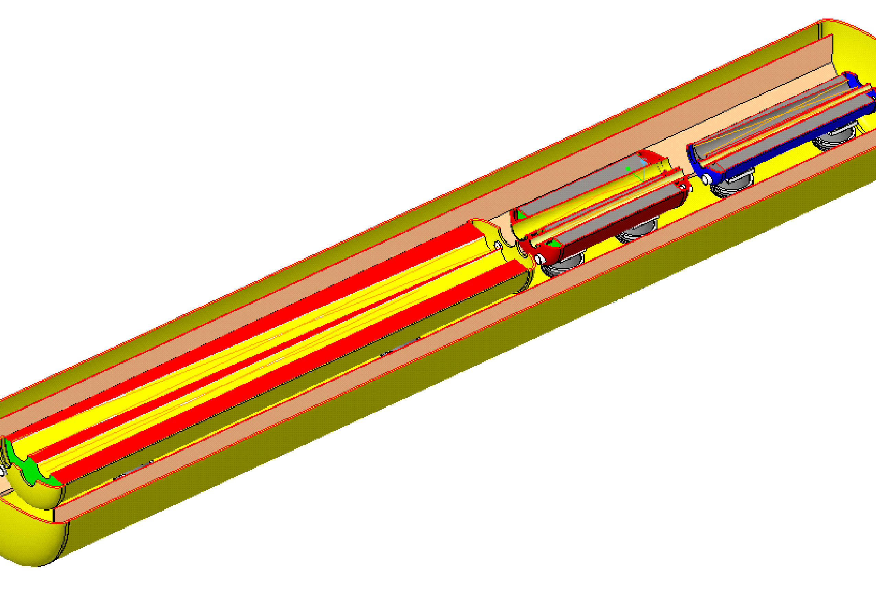
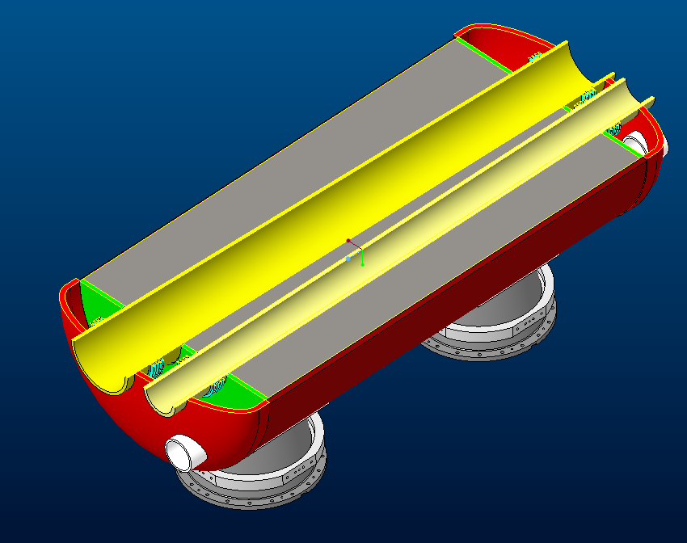
Rear Side Magnets, Cryostat Layout
Found that the space between rear elements is adequate.
Magnets in three separate helium vessels supported inside a common cryostat.
Near IP End
Electron Beam with Synrad
Hadron Beam
Helium Vessel Detail
Rear Cryostat Inside Tunnel
Electron Beam with Synrad
Hadron Beam

Slide 15
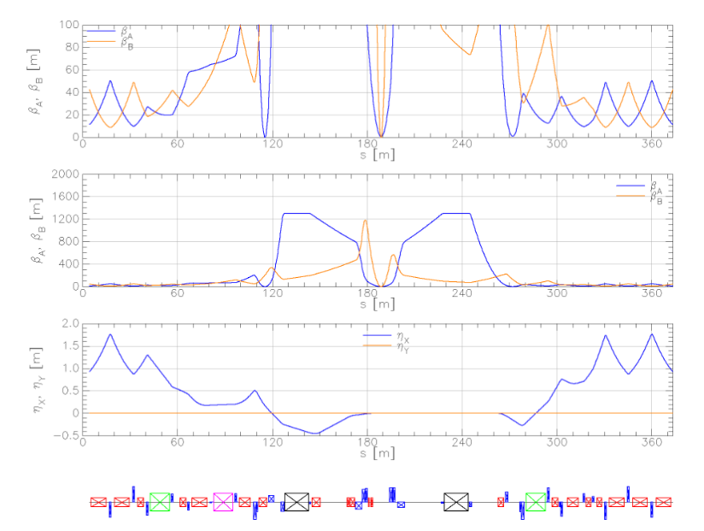
Match to Hadron Ring
β function
Forward and rear hadron lattice matched into RHIC/HSR
  Snake at correct angle
  95 mrad IP to rotator
  1300m at crab cavities
    Hor. phase advance 90º
Repurpose RHIC magnets
  Few additional magnets required
    Need to re-cryostat existing magnets
  New: 2 warm quads (5T/m)
Forward
Rear
Dispersion
Red: dipoles
Blue: Quads
Crab cavities
Rotators
275 GeV, β∗_{x} = 80 cm, and β∗_{y}=7.2 cm

Slide 16
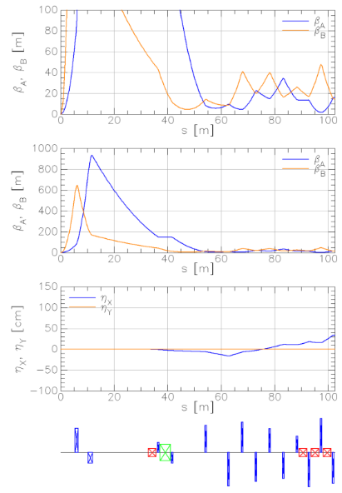
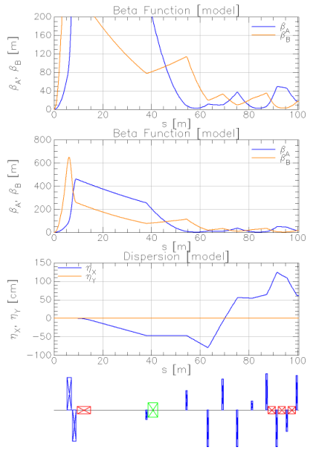
Match to Electron Lattice
Forward
Rear
IP
IP
Last dipole: 80mT
Matched into electron lattice
  150m β at crab cavities

Slide 17
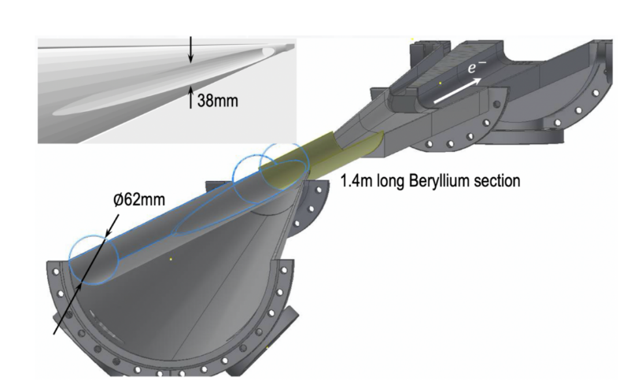


Central Vacuum Chamber
Real part of long. Impedance
Hadrons
Loss factor k_{loss} = 2.2mV/pC
Bunch length σ_{s} = 12mm
Total power loss = 262W
I_{avg} = 2.48A, N = 660, T_{o} = 12.79µs
Loss factor k_{loss} = 0.2mV/pC
Bunch length σ_{s} = 24mm
Total power loss = 30W
I_{avg} = 2.48A, N = 660, T_{o} = 12.79µs
Small diameter, thin walled Be in center region.
Smooth tapers and transitions to limit energy deposited by beam in trapped modes (wakes).
Considering HOM absorbers
$$P_{loss}=\frac{k_{loss}I_{av}^{2}T_{0}}{M}$$

Slide 18
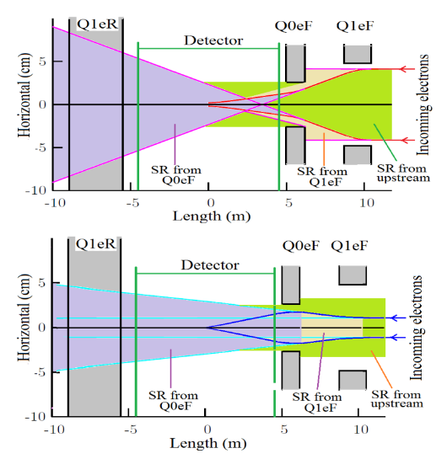
Synchrotron Radiation
Generated by quads and bending magnet upstream
Tails: can produce hard radiation
  Non-Gaussian
  Conventional collimators in the ESR
Aggressive collimation to a few sigma: extremely poor lifetime
Most radiation has to be passed through detector, absorbed far downstream to minimize backscatter
Photon absorber at -3.5 m from the IP (21/32 mm (h,v))
Preliminary studies of beam tails: 1-2h beam lifetime
  Detector backgrounds look acceptable
Synrad studies: using SYNC_BKG and Synrad3D
  Very good agreement

Slide 19
Summary
IR developed in collaboration with physics community
  Meets requirements of ‘white paper’
Lattices are stable
  Match into RHIC: recycle existing magnets
Synrad studies: masking scheme
  Reduces rear magnet apertures
IR Magnets
  Magnet and cryostat design mature

Slide 20
Thank you for your attention

Slide 21
Back-up Slides

Slide 22
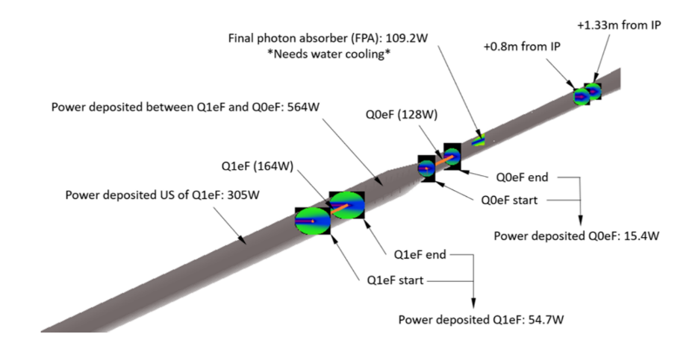
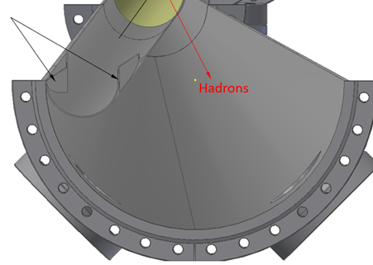
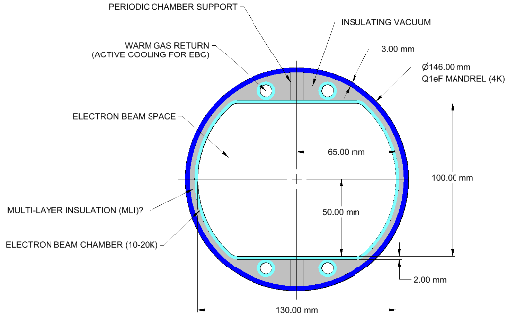
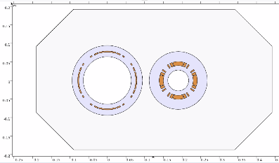
Synrad3D Studies
FPA
Cooling scheme
Q1BpR/Q2eR
FPA allows to reduce
Electron rear magnet apertures (18-20mm radially)
Non-tapered

Slide 23
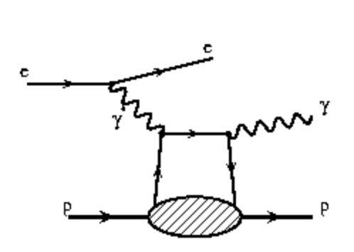
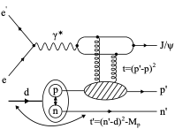
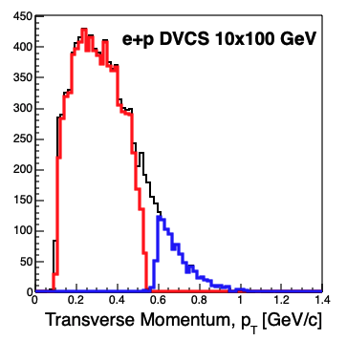
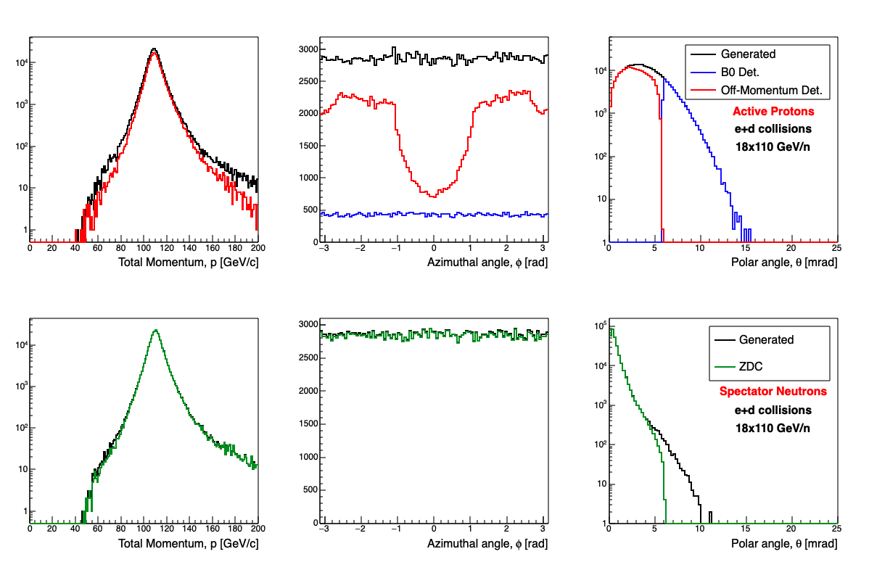
IR Simulations with GEANT4 for Various Physics Channels
Detector | Angular Accep. [mrad] | Pt coverage
ZDC @ ~30m | 𝜽 < 5.5 (𝜂 > 6) | pT<1.3 GeV
Roman Pots | 0.0* < 𝜽 < 5.0 (𝜂 > 6) | Low pT (t) (*cutoff driven by beam optics)
Off-Momentum Detectors | 0.0 < 𝜽 < 5.0 (𝜂 > 6) | Low-rigidity particles from nuclear breakup
B0-Forward spectrometer | 5.5 < 𝜽 < 20.0 (4.6 < 𝜂 < 5.9) | High pT (t)
e+d exclusive J/Psi with proton/neutron tagging:
DVCS with proton tagging:
Generated
Roman Pots
B0 Det.
Three of the four subsystems needed to cover the full acceptance range for e+d!
Both Roman Pots and B0-Det. needed to cover the full acceptance for forward protons from DVCS!

Slide 24
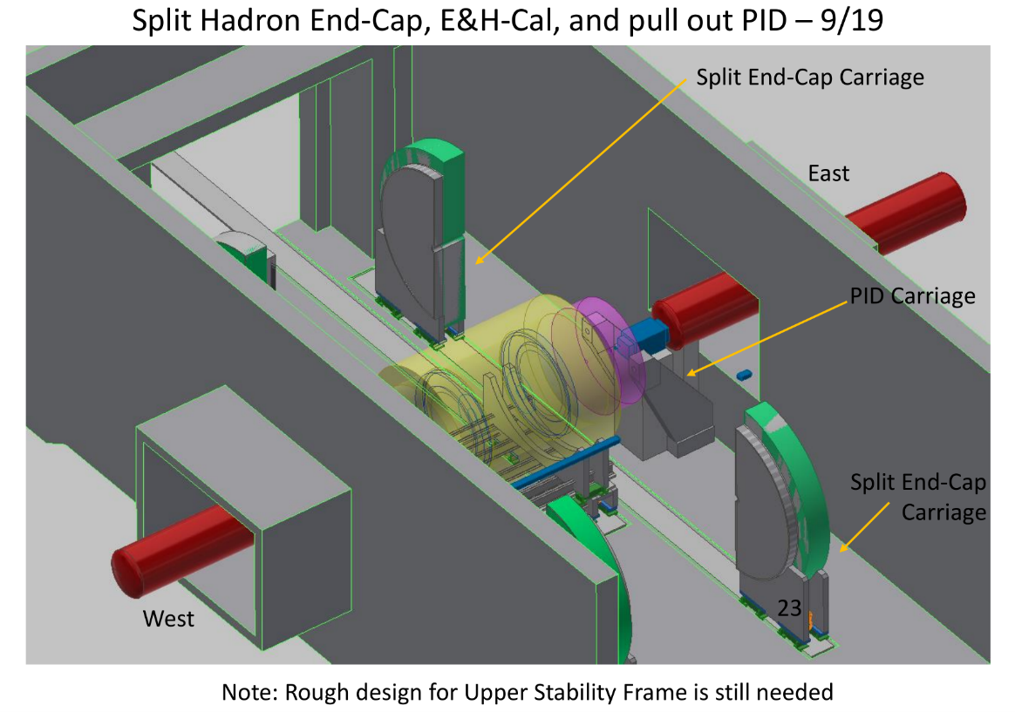
EIC Detector Infrastructure

