Slide 1
Discussion of Yellow Report Content - Tracking
with focus on two detector baselines
Leo Greiner, Domenico Elia, Kondo Gnanvo

Slide 2
Two baseline detector designs
This is not a new or even original idea – just one worth pursuing
A “hybrid” tracking detector (silicon + TPC + End Cap GEM layers) is part of the original BEAST concept and is the traditional configuration for general purpose HI collider detectors.
All silicon tracking options have been proposed since the beginning of EIC development (e.g. TOPSiDE) and developed in ERD16, ERD18 in the MAPS technology.
In YR process, mention made at Pavia meeting:
Ernst Sichtermann et.al.
https://indico.bnl.gov/event/8231/contributions/37776/attachments/28208/43596/Pavia.OpenMIC.Contributions.pdf
Endcap GEMs not included in the simulation

Slide 3
Two baseline detector designs
The concept of two possible baseline detectors (all-silicon and hybrid) has continued to be developed during the YR process in the tracking workgroup.
We now have optimized baseline layouts for both configurations.
The YR contains both options as baseline detector configurations.
The simulations for both have been completed in the barrel region (-1 < eta < 1) to a level that allows the performance characteristics to be assessed and compared to the physics derived requirements for most quantities. Preliminary performance studies in the forward/backward regions available, need to be finalized/completed by including further options (MPGDs) in the simulation. Coverage is provided for |eta|≤ 3.5
The concepts have been simulated based on ALICE ITS3 type sensors.
A number of options are presented for the gaseous detector in the hybrid versions.
Domenico’s
talk

Slide 4
Why present two baseline detector designs?
Both designs mostly meet the requirements in the physics requirements matrix.
Selection will likely be based on factors that are an optimization of the whole EIC detector design e.g. magnet size and field, PID considerations, cost, relative importance of compactness in a tracking detector design, etc.
The different characteristics will be useful in the complementarity studies and in the process of the development of a detector for the second interaction region.
Based on this, it is worthwhile to take another look at the tracking technology options as they relate to overall detector design.

Slide 5
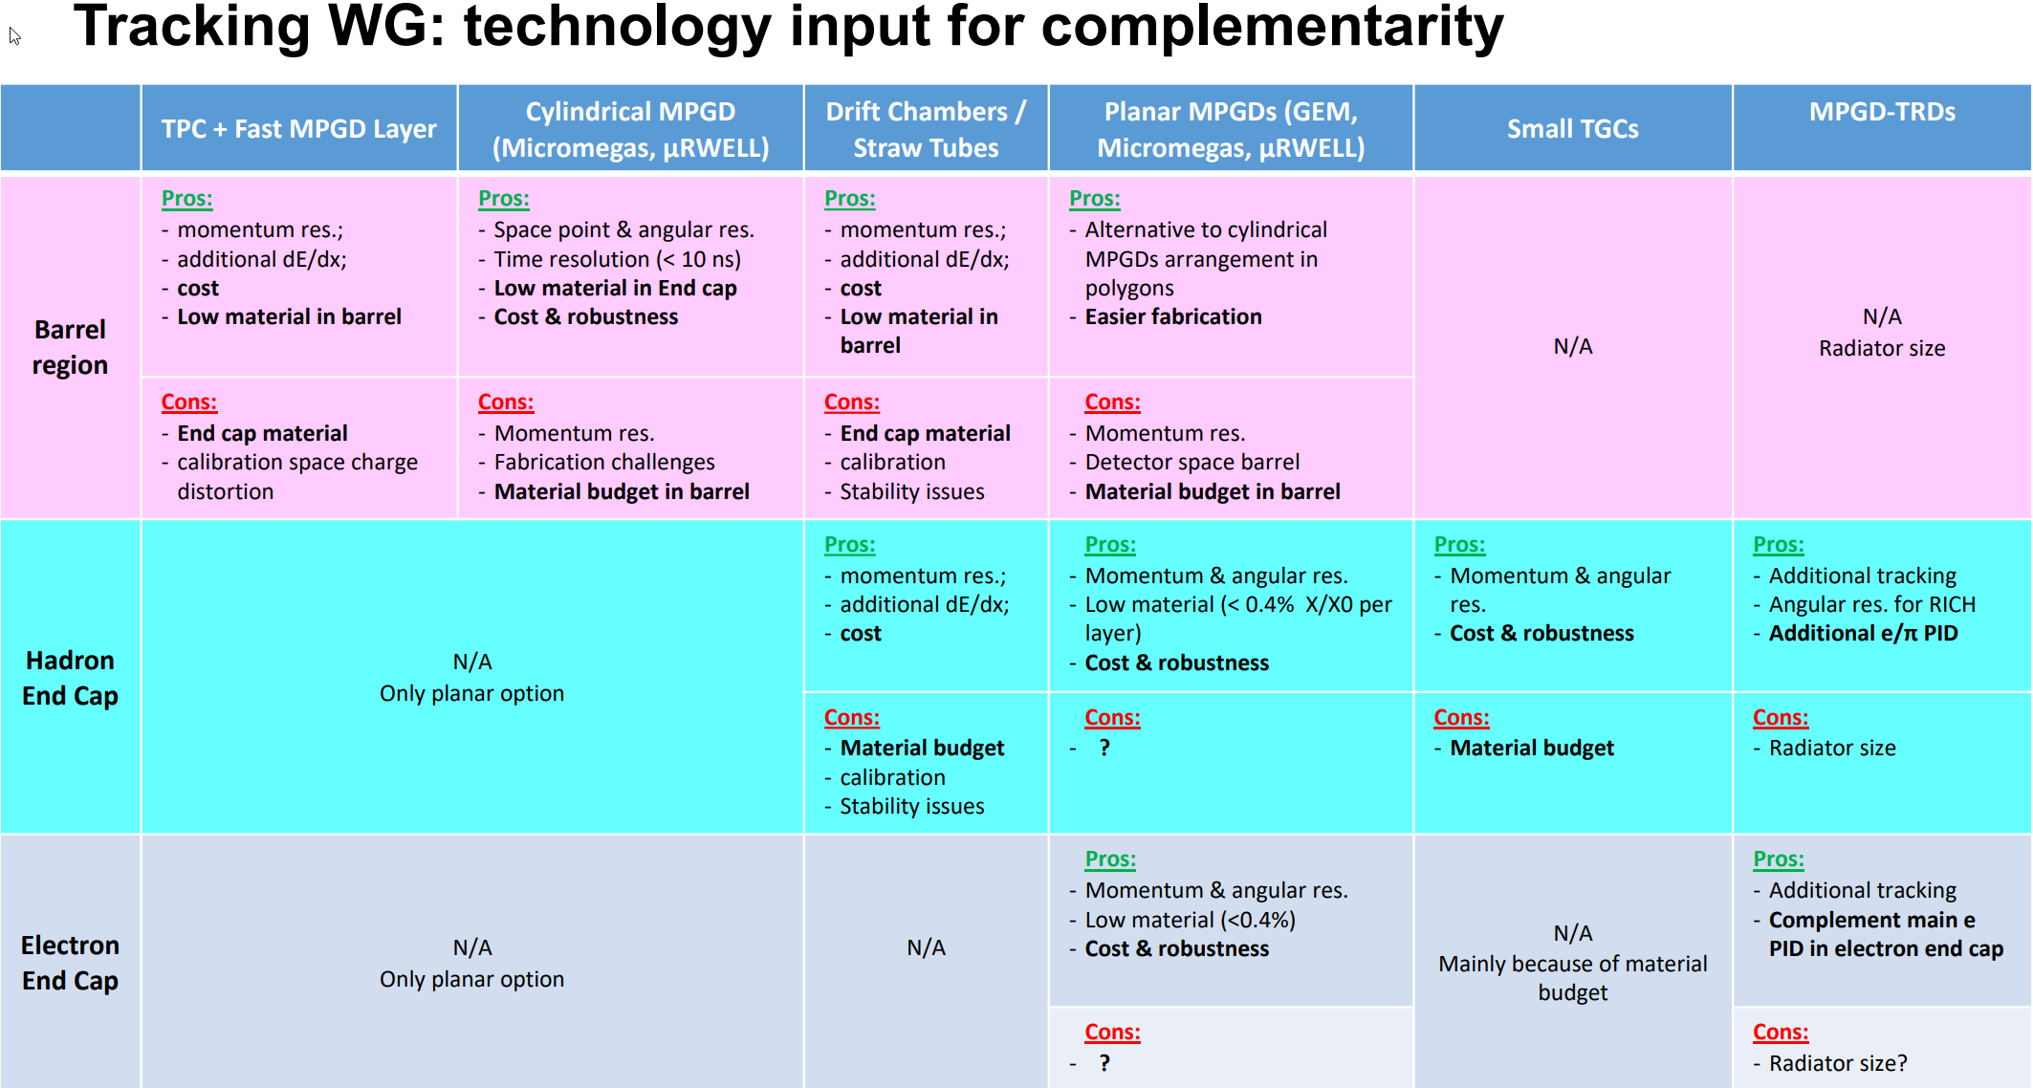
Technology Options and Attributes
In the Pavia meeting the tracking group presented a technology summary as it relates to complimentarity
(YES – too small to read)
https://indico.bnl.gov/event/8231/contributions/37908/attachments/28346/43620/2020_05_21_tracking_summary.pdf
These assessments have been updated and are on the following slides

Slide 6
Gaseous tracking technology options
 | TPC + Fast MPGD Layer | Cylindrical MPGD (Micromegas, µRWELL) | Drift Chambers / Straw Tubes | Planar MPGDs (GEM, Micromegas, µRWELL) | Small TGCs | MPGD-TRDs
Barrel region | Pros: momentum res.; additional dE/dx; cost Low material in barrel | Pros: Space point & angular res. Time resolution (< 10 ns) Low material in End cap Cost & robustness | Pros: momentum res.; additional dE/dx; cost Low material in barrel | Pros: Alternative to cylindrical MPGDs arrangement in polygons Easier fabrication | N/A | N/A Radiator size
 | Cons: End cap material calibration space charge distortion | Cons: Momentum res. Fabrication challenges Material budget in barrel | Cons: End cap material calibration Stability issues | Cons: Momentum res. Detector space barrel Material budget in barrel
Hadron End Cap | N/A Only planar option |  | Pros: momentum res.; additional dE/dx; cost | Pros: Momentum & angular res. Low material (< 0.4X0 layer) Cost & robustness | Pros: Momentum & angular res. Cost & robustness | Pros: Additional tracking Angular res. for RICH Additional e/π PID
 |  |  | Cons: Material budget calibration Stability issues | Cons: ? | Cons: Material budget | Cons: Available space i.e. radiator thickness
Electron End Cap | N/A Only planar option |  | N/A | Pros: Momentum & angular res. Low material (<0.4%) Cost & robustness | N/A Mainly because of material budget | Pros: Additional tracking Complement main e PID in electron end cap
 |  |  |  | Cons: ? |  | Cons: Available space i.e. radiator thickness

Slide 7
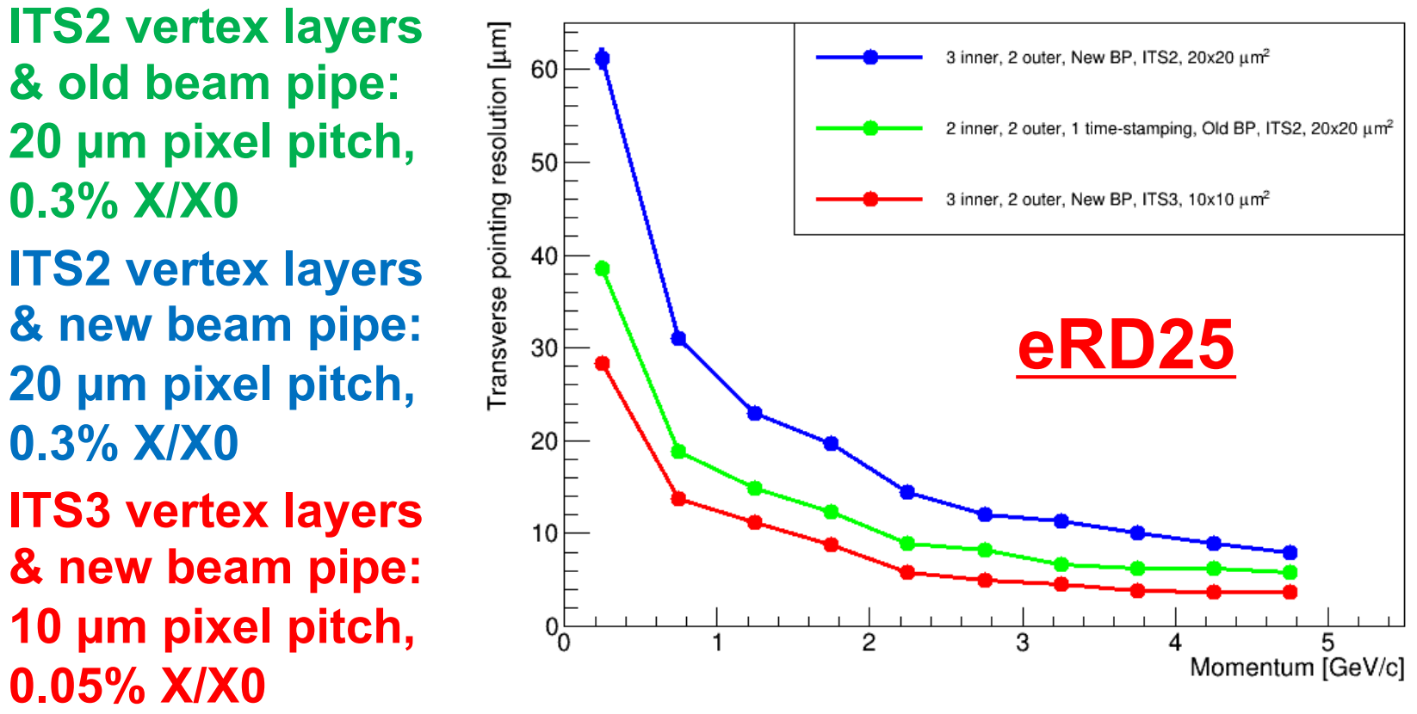
Inner Tracking Silicon technology options
Tracking WG: technology input for complementarity - Silicon
For the vertex, barrel and inner disc detectors, the only identified technology that meets the requirements are MAPS.
ALPIDE is the only existing MAPS sensor candidate that is available for use now or with planned availability within the next 1-2 years. All others are in prototype status. No currently existing MAPS sensor appears to fully meet all of the EIC requirements (early simulations were based on ALPIDE sensors with a smaller pixel size 20 um^2, current are 10 um^2).
In order to produce a new sensor design that meets the EIC requirements a consortium of EIC groups have joined the ongoing sensor development effort for ALICE ITS3 at CERN.
There are contingency (paths in both ITS3 and EIC Silicon Consortium) plans for modification of existing sensor designs to meet EIC requirements should this CERN effort be unsuccessful. Until the project reaches the point where it needs to commit to a particular sensor, it is prudent to monitor sensor progress in other technologies (180nm MAPS, SOI, LGAD, etc.) in order to be in a position to make the best sensor choice for EIC tracking. This is detailed in YR Ch. 14.
Studies have been carried out in the tracking workgroup on the effects of pixel size on pointing and momentum resolution for a variety of pixel sizes.
https://wiki.bnl.gov/conferences/images/1/1c/ERD25-proposal-Jul20.pdf

Slide 8
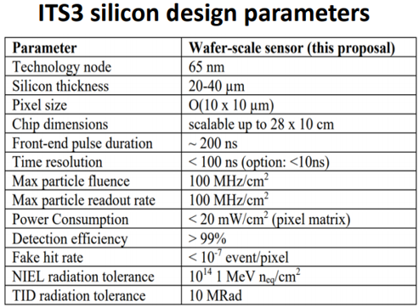
Inner Tracking Silicon technology options
Tracking detector component | Stave X/X0
ITS3 like vertexing | 0.05-0.1%
ITS3 like barrel (up to 1.5 m length) | 0.55%
ITS3 like disc (up to 60 cm diameter) | 0.24%
 | Si + gaseous | All Si
Attributes for consideration | dE/dx in gas for PID (TPC) Well understood technology - less R&D needed. Costs less (likely) Less material in tracking region but more in the endcap region. Worse single point resolution but more position samples | Readout faster than TPC Better momentum resolution than TPC at higher momentum (>~5GeV/c) Can be made more compact Less material in endcap regions Very high single point resolution

Slide 9
Mix and Match for overall detector optimizations
All of these considerations are linked and require optimizations to drive the particular complementarity in the physics topics that will be addressed.
In addition to the two baseline tracking detector configurations addressed in the YR we could consider:
All silicon option in existing Babar magnet with additional PID (possibly high pressure gas Cerenkov in the space gained from the more compact silicon tracking)
Compact new magnet at 2-3 Tesla using all silicon option – smaller detector overall (possible cost savings) better momentum performance, may limit some PID options, etc.
Etc., etc., etc.
This is a large parameter space just in tracking and when the other detector systems are included it becomes too large and interrelated to present in a slide format.
The approach of the tracking group was to deliver baseline simulations for the two different optimized detector configurations and at two magnetic field settings so that the strengths/weaknesses of various large feature combinations could be judged in the context of prioritized physics goals.
“Final” configurations again will be driven by what overall detector optimizations make sense in the context of performance in specific physics topics and complementarity. We hope that the inclusion of the baseline performance simulations will help stimulate this discussion.

Slide 10
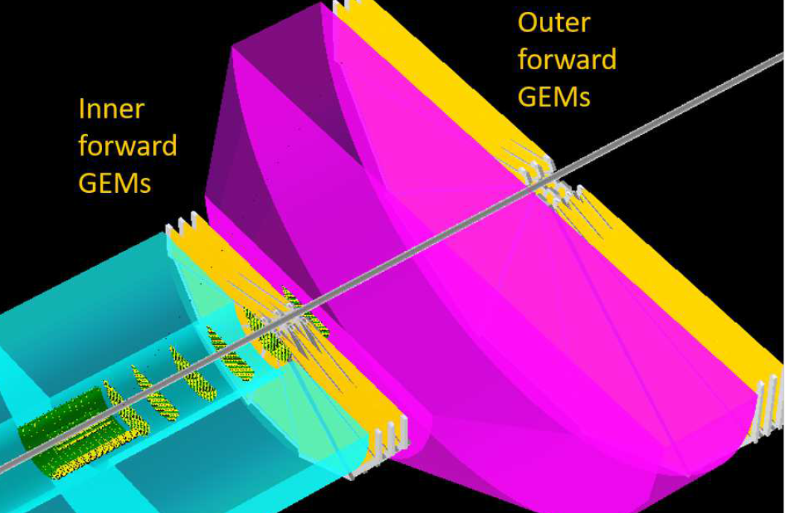
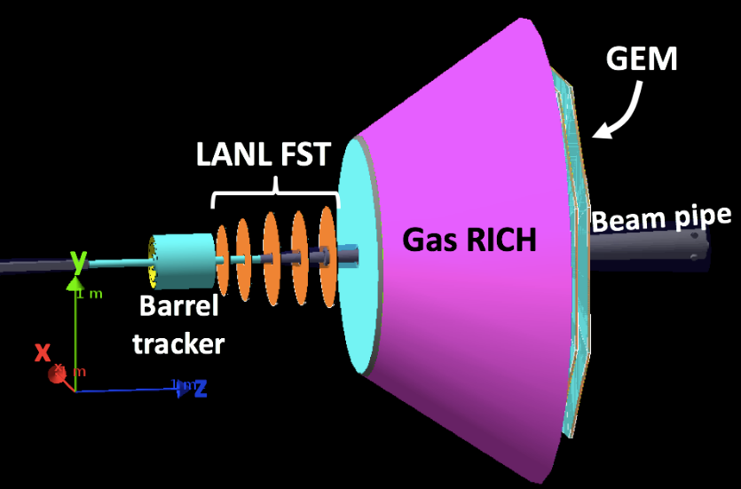
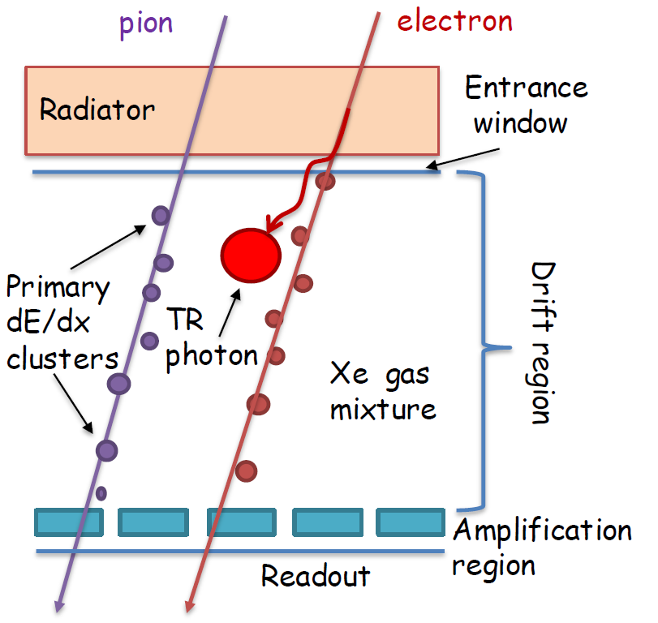
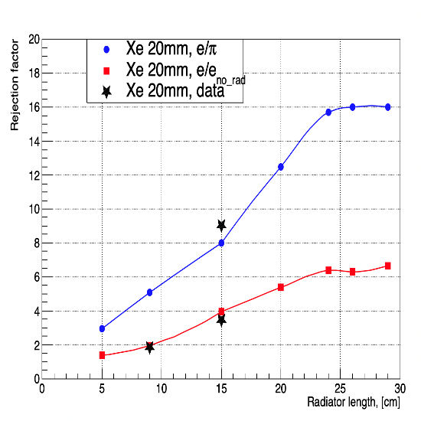
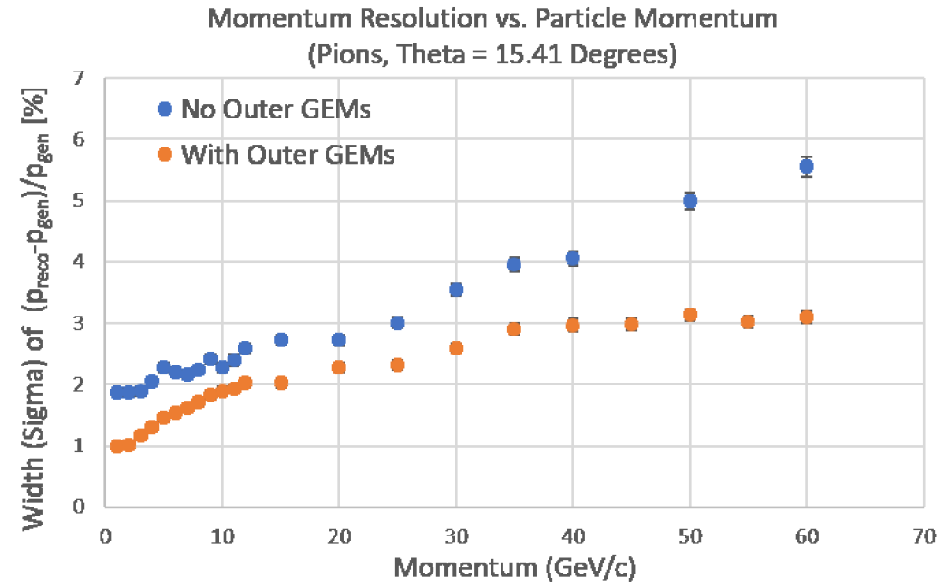
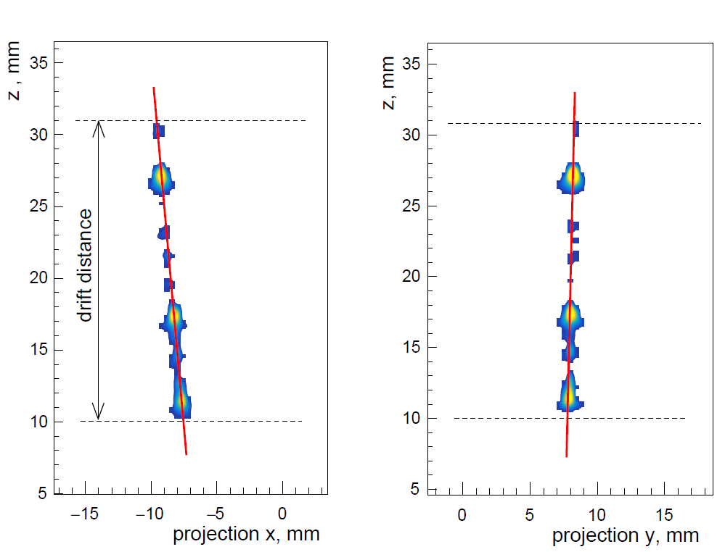
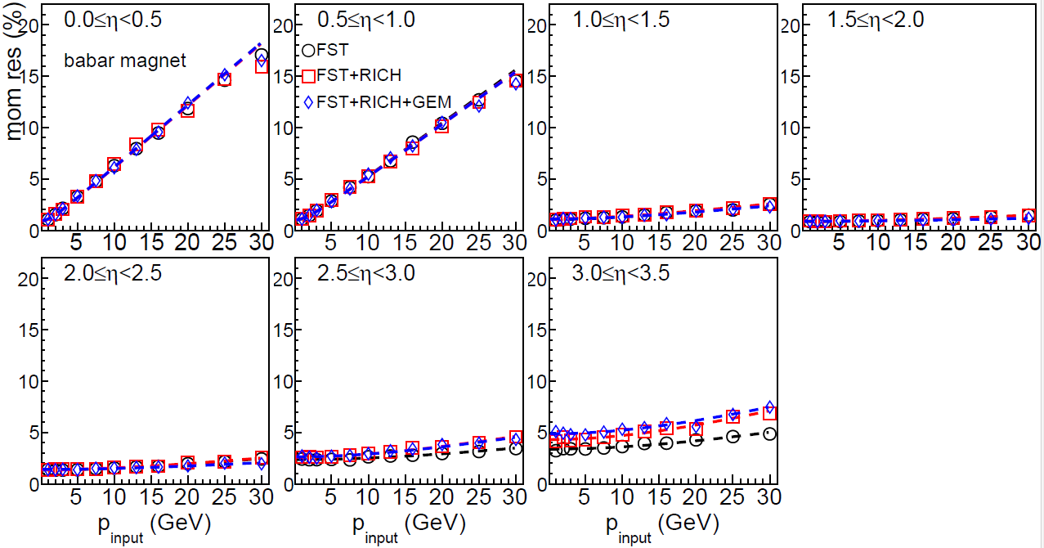
The Case for MPGD Trackers behind the dRICH in the Hadron End Cap
Hybrid option: Preliminary studies at FIT
“All Silicon” option: LANL studies at FIT
GEM-TRD-T: e-π separation - JLab test beam
Improved momentum resolution
Replacing Si-disks with GEM: no negative impact on momentum resolution
Provide additional Tracking in µTPC mode

Slide 11
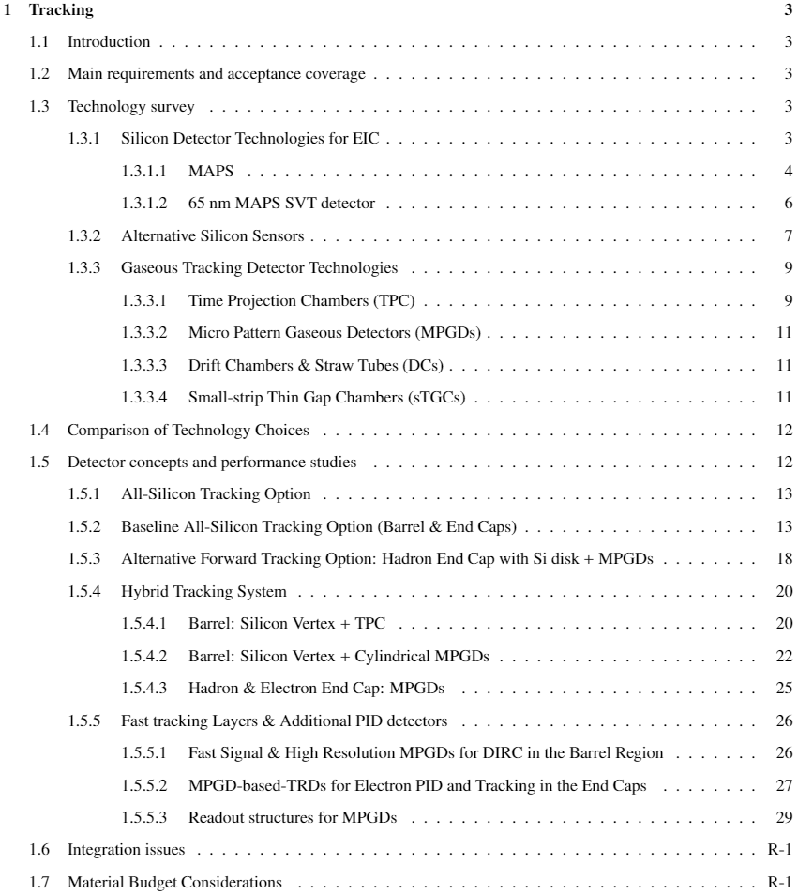
Tracking Section Contents

Slide 12
backup

Slide 13
Summary of ITS3 like Si tracking
stave
 | Stave X/X0 | Stave transition (per 100 cm^2 of Si surface) | Services (per 100 cm^2 of Si surface) | Patch panel (per 100 cm^2 of Si surface)
ITS3 like vertexing | ~0.5 – 0.1% | 6.66 cm^3 of material with X/X0 of 0.031 per traversed cm | 2.96 cm^2 cross section with X/X0 of 0.002 per traversed cm | 4.32 cm x 1cm x 1 cm with 0.03423 X/X0 per traversed cm
ITS3 like barrel (up to 1.5m length) | 0.55 % | 4.286 cm^3 of material with X/X0 of 0.0306 per traversed cm | 1.905 cm^2 cross section with X/X0 of 0.002 per traversed cm | 2.778cm x 1cm x 1 cm with 0.03423 X/X0 per traversed cm
ITS3 like disc (up to 60 cm diameter) | 0.24% | 6.66 cm^3 of material with X/X0 of 0.031 per traversed cm | 2.96 cm^2 cross section with X/X0 of 0.002 per traversed cm | 4.321 cm x 1cm x 1 cm with 0.03423 X/X0 per traversed cm
Stave
transition
services
Patch panel

Slide 14
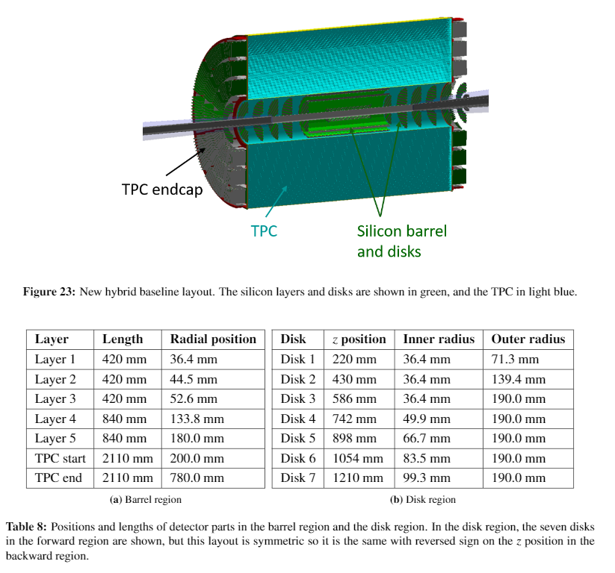
Hybrid detector baseline detector layout
Hybrid tracking detector layout taken from the current draft of the YR.

Slide 15
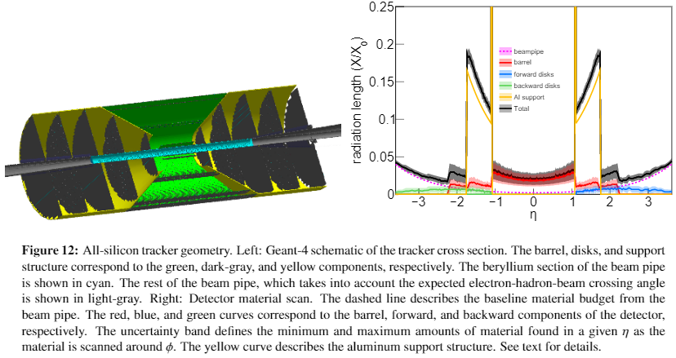
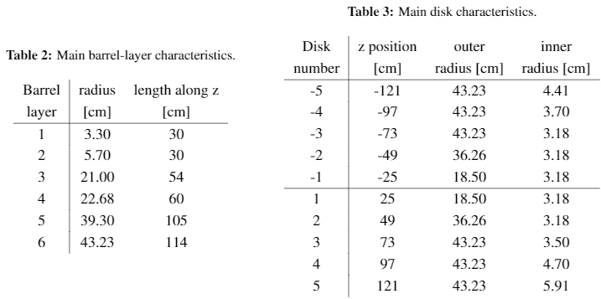
All-silicon baseline detector design
All-silicon tracking detector layout taken from the current draft of the YR.

Slide 16
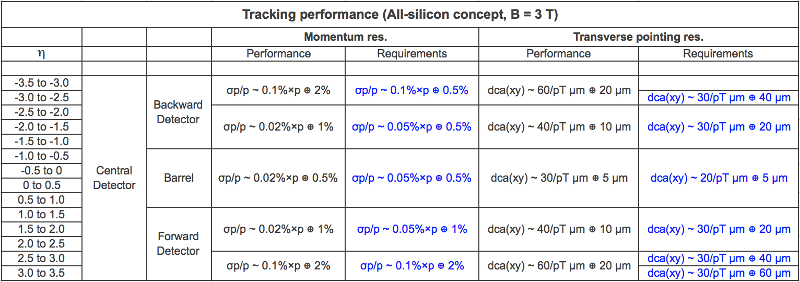
Comparison with requirements
ALL-SILICON tracking system:

Slide 17
Comparison with requirements
ALL-SILICON tracking system:

Slide 18
Comparison with requirements
HYBRID tracking system:

Slide 19
Comparison with requirements
HYBRID tracking system:

