Slide 1
PID in the Yellow Report Status and Beyond
TK Hemmick P Rossi

Slide 2
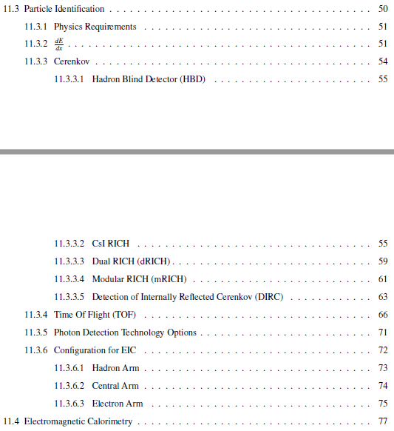
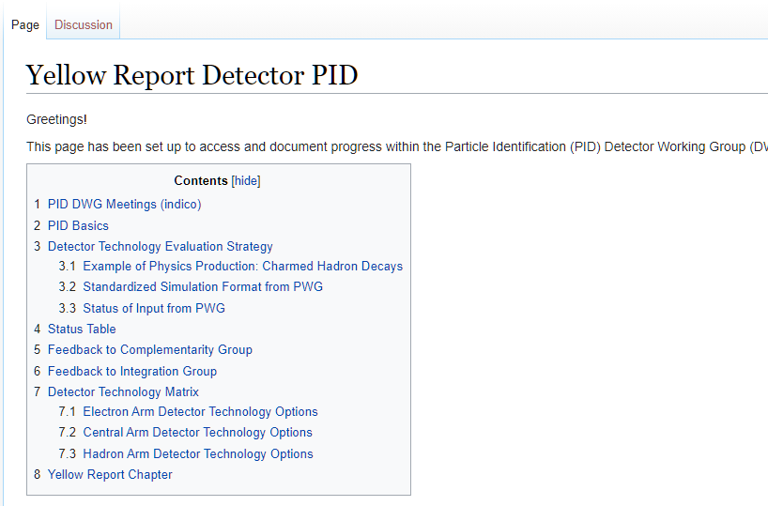
Outline
Two basic sections:
Technologies Summary
Match of technology to needs.
Information Gleaned from two basic sources:
PID Presentations: https://indico.bnl.gov/category/277/
PID Wiki Page(s): https://wiki.bnl.gov/eicug/index.php/Yellow_Report_Detector_PID
Tech
Match

Slide 3
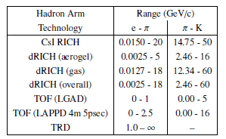
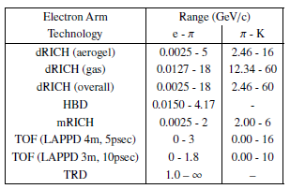
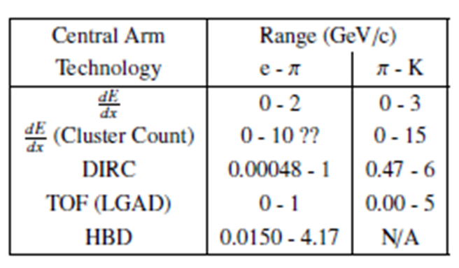
Status of the PID Section
Draft is ~Complete.
Some typos are known and will be addressed when unfrozen.
Some places where the clarity of text should be improved.
Improve referencing to physics section to minimize duplication.
Stylistic uniformity pass required.
Figure captions need to be more elaborated
Assumptions/details column required in performance summary tables.
References need throughout.
DRAFT

Slide 4
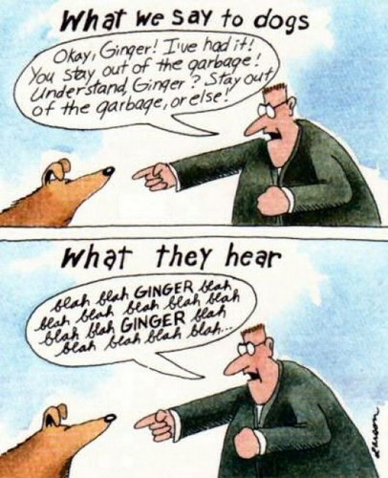
Reference Detector and Beyond
What Co-Convenors Hear
PID
PID
Much discussion yesterday:
Solid case for:
Detailed simulation to learn “Full Limits”
Future R&D:
Continued improvements of existing tech.
Development of new concepts

Slide 5
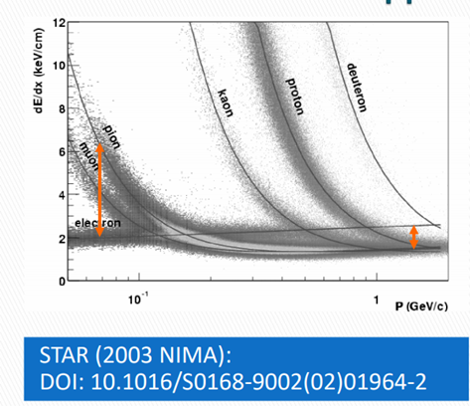
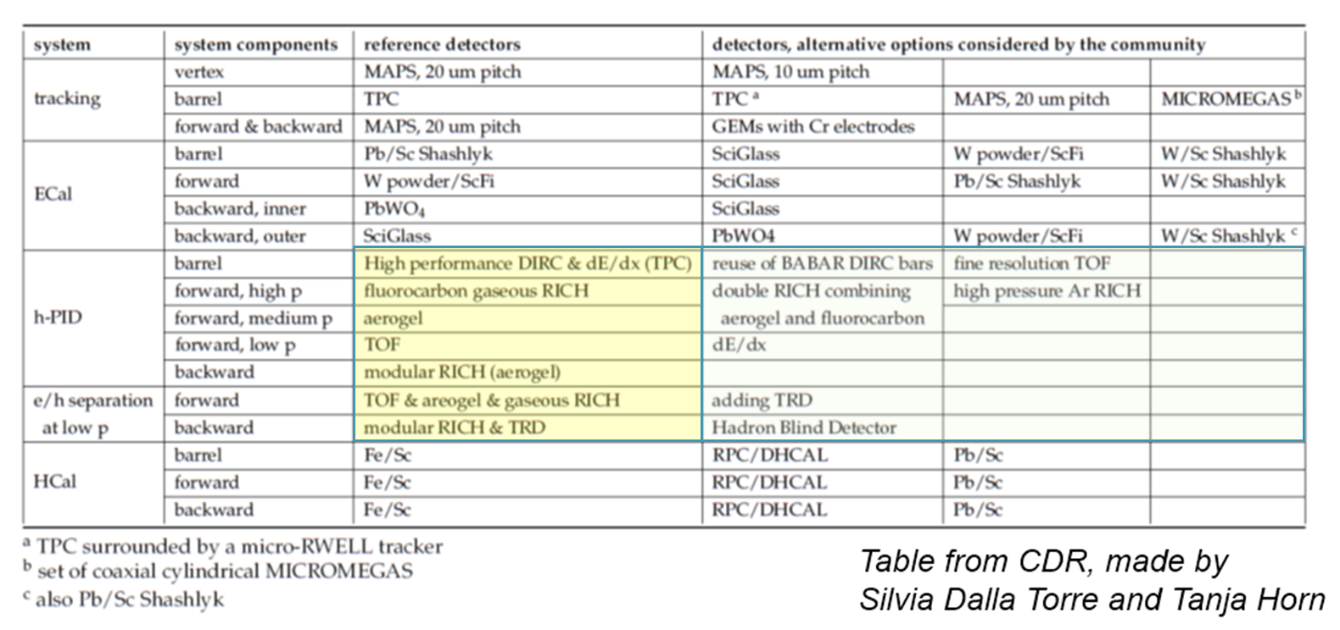
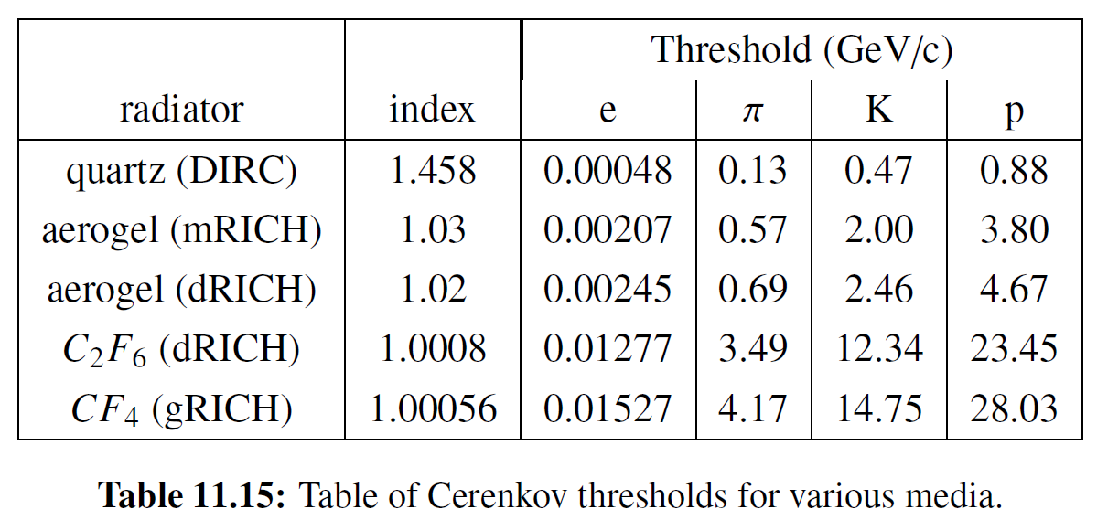
Reference Detector PID
β ~ 0.7
Rolf’s Presentation Yesterday
PID often requires a multi-detector approach in each aperture.
Many technologies have a “band” sensitivity:
dE/dx band crossings greatly assisted by TOF.
hID Cherenkov is complete only above Kaon threshold (K-proton separation)

Slide 6
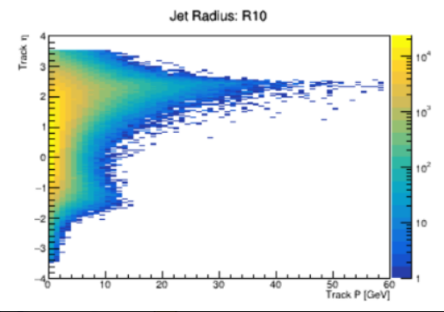
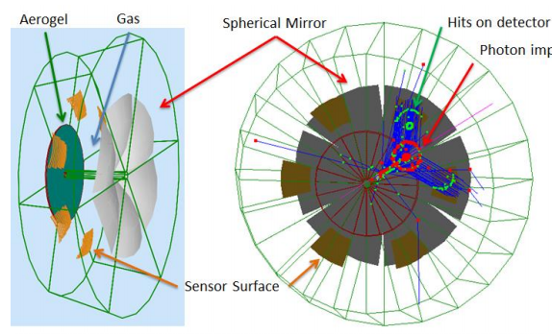
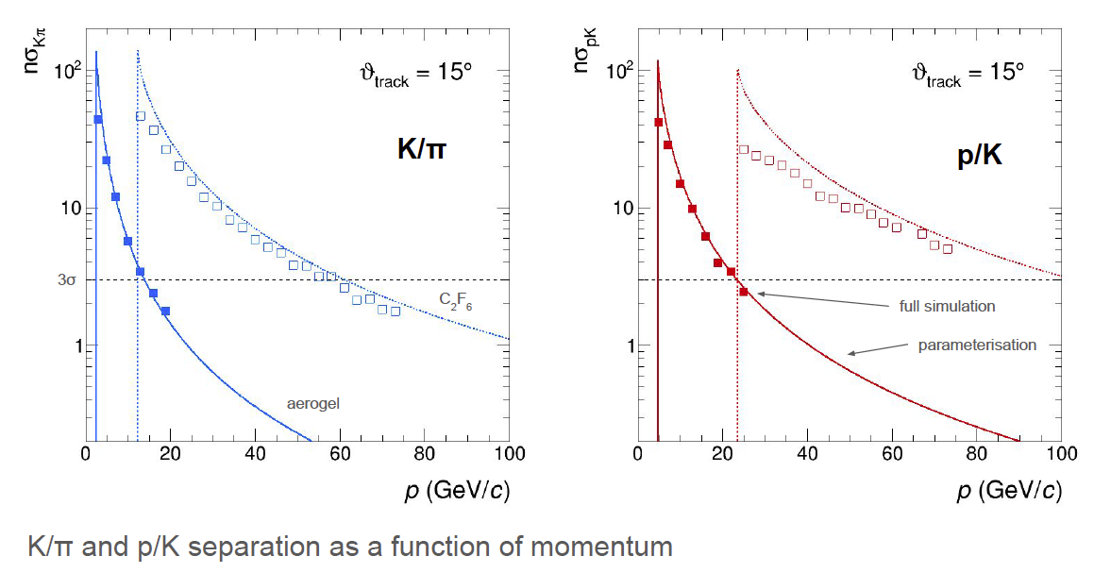
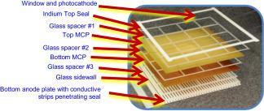
Forward Direction
LAPPD - TOF
Current World’s Best Timing
Cherenkov is only route to PID at extreme momentum.
Layered indices to combat high threshold in low index material.
Dual-RICH internally does two ranges.
LAPPD is present best TOF (OK in end caps, B-field trouble in barrel).

Slide 7
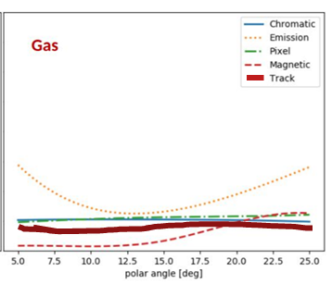
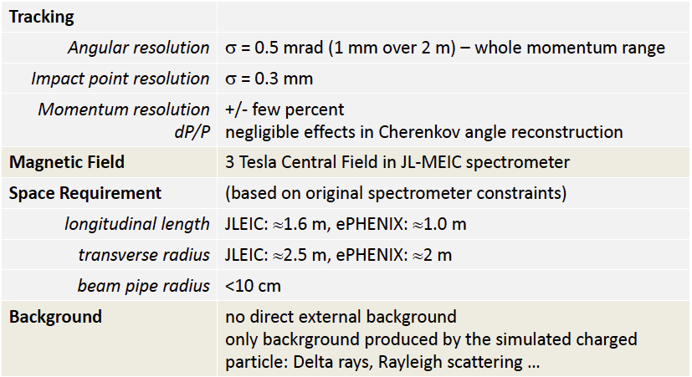
Hadron End: Dual RICH
Cherenkov radiator
○ Refractive Index
n = 1.02 (aerogel) 1.0008 (C₂F₆)
○ Length of the radiator
L = 4 cm (aerogel) , 160 cm (C₂F₆)
Mirrors
Photon Detector
3 mm pixel size; 200-500 nm MAPMT
Particle Generation
Originate from the vertex
Exquisite detail in simulation.
AI-based optimization.
Uses constant external angular resolution assumption.
Similar external constraint assumed as deduced for separate gas & aerogel RICHes
Tracking maybe tolerates ~2X sim (0.5 – 1.0 mrad)
NOTE: PMTs to the side makes optical aberration (“Emission”) dominant

Slide 8
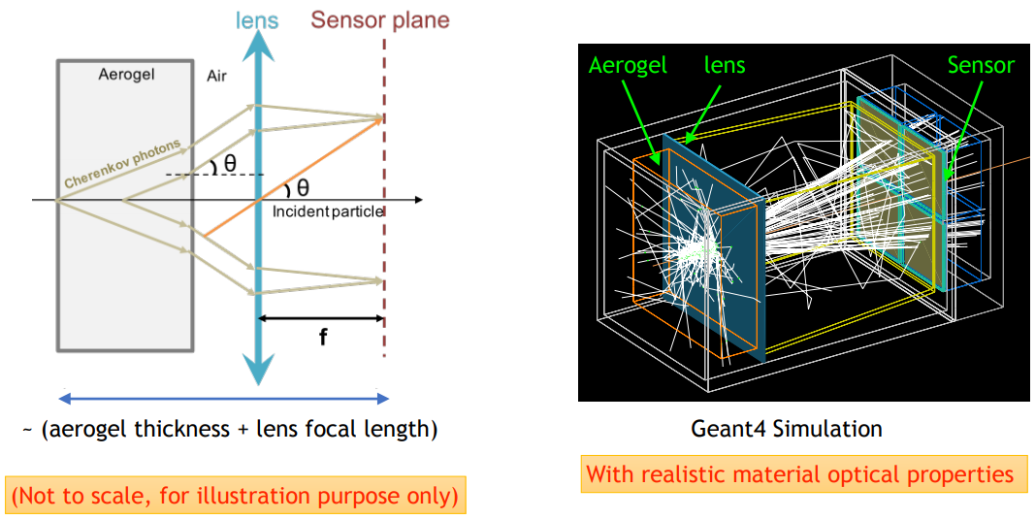
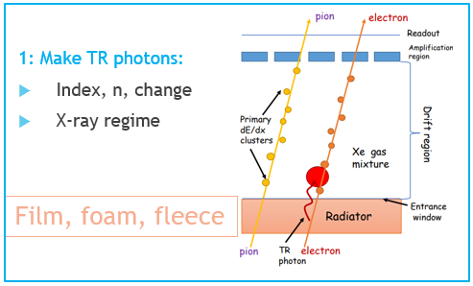
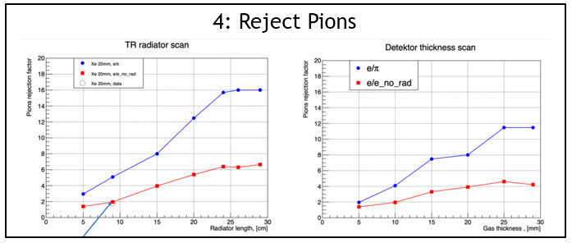
Backward Direction
mRICH viable in Forward and Backward.
Aerogel radiator “medium” momentum.
dRICH great performance, but space-challenged.

Slide 9
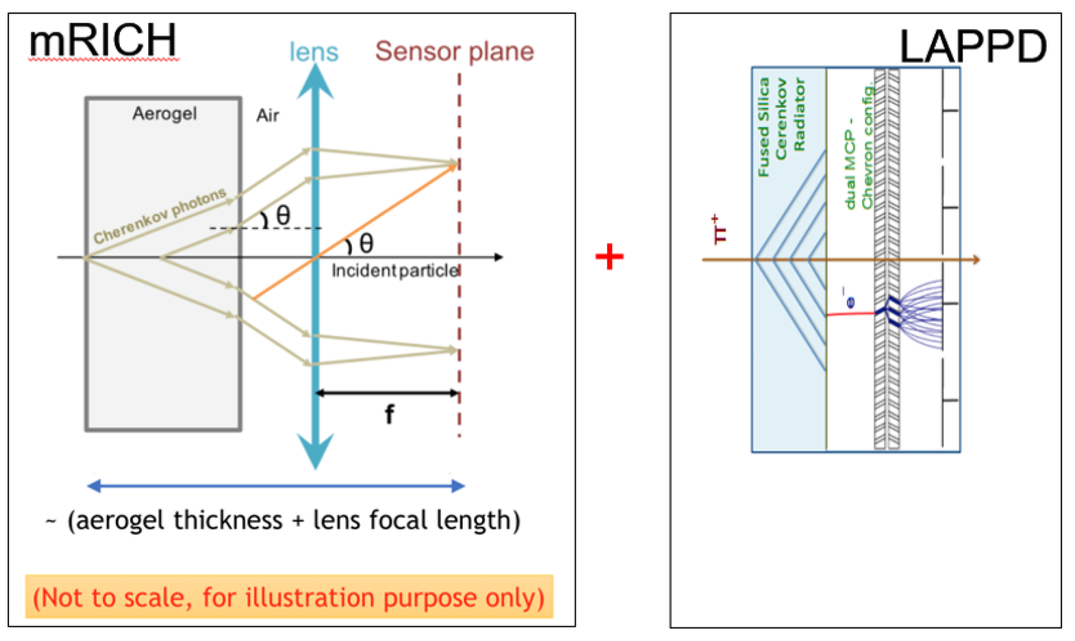
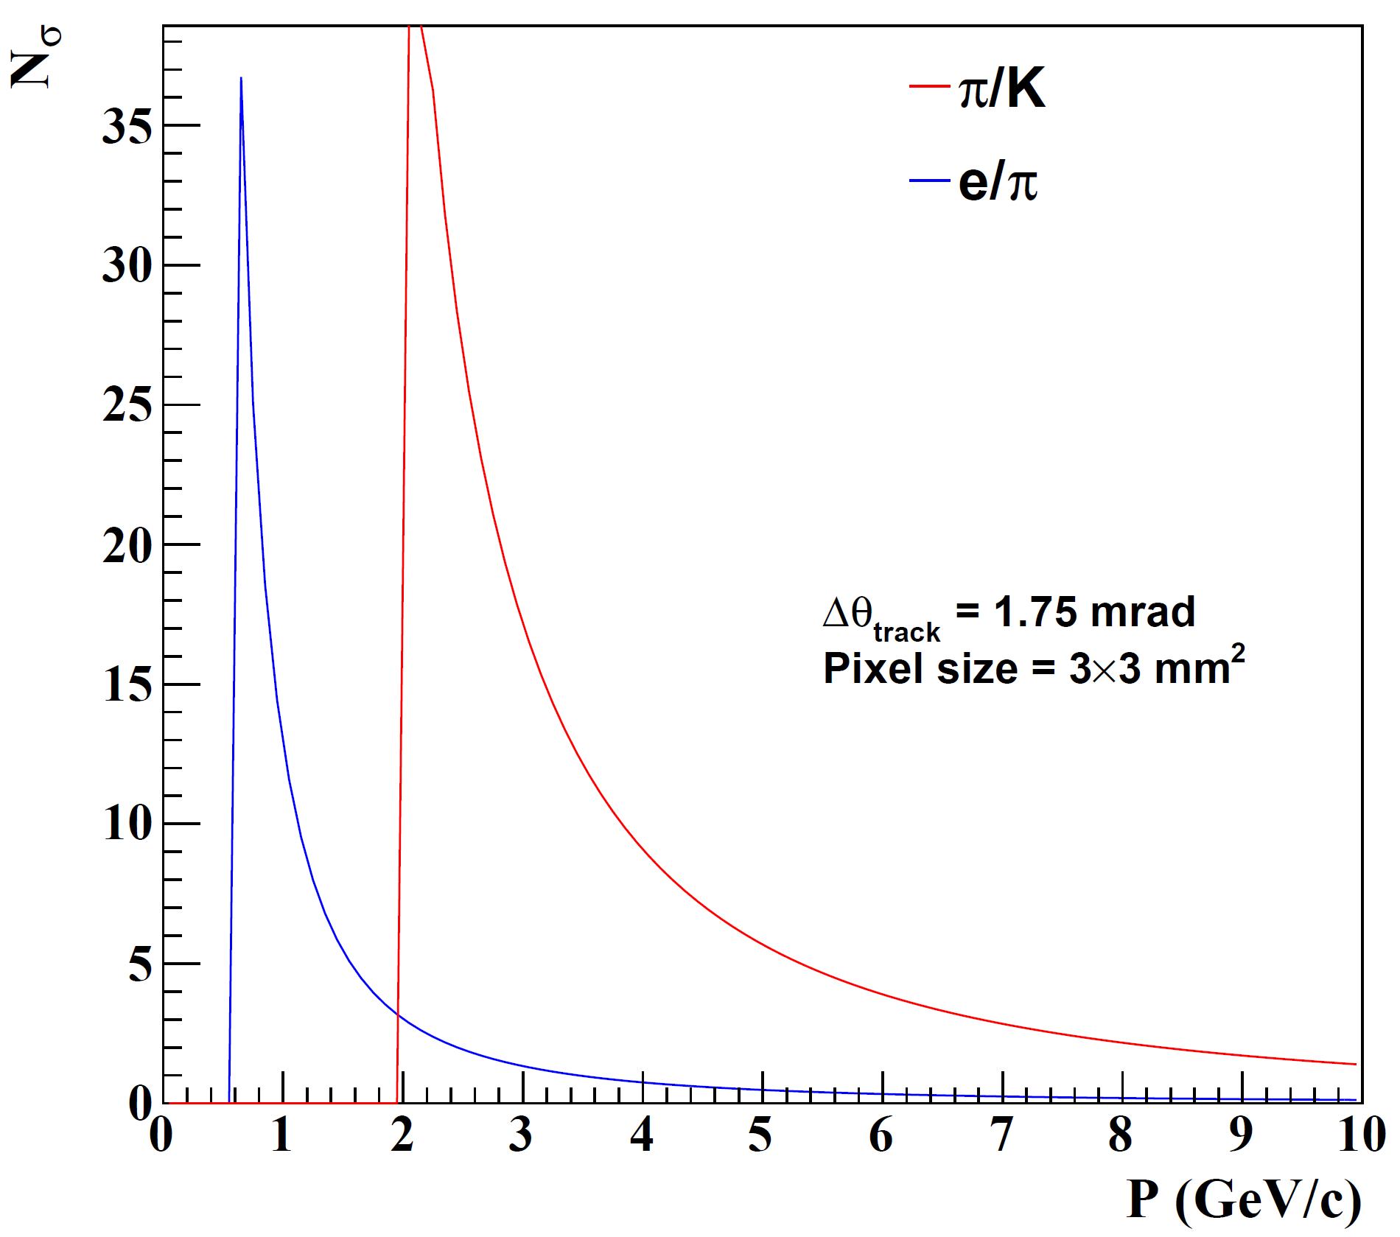
Electron Arm: Modular RICH
Cherenkov radiator
(Aerogel) refractive index, n = 1.03
Length of the radiator, L = 3cm
lens with focal length, 𝑓= 6”
Photon Detector
3 mm pixel size
Intrinsic TOF
Hadron ID requirements relaxed…aerogel only
Additionally require eID ~ 4GeV/c
Modular RICH focused by Fresnel Lens
Sharp image improves resolution.
Transmission of lens combats dispersion
Provides TOF with suitable readout device (LAPPD)
NOTE: Similar performance to aerogel in dRICH

Slide 10
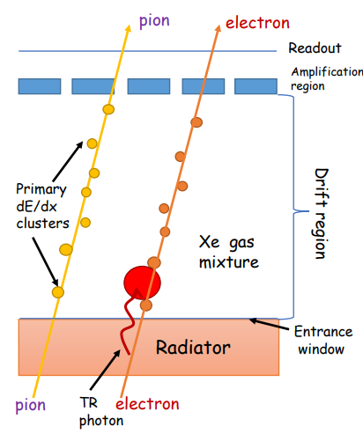
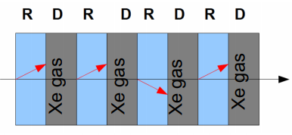
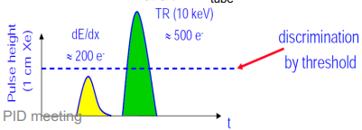
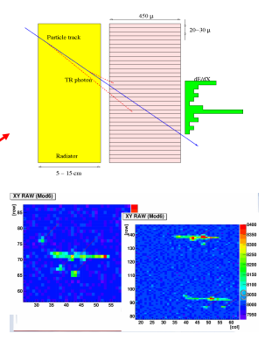
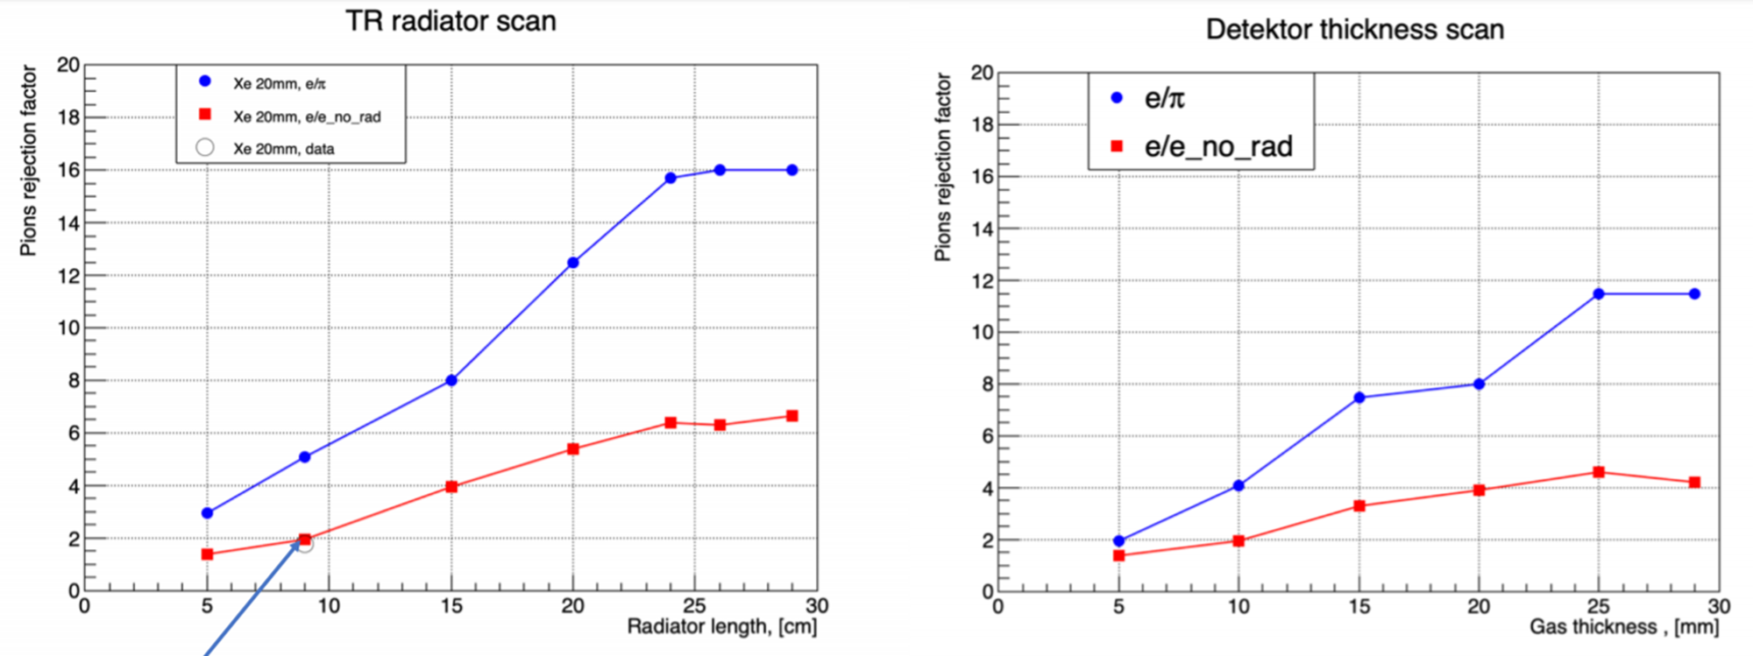
eID by Transition Radiation (TRD)
3: ID TR photons by energy/pos
1: Make TR photons:
Index, n, change
X-ray regime
Film, foam, fleece
2: Layered to get more photons
4: Reject Pions
“Threshold detector” (TR X-rays produced or not)
P_{min} ~ 1 GeV (rejection ~constant at higher momentum)
Balance between X₀ and rejection

Slide 11
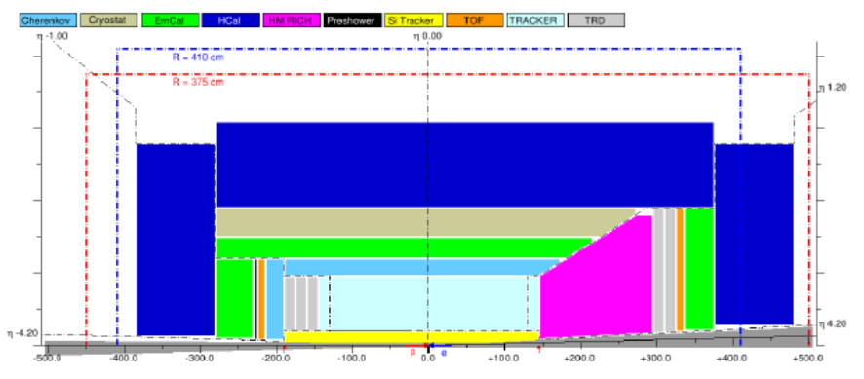
Barrel
Least high momentum requirement.
Most strict space requirement.
All things weighed, the barrel is a real challenge to eID and PID.

Slide 12
Leading Barrel PID Technology: DIRC
hpDIRC ala eRD14
DIRC in sPHENIX
:
At normal incidence, Cerenkov light is internally reflected for $n>\sqrt{2}$
Cerenkov angle preserved if bars meticulously flat with 90 degree corners.
Spectacularly compact PID device with photon detection at end.
Generic reference design: 1m barrel radius, 16 sectors
176 bars: synthetic fused silica,17mm (T) ´ 32mm (W) ´ 4200mm (L)
Photo sensors: MCP-PMTs -3x3mm2 pixels
12

Slide 13
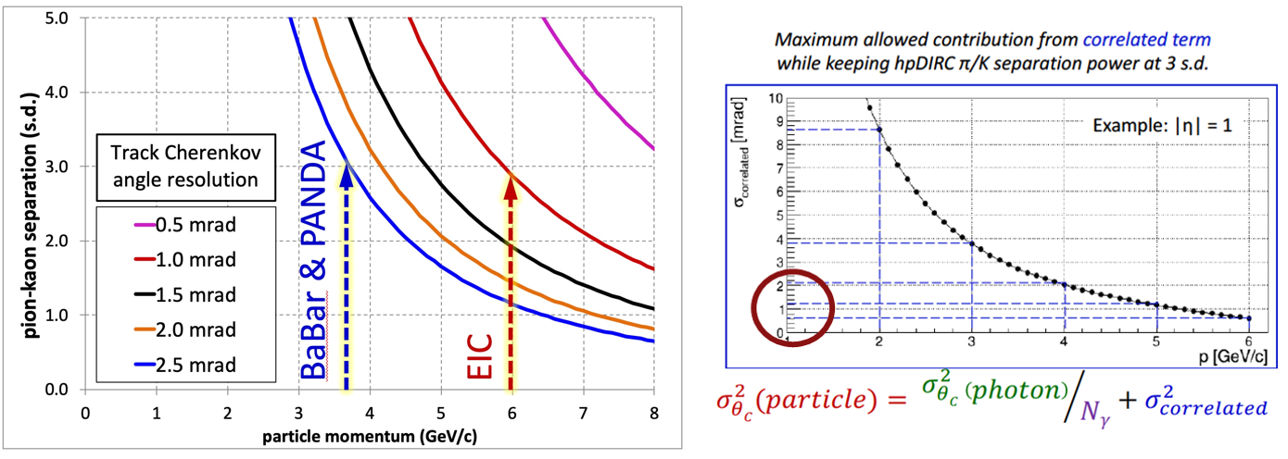
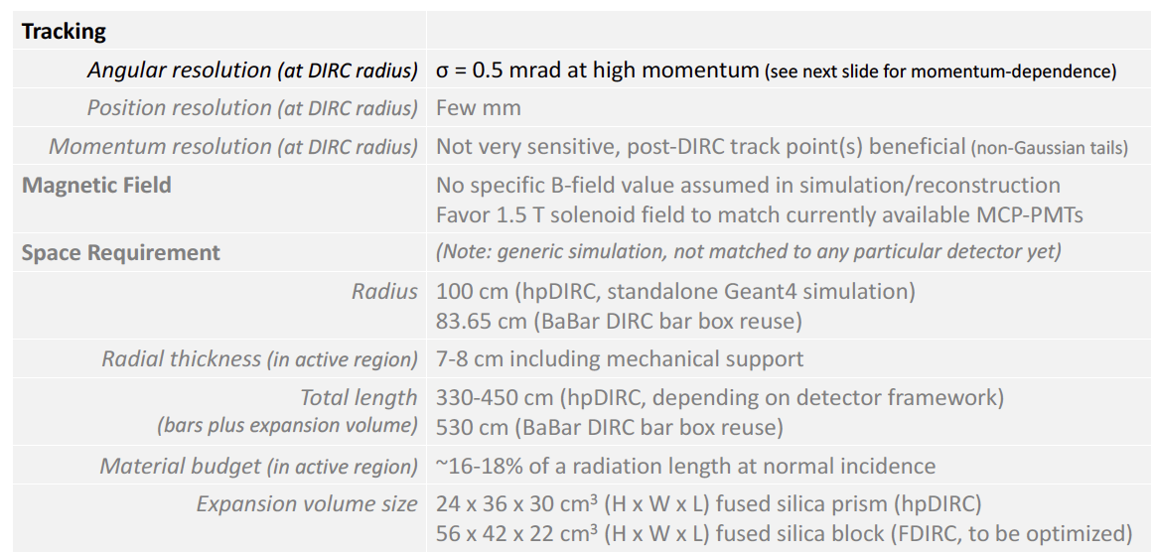
hpDIRC Performance Simulations
Original BaBar DIRC was effectively “proximity focused”
hpDIRC section creates focused ring improving resolution.
Excellent match to EIC needs.
Strict requirements on “correlated terms”, (e.g. angular resolution of tracking)
Works with either standard tracking solution.

Slide 14
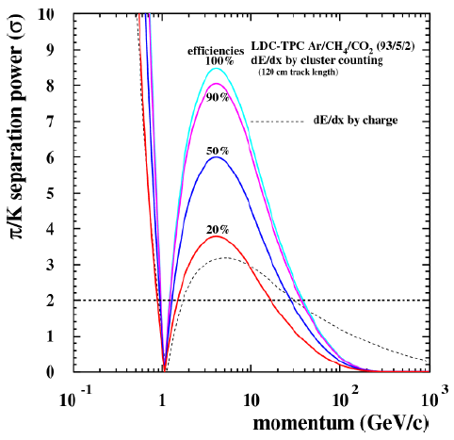
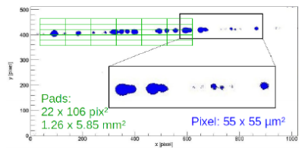
Speculative Cluster Counting Concept
Scaling to our available length:
$N_{cluster}∝Length$
$σ_{N}=\sqrt{N_{cluster}}∝\sqrt{L}$
Using a 3σ reference @ 40 cm gas:
$3\sqrt{\frac{120}{40}}=5.2$
Existing Concept (“Timepix”)
Avalanche onto Silicon Pixels
Tiny Pixels (smaller than cluster spacing)
Sufficient gain for single electron
In principle can work
Expensive for large area.
Can we accomplish with conventional tech?

Slide 15
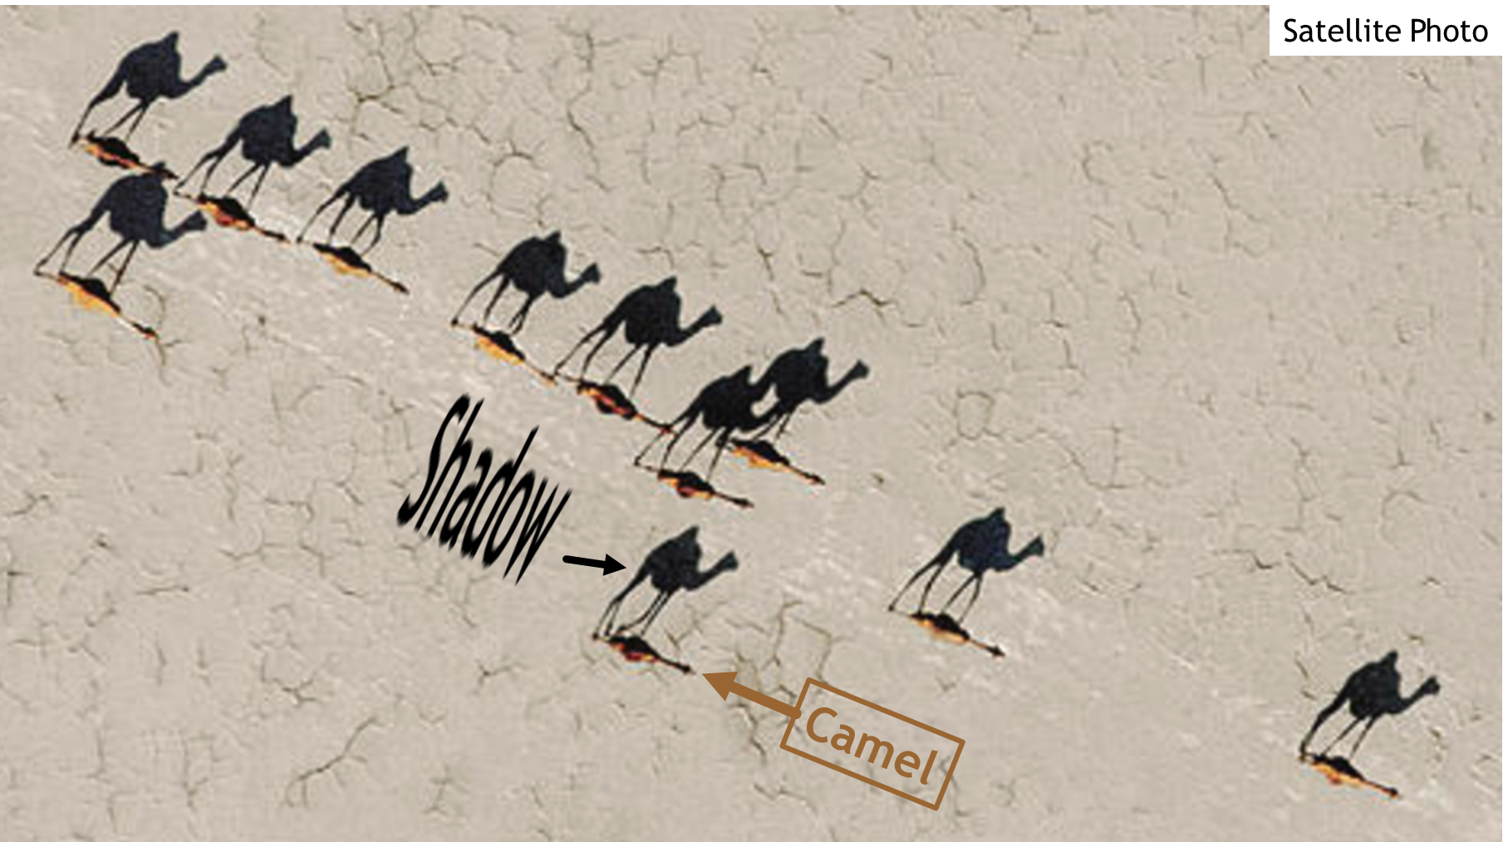
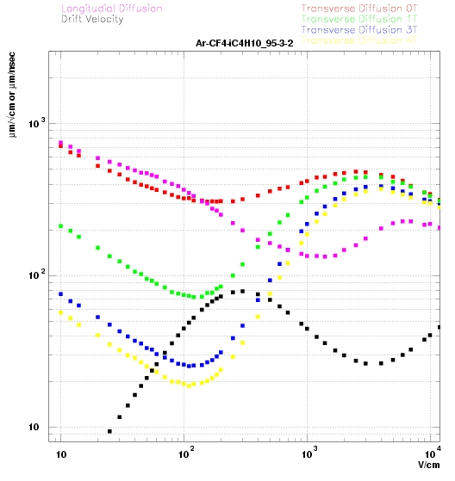
Long Shadow Detector -- LSD
Bad for Tracking
Good for PID
Multiple sections…
New Concept: Like a “Streak Camera”
Sensors
B-field
track
HV-
Silicon Tracker
Drift leverages huge Lorentz angle as “magnifier”
Clusters spread across space and time.
Higher B = Lower Transverse diffusion
Example: T2K(130 V/cm) has only $25\frac{μm}{\sqrt{cm}} at 3 Tesla$
Detect (count) clusters with conventional means.
Early Conceptual Stage: LSD merely a hallucination?

Slide 16
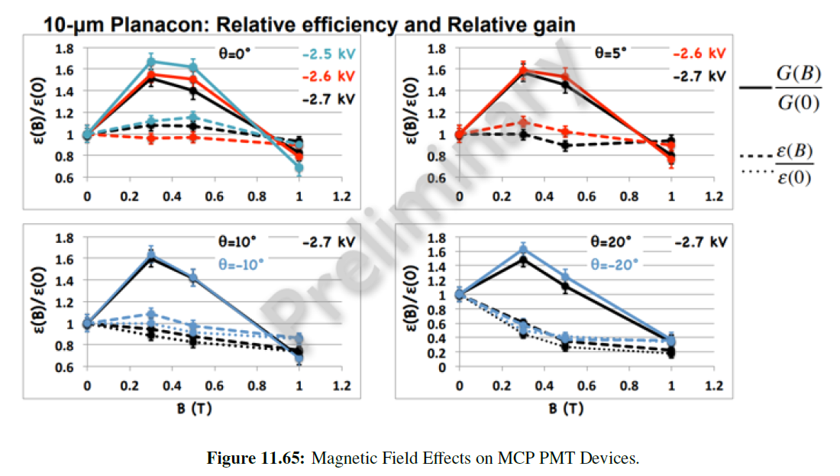
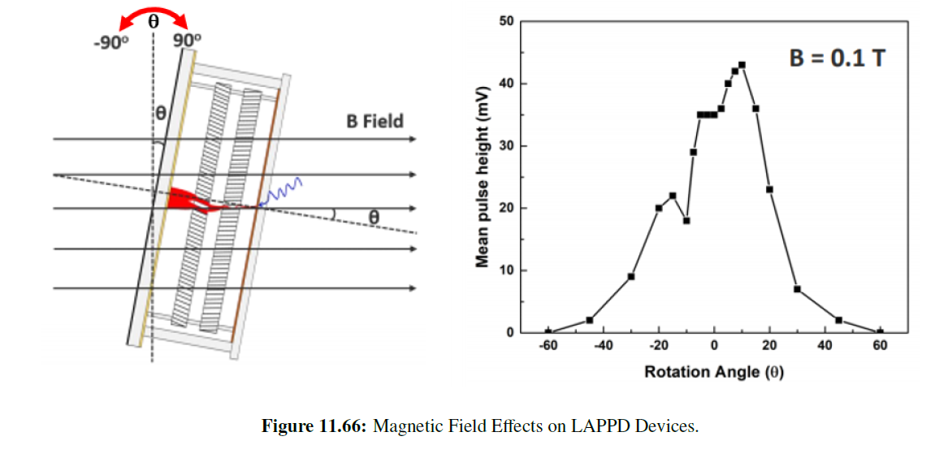
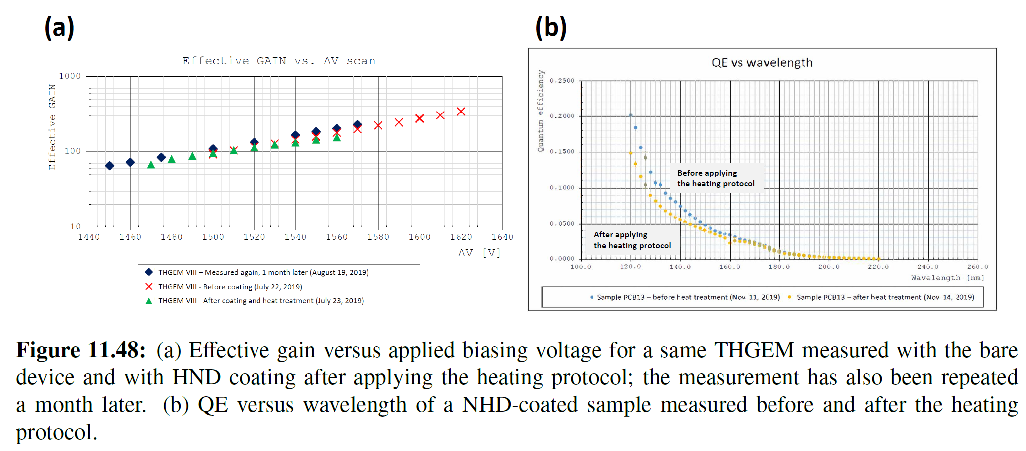
Photon Detection Technologies
Photon Detection Technology critical for many PID devices.
Cherenkov detection requires single photon-electron!
High gain.
Can tolerate/compensate moderate gain loss
Little room for Efficiency Loss
Many Technologies are B-field sensitive!
Can SiPM be operated longterm in a RICH?
Radiation damage prevention/mitigation (dark current makes HITS, not a simple pedestal shift)
New gas-tolerant B-tolerate photocathodes

Slide 17
Summary and Outlook
Draft of PID Yellow Report PID section is basically complete.
Contains the “usual” hit-list of needs to advance from draft to final.
Reference detector design well addressed by existing known technologies.
A few notes of tension between physics and reference design:
eID in barrel
PID reach in barrel.
Future work should address “global” PID within reference detector.
Need to understand the exact limits and smooth roll-off.
Future work should include R&D to develop/extend known technologies.
Future work should investigate speculative options (only some of which shown here)

