Slide 1
Complementarity: 2nd IR design considerations
Vasiliy Morozov
on behalf of 2nd IR Design Task Force
4th EIC Yellow Report Workshop at LBL
November 19-21, 2020

Slide 2
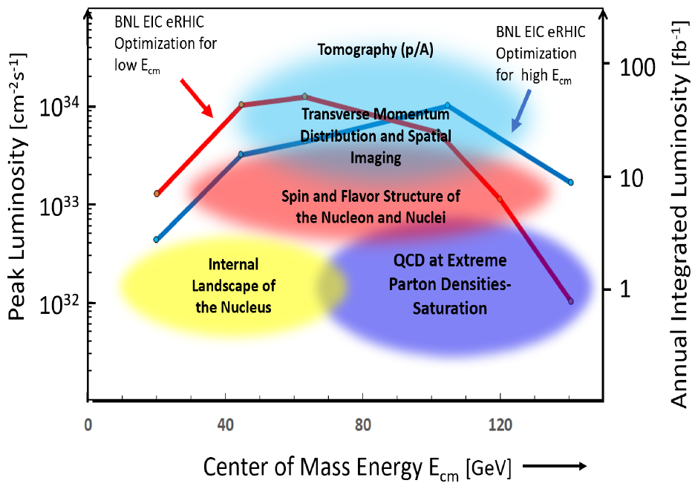
2nd IR Considerations
2nd IR of the EIC
Off project
Consider alternative design choices
Capability of having a 2nd IR is one of the EIC design specifications
Complementary measurements and capabilities to 1st IR
Interest and support of the nuclear physics community
High-level requirements
High luminosity at a low CM energy of ~60 GeV
Detector acceptance satisfying physics requirements (what matters most for the machine design is the forward acceptance requirements)
Compatibility with running in parallel with the baseline detector

Slide 3
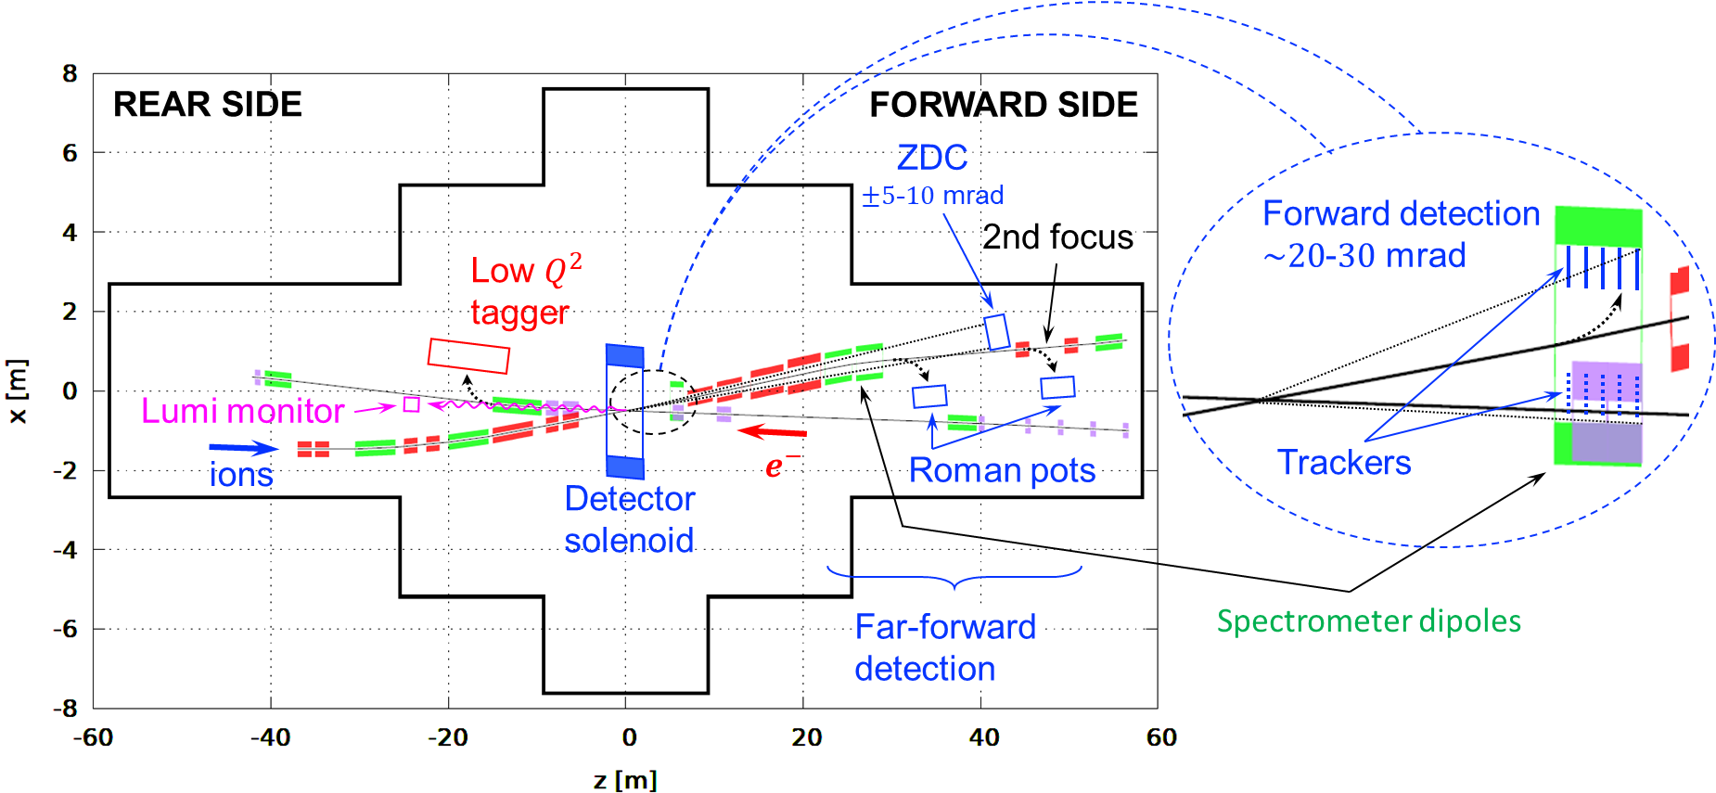
2nd IR Schematic

Slide 4
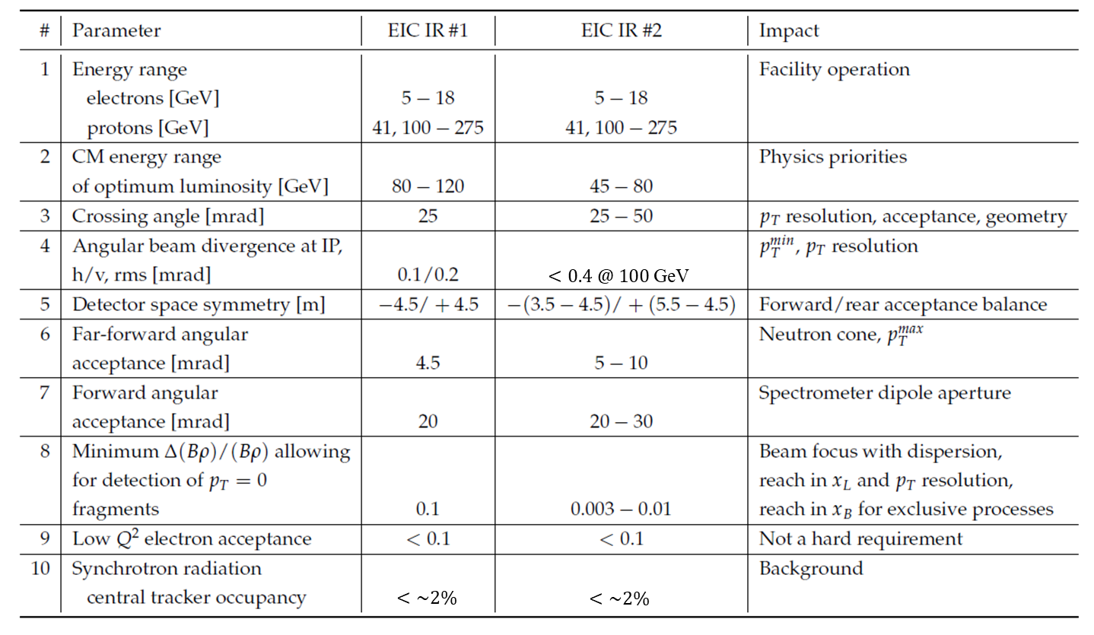
Complementarity to 1st IR

Slide 5
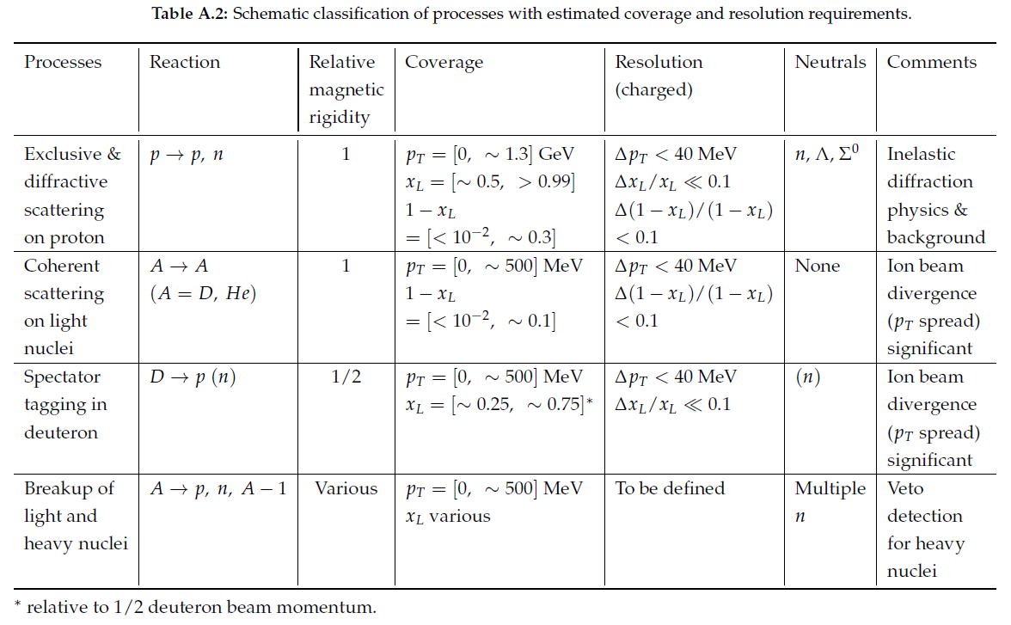
Physics Drivers for Low $(1−x_{L})$ at Small $p_{T}$

Slide 6
Geometric and Machine Constraints
Consistency with existing infrastructure: experimental hall and tunnel size
Integrate necessary components: spin rotators, crab cavities, ZDC, luminosity monitor, Roman pots, low-$Q^{2}$ tagger, etc.
Geometric and optical match to the rest of the collider rings
All beams transport over full energy range
Magnet aperture-edge fields < 4.6 T
Sufficient DA and momentum acceptance
Total beam-beam < 0.015 (p), 0.1 (e)
Beam aperture $>10σ$ (p); $>15σ_{x}/20σ_{y}$ H/V (e)
Dispersion and dispersion slope constraints at crab cavities

Slide 7
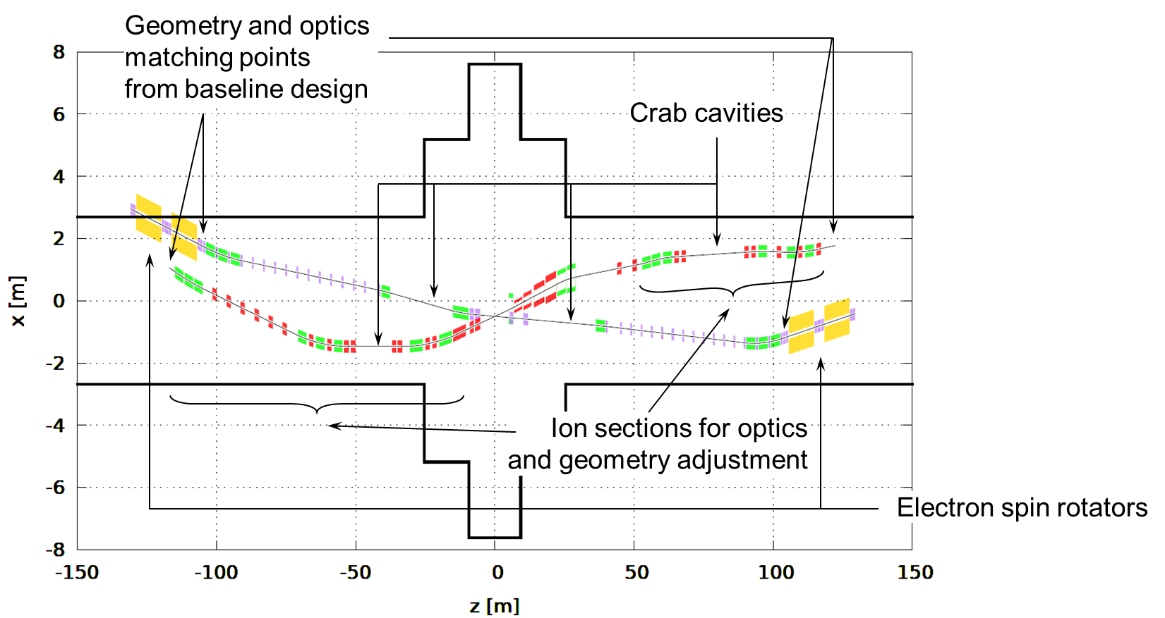
2nd IR Geometry and Optics Matching and Component Integration
Beam crossing direction flipped compared to the 1st IR
Not much flexibility in electron geometry because of electron spin rotator requirements
Electron beam line is a slightly modified baseline design
Enough knobs integrated into the ion beam line design to allow for testing different geometries
Started with 50 mrad crossing angle and plan to optimize it along with other parameters
To ion spin rotator
To ion spin rotator

Slide 8
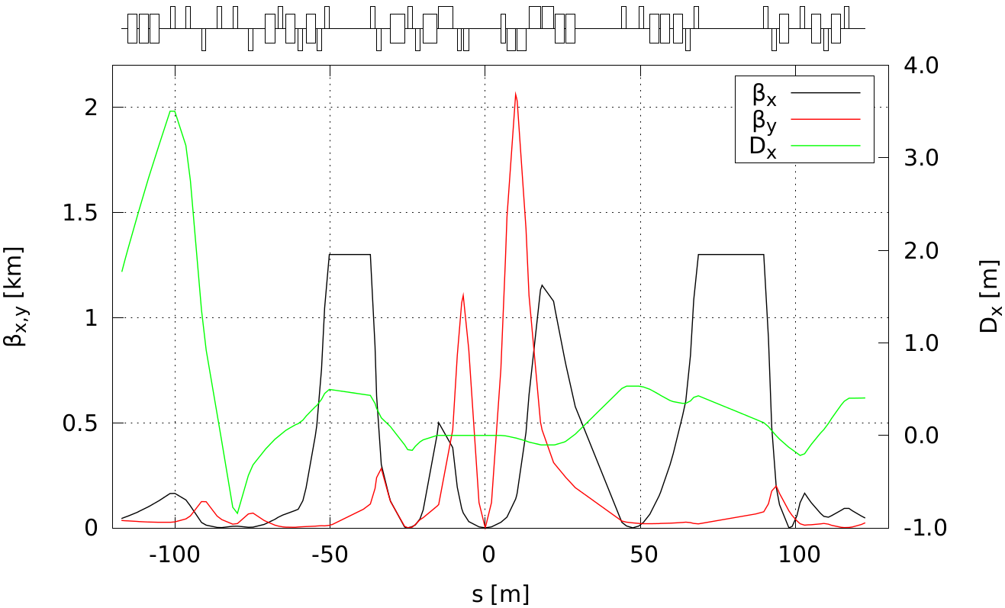
Ion 2nd IR Optics up to 275 GeV
Lengths of downstream final focusing quadrupoles optimized to provide 10 mrad polar angle acceptance with aperture-edge fields below 4.6 T
Use constraints on $β_{x}^{max}=1.2$ km and $β_{y}^{max}=2$ km as in the 1st IR
Upstream section is based on the 1st IR
Doublet optics with reversible polarity of the second quad depending on the energy $β_{x/y}^{∗}=96/3.3$ cm
Secondary focus with $\left(1−x_{L}\right)>7⋅{10}^{−3}$ acceptance
Chromatic contribution: ${ξ_{x}}/{ξ_{y}}=−24/−45$
Same optics and geometry as in baseline
IP
Roman pot
at 2nd focus

Slide 9
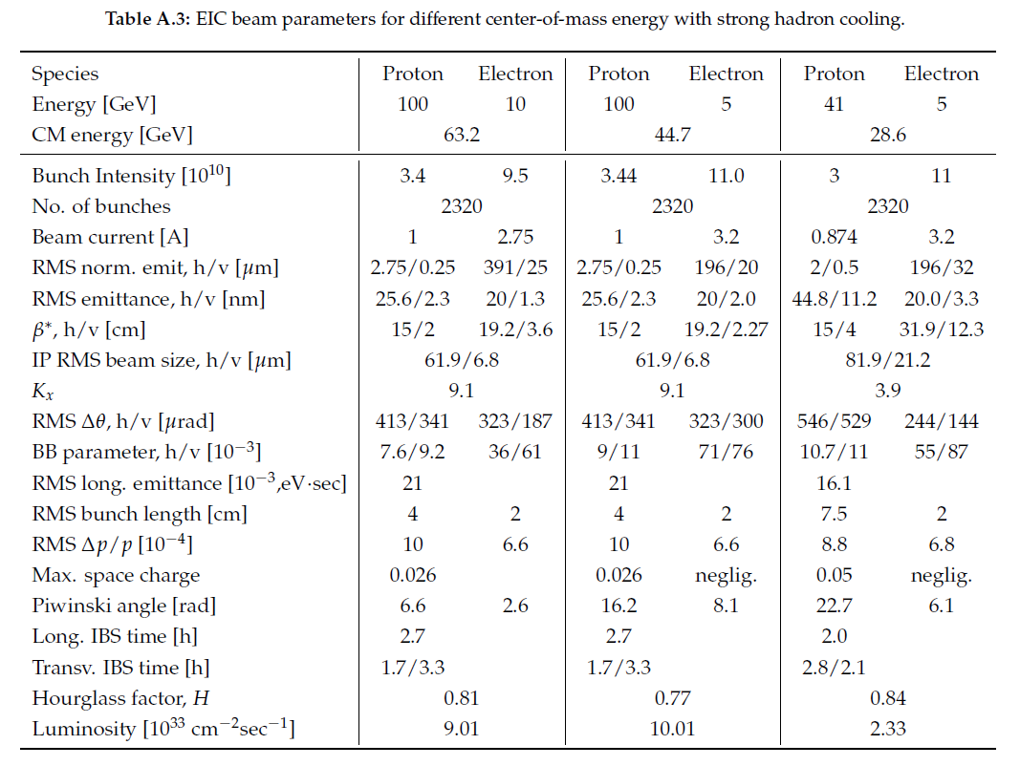
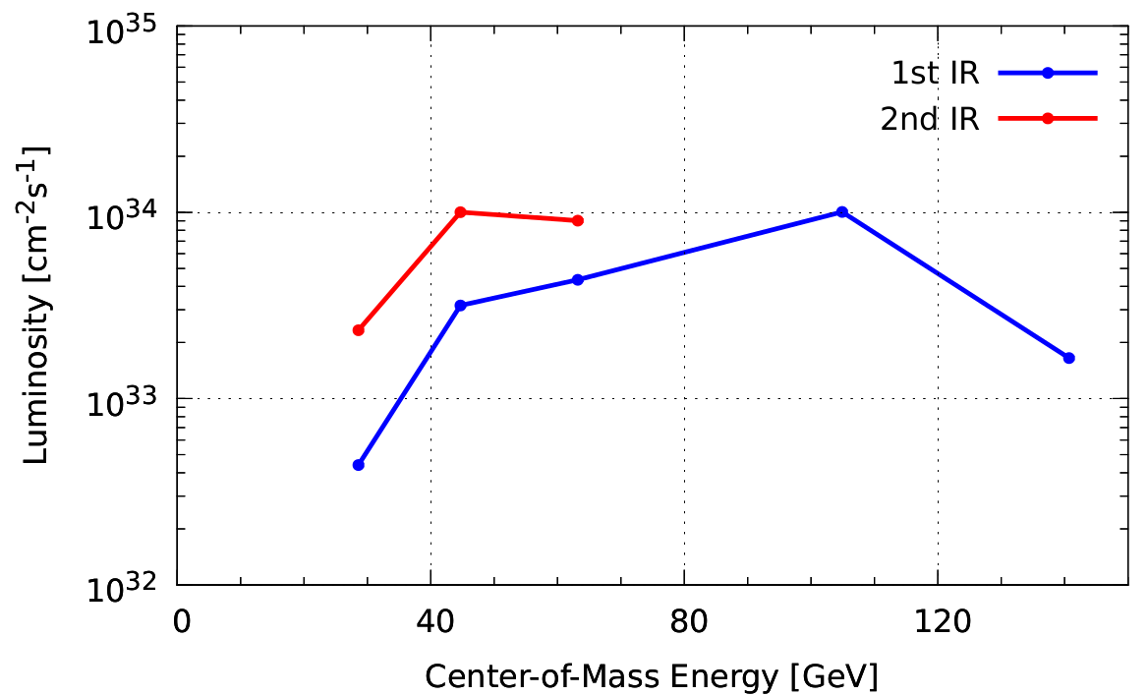
2nd IR Design Optimization
Grid search and optimization in the luminosity/ detector acceptance/ beam parameter phase space
Each iteration involves
Lattice design update
Luminosity estimate
Acceptance simulation
Streamline the process as much as possible
IRs optimized individually

Slide 10
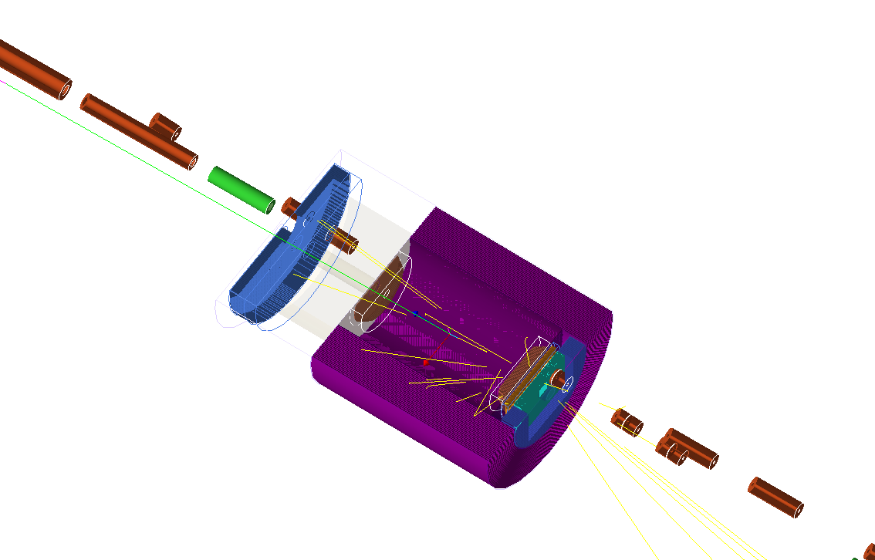
2nd IR Acceptance Simulations Under Way

Slide 11
Simultaneous Operation of Two IRs
Limit on the total beam-beam tune shift may result in luminosity sharing
$ξ^{p}≲0.015$
$ξ^{e}≲0.1$
Additional chromatic contribution of 2nd IR: chromaticity compensation, momentum acceptance and dynamics aperture
Local compensation scheme
Mutual compensation of the nonlinear effects of the two IRs
Doubling the bunch numbers
More challenging polarimetry due to shorter bunch spacing
Faster kicker for bunch swap in the electron collider ring
Larger number of parasitic collisions and their increased contribution to the total beam-beam tune shift
Impedance and instabilities need to be re-evaluated due to change of beam spectrum
Background due to events coming from parasitic collisions
Crabbing parameters need re-optimization
Additional machine components
IR magnets
Spin rotators
Crab cavities

Slide 12
2nd IR Feasibility Study Tasks
Completion of conceptual linear design
Footprint with optimization knobs developed
Conceptual linear optics design developed
Proof-of-principle studies of chromatic compensation schemes in the ion collider ring
Identify and use tracking to evaluate compensation schemes of the chromatic effect of the 2nd IR alone
Develop and evaluate by tracking a scheme for mutual compensation of the two IRs
Conceptual engineering assessment for critical/challenging components
Beam parameter optimization
Single-mode operation of the 2nd IR
Operation in parallel with the 1st IR
Simulation of detector acceptance
Parameter scan
Identify scan parameters and choose ~3-4 configurations of, e.g., crossing angle, repetition rate, and forward/ far-forward acceptance using nuclear physics input
Repeat items 4 and 5 for all of the different configurations
Summarize the 2nd IR concepts

