Slide 1
Complementary Detectors at EIC What we plan to integrate into the YR
E.C. Aschenauer (BNL)
P.R. Newman (Birmingham)

Slide 2
Background
DOE Statement:
High energy colliders usually have (at least) two detectors
We have a pretty good idea how one basic detector layout might look (details and technologies still being discussed)
Two detector provide the opportunity to refine and enhance EIC physics program
Important from the outset to assess ‘complementarity’ possibilities in terms of physics motivation and detector options
Yellow Report Complementarity group charged with collecting arguments why two detectors will enhance the physics output of the EIC

Slide 3
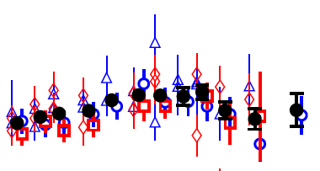
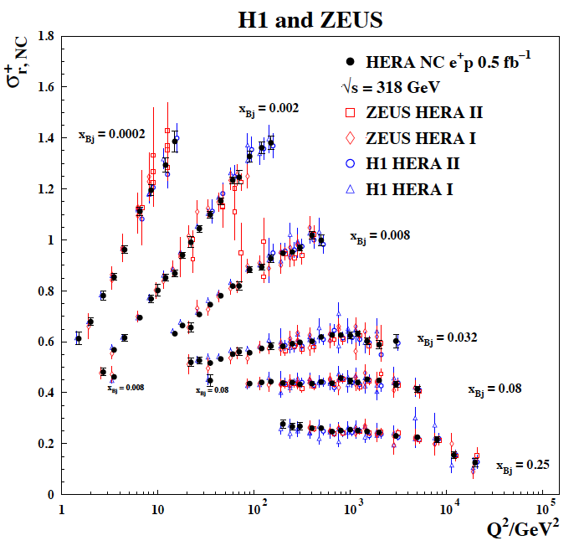
What do we want from “Complementarity”
Cross-checking important results (obvious!)
Cross calibration (eg H1 v ZEUS)
- Combining data gave well beyond the √2 statistical improvement …
Different dominating H1, ZEUS systematics…
Effectively use H1 electrons with ZEUS hadrons
… not all optimal solutions have to be in one detector…
[Selected
HERA-II bins]
3

Slide 4
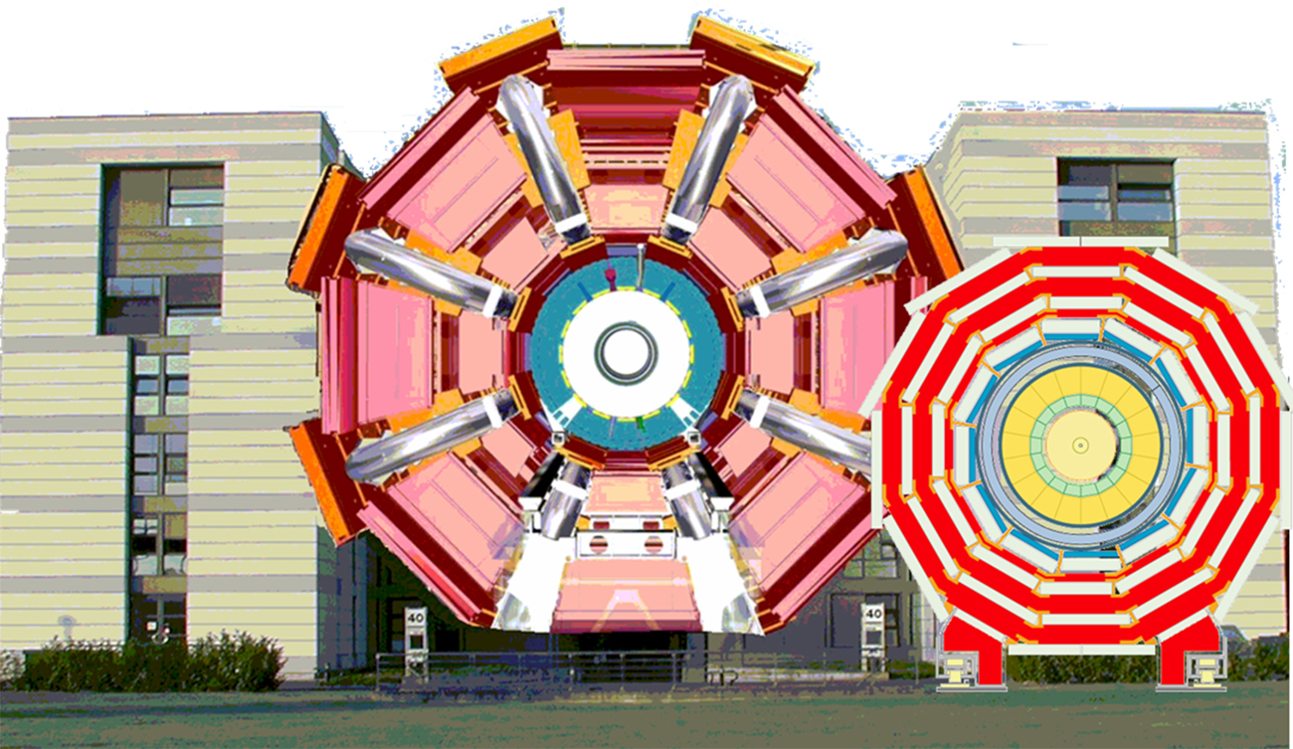
What do we want from “Complementarity”
Redundancy versus unforeseen technology
problems …
... by applying different detector technologies and philosophies to
similar physics aims
ATLAS
CMS
Different primary physics focuses …
…optimizing overall sensitivity to EIC physics program?...

Slide 5
There are Boundary Conditions
Experimental Equipment fully integrated in IR spans +/- ~40 m
length of Central Detector impacts luminosity
Distance 1st focusing quad to IP → L*
Beam elements / magnet structures limit central detector
Main detector $±$ 4.5m (-4.5/+5m) (& IR-instrumentation needs to be before Crabs)
→ Space requirement for dedicated muon detectors?
Synchrotron fan, crossing angle determine angular acceptance for main detector
and beam-line / IR instrumentation
→ IR instrumentation angular range to ~ 1.5º
→ Main detector instrumentation to |η| ~ 3.5 – 4.0
e beam
p/ion beam
far-backward
e-detection
e final-focus quads
“Central detector”, includes e-endcap, central, and p/ion endcap detectors
forward dipole
incl. h-detection
Ion final-focus quads
forward dipole
far-forward h detection
far-forward
h-detection
Low-Q²
spectroscopy
Inclusive Structure Functions, TMDs, heavy flavors and jets, electrons for GPDs
GPDs/DVCS, tagging, diffraction
high/medium t
Baryon decay
π/K structure
evaporated n
GPDs/DVCS, tagging, diffraction
lowest-t

Slide 6
Complementary Working Group Activities
Discuss detailed aims and needs with Physics Working Group conveners
“Have you identified key physics aims that conflict with
the current baseline /schematic detector and IR design?”
Discuss with Detector Working Group conveners
“Assuming we have two detectors, how you could build in complementarity
within the overall constraints imposed by the accelerator
and associated considerations?”
Many subsidiary questions → see wiki
… no compelling argument (yet) for a second detector
with specialised / limited physics focus.
→ Working assumption is two complementary GPDs
Advantage:
one device for all physics, better back-
ground rejection and systematic control
Lifetime = Facility lifetime
Disadvantage:
More challenging to design

Slide 7
Some`Bold’ Summary Statements: Common features of two detectors
Wide range of topics require hermiticity of central detector elements
→ maximal acceptance for SiDIS, exclusives, charm, jets … → resolution for kinematic reconstruc’n using both electrons & hadrons.
Both detectors should have tracking, EM and HAD calorimeter coverage, PID and heavy flavor identification to large |η| (typically $±$ 4)
Operate both detectors in parallel at the full √s – luminosity range of EIC
Wide range of topics require beamline instrumentation in both outgoing proton (p, n) and electron (e, g) directions
→ exclusive and diffractive processes, including (in)coherent eA
→ kinematic coverage to Q²→0 and lumi monitoring with Bethe-Heitler
Should be a baseline feature of both detectors
Angular range more or less fixed by synchrotron fan
Both interaction regions need to be compatible with the current accelerator design
Wide range of topics require high luminosity and polarization
EIC physics is best realized with a variation in $√s$
→ Maximize kinematic range in (x, Q²) for all measurements
→ Vary x / η correlation for SiDIS, HF, exclusives …

Slide 8
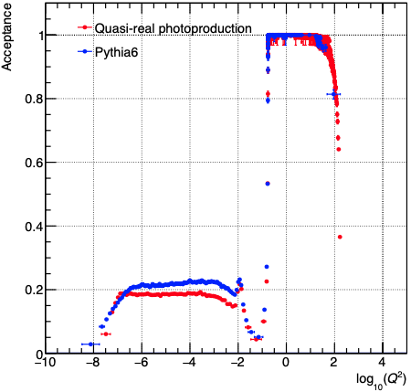
Some`Bold’ Summary Statements: Opportunities for Complementarity
Solenoid field
→ High field for precise measurement of high p_{T} charged particles (scattered electron, leading particles in SiDIS …)
→ Lower field for acceptance of lower p_{T} charged particles (spectroscopy, some charm decays …)
Dipole and low Q² tagger set-up
→ Is it possible to place Q² gap in different places?
Would have implications for IR design?
Beamline proton and neutron instrumentation
→ Need better understanding for eA (dissociation models)
→ Roman pots at secondary beam focus to extend x_{L} acceptance?
Also has implications for IR design
Optimise to Performance at different $√s$
EIC runs with varying (staged?) CMS energies …
Automatic complementary of kinematic regions corresponding to central acceptance

Slide 9
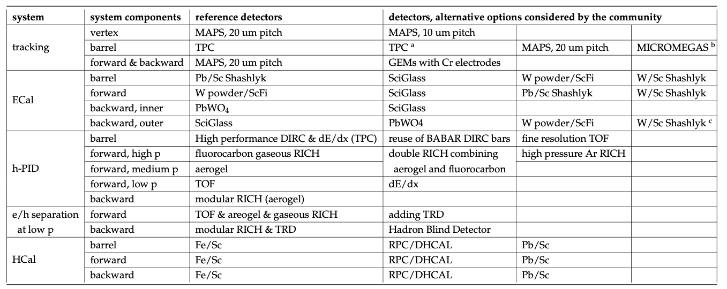
Complementarity through Technology Choices
Multiple proposals / alternatives for each subdetector …
→ Different strengths and weaknesses
→ Optimized to different p_{T} / other kinematics
→ Different space requirements
→ Different risks / technology-readiness
→ Material budget
… final choices will require detailed full GEANT simulations and
simultaneous optimization of the full detector, not
just individual components

Slide 10
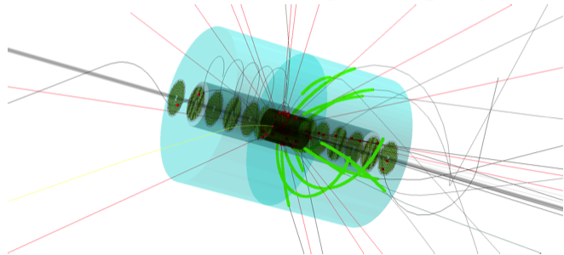
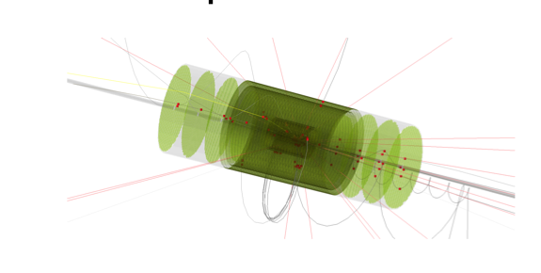
Example Complementarity through Detector Technology Choices: Tracking Region
Si + TPC:
80cm outer radius TPC
MAPS Si inner barrels and disks
All Silicon Concept:
45cm outer radius
MAPS barrels and disks (15m²)
Si version improves momentum, vertexing performance and saves space to implement other detectors
TPC version provides PID from dE/dx & keeps low material budget
→ Impact on Magnet bore radius

Slide 11
More In-built Complementarity
Integrate possibility of fixed target mode into detectors (based on either e- or p-beam) to emphasize new kinematic ranges that would normally be very forward or backward
→ High x physics in ep / eA
→ Novel regions for pp / pA
→ Successfully done previously at ALICE, LHCb, STAR

Slide 12
2nd IR Flowchart
11/20 Call for Expression of Interest
02/21 EICUG 2nd IR workshop
Sufficient interest to decide on 2nd detector and IR?
YES
Discuss with DOE/NP how to do 2nd detector and 2nd IR scope
NO
06/21 Survey international engagement in EIC Accelerator & 2nd IR design
Sufficient interest to request integration of 2nd IR?
YES
Discuss with DOE/NP possibility of integration of 2nd IR scope in EIC TPC
NO
Continue conceptual design of 2nd IR, Initiate R&D plan to validate concept.
Sufficient interest to continue 2nd IR design?
YES
NO
Complete conceptual design of 2nd IR
2nd IR at CD-4B timescale is not within the range of EIC possibilities
06/24 Sufficient non-DOE interest in 2nd IR?
YES
Discuss with DOE/NP how to do 2nd IR scope
NO

Slide 13
 | Activity Name | 2019 | 2020 | 2021 | 2022 | 2023 | 2024 | 2025 | 2026 | 2027 | 2028 | 2029 | 2030 | 2031 | 2032
 | CD-0 Mission Need
 | CD-1 Preliminary Baseline
 | CD-2 Performance Baseline
 | CD-3 Construction Start
 | CD-4A Initial Operations
 | CD-4 Project Complete
 | Physics/Detector book 1
 | Call for Detectors/ Collaboration Formation
 | Design of Detectors
 | Down-select to Two Full-Size Detectors
 | Detector/IR TDRs, Detector/IR construction
 | Expressions of Interest for Detectors
 | 2nd IR workshop
 | 2nd IR conceptual design
 | 2nd IR accelerator R&D
 | 2nd IR engineering & design
 | 2nd IR construction & installation
DOE Driven
EICUG Driven
DRAFT
2nd IR Driven

Slide 14
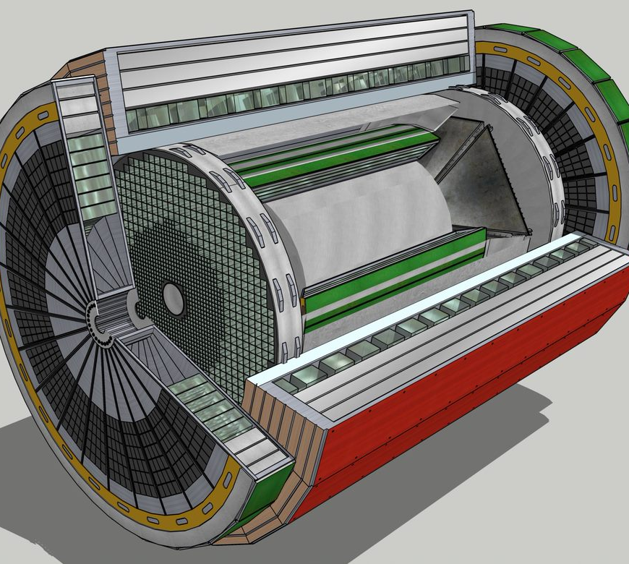
Summary
Essential to robustness of science program to have two detectors
To date no compelling arguments for a ‘specialized’ detector
→ working towards two
GPDs with complementarity
in details such as solenoid field and technology choices.
2nd IR design is still ongoing
Progress will ultimately require detailed GEANT simulations to simultaneously optimize both detectors and IR
Talk represents the content of the
YR chapter → complete after Thanksgiving
two detectors for EIC

Slide 16
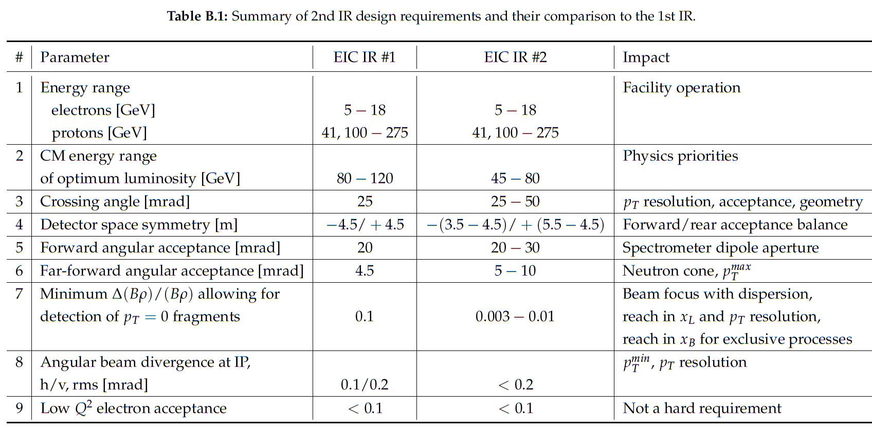
Boundary Conditions
Interaction Region:
All beams transport over full energy range
Magnet aperture-edge fields < 4.6 T
Detune low-beta or do not run for E_{p}>~180 GeV
Sufficient DA and momentum aperture
Total beam-beam < 0.03 (p), 0.1 (e)
Beam aperture >10σ (p); >15σ_{x}/20σ_{x} H/V (e)
Electron aperture accommodates non-Gaussian tails
Dispersion and dispersion’ constraints at crab cavities

Slide 17
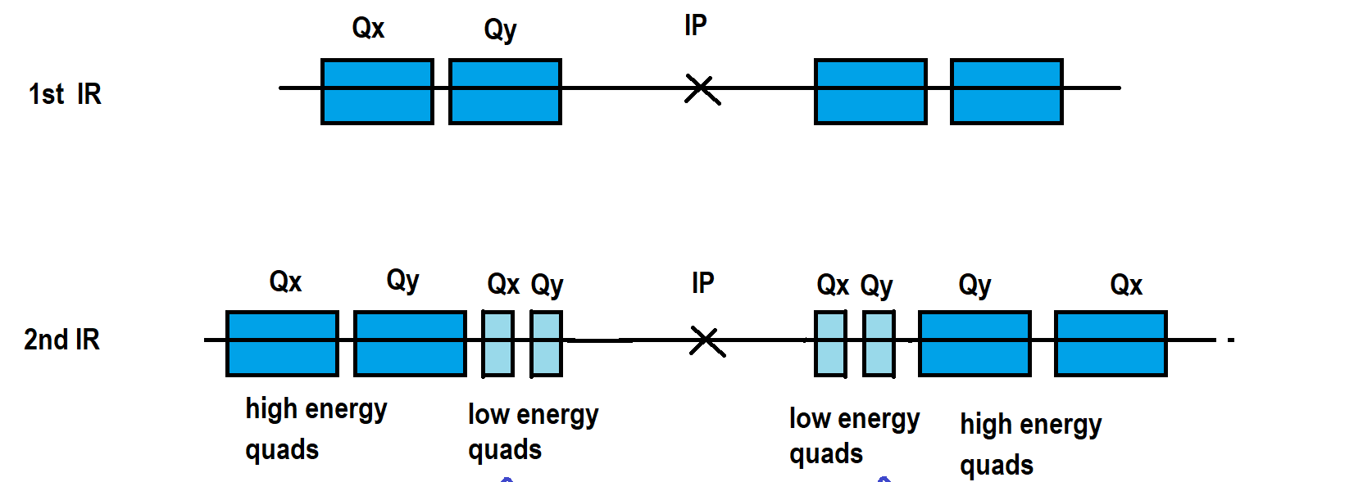
Luminosity vs. Detector Space
$$L= \frac{{h∙f}_{rev}∙{n·n}_{b}∙N_{e}/n∙N_{p}/n}{4π∙\frac{σ_{x}σ_{y}}{n}}$$
Luminosity:
but reduce emittances by factor n ( note n_{b} is original number of bunches, new is n·n_{b}), which requires much stronger cooling τ_{cool} ➔ τ_{cool} / 2,4, …
The original luminosity is then recovered
Luminosity can now be increased by squeezing the betas by a factor 2 which is possible since the envelope in the final focus quadrupoles has shrunk by a factor of √2 in x and y
One is left to deal with the enhanced IR chromaticity which went up by a factor of 2 which reduces the dynamic aperture by a factor ~2
How to reduce IR chromaticity?
Increase crossing angle to get final focus quadrupoles closer to IP
θ_{cross} ➔θ_{cross} x 2
→ Impact on detector: asymmetric material budget in outgoing hadron beam direction
asymmetric and reduced acceptance for high η hadrons
Electrons: final focus quadrupoles in the detector
Hadrons:
$$\hat{β }∝{L^{∗2}}/{β^{∗}}$$
L*
Detector Size directly coupled to Luminosity

Slide 18
What is important to define Complementarity
Different CMS energies, luminosities can place emphasis on complementary kinematic regions (possible staging?) …
most physics topics require a wide range in (x,Q²)
→ need to run at different √s
→ Vary x-Q² / η correlation for SiDIS, HF, exclusives …
Some topics (eg far forward) may require dedicated set-up of detector or interaction region
synchrotron radiation fan and crossing angle define acceptance
solenoid aligned with lepton beam
asymmetric acceptance in central detector in hadron beam direction
gaps between different detectors along beamlines can be optimized differently in both IRs
Other possible key parameters:
Material budgets
Solenoid / forward magnetic field strength
Space for detector (minimum: +/-4.5m longitudinally)
Beamline instrumentation vs. IR design
Technology readiness

Slide 19
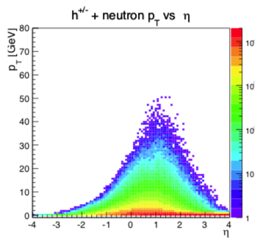
Example Opportunity for Physics Complementarity
Magnetic Field Strength compromises for charged particles in central region
- Low field → low p_{T} acceptance : Semi-inclusive DIS for TMDs, FFs etc
: Samples for Spectroscopy (HF etc)
High field → high p_{T} precision : Scattered electron in inclusive NC DIS
: Inclusive hadrons for inclusive CC DIS
: `Back-to-back’ for gluon Sivers / satn
: Mass precision in Spectroscopy (HF etc)
[Also opportunities to trade off space allocations for tracking v Particle ID]

