Slide 1
Expressions of Interest – Status, Plans
E.C. Aschenauer (BNL)
R. Ent (JLAB)
EIC-UG 4th YR Meeting
Electron Ion Collider

Slide 2
Expression of Interest Timeline
(non-binding) Expressions of Interest (EoI) to get guidance on detector scope
Introduce concept and timeline for Call for Expressions of Interest March 2020
(introduce notion for Expressions of Interest for contribution to EIC
detectors in plenary talks at 1stYellow Report (remote) meeting at Temple)
Discussion Call for EoI for potential cooperation to EIC Detectors
initial discussion session at Remote EICUGM April 23 2020
final discussion at 2nd Yellow Report meeting at Pavia May 20 2020
Call for EoI for potential cooperation to EIC Detectors May 31 2020
(issue call after folding in feedback of EICUG)
Deadline EoI for potential cooperation to EIC Detectors November 1 2020
Status report at 4th (final) Yellow Report meeting at UCB/LBL November 19-21 2020
(also discussion session at 4th Yellow Report meeting
on 2nd IR ideas based on YR and Accelerator Task Force status)
Evaluate EoI and inform Call for Detector Proposal(s) February March 2021
(complete after assumed January 2021 Yellow Report
completion, EoI can give guidance on detector scope)
https://www.bnl.gov/EIC/EOI.php

Slide 3
Expression of Interest – Assessment Process
Asked Detector Advisory Committee for input on “Advice on the process of assessment of the received Expressions of Interest (EOI), …”
“The reference detector and the broad EOI input should allow matching of groups with detector needs. The laboratory management and users group representatives are expected to help resolve duplicate proposals, identify holes and determine where funds are needed to further develop promising technologies. Given the short timeline to full detector proposals, this process could be challenging and may require careful attention to governance and transparency.”
After deadline of November 1, group of people representing EIC Project and EIC User Group, started an early assessment process.
Elke Aschenauer (BNL, EIC Project)
Rolf Ent (JLab, EIC Project)
Christine Aidala (U Michigan, EICUG IB Chair)
Marco Contalbrigo (INFN Ferrara, EICUG representative)
Rosi Reed (Lehigh U, EICUG representative)
Bernd Surrow (Tempe U, EICUG SC Chair)
Early results shown here, a more detailed analysis to follow.
Remember all EoIs available at https://indico.bnl.gov/event/8552/

Slide 4
Expressions of Interest – Distribution
Total = 47
Note: some arbitrariness in categorization, like two national labs (and one international lab) came in together with universities, and one national lab came in as detector consortium, etc.

Slide 5
Expressions of Interest – Geographically

Slide 6
Expressions of Interest – Equipment Interest
Note: some double counting in numbers, e.g., interest expressed by a detector consortium could be echo’ed in EoIs of countries, universities, etc. participating in this consortium.

Slide 7
Expressions of Interest – Labor
EIC User Group:
1197 members
245 institutions
33 countries (6 world regions)
Experiment Scientists: 728,
Theory Scientists: 299,
Accelerator Scientists: 160, Computer Scientists: 5, Support: 3, Other: 2

Slide 8
Expressions of Interest – Labor (scientific vs technical)

Slide 9
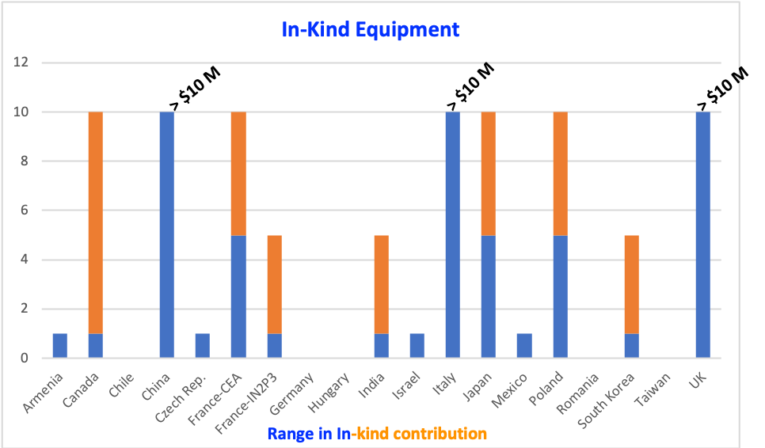
Expressions of Interest – In-Kind Equipment (non-US)
Ranges have some judgement factor involved
Country | Comments
Italy-INFN | One country that clearly indicates this level of possible contribution to detector in EoI.
France-CEA | Level not clear yet. Based on experience at JLab-12 which they point to. Did commit to PED until CD-2 for magnet already.
UK | Level not clearly stated, but they did submit phase-I R&D proposal to STFC already. Also interest in both detector and accelerator.
China | We are aware this is difficult, but this is the level they indicate they may contribute in-kind.
Canada | Level of in-kind for detector $1M-5M may be augmented by $5M-10M accelerator in-kind from TRIUMF.
Japan | Level indicated at EoI as possible request to their agencies.
France – IN2P3 | States $1M in EoI for backward calorimetry, but other topics seem possible.
India | Mostly commits to (lot of) labor for scientific tasks, some small requests possible.
Poland | Level of in-kind contribution that may be possible.
Czech Republic | Do not explicitly indicate in-kind non-labor contribution, some seems likely.
Korea | Do not explicitly indicate in-kind but hint at possibility. Unclear.
Mexico | Mostly labor, small in-kind only
Israel | A $1M contribution seems possible
Armenia | Mostly labor, small in-kind only
Does not include separate strong interest by
academia-industry consortium in Spain to accelerator scope.
Also, for countries like Canada and UK folded in some separate accelerator scope interest in the estimates.

Slide 10
Expressions of Interest – In-Kind Equipment (reuse)
Possible equipment for use of EIC detector:
sPHENIX/BABAR magnet (with some modifications)
Accompanying sPHENIX Hadronic Calorimetry
Perhaps also some sPHENIX EM Calorimetry
STAR HCal Calorimetry (FeSc 520 towers)
E864 lead-scintillating fiber HCal 754 towers, 10cm x10cmx117cm
TPC
Few-100 PbWO4 crystals (2.05 x 2.05 x 20 cm3)
JLab + BNL ~10k Pb-Glass blocks (3.8 x 3.8 x 45 cm3)
BNL Pb-Glass blocks (5.8 x 5.8 x 60 cm3)
Ex-BABAR DIRC bars
Examples only!

Slide 11
Expression of Interest – Gap Analysis
Equipment
Bases seem covered but lean on HCal
Magnet
But secured non-EoI commitment for Engineering and Design help from CEA, Saclay (great!).
US
Many universities submitted
We also miss many that are not part of any EoI submission (e.g., many Minority-Serving Institutions, many Heavy-Ion Groups).
Countries
Many countries came through (thank you!) despite difficulty times
But we need to work on other countries to be as inclusive as can be
Germany? (yes, this one is difficult with LHC and FAIR)
Argentina, Brazil, Chile?
Russia? (yes, times are difficult)

Slide 12
Expressions of Interest – Final Perspective
There is clearly large interest in EIC science and experimental equipment
Both domestically among universities and national labs
And international, with many countries represented (Canada, China, Czech, France, India, Italy, Japan, Korea, Poland, UK and institutional EoIs of Chile, Hungary, Mexico, Rumania, and group EoIs with Armenia, Israel, Saudi Arabia and Taiwan as members)
At this stage of early-project development, with EIC science still a decade away, impressively many are committed to work on EIC.
In-kind contributions, from EIC project point of view, clearly suffice to maintain low-risk for a general-purpose EIC detector that is assumed to be 70% project-funded and 30% contributions (in-kind and labor).
EIC Project Risk Registry #120: “Failure to Secure in-Kind Detector Components and Labor” – risk assignment “Very Low”.
The EIC train clearly left the station!
However, it is clear we need to remain vigilant and follow up to secure in-kind contributions and even argue, based on our strong EIC science, for further contributions, if we want to be able to secure a second detector, with crisp arguments on why.
We is all of us: remain unified and (internationally) argue our EIC case.

