Slide 1


Multi-dimensional Imaging of Nucleons, Nuclei, and Mesons at the EIC
15+5
Anselm Vossen
Research supported by the

Slide 2
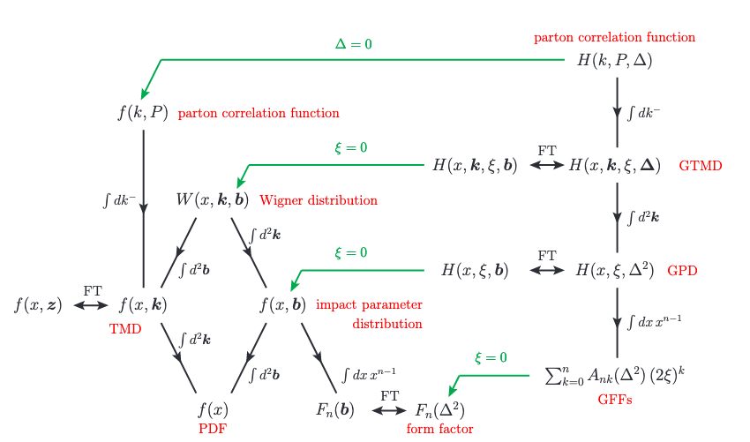
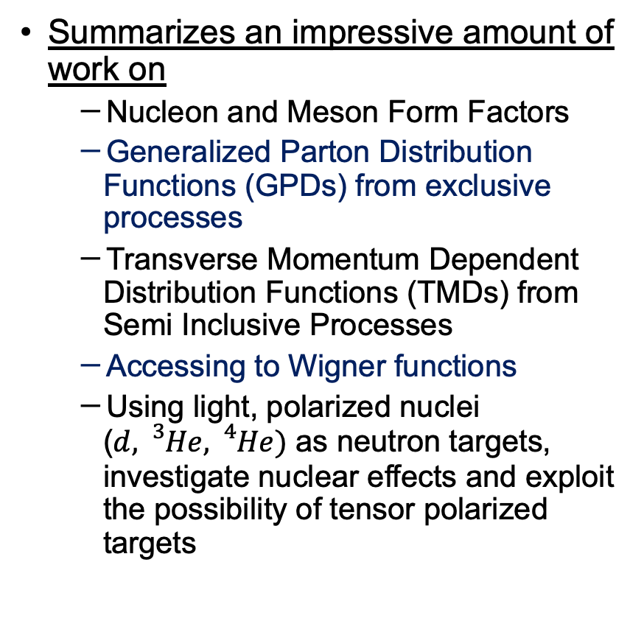
Overview
Summarizes an impressive amount of work on
  Nucleon and Meson Form Factors
  Generalized Parton Distribution Functions (GPDs) from exclusive processes
  Transverse Momentum Dependent Distribution Functions (TMDs) from Semi Inclusive Processes
  Accessing to Wigner functions
  Using light, polarized nuclei ($d, {}_{}^{3}{He},{}_{}^{4}{He})$ as neutron targets, investigate nuclear effects and exploit the possibility of tensor polarized targets
Diehl,2003

Slide 3
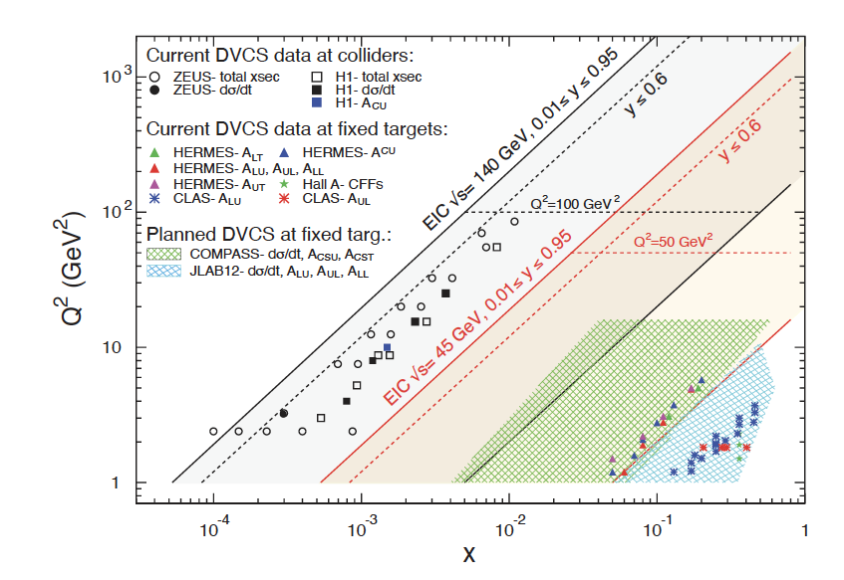
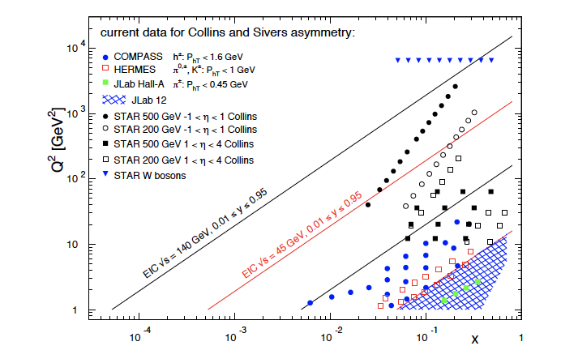
Coverage
Common theme on EIC impact
  Extended kinematic coverage and precision, along with polarization
  and possible beam charge degrees of freedom allow multi-pronged approach →needed to extract multidimensional objects
  TMD factorization is valid
Large $Q^{2}$ lever arm: probe evolution, disentangle contributions to $σ$
Coverage to low $x:$ access sea and gluon distributions

Slide 4
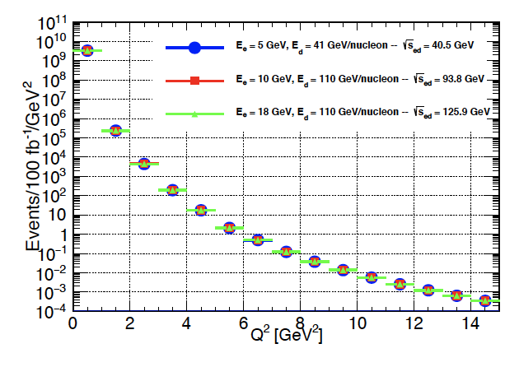
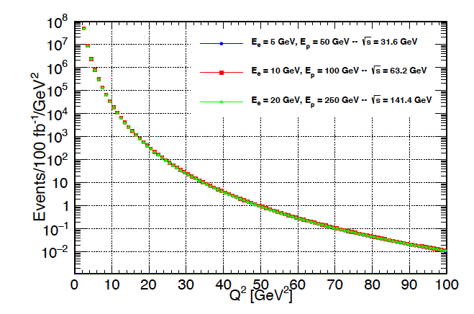
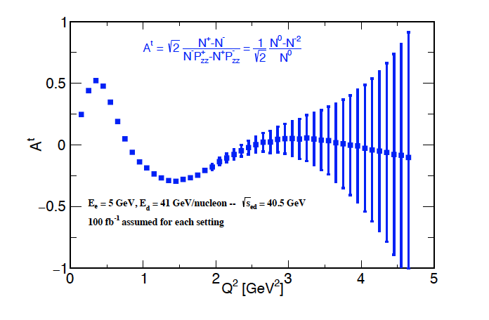



Nucleon
$$ed$$
Magnetic form factors up to the highest $Q^{2}$
Nucleon FF up to ~45 $GeV^{2}$
Deuteron up to ~5 $GeV^{2}$
Tensor polarized up to $≈2.5 GeV^{2}$
$$ep$$

Slide 5
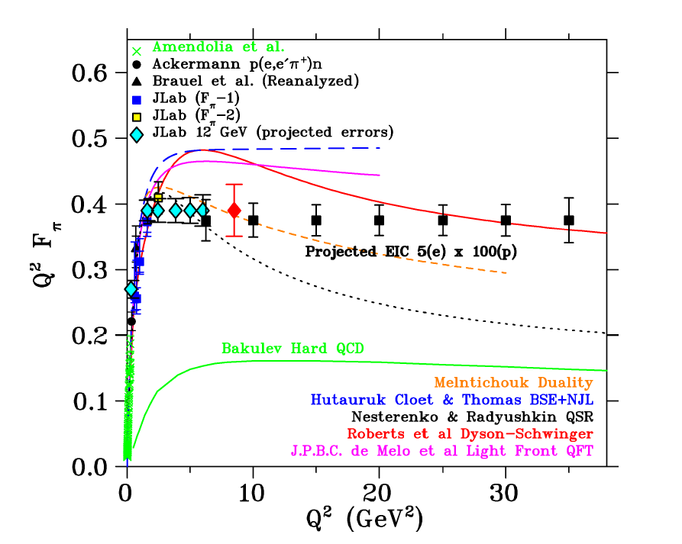
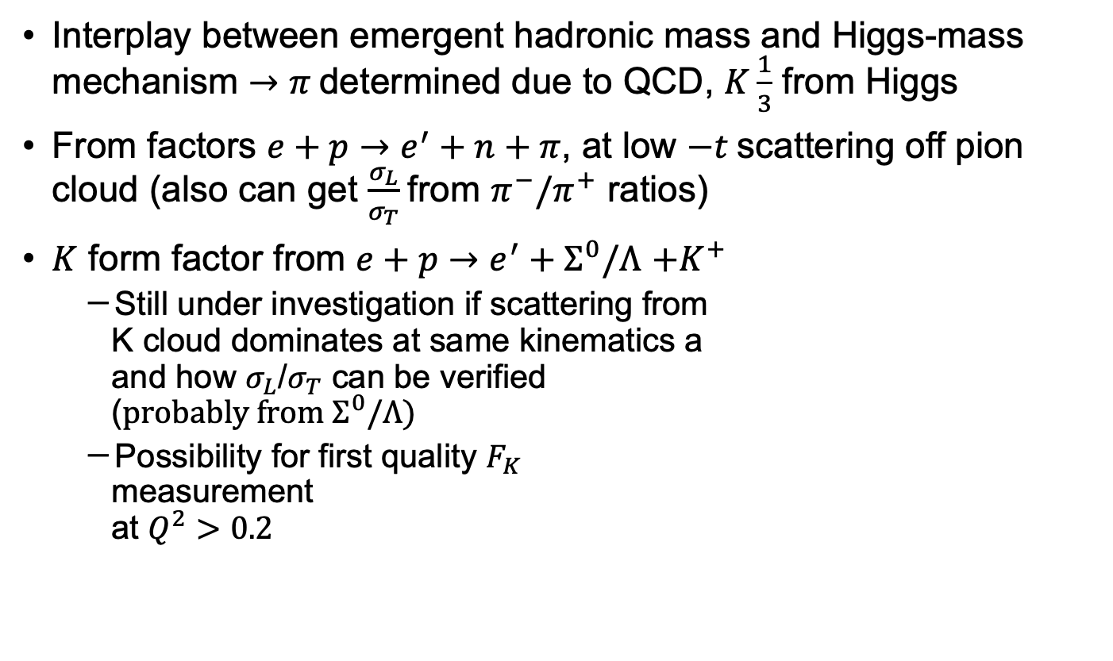

Meson Form Factors
Interplay between emergent hadronic mass and Higgs-mass mechanism $→π$determined due to QCD, $K\frac{1}{3}$ from Higgs
From factors $e+p→e^{′}+n+π$, at low $−t$scattering off pion cloud (also can get $\frac{σ_{L}}{σ_{T}}$from $π^{−}/π^{+}$ ratios)
$K$ form factor from $e+p→e^{′}+Σ^{0}/Λ$ $+K^{+}$
  Still under investigation if scattering from
  K cloud dominates at same kinematics a
  and how $σ_{L}$/$σ_{T}$ can be verified
  ($probably from Σ^{0}/Λ)$
  Possibility for first quality $F_{K}$
  measurement
  at $Q^{2}>0.2$
Using $20fb^{−1}$, $5×100$

Slide 6
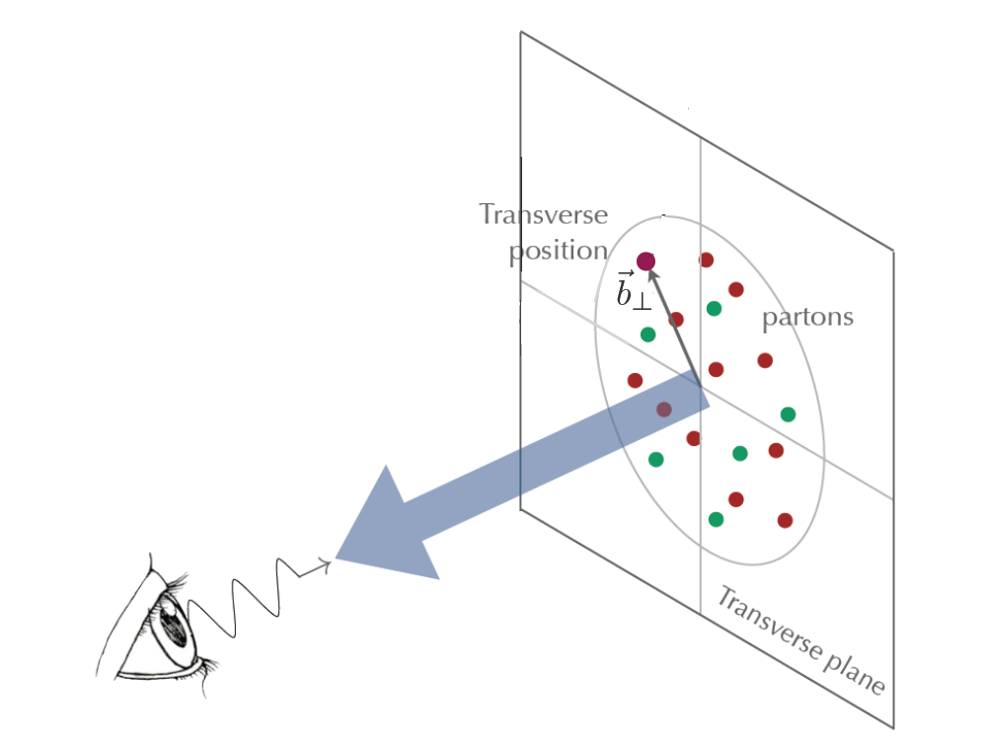

Generalized Parton Distribution Functions
Four chiral even ($H,E,\tilde{H},\tilde{E})$, four chiral odd ($q_{T})$
Depend on $x,Q^{2},ξ,t$
Can be related to impact parameter
$q\left(x,\vec{b} \right)=∫\frac{{ d}^{2}\vec{q}}{4π^{2}}e^{i\vec{b}⋅\vec{q}}H^{q}(x,ξ=0,t=−{\vec{q}}^{2},μ^{2})$

Slide 7
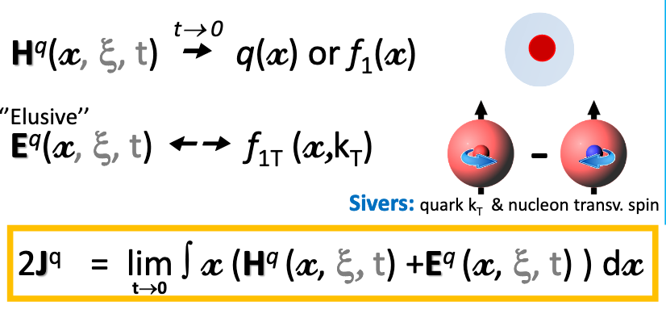
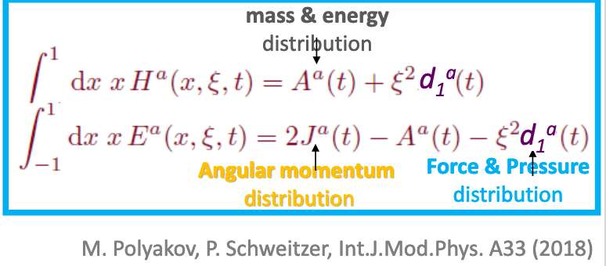
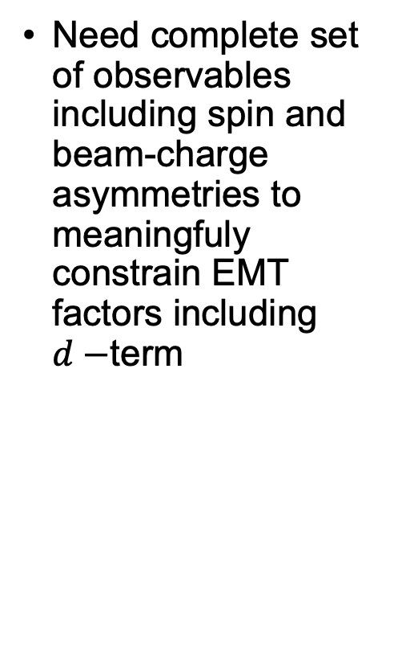
Energy Momentum Tensor Form Factors
Need complete set of observables including spin and beam-charge asymmetries to meaningfuly constrain EMT factors including $d−$term
Slide from N d’Hose

Slide 8
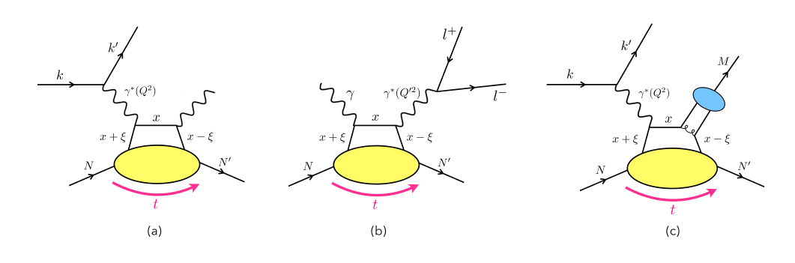

Generalized Parton Distribution Functions
Four chiral even ($H,E,\tilde{H},\tilde{E})$, four chiral odd ($q_{T})$
Depend on $x,Q^{2},ξ,t$
Can be related to impact parameter
$q\left(x,\vec{b} \right)=∫\frac{{ d}^{2}\vec{q}}{4π^{2}}e^{i\vec{b}⋅\vec{q}}H^{q}(x,ξ=0,t=−{\vec{q}}^{2},μ^{2})$
Accessed in exclusive processes
DVCS
TCS
Meson Production

Slide 9

Generalized Parton Distribution Functions
Four chiral even ($H,E,\tilde{H},\tilde{E})$, four chiral odd ($q_{T})$
Depend on $x,Q^{2},ξ,t$
Can be related to impact parameter
$q\left(x,\vec{b} \right)=∫\frac{{ d}^{2}\vec{q}}{4π^{2}}e^{i\vec{b}⋅\vec{q}}H^{q}(x,ξ=0,t=−{\vec{q}}^{2},μ^{2})$
Accessed in exclusive processes
Meson production channels at the EIC
  Heavy: access to gluons
  Vector : similar to DVCS but allows quark flavor separation
  Light pseudoscalar: access to parity odd and chiral odd GPDs
  → connection to transversity

Slide 10
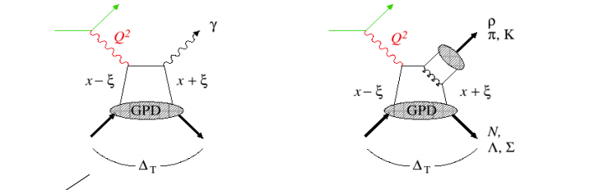
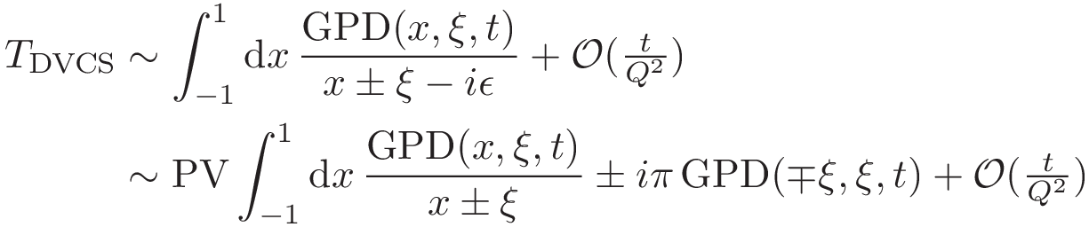
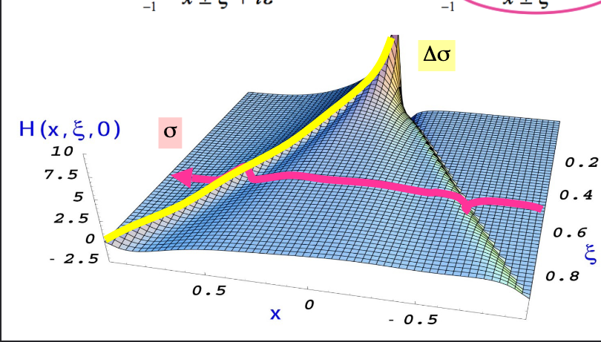

Generalized Parton Distribution Functions
Four chiral even ($H,E,\tilde{H},\tilde{E})$, four chiral odd ($q_{T})$
Depend on $x,Q^{2},ξ,t$
Can be related to impact parameter
$q\left(x,\vec{b} \right)=∫\frac{{ d}^{2}\vec{q}}{4π^{2}}e^{i\vec{b}⋅\vec{q}}H^{q}(x,ξ=0,t=−{\vec{q}}^{2},μ^{2})$
Accessed in exclusive processes
Measured amplitudes contain complex convolutions of GPDs
Cross section also contains contributions from competing processes and interferences
→Need many degrees of freedom and long
kinematic lever arms to disentangle GPDs from
measured cross-section
Flexibility of EIC ideal with wide coverage in $Q^{2},t$, polarization,
possibly beam charge + high precision
Everything can be measured at the same experiment

Slide 11
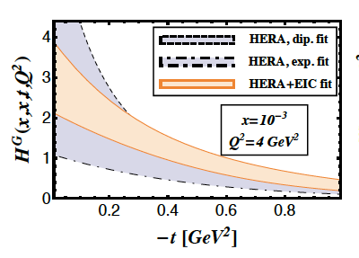
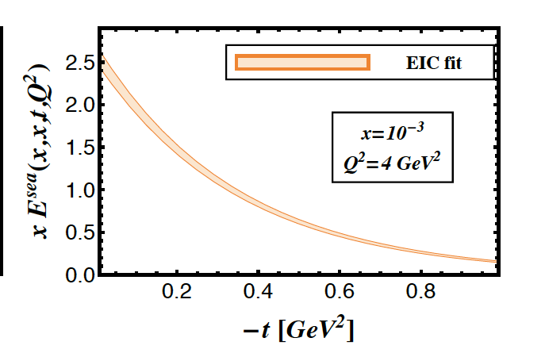
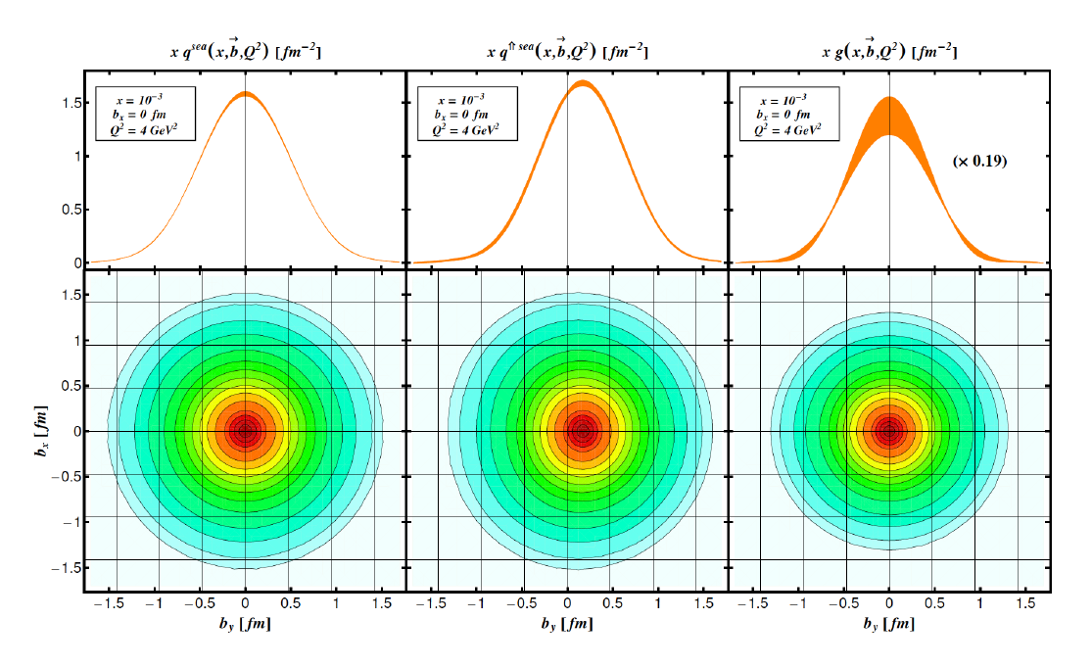

EIC kinematic lever arm
EIC impact on sea quarks
Extraction of $E$ needs polarized beams
→no constraints from Hera data
→E crucial in ingredient in Ji sum rule
EIC with good forward acceptance will
cover a large lever arm in $t$→needed for
spatial imaging

Slide 12
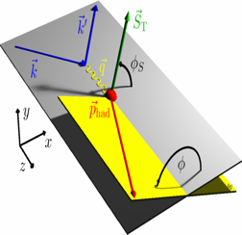
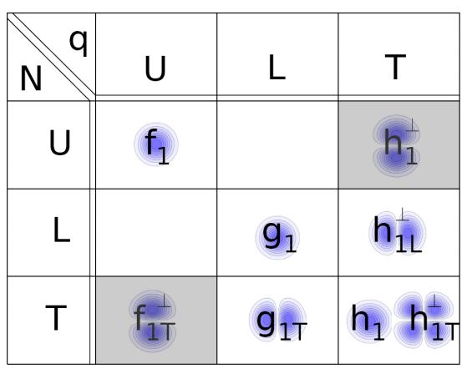
TMD PDFs from SIDIS
Boer-Mulders
Unpolarized
Worm Gear
Transversity
Polarized target
Sivers
Pretzelosity
Polarzied beam and target
Worm Gear
S_{L} and S_{T}: Target Polarizations; λe: Beam Polarization
x: momentum fraction carried by struck quark, z: fractional energy of hadron
Notes:
Identifiy with

Slide 13
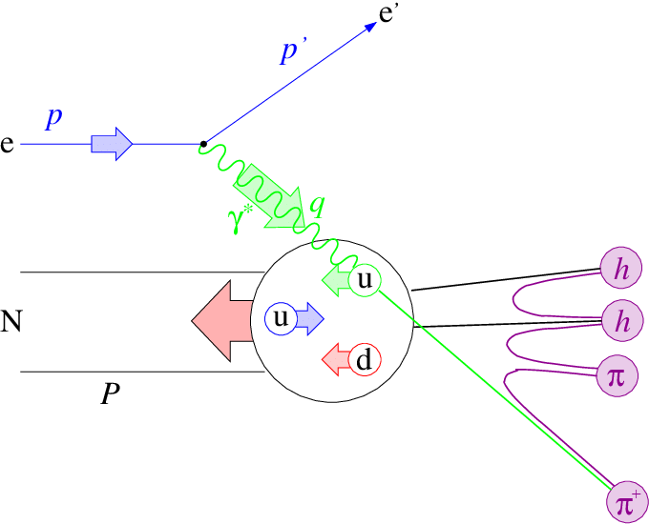
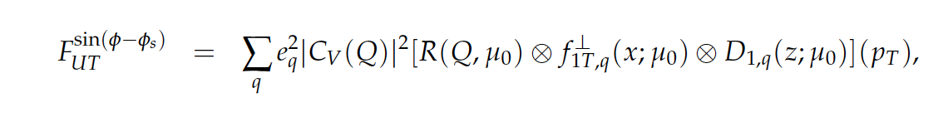
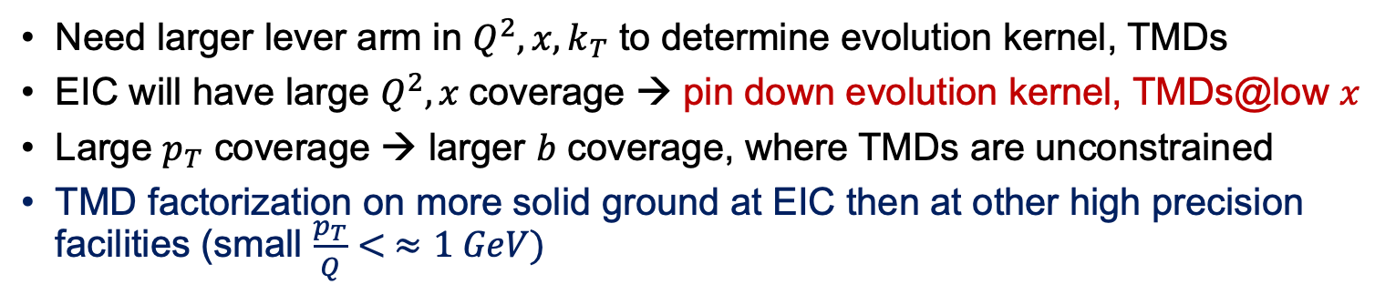
Evolution of TMDs
Evolution Kernel
TMD PDF
TMD FF
Need larger lever arm in $Q^{2}, x, k_{T}$ to determine evolution kernel, TMDs
EIC will have large $Q^{2}, x$coverage → pin down evolution kernel, TMDs@low $x$
Large $p_{T}$ coverage → larger $b$ coverage, where TMDs are unconstrained
TMD factorization on more solid ground at EIC then at other high precision facilities (small $\frac{p_{T}}{Q}< ≈1 GeV)$

Slide 14
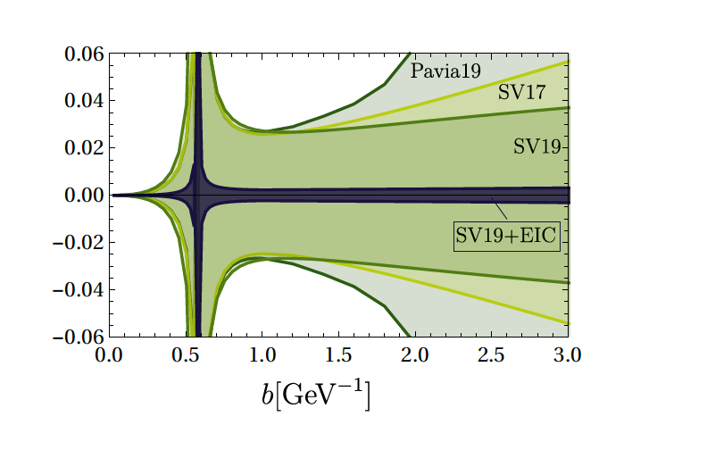
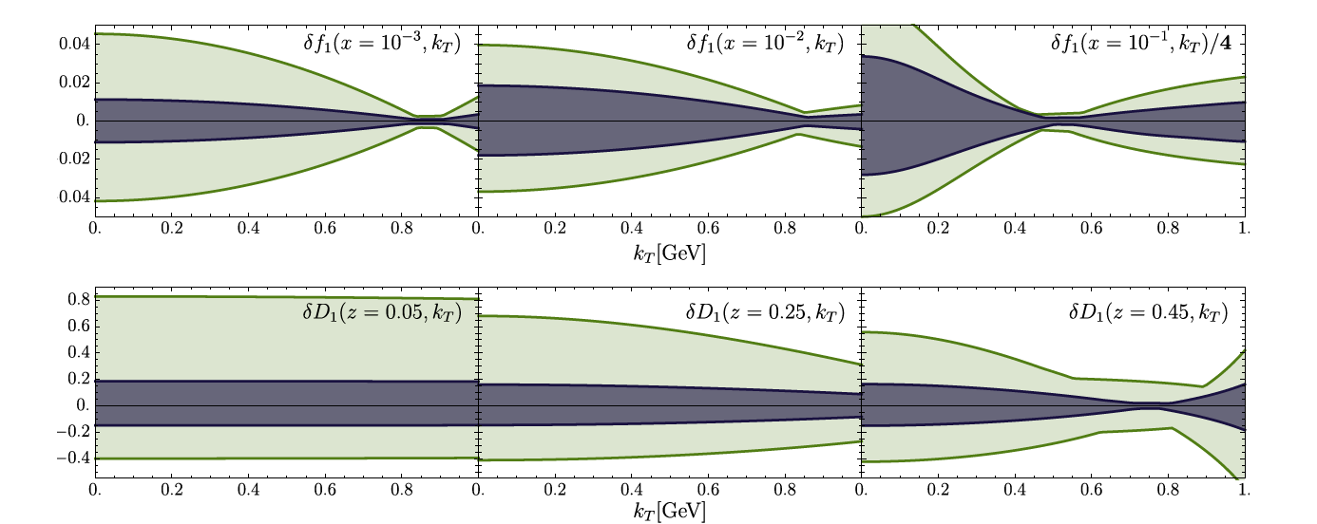
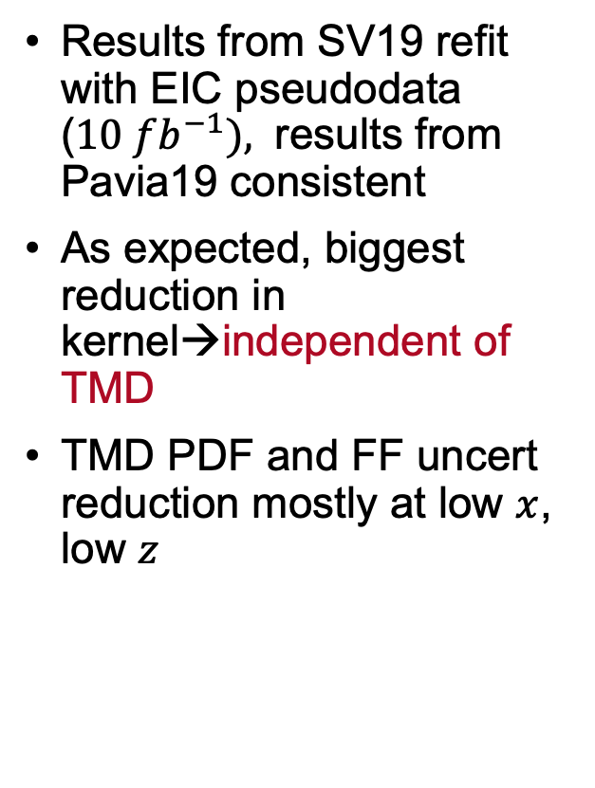

Impact of EIC on TMD measurements
Results from SV19 refit with EIC pseudodata ($10 fb^{−1}),$ results from Pavia19 consistent
As expected, biggest reduction in kernel→independent of TMD
TMD PDF and FF uncert reduction mostly at low $x$, low $z$
TMD PDF $f^{u}$(top) and FF $D^{π^{+}}$ (bottom)

Slide 15
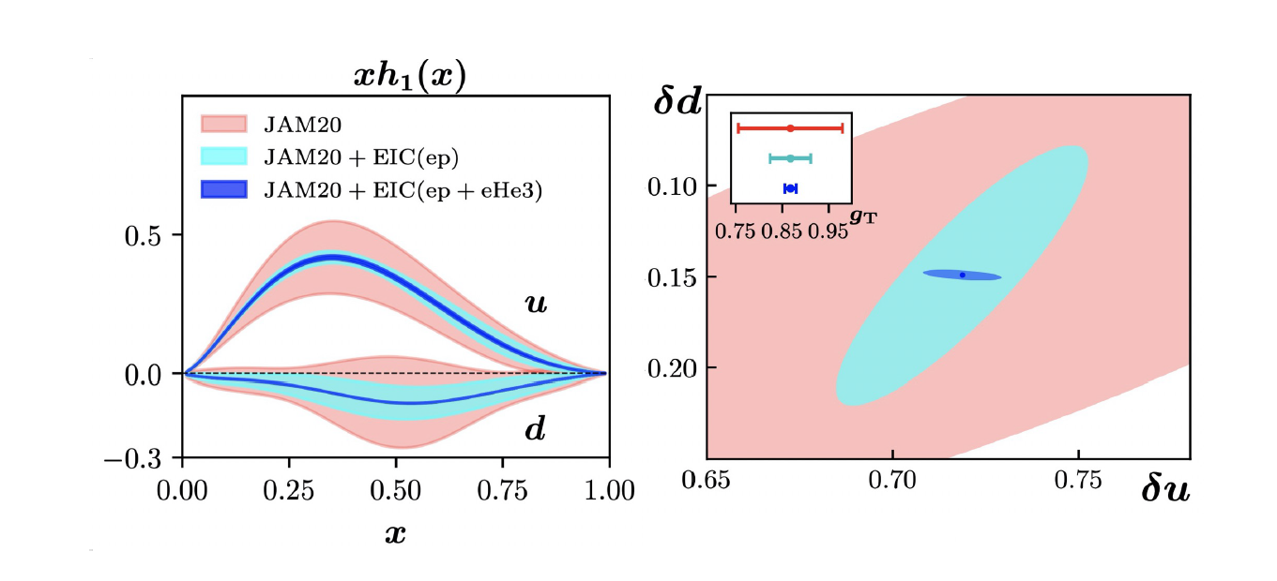
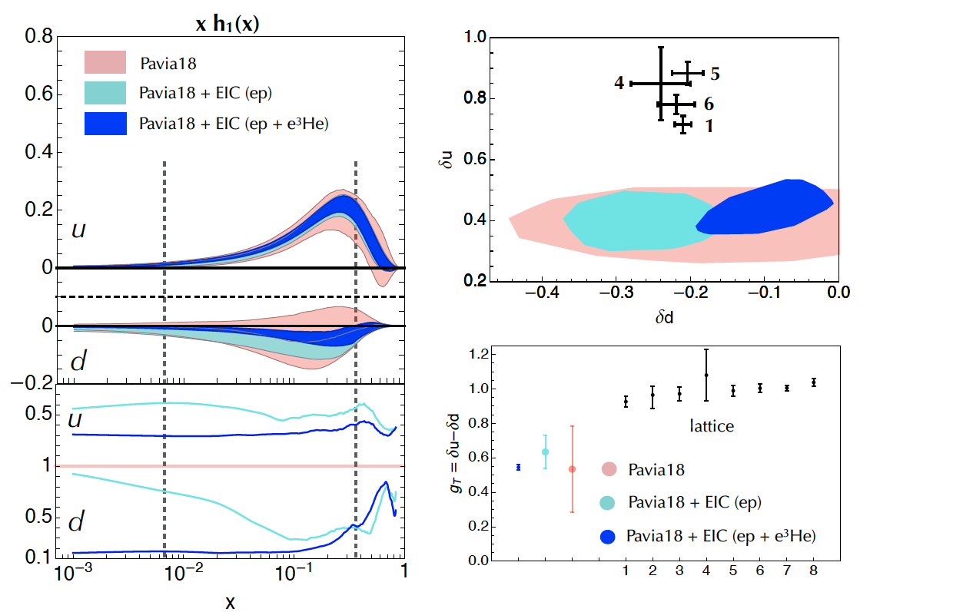
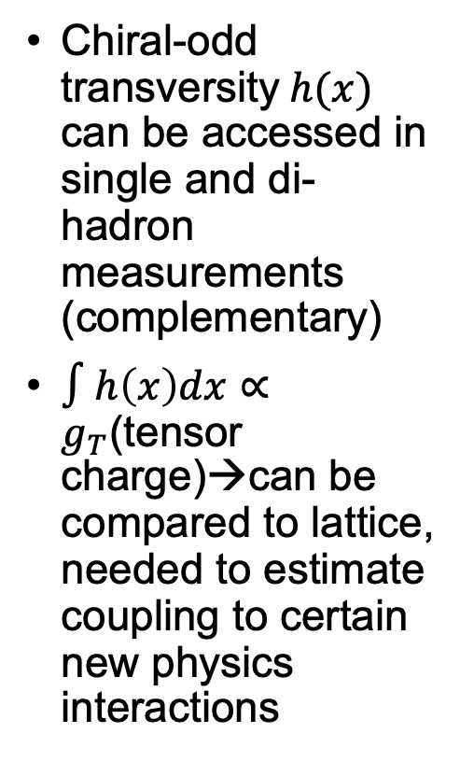
Impact on Transversity and Tensor charge
Chiral-odd transversity$h(x)$ can be accessed in single and di-hadron measurements (complementary)
$∫h\left(x\right)dx∝g_{T}$(tensor charge)→can be compared to lattice, needed to estimate coupling to certain new physics interactions

Slide 16
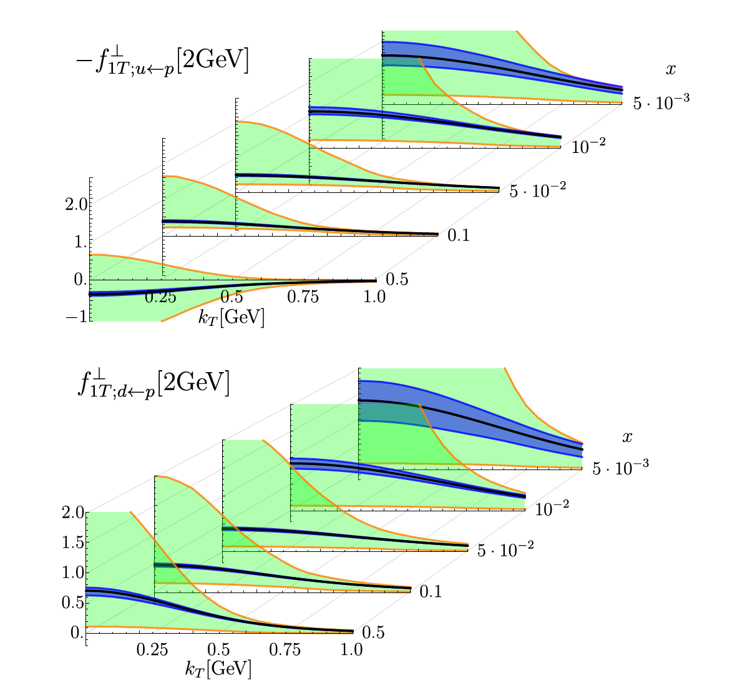
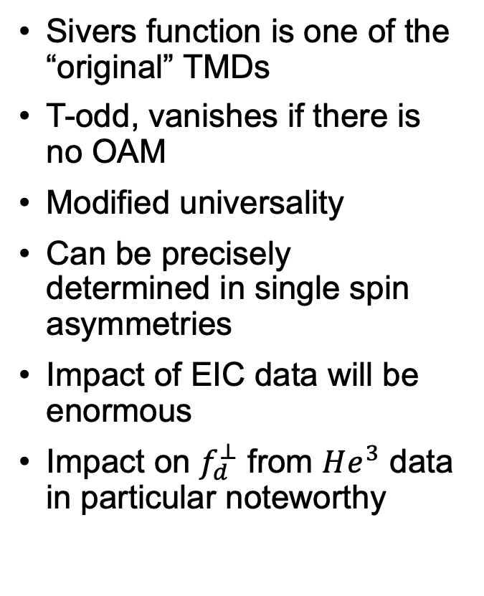
Constrains on T-odd Sivers
Sivers function is one of the “original” TMDs
T-odd, vanishes if there is no OAM
Modified universality
Can be precisely determined in single spin asymmetries
Impact of EIC data will be enormous
Impact on $f_{d}^{⊥}$ from $He^{3}$ data in particular noteworthy

Slide 17
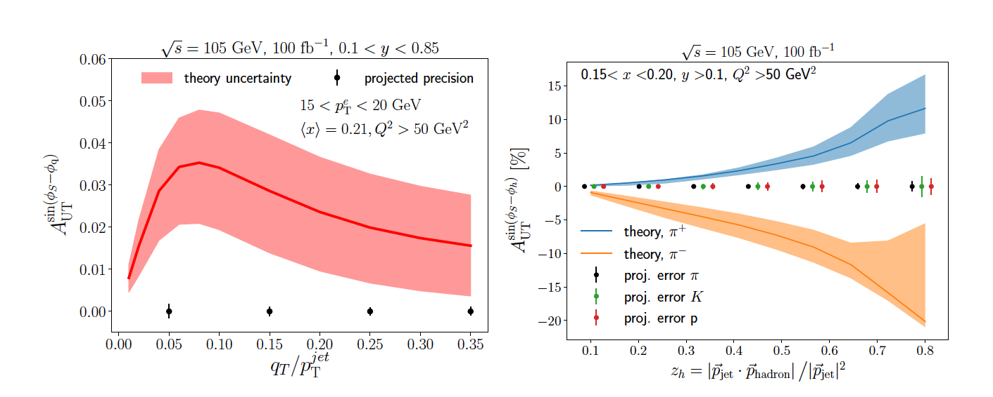
Accessing TMD PDFs and FFs with Jets
Jets can be used as proxy for outgoing parton
→Decouple PDF and Fragmentation function (FF)
→breaks convolution of transverse momenta
Enables to
  measure TMD w/o FF contribution
  FF w/o TMD contribution
Phys.Rev.D 102 (2020) 7, 074015
Sivers asymmetry
Collins asymmetry

Slide 18
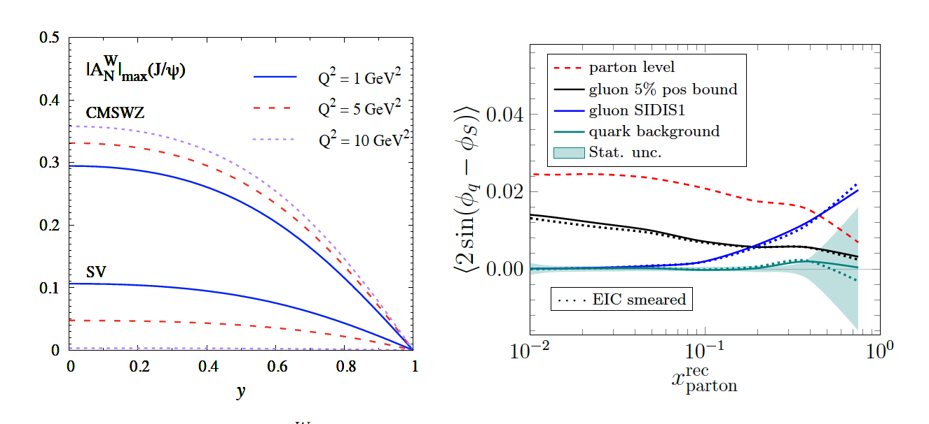



Access to Gluon TMDs with dijets
$J/Ψ$ $A_{N}$
Gluon TMDs structure more involved than quark sector
  8 TMDs, two types: Weizsacker-Williams (WW) and dipole
  SIDIS unique for WW type
  Very little known about unpolarized and polarized gluon TMDs
  Heavy quarkonium ideal channel, but relation of asymmetries to gluon TMDs model dependent
  Open heavy quark (e.g. D meson pairs) also good, but large uncertainties
  →dijet/dihedron most promising
Example: Gluon Sivers via dijet asymmetries
Dijet $A_{N}$
$$10 fb^{−1}, 18×275$$

Slide 19
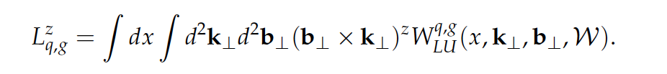
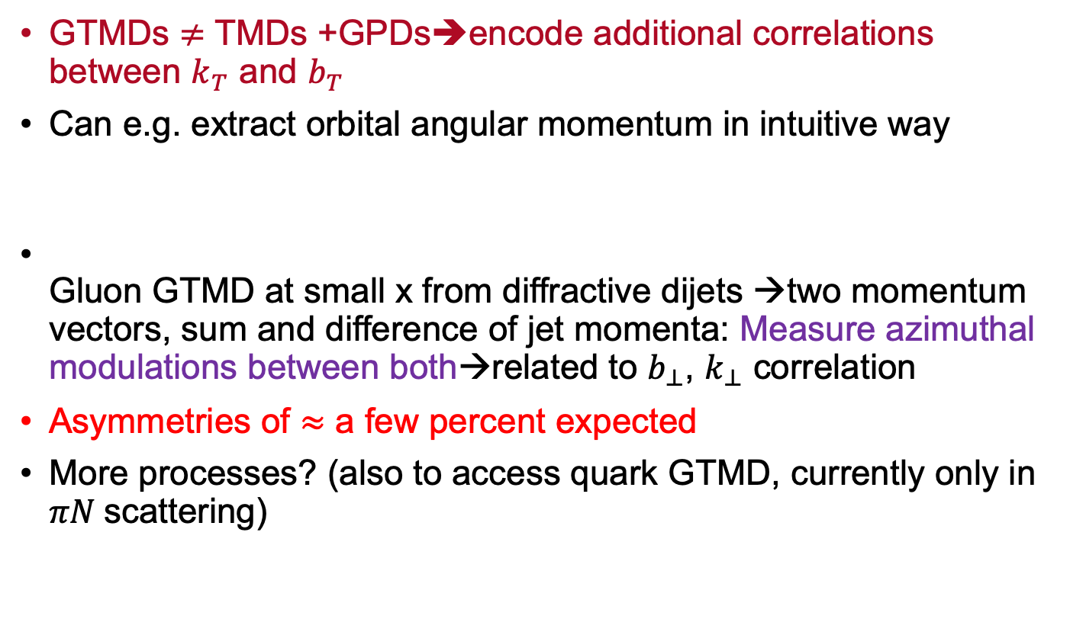
Wigner/GTMDs
GTMDs $≠$ TMDs +GPDs➔encode additional correlations between $k_{T}$ and $b_{T}$
Can e.g. extract orbital angular momentum in intuitive way
Gluon GTMD at small x from diffractive dijets →two momentum vectors, sum and difference of jet momenta: Measure azimuthal modulations between both→related to $b_{⊥}$, $k_{⊥}$ correlation
Asymmetries of $≈$ a few percent expected
More processes? (also to access quark GTMD, currently only in $πN$scattering)

Slide 20
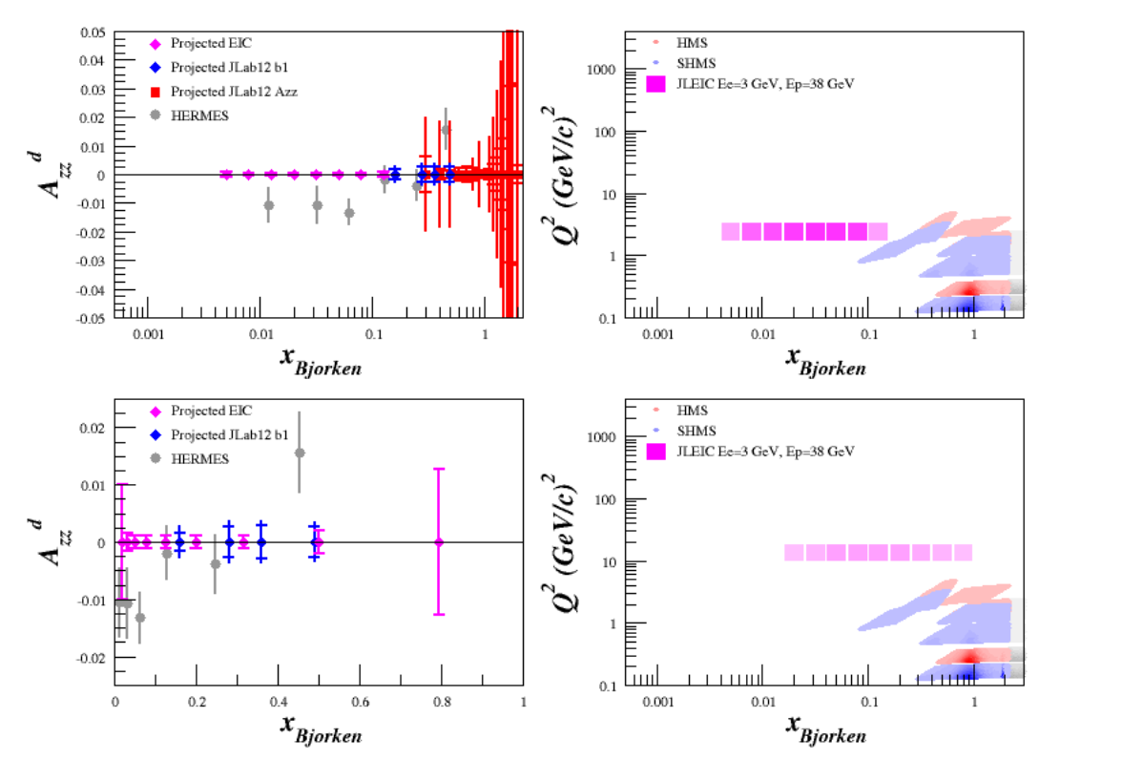
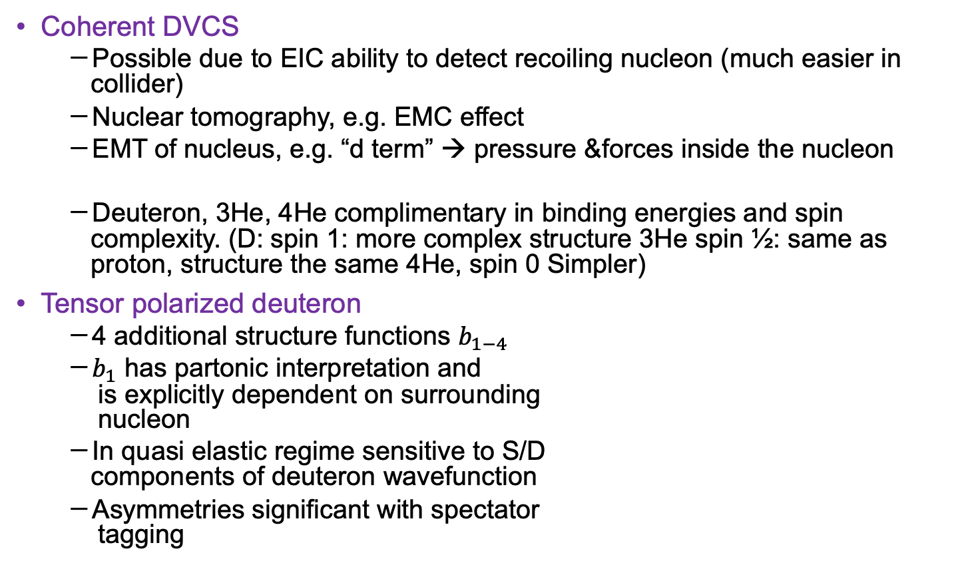

Light Nuclei
Coherent DVCS
  Possible due to EIC ability to detect recoiling nucleon (much easier in collider)
  Nuclear tomography, e.g. EMC effect
  EMT of nucleus, e.g. “d term” → pressure &forces inside the nucleon
  Deuteron, 3He, 4He complimentary in binding energies and spin complexity. (D: spin 1: more complex structure 3He spin ½: same as proton, structure the same 4He, spin 0 Simpler)
Tensor polarized deuteron
  4 additional structure functions $b_{1−4 }$
  $b_{1}$ has partonic interpretation and
  is explicitly dependent on surrounding
  nucleon
  In quasi elastic regime sensitive to S/D
  components of deuteron wavefunction
  Asymmetries significant with spectator
  tagging
$1fb^{−1}$@$3×38$

Slide 21
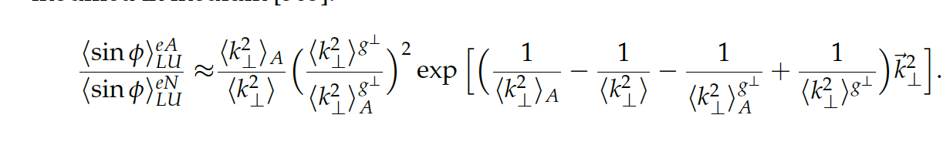
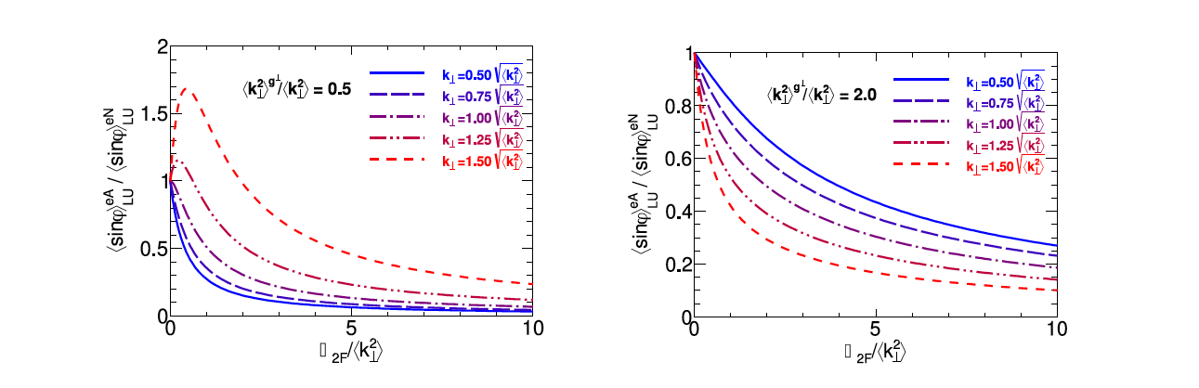



Medium Modification of Azimuthal Asymmetries
In gaussian approximation
$f_{1}^{A}\left(x,k_{⊥}\right)≈{\frac{A}{πα}f}_{1}^{N}\left(x\right)e^{\frac{−{\vec{k}}_{⊥}^{2}}{α}}$, with $α=\left\langle k_{⊥}^{2}\right\rangle +Δ_{2F}$
$\text{Quark} \text{transport} \text{parameter} Δ_{2F} \text{related} \text{to} \text{gluon} \text{density} \text{(}\text{due} \text{to} \text{interaction} \text{with} \text{gluons}\text{)}$
Jets are sensitive to TMD PDF $k_{T}$ only
$$\frac{Δ_{2F}}{⟨k_{⊥}^{2}〉}$$
$$\frac{Δ_{2F}}{⟨k_{⊥}^{2}〉}$$

Slide 22
Summary
Thank you all for your contributions!

Slide 23
Backup

Slide 24
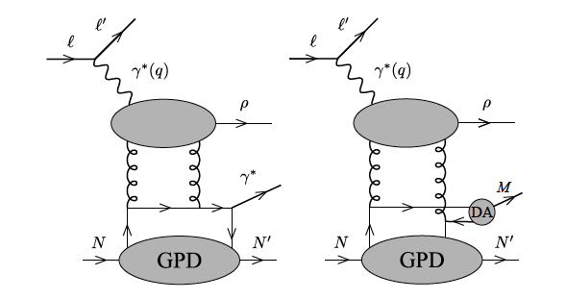
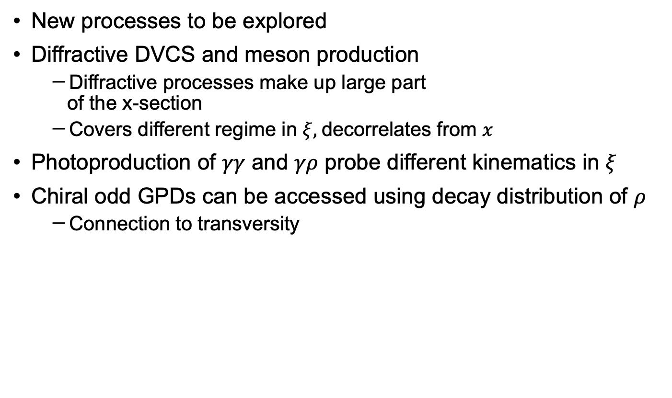
Diffractive DVCS and photoproduction of $γγ$ / $γρ$
New processes to be explored
Diffractive DVCS and meson production
  Diffractive processes make up large part
  of the x-section
  Covers different regime in $ξ,$decorrelates from $x$
Photoproduction of $γγ$ and $γρ$ probe different kinematics in $ξ$
Chiral odd GPDs can be accessed using decay distribution of $ρ$
  Connection to transversity

Slide 25

Tensor
asymmetry
Tensor polarized up to $≈2.5 GeV$

Slide 26

Di-hadron and jets
Quark transport parameter $Δ_{2F}$ related to gluon density (interaction with gluons)

Slide 27

Meson form factors
Elucidating in vis a vis mass generation (see also discussion about mass generation in 7.1) (kaon 1/3 higgs, pion almost 100% QCD)
(how is F extracted again?)
Kaon cloud unclear, to be verified by Jlab →sigma0/lambda ratio to get \sigma_L/sigma_T

Slide 28
f

Slide 29

GPD
GPDs are related to CFF which
in general contain convolutions
Impact picture is FT of t dependence
→large kinematic coverage essential

Slide 31
TMD

Slide 32
EMT → D term (with positron beam)

Slide 33
GPD measurements in meson production
  Heavy: access to gluons
  Vector : similar to DVCS but allows quark flavor separation
  Light pseudoscalar: access to parity odd and chiral odd GPDs, connection to transversity

Slide 34
”Golden channels”… :.?
TMDs,
  Precision in x,kT
  Evolution (← strong suite of the EIC)
Collins/Sivers →Tensor charge
Gluon TMDs →di-hadrons, jets, heavy quarks
Di-hadron
Jets
Wigner

Slide 35
Light nuclei
Coherent DVCS by detecting recoling nucleon
Deuterium →tensor polarization
Medium Modification azimuthal modulation

Slide 36
Outline
Imaging in position space and GPDs
TMDs
Wigner functions
Nuclei

Slide 37

Imaging in Position Space
Form factor
  →probe magnetic form factors to highest Q2 (I guess at low Q2 one loses sensitivity anyways…)
  At $ε≈1$(unlike fixed target) → I guess that means no G_E?
  Q2> 1.0 (acceptance for Q2 < 1.0 not there for electron), proton will need far forward detectors for low Q2
  No double spin asymmetries (too small)
  Adding positron beam will help with studying two-photon processes
  e-d possible up to $Q^{2}=5$GeV²
  Tensor polarization measureents up to 2.5GeV2

Slide 38
Nuclei
  Tensor polarization possible at EIC?

Slide 39
GPDs
[306][309],[310]
See pub in [306]
Form factor of EMT

