Slide 1
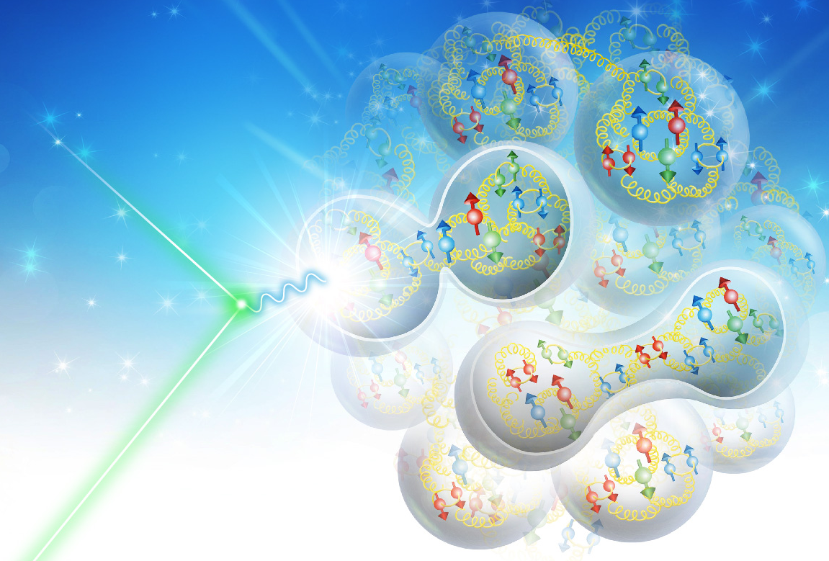

Optimizing EIC Luminosity at Low CM Energy
Yuhong Zhang, Jefferson Lab
on behalf of the EIC Low Energy Luminosity/Facility Optimization task force
Participants: Elke Aschenauer, Scott Berg, Randika Gamage, Jiquan Guo, Andrew Hutton, Fanglei Lin, Yun Luo, Tim Michalski, Vasiliy Morozov, Robert Palmer, Bratt Parker, Vadim Ptitsyn, Robert Rimmer, Todd Satogata, Kevin Smith, Amy Sy, Holger Witte, Yuhong Zhang
Motivation and task force
Exploring parameter space
Main IR luminosity optimization
2nd IR luminosity optimization
Some comments
4th EIC Yellow Report Workshop at LBL, November 20, 2020

Slide 2
EIC Baseline (pCDR & Drafted CDR) and Motivation of Study
Requiring on-energy cooling
63.2 44.7 28.6
With on-energy strong cooling
1st IR
Detector | 275x18 | 275x10 | 100x10 | 100x5 | 41x5
High divergent | 1.65 | 10.03 | 4.35 | 3.16 | 0.44
High Acceptance | 0.83 | 6.4 | 4.07 | 3.16 | 0.44
No cooling (Appendix A)
10³³ /cm²/s
Without on-energy strong cooling
Detector | 275x18 | 275x10 | 100x10 | 100x5 | 41x5
High divergent | 0.54 | 4.28 | 0.64 | 0.51 | 0.14
High Acceptance | 0.26 | 1.85 | 0.64 | 0.51 | 0.14
High acceptance detection mode: able to detect scattered protons with as low as 200 MeV transverse momentum
There is a desire from the physics user community to enhance performance of integrated luminosity in the low CM energy range up to ~65 GeV for certain luminosity-hungry experiments.
Presently, the low energy luminosity for the main IP is low 10³³ or even below it
A 2nd detector is highly wanted. It provides an opportunity that the 2nd detector/IR could be optimized specifically for the low CM energy physics runs
V. Morozov: 2nd IR design considerations

Slide 3
Guidelines/Constraints for EIC Main Detector (pCDR & CDR)
Vadim Ptitsyn
Bunch intensity: N_{p}/bunch < 3E11, N_{e}/bunch < 3E11, Beam current: I_{p} < 1A, I_{e} < 2.5A
Electron synchrotron radiation power < 10 MW
Beam-beam parameters χ_{p}<0.015, χ_{e}<0.1, Ion beam space charge tuneahift < 0.05
β*_{ey} > 5 cm, β*_{py} > 4 cm, β*_{ex} > 35 cm, β*_{px} > 90 cm (final focusing)
Electron horizontal emittance” ε_{ex} = 24 nm (18 GeV), 20 nm (10 GeV), 20 nm (5 GeV)
Electron vertical emittance: ε_{eny} > 20 mum
ε_{pnx/y}: > 2.5 um (without cooling), > 0.1 um (with cooling), aspect ratio: ε_{py}/ε_{px} > 0.05
IBS times: > 8h (without cooling); > 2h (with cooling)
Beam divergence (angle spread) at IP: σ_{x/ye’} < 220 μrad, σ_{yp’} < 380 μrad
High Acceptance: σ_{xp’} < 65 μrad (275 GeV); 180 μrad (100 GeV); 220 μrad (41 GeV)
High Divergence: σ_{xp’} < 150 μrad (275 GeV); 220 μrad (100 GeV); 220 μrad (41 GeV)
Luminosity reduction factor > 80%
Proton longitudinal emittance without cooling > 0.4 ev*
There are not many knobs to turn for optimizing the luminosity
We will focus on a few key parameters
  Electron current at low energies
  Electron emittance
  Beam flatness
  Beam angle spreads at IP
  Beta_star
After pCDR
several important studies have been accomplished, leading to better definition of beam parameters:
In beam-beam studies the limit on beam flatness at the IP has been thoroughly investigated.
➔ to prevent fast proton emittance growth, K_{x} = σ_{x}/σ_{y} should not exceed 11.
Proton dynamic aperture studies indicated that horizontal β*_{x} can be as low as 60 cm (instead of 90cm in pCDR) at lower energies.
Also, the luminosities were reoptimized to have equal (or near equal) proton beam divergences at IP, maximizing the acceptance.

Slide 4
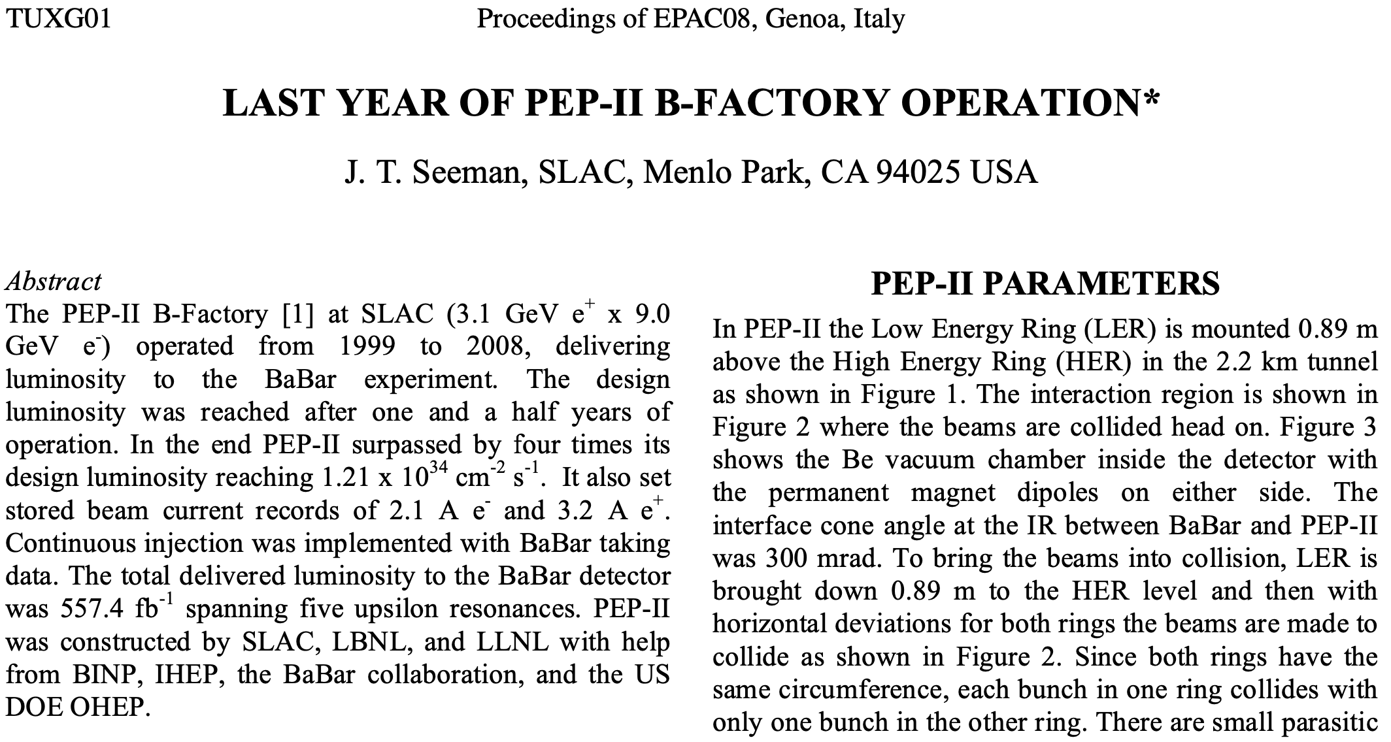
Exploring Boundary of EIC Parameter Space:
Electron beam current
Proton beam angle spread
Electron current
  Up to 2.5 A@10 GeV ⬅ SR radiation power: < 10 MW
Ion beam angle spread at IP
  Horizontal beam angle spread is defined by σ_{xp’}=sqrt(ε_{px} /β*_{px})
  Design constraints: 180 μrad (100 GeV);
  220 μrad (41 GeV)
  This sets a limit of smallest horizontal beta_star_x
  This constraint is derived by an acceptance condition
  angle of scattered protons > 10 x angle spread
  EIC acceptance requirement: transverse momentum >200MeV
  Theoretical limits of beam angle spread,
    100 GeV: σ_{xp’} < 200 MeV/100 GeV / 10 ~ 200 μrad
    41 GeV: σ_{xp’} < 200 MeV/ 41 GeV / 10 ~ 480 μrad
  This provides room for small beta_star ➔ potentially higher luminosity
Beam energy (GeV) | Beam current (A) | Bunches in Ring | Rep rate (MHz) | Bunch Intensity 10¹⁰ nC |  | pCDR Table | SR Power MW | Room for increase
18 | 0.227 | 290 | 23 | 6.25 | 10.0 | 3.3 | 8.58
18 | 0.264 | 290 | 23 | 7.29 | 11.7 |  | 10 | 17%
10 | 2.5 | 1160 | 91 | 17.2 | 27.5 | 3.3 | 9
10 | 2.78 | 1160 | 91 | 19.1 | 20.6 |  | 10 | 11%
5 | 2.5 | 1160 | 91 | 17.2 | 27.5 | 3.1 | 0.563
5 | 3.2 | 1160 | 91 | 22.0 | 35.3 |  | 0.72 | 28%

Slide 5
Exploring Boundary of EIC Parameter Space:
Electron beam emittance
Beam flatness at IP
Electron beam emittance
Lattice cell phase advance vs. equilibrium emittance
  60° at 5-10 GeV ➔emittance ~20 nm for on-center orbit at 10 GeV
  90° at 18 GeV; on center orbit emittance = 27 nm
Emittance variation with radial shift of orbit, but there are drawbacks
  positive radial shift decreases horizontal damping decrement
  hadron radius has to be shifted accordingly to maintain collision synchronization
Beam flatness
Beam flatness at IP (σ_{x}*/σ_{y}*) is highly relevant to luminosity, more flatter beam ➔ higher luminosity
Very flat beam enhances beam-beam problem, amplifying beam size growth
pCDR flatness: 11.9@275x10 GeV, 20@100x10 GeV, 14.9@100x5 GeV
pCDR design point, 21.6 nm
100x10 GeV
100x5 GeV
pCDR design point, 20 nm
275 GeV x 10 GeV
vertical emit. range: 0.2 to 1.4 nm
Vertical emit. range: 0.2 to 1.7 nm
flatness | Lumi. | Beam size growth rate
σ_{x}*/σ_{y}* | 10³⁴ | %/h | %/h
16.7 | 1.2 | 1000/2500 | -0.7±1.1, 15±7.1
12.5 | 0.98 | 900/1700 | -0.5±0.4, 2.6±1.9
10 | 0.83 | 800/1100 | 0.1±0.9, 1.2±2.6
8.33 | 0.71 | 900/1000 | 0.05, 0.87
 |  | strong-strong | weak-strong
In the range of 15 to 42 nm, the luminosity curve is flat
20 nm horizontal emitt. is not optimized,
10% luminosity gain if emittance is 30~40 nm
New constraint: σ_{x}*/σ_{y}* < 11

Slide 6
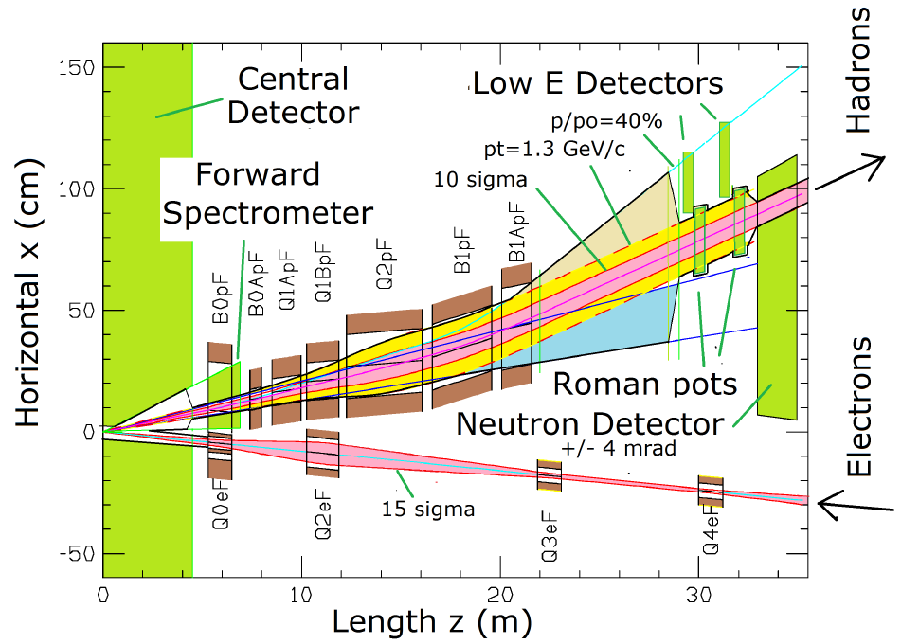
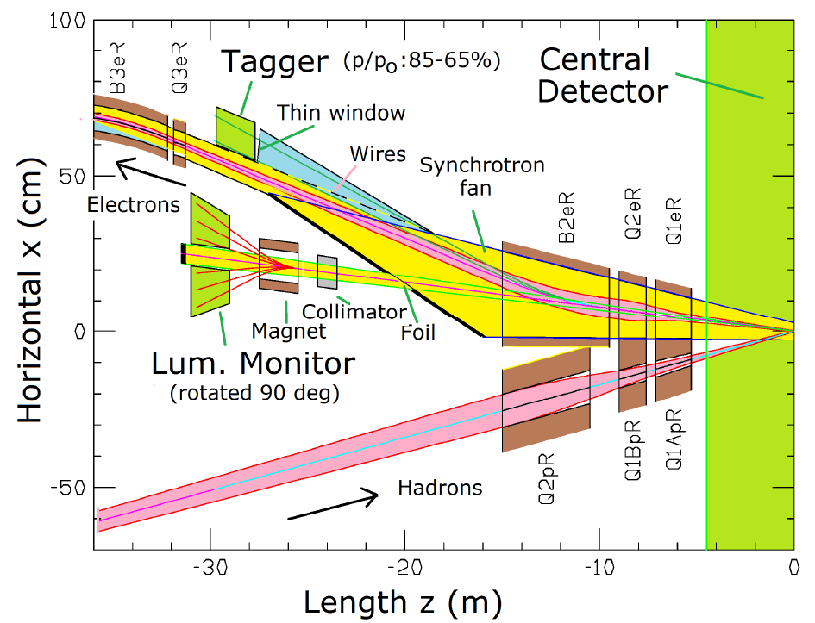
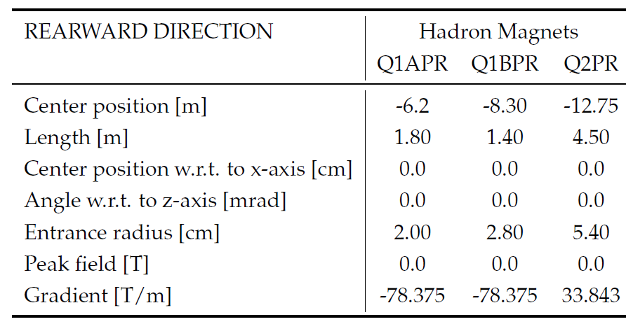
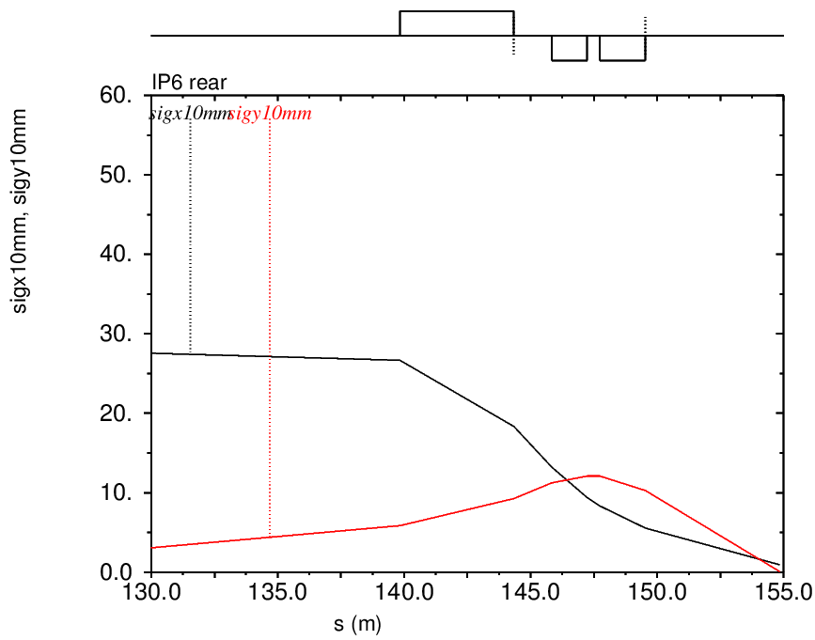
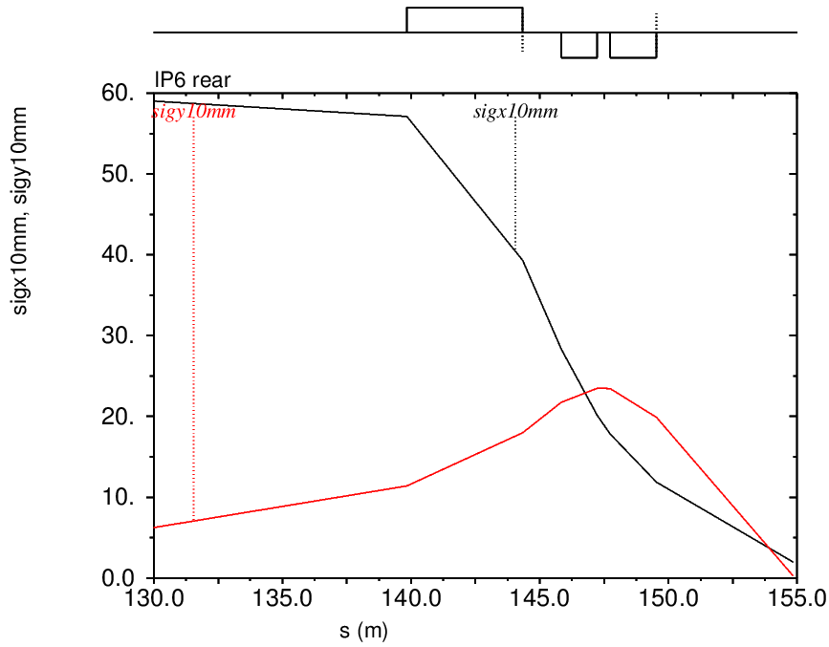
Exploring IR Optics Design: D-D-F Configuration in Baseline
IR designed to meet physics requirements
Machine element free: +/-4.5 m main detector
ZDC: 60cm x 60cm x 2m @ ~30 m
Scattered proton/neutron detection
  Protons 0.2 GeV < p_{t} < 1.3 GeV
  Neutron cone +/- 4 mrad
Why D-D-F optics: needs two quads for vertical final focusing of 275 GeV protons
electron
Ion
Focusing
defocusing
F
D
D
F
D
D
275 GeV
41 GeV
~14 m focal length
~14 m
focal length
IP
β*: 90/7 cm
ε: 44/10 nm
type: D D F
β*: 90/4 cm
ε: 9.6/1.5 nm
IP

Slide 7
Exploring IR Optics Design: D-F-D Configuration
Opportunity! At lower energy (<100 GeV), it does not need two SC quads to achieve vertical focusing near an IP
If polarity of the 2nd quad can be reversed, horizontal final focusing can be started much close to the IP
This can reduce horizontal focal length, thus with the same magnet aperture, the beta-star can be reduced, and luminosity can be increased
D-F-D configuration is a standard triplet FF design
electron
Focusing
Ion
defocusing
100 GeV
D
F
D
~9 m
focal length
β*: 39.1/3.1 cm
ε: 25.1/2.5 nm
for 41 GeV: -5.62 34.69 -18.6
for 100 GeV: -13.72 84.61 -45.36
type: D F D
7

Slide 8
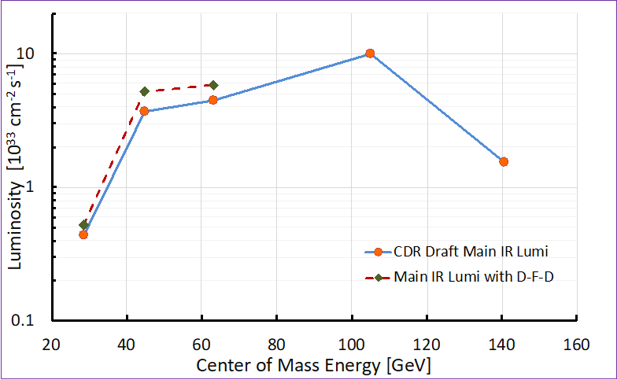
EIC Parameters for the Main IR: High Divergence
Species | Proton | Electron | Proton | Electron | Proton | Electron
Energy [GeV] | 100 | 10 | 100 | 5 | 41 | 5
CM energy [GeV] | 63.2 |  | 44.7 |  | 28.7
Bunch Intensity [10¹⁰] | 6.9 | 18.9 | 4.82 | 17.9 | 3.85 | 13.5
No. of bunches | 1160 |  | 1160 |  | 1160
Beam current [A] | 1 | 2.75 | 0.7 | 2.6 | 0.56 |  | 1.96
RMS norm, emit, h/v [μm] | 3.1/0.33 | 391/30 | 2.7/0.27 | 196/20 | 1.9/0.45 |  | 196/34
RMS emittance, h/v [nm] | 29.1/3.1 | 20/1.5 | 25.1/2.5 | 20/2.0 | 43.5/10.3 |  | 20.0/3.5
β*, h/v [cm] | 45/3.5 | 65.5/7.1 | 39/3.5 | 48.9/4.3 | 67/7.2 |  | 145.4/21.3
IP RMS beam size, h/v [μm] | 114.4/10.4 |  | 99.0/9.4 |  | 170.7/27.2
Beam flatness K_{x}=σ_{x}/σ_{y} | 20 → 11 |  | 14.9 → 10.6 |  | 7.3 → 6.3
RMS Δθ, h/v [μrad] | 254/298 | 175/147 | 254/268 | 202/218 | 255/378 | 117/128
BB parameter, h/v [10⁻³] | 13.7/11.7 | 72/86 | 15/14 | 100/93 | 15/10 | 76/70
RMS long. Emitt. [10⁻³,eV∙sec] | 21 |  | 21 |  | 16.1
RMS bunch length [cm] | 7 | 2 | 7 | 2 | 11 | 2
RMS Δp/p [10⁻⁴] | 9.7 | 5.8 | 9.7 | 6.8 | 10.3 | 6.8
Max. space charge | 0.024 |  | 0.02 | neglig. | 0.05 | neglig.
Piwinsk angle [rad] | 7.7 | 2.2 | 8.8 | 2.5 | 8.1 | 1.5
Long. IBS time [h] | 2.6 |  | 3.2 |  | 3.7
Transv. IBS time [h] | 2/5.4 |  | 2/4.8 |  | 3.3/2.2
Hourglass factor H | 0.83 |  | 0.80 |  | 0.89
Luminosity [10³³ cm⁻²sec⁻¹] | 6.55 |  | 5.36 |  | 0.72
pCDR Luminosity | 4.35 (up by 51%) |  | 3.16 (up by 70%) |  | 0.44 (up by 64%)

Slide 9
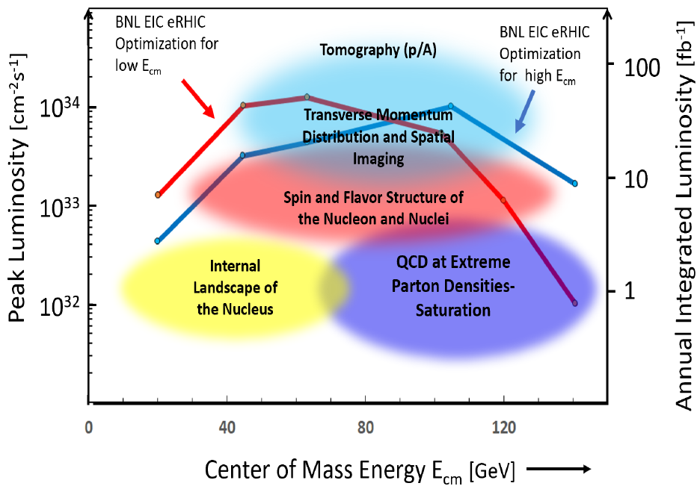
Feasibility Study of 2nd IR: Opportunity for Low Energy Collisions
“Possibilities of having more than one interaction region” by the EIC White Paper, but not part of the project
Provides more freedom to meet different science programs (high luminosity at low energies)
Detector acceptance satisfying physics requirements (what matters most is the forward acceptance)
Compatibility with running in parallel w/ the primary detector
There is a design concept for the 2nd IR in pCDR appendix
Important gradients for enhancing luminosity
More bunches, higher bunch rep rate
Smaller bunch charge, still high current
Short bunch, small emittance, shorter IBS time
Smaller vertical beta_star
Short IBS time (even strong hadron cooling)
EIC pCDR appendix
9

Slide 10
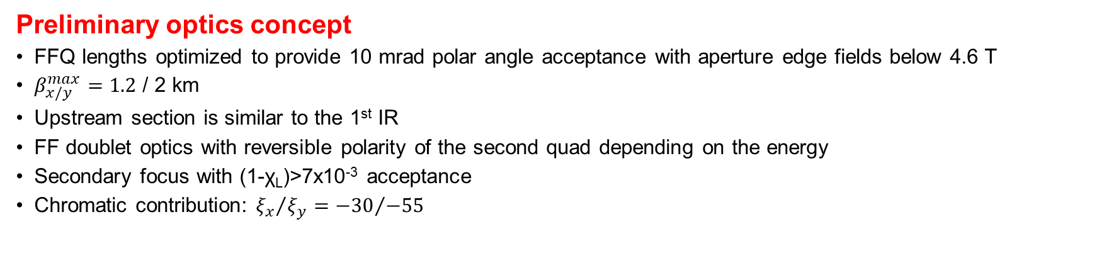
2nd IR: Physics/Detector Requirements and Design Concept
 | Parameter |  | EIC IR1 | EIC IR2 | Impact
1 | Energy range: electron/proton | GeV | 5–18 / 41, 100 – 275 |  | Facility operation
2 | CM energy of optimum lumi | GeV | 80 – 120 | 45 – 80 | Physics priority
3 | Crossing angle | mrad | 25 | 25 – 50 | p_{T} resolution, acceptance, geometry
4 | Angular beam divergence at IP, h/v, RMS | mrad | 0.1/0.2 | < 0.2 | p_{T}^{min}, pT resolution
5 | Detector space | m | -4.5/+4.5 | -(3.5-4.5) / +(5.5-4.5) | Forward/rear acceptance balance
6 | Far-forward angular acceptance | mrad | 4.5 | 5 – 10 | Neutron cone, p_{T}^{max}
7 | Forward angular acceptance | mrad | 20 | 20 – 30 | Spectrometer dipole aperture
8 | Minimum Δ(Bρ)/(Bρ) allowing for detection at p_{T}=0 fragments |  | 0.1 | 0.003 – 0.01 | Beam focus with dispersion, reach in χ_{L}, and p_{T} resolution, reach χ_{B} for exclusive process
9 | Low Q² electron acceptance |  | < 0.1 | < 0.1 | Not a hard requirement
10 | SR central tracker occupancy |  |  | < 2% | Background
V. Morozov, E. Aschenauer, R. Ent, V. Ptitsyn, A, Seryi, W. Wittmer
Preliminary optics concept
FFQ lengths optimized to provide 10 mrad polar angle acceptance with aperture edge fields below 4.6 T
$β_{x/y}^{max}=1.2$ / 2 km
Upstream section is similar to the 1st IR
FF doublet optics with reversible polarity of the second quad depending on the energy
Secondary focus with (1-χ_{L})>7x10⁻³ acceptance
Chromatic contribution: ${ξ_{x}}/{ξ_{y}}={−30}/{−55}$
V. Morozov: 2nd IR design considerations

Slide 11
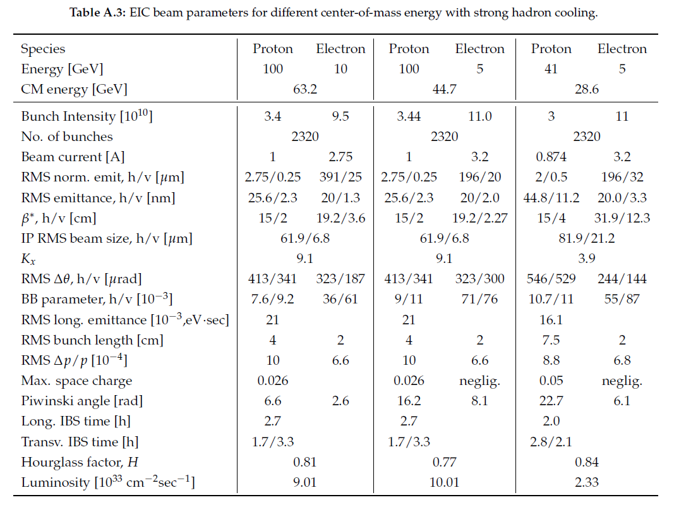
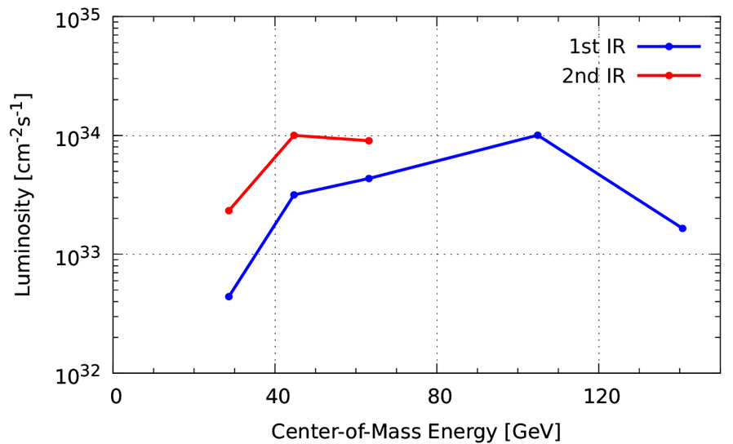
2nd IR Luminosity Optimization
Bunch number doubled
Higher electron current but within SR power limit
Crab crossing angle doubled
Small β* (2 cm) but meets acceptance requirement
Beam flatness satisfies new constraint
Restored long IBS time
Reach 10³⁴ /cm²/s

Slide 12
Comments on Low Energy Luminosity Optimization
Main IR
The low energy luminosities could be significantly boosted if adopting a D-F-D configuration in the IR optics design
Satisfy new design constraints (beam flatness), other parameters are basically within the pCDR design constraints
The optimized results are summarized in an appendix in the drafted EIC CDR
To make EIC adopt the D-F-D scheme for low energy operation, the following studies have to be accomplished:
  Adjust/optimize the D-F-D configuration to fully satisfy the present IR magnet arrangement; match it into the arcs
  Assess impact on chromaticity, demonstrate the chromatic correction and sufficient dynamic aperture
  Verify forward acceptance with detector simulation studies
2nd IR Feasibility Study
Feasibility study of the 2nd IR was just began
Some technical challenges
  Impact of shorter (5 ns) bunch spacing on electron injection kicker and proton polarimetry background issue
  Chromaticity compensation and non-linear dynamics studies with smaller beta-star
  Large crab crossing angle and higher crabbing voltage, and its impact on beam-beam
  Integration of machine and detector components, engineering feasibility of key IR elements
  Two detector operation mode and beam-beam tune-shift sharing, chromaticity compensation
Luminosity optimization is a process closely integrated with development of IR and detector
  The luminosities presented here are preliminary

