Slide 1
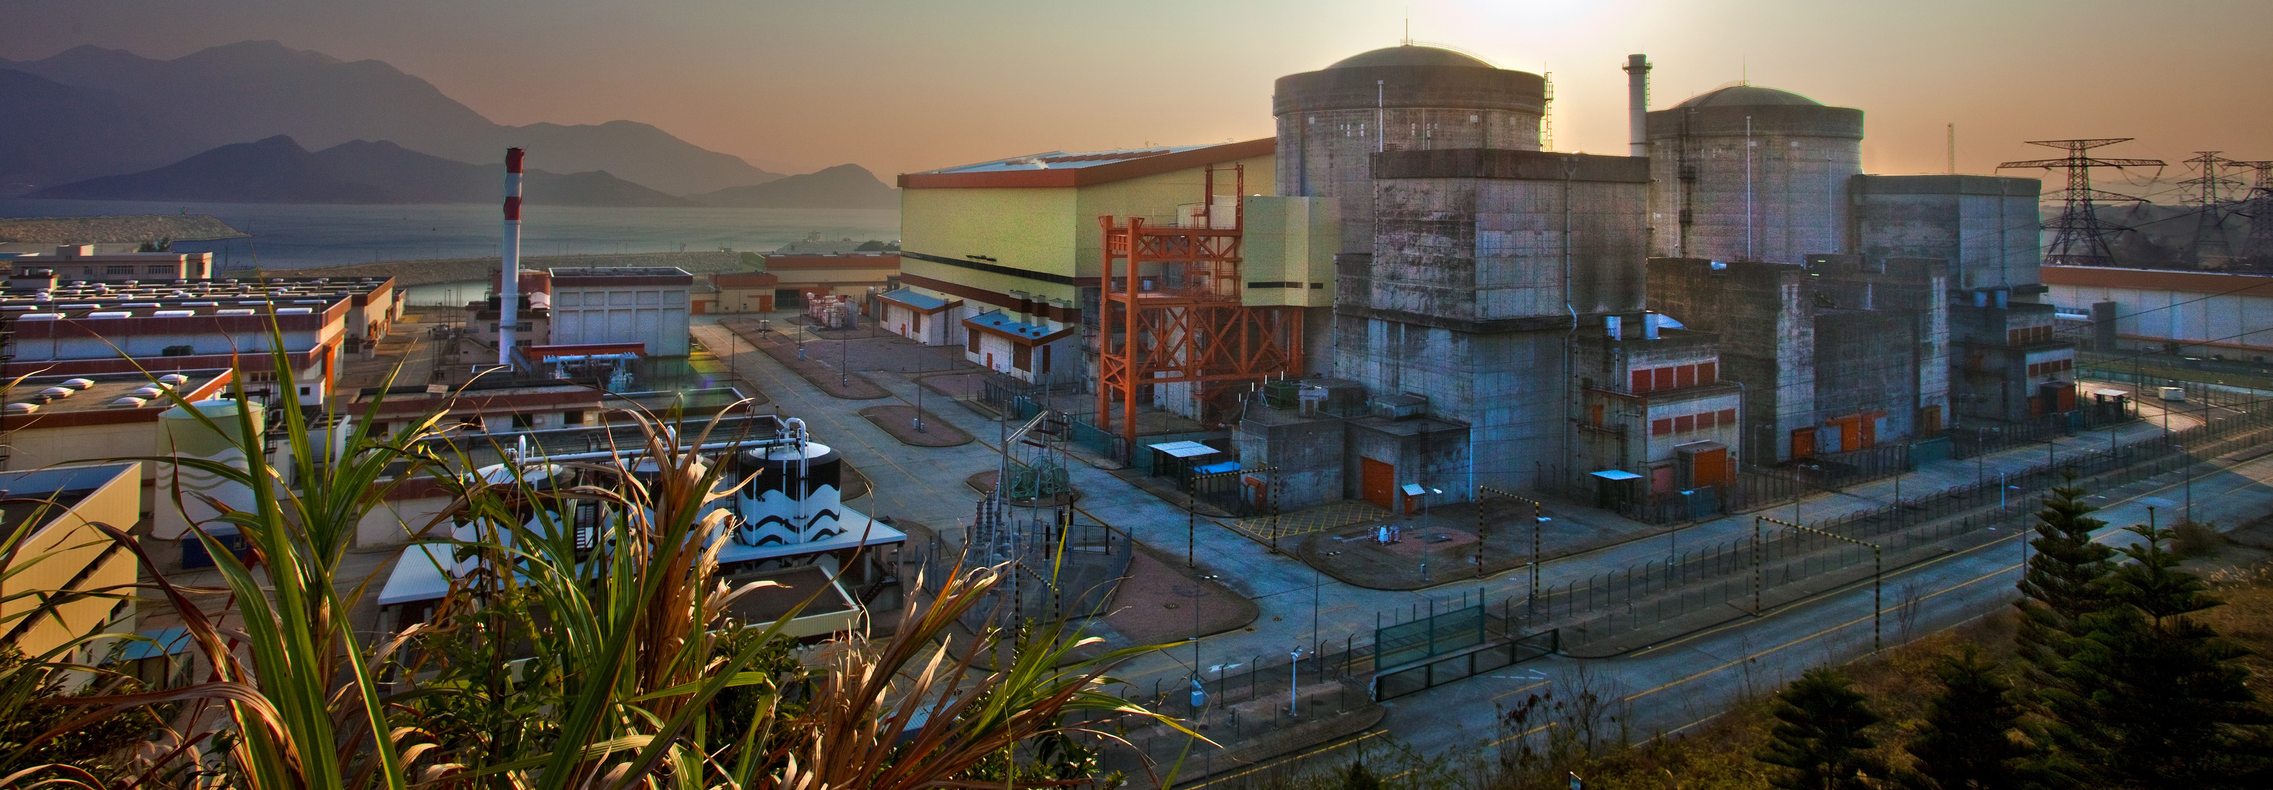
Daya Bay
L. Littenberg

Slide 2
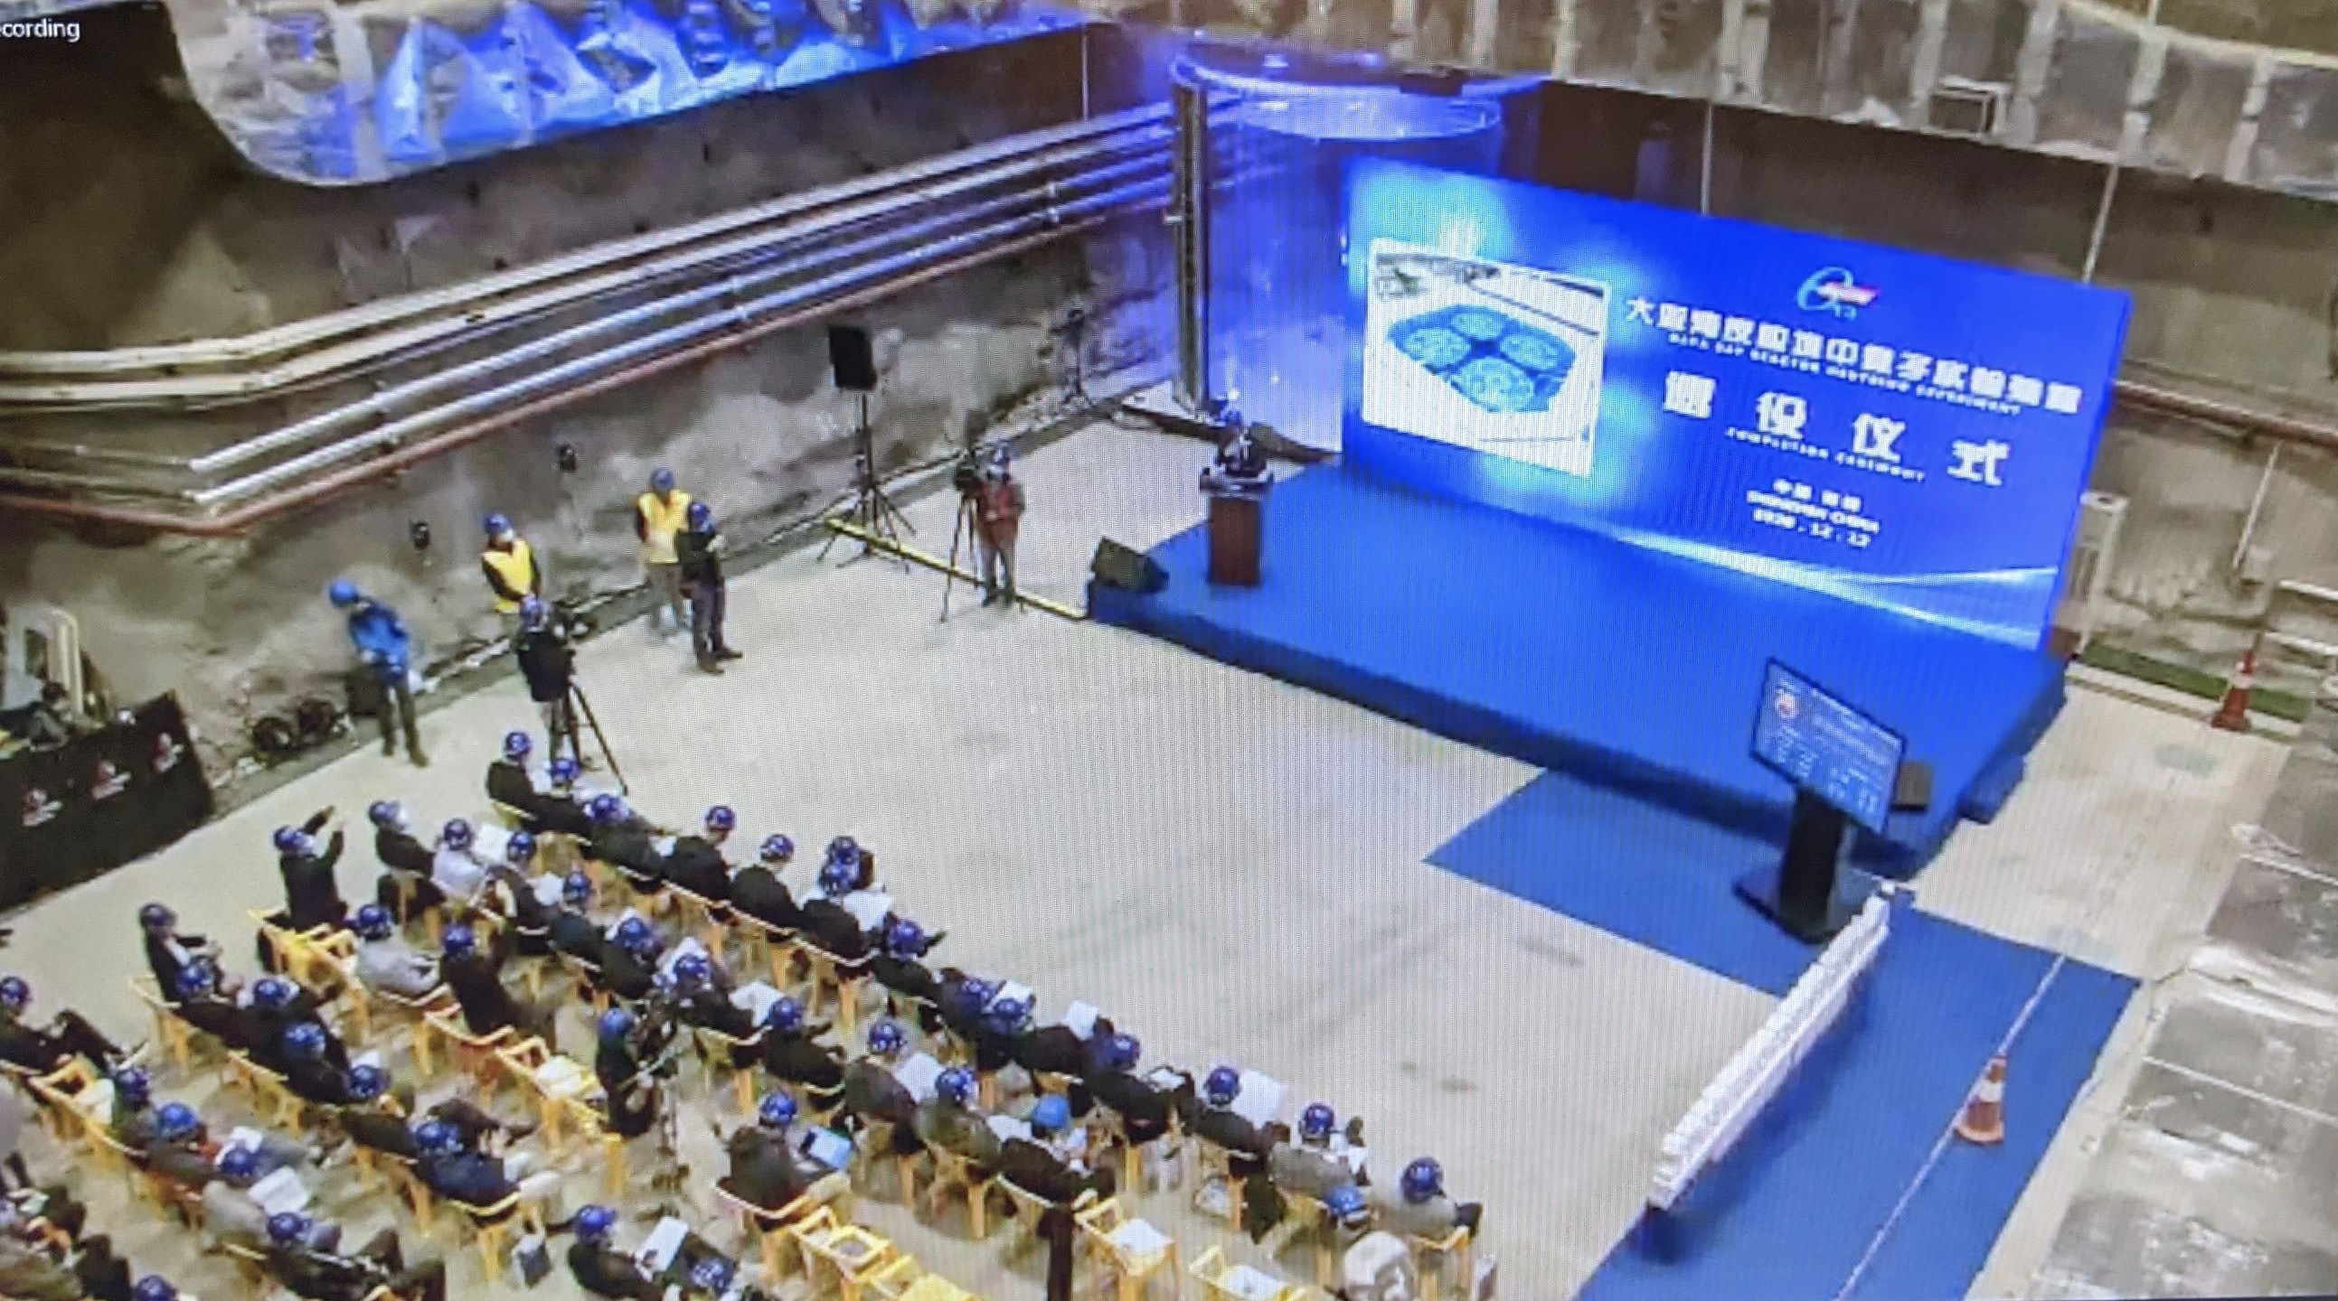
Daya Bay Close of Operations
Last Friday marked the close of operations of one of the most impactful particle physics experiments of the last couple of decades, and one in which BNL played a pivotal role.

Slide 3
This week’s events
This milestone led to commissioning a number of presentations:
Three today –
Why is non-zero theta13 important – Julia Gehrlein
Early history of Daya Bay and BNL involvement – Steve Kettell
Discovery of non-zero theta13 at Daya Bay in 55 Days – Chao Zhang
One Thursday at 3pm
A Decade of Discoveries by the Daya Bay reactor neutrino experiment – David Jaffe

Slide 4
A few personal reminiscences about the other end …
2005 was a very difficult year for the Electronic Detector Group
We’d had a proud history in the study of kaon decays.
We’d assembled a remarkably strong cadre of physicists.
But one by one our experiments had been canceled…

Slide 5
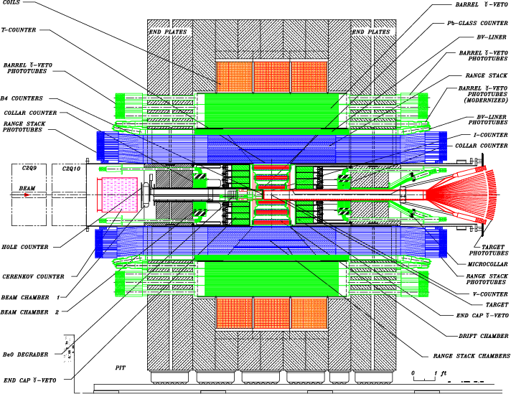
BNL AGS E949 K⁺→π⁺νν
DOE

Slide 6
A few personal reminiscences about the other end …
2005 was a very difficult year for the Electronic Detector Group
We’d had a proud history in the study of kaon decays.
We’d assembled a remarkably strong cadre of physicists.
But one by one our experiments had been canceled.
That summer, the NSF MREFC Rare Symmetry Violating Processes was canceled too, taking with it, our last surviving initiative, KOPIO

Slide 7
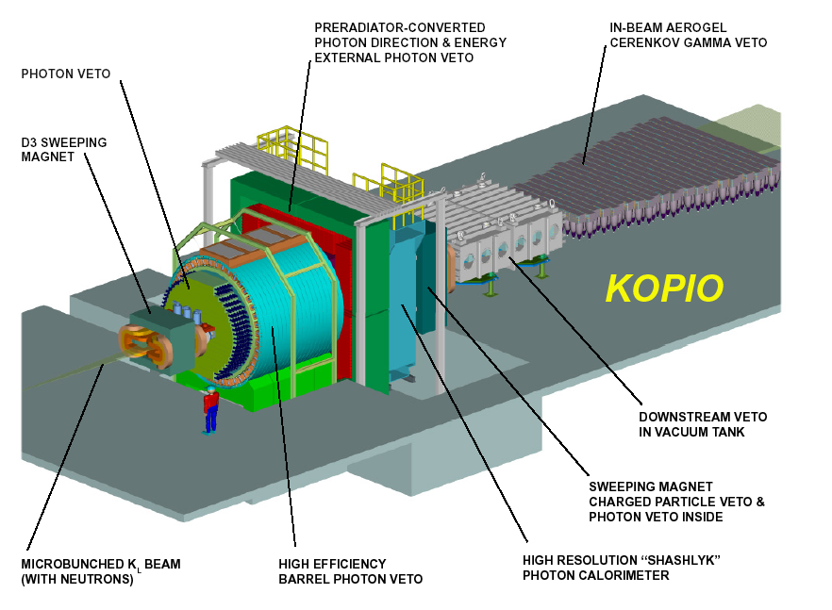
KOPIO K_{L}→π⁰νν at BNL
NSF

Slide 8
Outlook
Had a little margin, important data to analyze, other involvement
But the writing was on the wall.

Slide 9
Outlook
Had a little margin, important data to analyze, other involvement
But the writing was on the wall.
Your Group is Expensive

Slide 10
Considered Alternatives
Kaon experiment at Fermilab?
Kaon experiment at CERN?
Kaon experiment in Japan?
Neutrino experiment at Fermilab (already somewhat involved)
Muon experiment at Fermilab?
Nothing gelled

Slide 11
The Visit
In the fall, Kam-Biu Luk visited, pushing a reactor experiment in China
Initially not my favorite,
Never studied neutrinos – industrial strength experiments
Precision required (effect possibly ~1%), personally incompetent
Neutrinos just seemed to complicated -

Slide 12
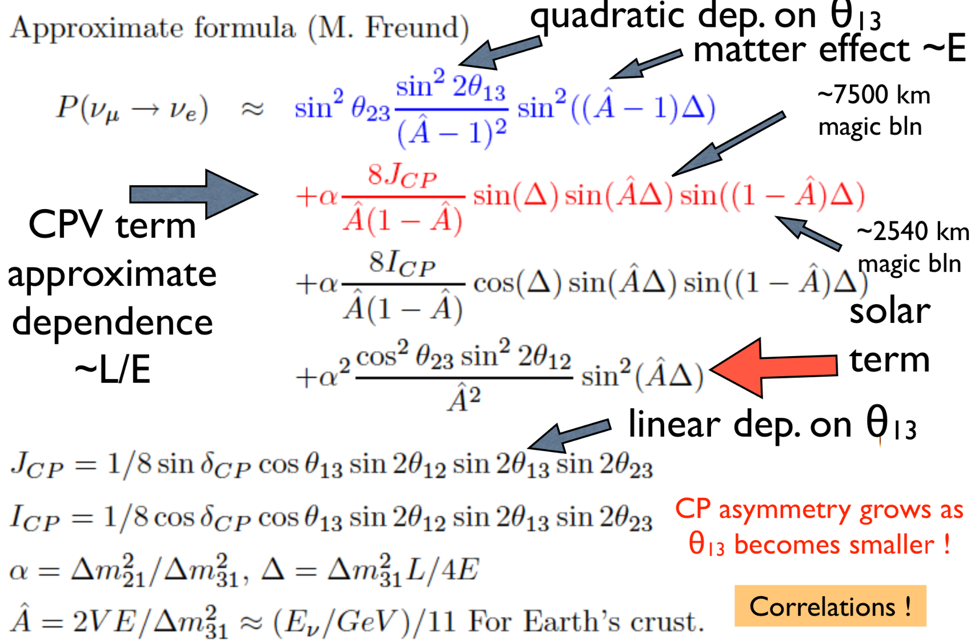

Slide 13
The Visit
In the fall, Kam-Biu Luk visited, pushing a reactor experiment in China
Initially not my favorite,
Never studied neutrinos – industrial strength experiments
Precision required (effect possibly ~1%), personally incompetent
Neutrinos just seemed to complicated -

Slide 14
The Visit
In the fall, Kam-Biu Luk visited, pushing a reactor experiment in China
Initially not my favorite,
Never studied neutrinos – industrial strength experiments
Precision required (effect possibly ~1%), personally incompetent
Neutrinos just seemed to complicated –
But then my colleagues explained things to me.
The reactor experiment was much simpler.
Could be looked at as a check on whether reactor neutrinos obey the inverse square law.

Slide 15
Reactor Experiment Reduced to Its Essence
Detector 2
Detector 1
Reactor core
Same Rate?

Slide 16
The Visit
In the fall, Kam-Biu Luk visited, pushing a reactor experiment in China
Not my favorite,
Never studied neutrinos – industrial strength experiments
Precision required (effect possibly ~1%), personally incompetent
Neutrinos just seemed to complicated –
But then my colleagues explained things to me.
The reactor experiment was much simpler.
Could be looked at as a check on whether reactor neutrinos obey the inverse square law.
Even the relation between any deviation and the parameter you were trying to measure was pretty manageable.

Slide 17
The Decision
After this, it wasn’t hard to decide to pursue such an experiment, which really was a remarkable opportunity.
As you will hear, it occupied a central role in the emerging picture of neutrino behavior, which seemed to be the first unambiguous deviation from the Standard Model of particle physics.
It was well-aligned with the interest of several of the group members.
It made excellent use of the considerable skills of the group in designing, building, operating and analyzing experiments.
Of course, the funding agency still had to be convinced to go forward with the experiment.

Slide 18
Back to this week’s events
Three today –
Why is non-zero theta13 important – Julia Gehrlein
Early history of Daya Bay and BNL involvement – Steve Kettell
Discovery of non-zero theta13 at Daya Bay in 55 Days – Chao Zhang
One Thursday at 3pm
A Decade of Discoveries by the Daya Bay reactor neutrino experiment – David Jaffe

